Slide 1
rStudio cloud
Lucy Sinke - l.j.sinke@lumc.nl

Slide 2
What is rstudio cloud?
Online workspace for RStudio Projects
All students have the same workspace
Required packages already installed inside each Project
Much less time debugging and more time spent learning

Slide 3
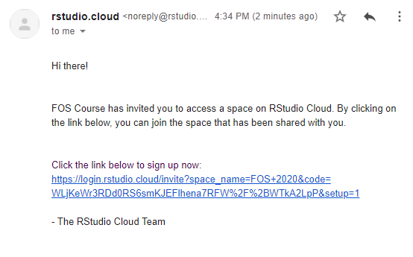
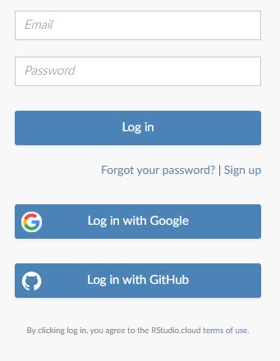
How to log on
Will be sent a link by email
Create an account to access the course (or link to Google or GitHub)

Slide 4
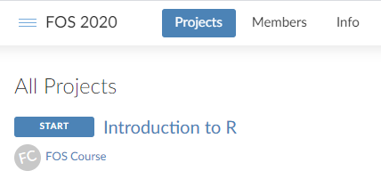
Navigating the cloud
Each section of the FOS course is an Assignment
Click the project title to start – but please don’t click them before the day!
Can always close and continue later

Slide 5
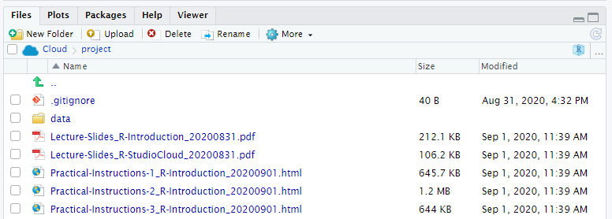
Inside assignments
Looks just like RStudio except in your browser
Lecture Slides
Practical Instructions
/data and /source
More > Export…

Slide 6
Giving in work
Knit your R Markdown document
Save locally and hand in
Discord server: Join using RKgSEBrg

