Slide 1
rStudio cloud
Lucy Sinke - l.j.sinke@lumc.nl

Slide 2
What is rstudio cloud?
Online workspace for RStudio Projects
All students have the same workspace
Much less time debugging and more time spent learning

Slide 3
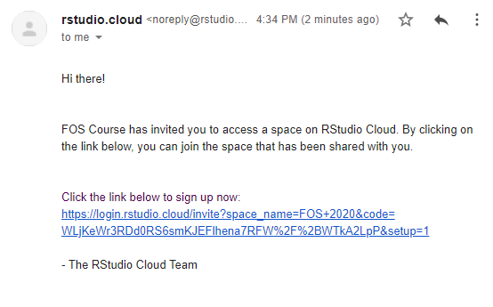
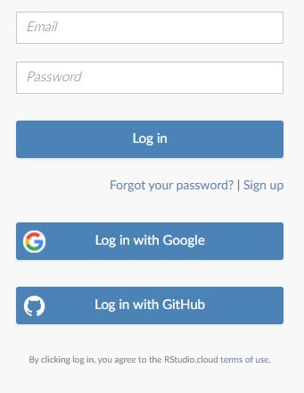
How to log on
Should have been sent a link by email
Create an account to access the course (or link to Google or GitHub)

Slide 4
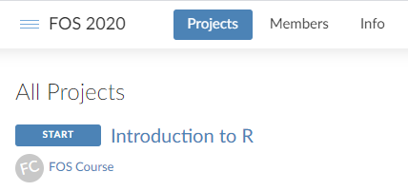
Navigating the cloud
Each section of the FOS course is an Assignment
Click the project title to start

Slide 5
Inside assignments
Lecture Slides
Practical Instructions
Practical Setup – always run first to load packages and data
Practical Outline – an R Markdown document to get you started
Two folders: /data and /source

Slide 6
Giving in work
Knit your R Markdown document
Save locally and hand in

