Slide 1
Introduction to r
Lucy Sinke - l.j.sinke@lumc.nl

Slide 2

Course overview
2 day course: 2 lectures + 3 practical sessions
Lectures: Introduction to R and RStudio Cloud
Practicals
1
2
3
reproducible work
importing data
data manipulation
data visualization
analysis
writing functions
bioconductor
genomic ranges
basic analysis

Slide 3
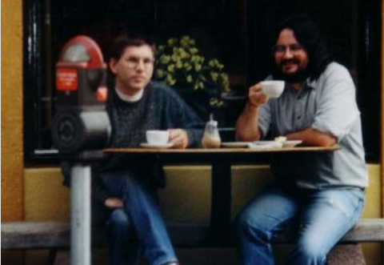
What is R?
Language for statistical analysis and graphics
Developed by Ross Ihaka and Robert Gentlemen
Inspired by the programming language, S
Maintained by R Development Core Team
Large group of primarily statisticians
Source - R. Ihaka

Slide 4
free and open source
Compared to other software
No hidden costs
Source code can be viewed and modified by anyone
Actively maintained
Stable and reliable

Slide 5
platform support
Multiple operating systems
Ported to different hardware

Slide 6
community
Large and active community
Happy to provide support and information on developments
Scripting language - write your own functions
Import other user written functions as packages
Incredibly versatile and stays up-to-date

Slide 7
integrative
Widely used - econometrics to bioinformatics
Individuals extended R to combine with current workflows
Can read in multiple data types - html, sav, databases
Implement other languages - C, Python, Java
Output many file formats - markdown, sav, pdfs

Slide 8
computation
Intensive tasks can be written in lower level languages
Easy parallelization - meaning faster calculations
Optimized for vector operations - better than loops

Slide 9
visualizations
Stunning graphics - especially using ggplot2
Used by Google, Twitter, and Facebook
Build interactive web applications with Shiny

Slide 10
disadvantages
Not always intuitive syntax
Steep learning curve - command-line type user interface
Requires experience - multiple options for any problem
Continuously changing - need to stay up-to-date
No official support - sometimes poor documentation

Slide 11
bioconductor
Software repository - over 1,500 bioinformatics packages
Analysis of high-throughput genomic data
Integration of annotations, such as GO
Obligatory vignettes - high quality documentation
Daily build system - guarantees software works

Slide 12
resources
R graph gallery: http://www.r-graph-gallery.com/
R web application: https://shiny.rstudio.com/gallery/
Bioconductor: https://bioconductor.org/
Online courses: https://www.datacamp.com/
Books
R course at LUMC: https://barmsijs.lumc.nl/R_course/

