Slide 1
concepts of computing
Gaurav Gupta

Slide 2
OUTLINE
Hardware
Software
Databases
Network
Data

Slide 3
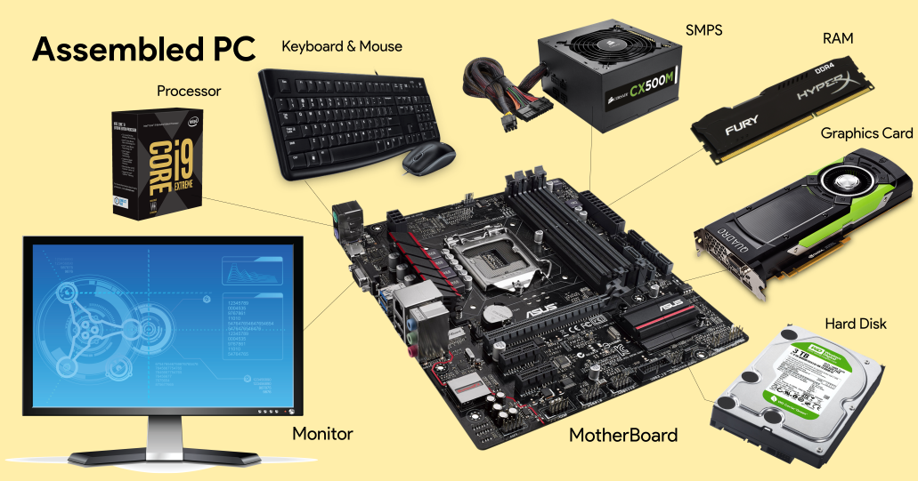
HARDWARE
https://commons.wikimedia.org/wiki/File:Assembledparts.png

Slide 4
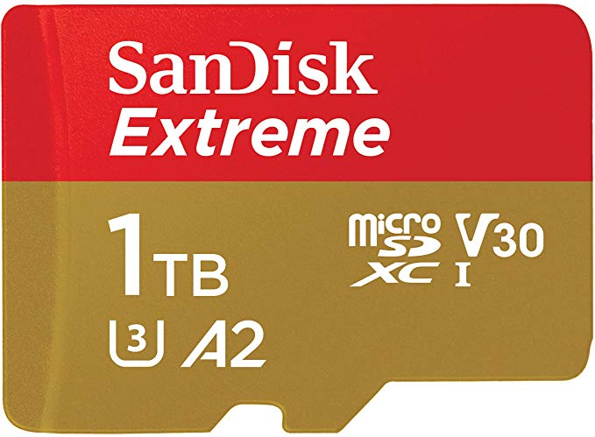
PROGRESS IN HARDWARE
1956
to
2020
https://de.wikipedia.org/wiki/IBM_350#/media/Datei:IBM_350_RAMAC.jpg
https://images-na.ssl-images-amazon.com/images/I/81ZBMVgCiLL._AC_SL1500_.jpg

Slide 5
PROGRESS IN HARDWARE Relative size
1956
to
2020

Slide 6
SOFTWARE
Operating System (UNIX and beyond)
Applications (Kernel vs. Shell)
Programming languages (C and beyond)
Spreadsheets
Databases – can “query” these + SQL

Slide 7
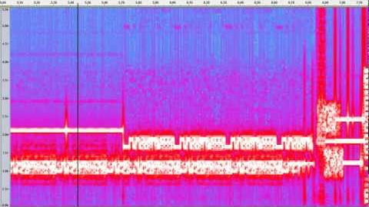
NETWORK
Communication channel
IPv4, IPv6

Slide 8
Internet Speeds
Kbps → Mbps → Gbps
2G →
3G →
4G (~1Gbps) →
5G (~100Gpbs)

Slide 9
Data
Computers are 2-state devices, where a bit can either be 0 or 1.
A byte is the smallest piece of memory that we can reserve.
This means that data is stored in a binary (base-2) format in computers.
You must have encountered computer components coming in powers of 2 (1, 2, 4, 8, 16, 32, 64, 128, 256, 512, 1024, …)
Binary number system is just like decimal system but with 2 symbols (0, 1) instead of 10 (0, …, 9)
684 in decimal = 10²*6 + 10¹*8 + 10⁰*4
110 in binary = 2²*1 + 2¹*1 + 2⁰*0 = 6
4013 in base 5: 3*1 + 1*5 + 0*25 + 4*125 = 508

