Slide 1
EXCEL BASICS
Gaurav Gupta

Slide 2
Outline
Excel
Structure
Cell addressing
Formulae
Absolute vs relative: $ prefix
Conditionals
Boolean operators (AND, OR, NOT)

Slide 3

Excel history
Originally released in 1982 as Multiplan.
Lost out to Lotus 1-2-3.
Beat Lotus when moved to Windows in 1987 (Excel 2.0) with addition of GUI.
Added Visual Basic for Applications in version 5.0.
Flight simulator Easter Egg in Excel 97.
Current version Excel 2016 (Part of Office 2016).
One of the most popular and profitable Microsoft products.
Cloud-based + Version Control

Slide 4
Use of excel
Balance sheets
Transactions
Enrolments
Merit lists
Appointments
Sport results
…anything which is represented as a collection or list of values.

Slide 5
Excel structure
Spreadsheets
Each spreadsheet may contain multiple worksheets (or simply sheets).
Major components
Menu
Toolbar
Formulae Box
Current cell address
Editing area
Sheet tab
https://techcrunch.com/2018/03/15/teacher-in-ghana-who-used-blackboard-to-explain-computers-gets-some-microsoft-love/

Slide 6
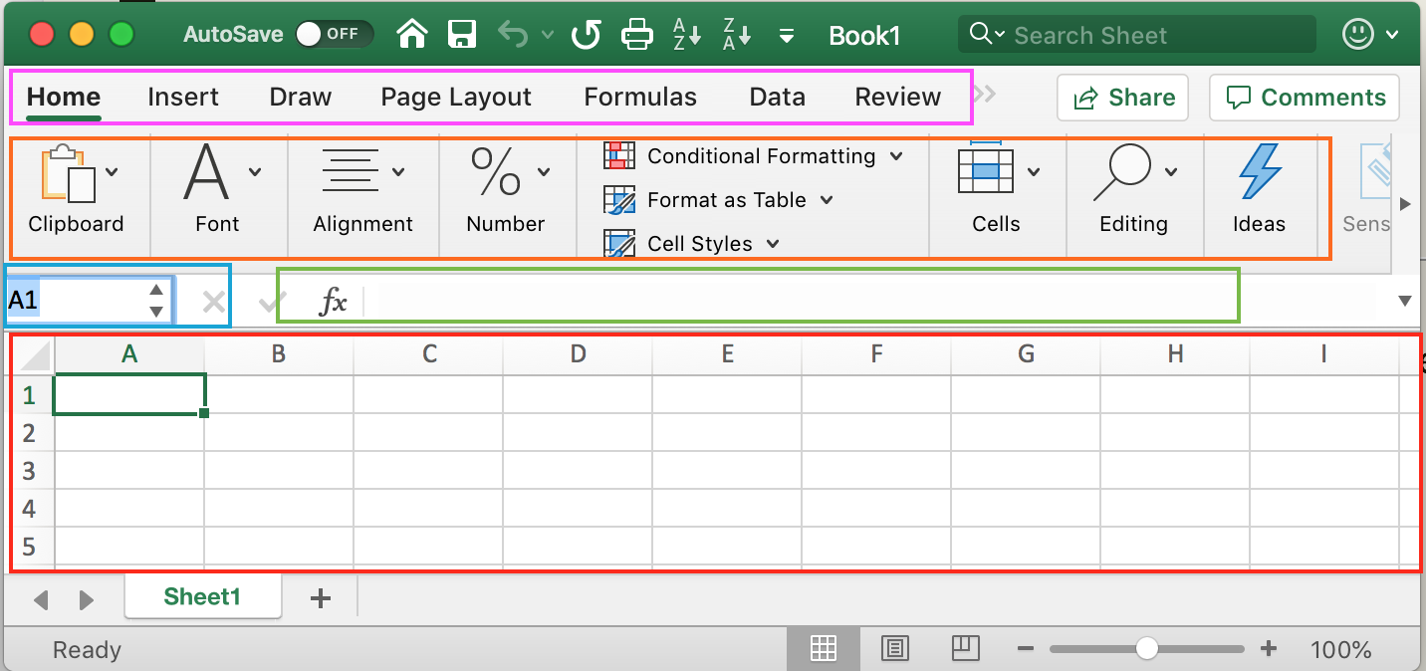
Excel Layout
Menu
Toolbar
Current cell address
Formulae Box
Editing area
Sheet tab

Slide 7
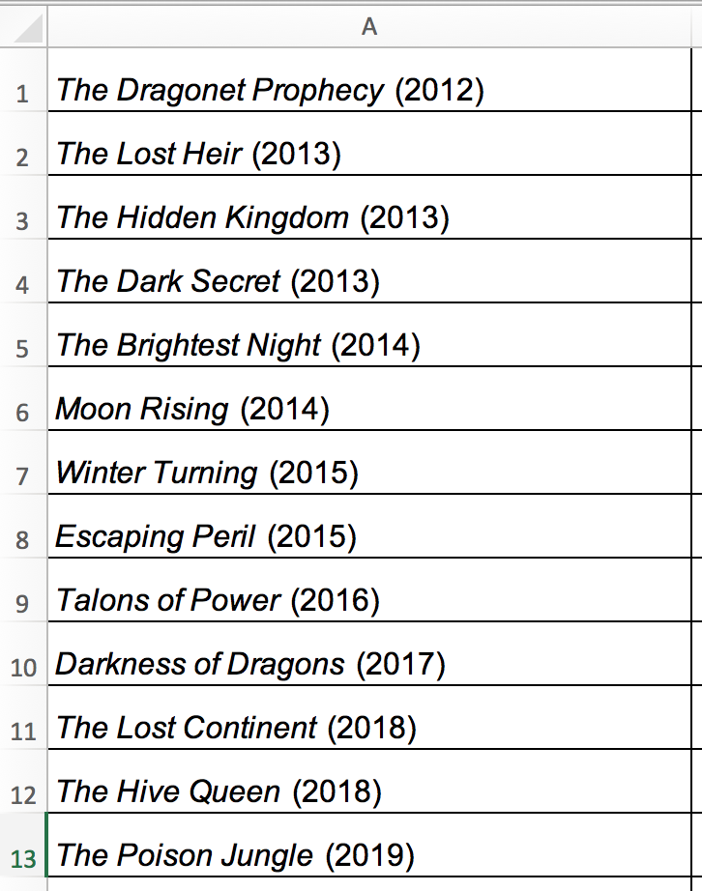
Rows and Columns – The backbone of Spreadsheets
Data is traditionally organized in rows and columns where all values in either a single column or a single row are items of a collection.

Slide 8
Row and Columns
Columns are labelled with letters of the English alphabet.
A, B, C, …, Z,
AA, AB, …, AZ, BA, BB, BC, …, BZ, …, ZA, …, ZZ,
AAA, AAB, …
Think of A as 1 and Z as the last digit.
Once you go through all combinations, add a 1 to the front and carry on.
Maximum number of columns is 16384 (2¹⁴)
Rows are numbered 1 … 1048576 (2²⁰).

Slide 9
Cell Addressing
A particular cell in Column C (C can be between A and ….) and Row R (R can be between 1 and 1048576) has the address CR.
For example,
a cell in column D and row 5 has address D5
a cell in column CF and row 27 has address CF27
QUESTION TIME
What are the addresses of cells in,
6th row, 3rd Column
2 rows down from D5
4 columns to the left of G8

Slide 10
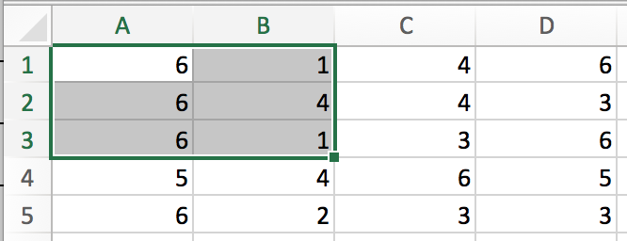
Range
You can specify a range using
START_ADDRESS : END_ADDRESS
For example,
A1:B3 gives you all the cells from A1 to B3
Note that A3:B1 also gives you the same region
A2:D2 gives you values in row 2 (from column A to column D)
Equivalent to D2:A2
C1:C5 gives you values in column C (from row 1 to row 5)
equivalent to C5:C1
Getting entire columns and rows
C:C gives you the entire C column
5:5 gives you the entire 5th row.

Slide 11
Formulae
Excel has numerous built-in formulae using which we can perform operations like:
Total - SUM()
Count non-blank cells – COUNTA()
Average - AVERAGE() (equivalent to SUM()/COUNTA())
Standard Deviation - STDEV()
Highest – MAX()
Lowest – MIN()
Getting a random value – RAND()
Getting a random value in a range - RANDBETWEEN()
And so on …
Called using = prefix
Case insensitive (upper or lowercase doesn’t matter)
*In the in-class tests, skip spaces when possible

Slide 12
SUM()
Need to pass a list of addresses or a range
When range is used, the two addresses are used as “opposite corners” of the range to add
For example:
SUM(A3, B5, C2) adds the values at the three given addresses
SUM(A1:C4) adds the values across the three columns between the four rows (so 12 values are added)
SUM(A3:B1) adds 6 values. Note: Excel normalizes as =sum(A1:B3)
SUM(A1:B2,C5:D3) adds a total of 10 values.

Slide 13
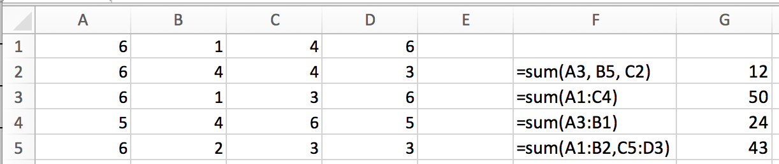
SUM - DEMO
QUESTION TIME
Add January sales in sales.xlsx and store the result in cell B9

Slide 14
Other important functions that accept a list/range
Total - SUM()
Average - AVERAGE()
Standard Deviation - STDEV()
Highest – MAX()
Lowest – MIN()

Slide 15
Auto-filling formulae
You can apply a formulae to the neighboring cells by,
Select the cell containing the formulae and go to its bottom right corner.
The white plus cursor should change to black.
Drag across to the neighboring cell to which you want to apply the formulae.
If you drag to the right, column numbers will increase. Similarly, if you drag left, column numbers will decrease.
If you drag down, row numbers will increase. Similarly, if you drag up, row numbers will decrease.
For example,
A formula SUM(A1:A10) dragged right will get updated to SUM(B1:B10)
A formula AVERAGE(B5:G5) dragged down with get updated to AVERAGE(B6:G6)

Slide 16
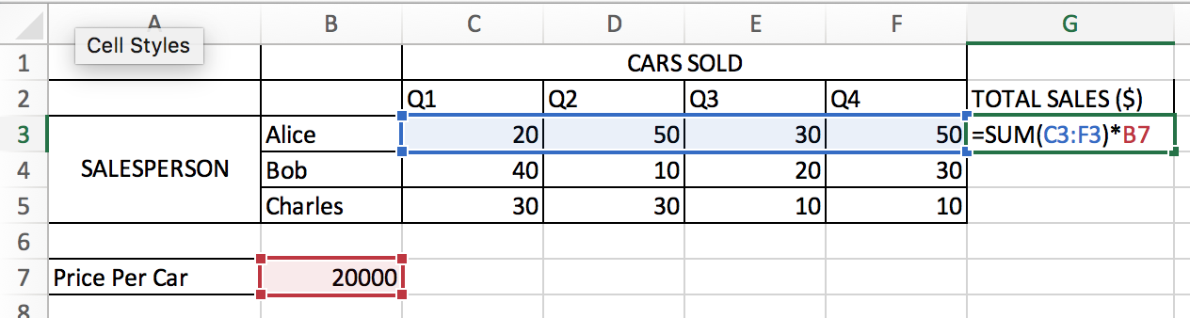
When fixed cell addresses are needed.
What happens when we drag the formula down for the other two salespeople?
It will get updated to =SUM(C4:F4)*B8
But the correct formula is: =SUM(C4:F4)*B7
We don’t want the row number to change. So we add a $ in front of it, making it fixed.

Slide 17
Mixed/Absolute addressing
Add $ in front of row and/or column value to keep it fixed.
$B7 will retain the value as B7 when dragged to the left or right. But it will get updated to B8, B9… if dragged down.
B$7 will retain the value as B7 when dragged up or down. But it will get updated to C7, D7… if dragged down.
$B$7 will retain the value as B7 wherever it’s dragged.
B5: Relative
B$5/ $B5: Mixed
$b$5: Absolute

Slide 18
COMPARISON OPERATORS
More than: ">"
More than or equal to: ">="
Less than: "<"
Less than or equal to: "<="
Equal to: "="
Not equal to: "<>"
Examples:
"=10", "<=6", "<>4"

Slide 19
IF
IF(CRITERION, IF_TRUE, IF_FALSE)
IF(5 > 3, 10, 20) evaluates to 10 because 5 IS more than 3
IF(2 = 4, 10, 20) evaluates to 20 because 2 IS NOT equal to 4
IF(B2 > C2, B2, C2) evaluates to the higher of B2 and C2 - same as max(b2, c2)
IF(B5 >= 0, B5, -B5) gives you the absolute value of B5 – same as abs(b5)

Slide 20
SUMIF
SUMIF(RANGE, CRITERION, <SUM_RANGE>)
Notice the third parameter (SUM_RANGE) is optional
SUMIF(A5:A10, ">10") adds all values in the range A5:A10 that are more than 10.
SUMIF(A5:A10, ">10", B5:B10) adds all values in the range A5:A10 that are more than 10.
COUNTIF, AVERAGEIF work similarly

Slide 21
BOOLEAN OPERATORS – AND, OR, NOT
AND(criterion1, criterion2, …) evaluates to
TRUE if all criteria are TRUE,
FALSE otherwise
OR(criterion1, criterion2, …) evaluates to
TRUE if any criteria are TRUE,
FALSE otherwise
NOT(criterion) evaluates to
TRUE if criterion is FALSE,
FALSE otherwise (if criterion is TRUE)
You can mix and match as you need

Slide 22
BOOLEAN OPERATORS – AND, OR, NOT
AND(5>3, 2>5) evaluates to FALSE
AND(5>3, 2<5) evaluates to TRUE
OR(5>3, 2>5) evaluates to TRUE
OR(1<>1, 2=3) evaluates to FALSE
AND(2 < 3, OR(2 < 3, 5 < 3)) evaluates to
AND(TRUE, TRUE) evaluates to
TRUE

Slide 23
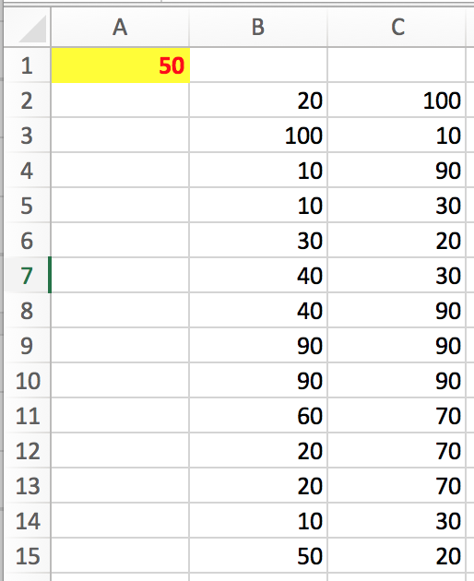
Using cell address in a criterion
While using SUMIF, COUNTIF, AVERAGEIF,
You cannot put a cell address inside the double quotes.
"=B5" is not correct.
You must use an ampersand (&) operator.
"="&B5 is correct.
=SUMIF(B2:B15,<A1,C2:C15) won't work
= SUMIF(B2:B15,"<A1",C2:C15) will work, but NOT correctly (worse than not working)
= SUMIF(B2:B15,"<"&A1,C2:C15) works correctly.

Slide 24
BOOLEAN OPERATORS – AND, OR, NOT
AND(2 > 3, OR(2 < 3, 5 < 3)) evaluates to
AND(FALSE, TRUE) evaluates to
FALSE
OR(NOT(2 < 3), 1=1) evaluates to
OR(NOT(TRUE), TRUE) evaluates to
OR(FALSE, TRUE) evaluates to
TRUE

Slide 25
AND
X Y AND(X, Y)
FALSE FALSE FALSE
TRUE FALSE FALSE
FALSE TRUE FALSE
TRUE TRUE TRUE

Slide 26
OR
X Y OR(X, Y)
FALSE FALSE FALSE
TRUE FALSE TRUE
FALSE TRUE TRUE
TRUE TRUE TRUE

Slide 27
NOT
X NOT(X)
TRUE FALSE
FALSE TRUE

Slide 28
EXAMPLE
=AND(OR(TRUE,NOT(FALSE)),AND(NOT(FALSE),NOT(NOT(FALSE)))
=AND(OR(TRUE,TRUE),AND(TRUE,NOT(TRUE))
=AND(OR(TRUE,TRUE),AND(TRUE,FALSE))
=AND(OR(TRUE,TRUE),AND(TRUE,FALSE))
=AND(TRUE,AND(TRUE,FALSE))
=AND(TRUE,FALSE)
=FALSE

