Slide 1
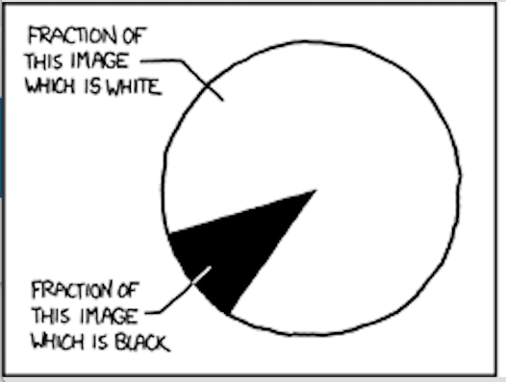
DATA VISUALIZATION
Gaurav Gupta
Source: https://xkcd.com/688/

Slide 2
Chart types
Type | Purpose | Example
Histograms | frequency distribution | Frequency of students in different mark ranges (0-10, 11-20, …)
Column/Bar | distribution across categories | Rainfall by months
Line | trends | Annual Sales figures, Google Search Trends
Pie | proportions | Citizens, Permanent Residents and International student percentages
Scatter | correlation, great example | Goal scoring
Clustered column | distribution across sub-categories

Slide 3
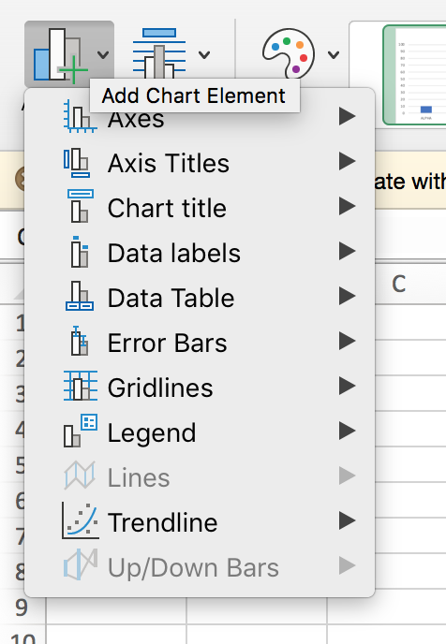
Chart elements
Axes
Axes titles
Chart title
Data labels
Data table
Error bars (A good explanation)
Gridlines
Legend
Lines (for Line charts)
Trendline
Up/Down Bars

Slide 4
Inserting charts
Select data (including headers if applicable)
Click on “Insert”
Choose specific chart or recommended charts (Excel is fairly clever)
Adjust
chart data,
formatting (like font size, color, line width),
chart elements
Change chart type if required

Slide 5
Sources
[1] http://www.xkcd.com/
[2] https://fivethirtyeight.com/features/lionel-messi-is-impossible/

