Slide 1
FOSE1025 Scientific computing
Gaurav GUPTA

Slide 2
About this unit
Part of Bachelor of Advanced Science
Belongs to the option set of electives
You must attempt and pass 2 of 3 units from this set
FOSE1005 (Mathematical Concepts for Science)
FOSE1015 (Statistical Concepts for Science)
FOSE1025 (Scientific Computing)

Slide 3
Useful links
https://ilearn.mq.edu.au/
https://timetables.mq.edu.au/
https://iexams.mq.edu.au/
https://ask.mq.edu.au/
http://onehelp.mq.edu.au/
http://mq.edu.au/library

Slide 4
Assessments
In-class tests (x4) Weeks 3, 6, 8, 10
Project and portfolio
Reproducibility project
Foundation activities

Slide 5

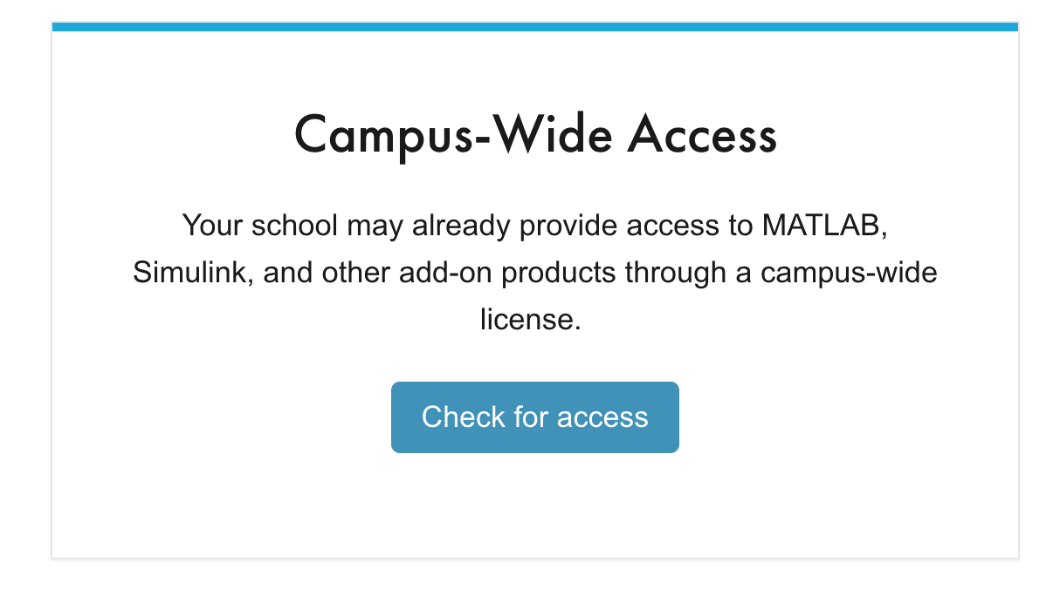
Resources
Microsoft Excel
https://www.microsoft.com/en-us/education/products/office/default.aspx
Enter your email address.
Choose “I’m a student”.
Follow links.
MATLAB
https://au.mathworks.com/products/matlab/student.html
Click on “Check for access”.
Enter “Macquarie University” and your email ID.
Wait for email.

Slide 6
Excel
The Good!
Quick
Powerful
Actually useful
Easy to learn
Ability to add modules available, if required
Flexibility to convert to primitive format
The bad
Limited to data sets (not a programming language)

Slide 7
MATLAB
The Good!
Easy plotting
Variety of in-built functions
Intuitive operations on data sets
Big range of libraries and algorithms
Image and video processing
The bad
Proprietary

Slide 8
Unit Schedule
Weeks 1 – 5: Gaurav Gupta
Weeks 6-10: Diego Molla-Aliod
Weeks 11-13: Faculty Contact

