Slide 1
COMPUTATIONAL
THINKING (CT)
Gaurav Gupta

Slide 2
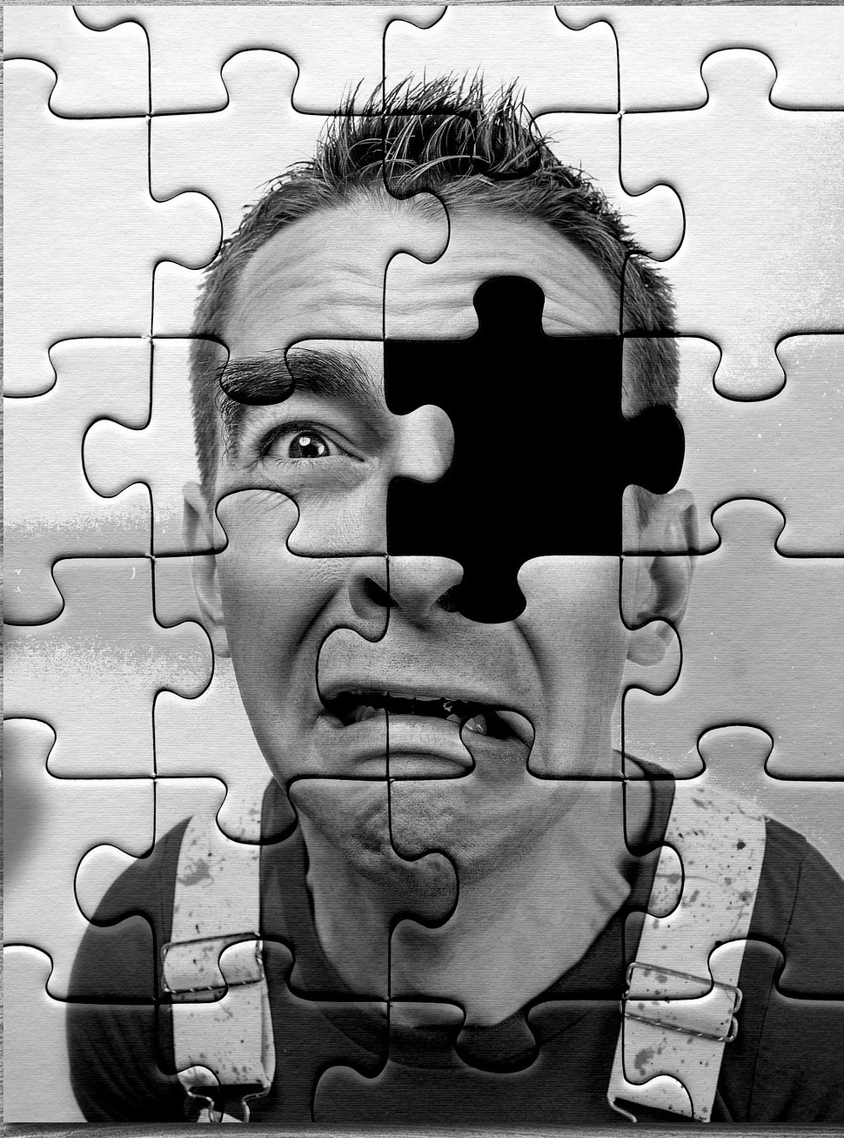
Examples
Cooking
Driving
Painting
Jigsaw
Math
Learning a language
(essentially anything you do)
Source: https://pixabay.com/

Slide 3
Why talk about CT?
Way of thinking
Logical approach
Deterministic (as opposed to ad-hoc approach)

Slide 4
Target audience
Ages 0… and above

Slide 5
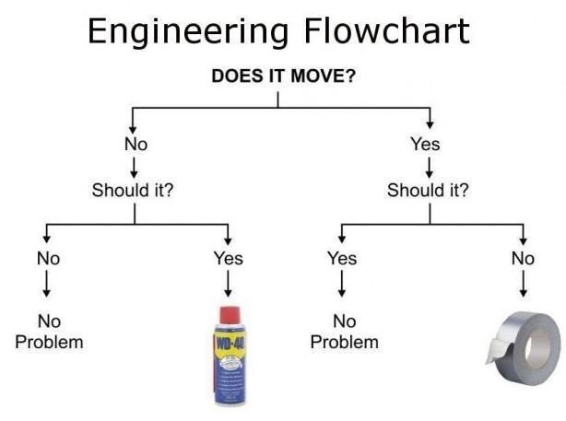
Stages
Decomposition
Pattern recognition
Pattern generalisation (abstraction)
Algorithm development
Testing
Source: https://www.flickr.com/

Slide 6
Decomposition
Breaking a problem down into sub-components.
Identifying aspects, participants, processes.
For example, decomposing the process of making tea leads us to identifying the ingredients - water, tea, sugar, milk, etc and also other entities required like kettle, stove, strainer, pot/cups.

Slide 7
Pattern recognition
Identifying patterns that appear in the domain. For example, a pattern in the process of tea is that the best flavours are released when
the water is in a specific temperature range (when tea bags are dunked)
the duration of steeping is within a specific time range.

Slide 8
Pattern abstraction
Applying identified patterns to a wider range of scenarios.
For example, you can extend the following parameters that are there for making one cup of tea for making a larger quantity
one tablespoon of tea leaves
water at 95 degrees celsius
steeping time of 3 minutes

Slide 9
Algorithm
Given a set of inputs, a well-defined (step-by-step) process to achieve a result.
An algorithm can be more abstract/generic or more specific/detailed

Slide 10
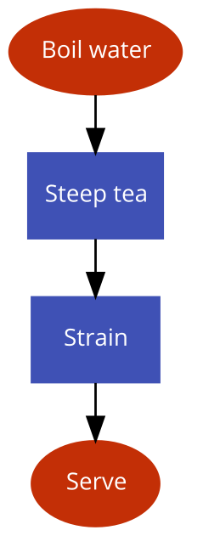
Tea algorithm
(Generic)

Slide 11
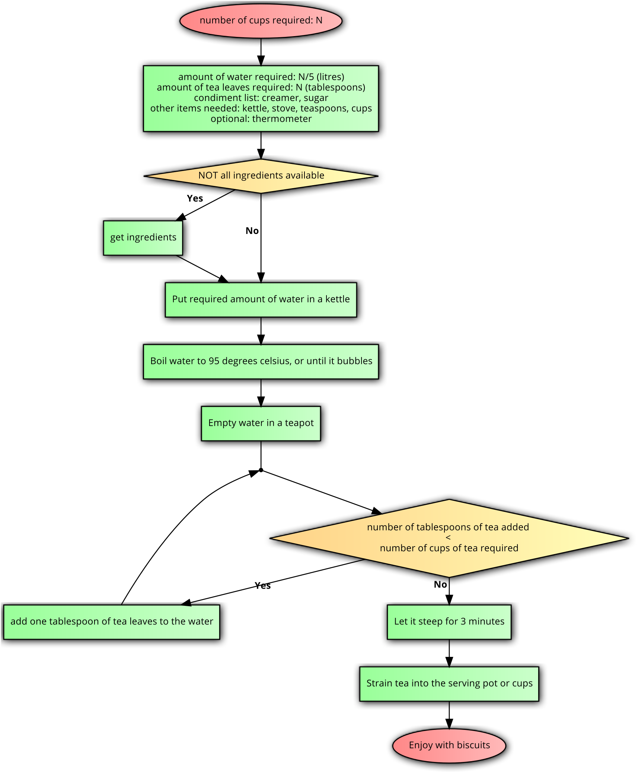
Tea algorithm
(Specific)

Slide 12
Testing
Critical, yet often overlooked step, of learning from the outcome to modify the process or even the understanding of the process.

Slide 13
Activity – Youngest to Oldest
Sorting birthdays
Decomposition
Pattern recognition
Pattern generalization
Algorithm
Testing

Slide 14
Activity - Youngest to Oldest
Which one comes first?
2nd December or 17th February?
15th March or 28th March?
4th April or 4th April?

Slide 15
Activity - Searching

Slide 16
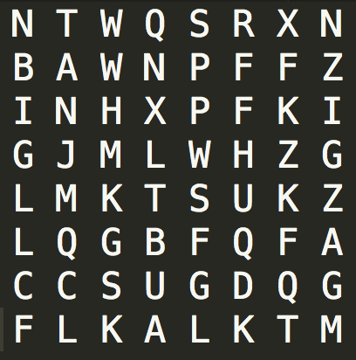
Find "ZIGZAG"

Slide 17
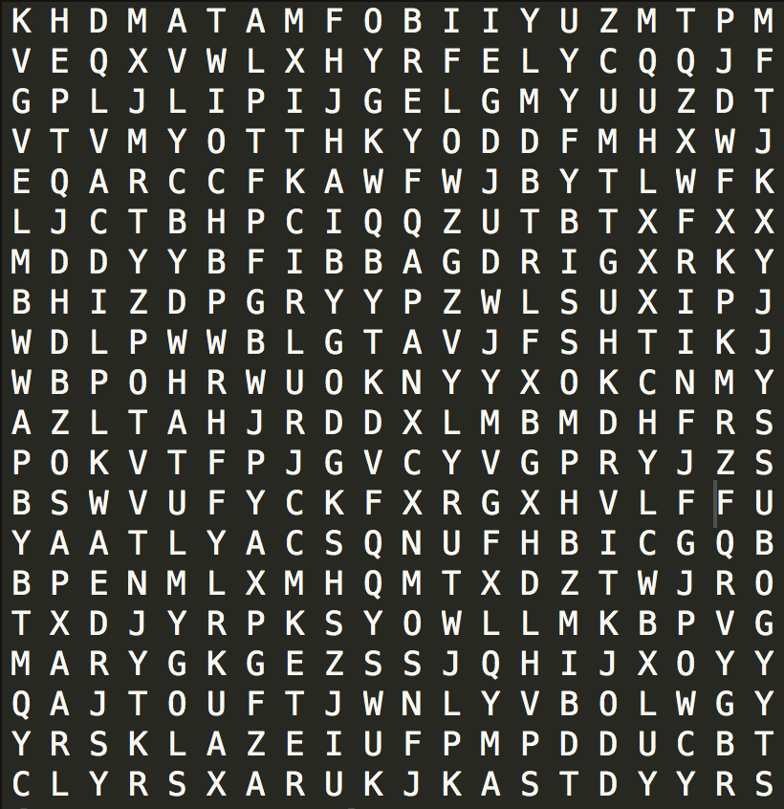
Find "WHAT"

Slide 18
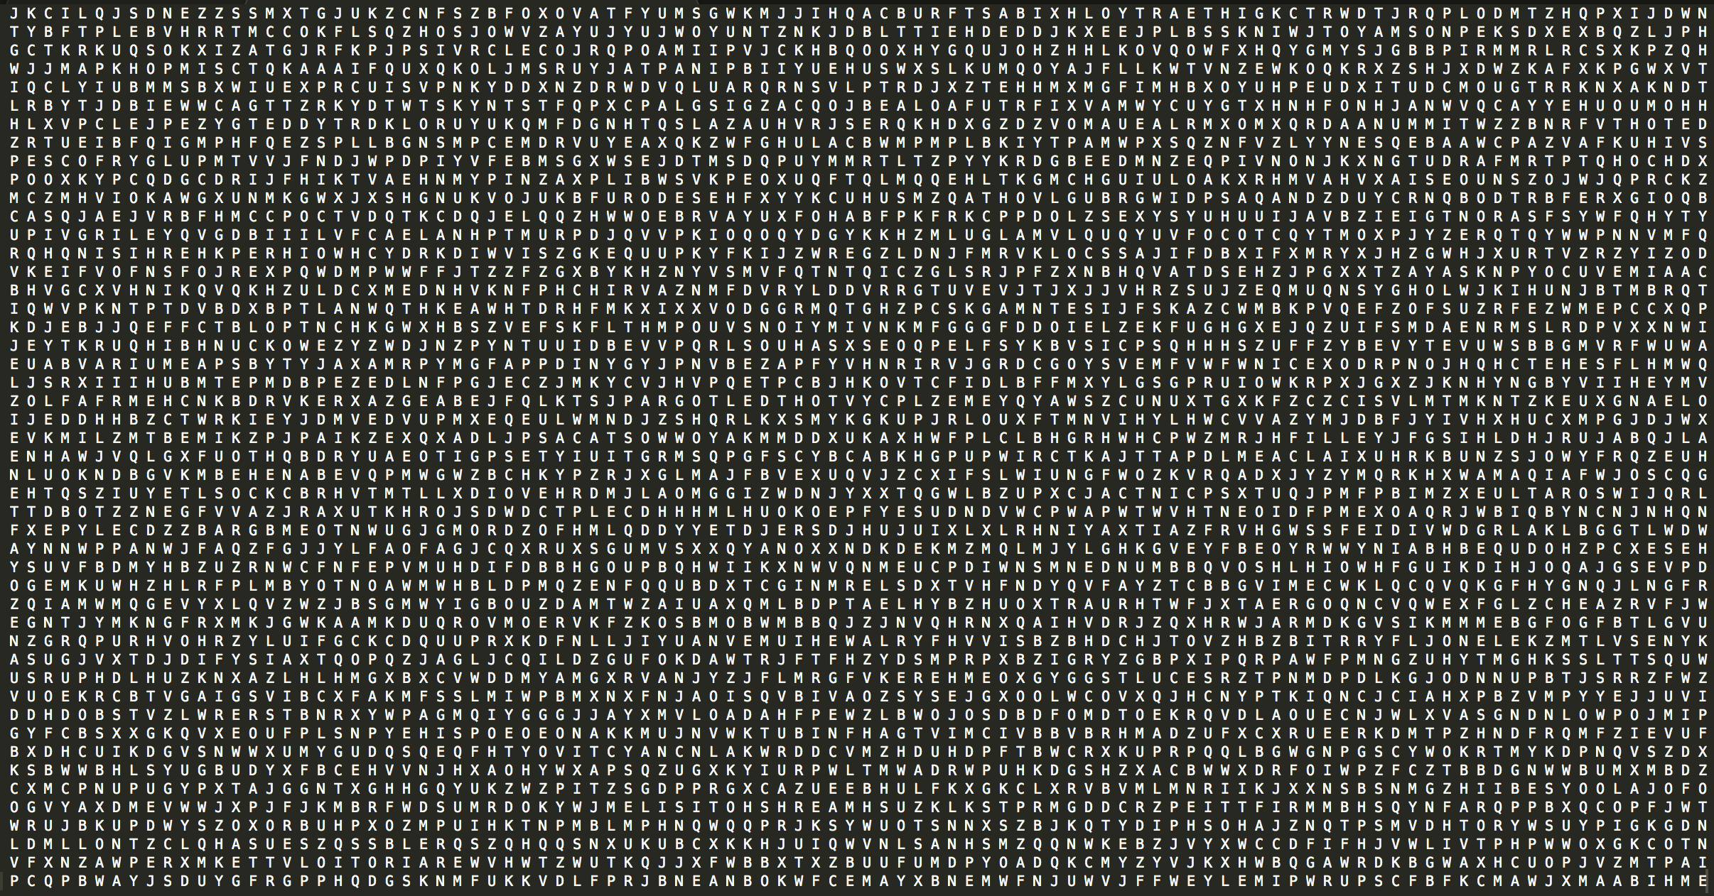
Find "NICE"

Slide 19
Search techniques
Random search (sometimes known as "visual inspection")
Linear search (systematically eliminating items)
Binary search (requires ordered/sorted data)

Slide 20
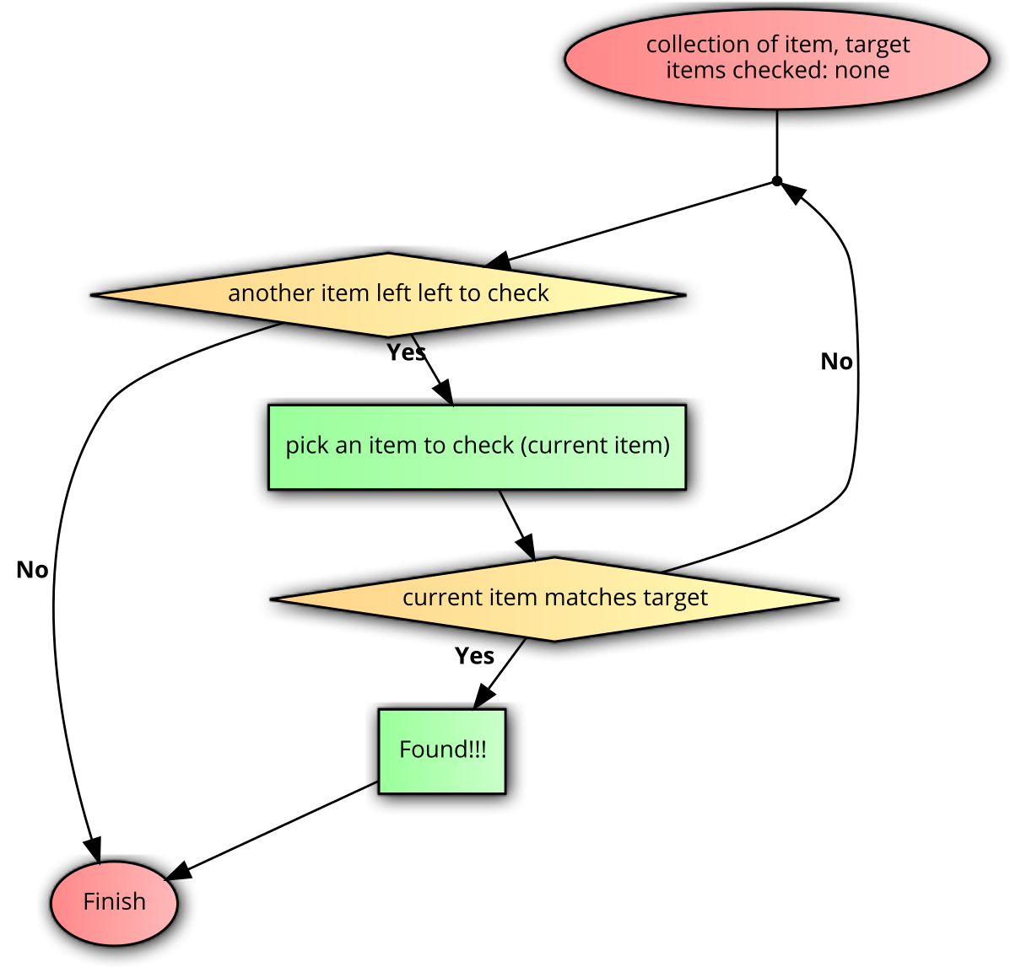
Linear search
Algorithm

Slide 21

I’ve got the blues

Slide 22
Is this color present in the gradient?

Slide 23
Approach 1 step 1

Slide 24
Approach 1 step 2

Slide 25
Approach 1 step 3

Slide 26
Approach 1 step 4

Slide 27
Approach 1 step 5

Slide 28
IS IT EFFICIENT?

Slide 29
I’ve got the blues

Slide 30
Checkpoint 1 - Pass/Fail?

Slide 31
Checkpoint 2 - Pass/Fail?

Slide 32
Checkpoint 3- Pass/Fail?

Slide 33
Checkpoint 4- Pass/Fail?

Slide 34
Estimate of checkpoints required?
Let’s say we start with 16 values
After 1st checkpoint, we are left with 8 values
After 2nd checkpoint, we are left with 4 values
After 3rd checkpoint, we are left with 2 values
After 4th checkpoint, we are left with 1 value
Total checkpoints to go from 16 to 1 = 4

Slide 35
Estimate of checkpoints required?
Let’s say we start with 32 values
After 1st checkpoint, we are left with 16 values
and then it takes another 4 checkpoints to reach 1 value.
So, total checkpoints to go from 32 to 1 = 5

Slide 36
Estimate of checkpoints required?
Let’s say we start with 64 values
After 1st checkpoint, we are left with 32 values
and then it takes another 5 checkpoints to reach 1 value.
So, total checkpoints to go from 64 to 1 = 6

Slide 37
Estimate of checkpoints required?
Checkpoints required to go from N to 1 =
(Checkpoints required to go from N/2 to 1) + 1

Slide 38
Binary search benefits
With each comparison, the search space is halved.
To apply binary search on a data of twice the size (compared to current data), you only need 1 extra comparison.

Slide 39
ACTIVITY - Sudoku
Sudoku
Sudoku is defined as a square grid with N rows, N columns where N is a square (so 1, 4, 9, 16, …). Let’s say the square root of N is K (So if N = 4, K = 2)
Sudoku grids are of size 1 by 1, 4 by 4, 9 by 9, 16 by 16, …
N unique symbols can be placed in each of the cells.
Aim is to start with a partially filled grid and fill it such that no symbol appears more than once in each
rows,
column,
block (defined as K by K sub grid).

Slide 40
4 by 4 Sudoku board

Slide 41
4 by 4 Sudoku board - rows

Slide 42

4 by 4 Sudoku board - columns

Slide 43

4 by 4 Sudoku board - blocks

Slide 44
Starting point
1
2
4
1
4
2
4
3

Slide 45

Filled 4 by 4 Sudoku board
1
2
3
4
4
3
2
1
3
1
4
2
2
4
1
3

Slide 46
Each row has every symbol
1
2
3
4
4
3
2
1
3
1
4
2
2
4
1
3

Slide 47
Each column has every symbol
1
2
3
4
4
3
2
1
3
1
4
2
2
4
1
3

Slide 48
Each block has every symbol
1
2
3
4
4
3
2
1
3
1
4
2
2
4
1
3

Slide 49
Sudoku - Decomposition

Slide 50
Sudoku - Pattern recognition

Slide 51
Sudoku - Pattern generalization

Slide 52
Sudoku - Algorithm

Slide 53
Sudoku - Testing

Slide 54
Testing sample 1
1
2
3
3
3
4
4
2

Slide 55
Testing sample 2
1
2
3
4
4
3

Slide 56
Sudoku is ALL about
Search and repeat

Slide 57
ACTIVITY
Each group will now solve
1 x 4 by 4 sudoku
1 x 9 by 9 sudoku
1 x 16 by 16 sudoku
(16 symbols are 0 through 9 and A through F)

Slide 58
ACTIVITY – NUMBER SYSTEMS

Slide 59
Number Systems
Why decimal?

Slide 60
Breaking down a number
1729 =
1*1000 +
7*100 +
2*10 +
9*1

Slide 61
Breaking down a number
1729 =
1*10^3 +
7*10^2 +
2*10^1 +
9*10^0
Where 10 is the number of symbols in the number system.
This representation is called sum of products.

Slide 62
Breaking down a number
1729 =
1*10^3 +
7*10^2 +
2*10^1 +
9*10^0
Why is the base of the weight always 10?

Slide 63
Decimal Number System
Decomposition: Symbols (0 to 9)
Pattern recognition: Digit, weight
For example, weight of 7 in 1729 is 100
Pattern generalization
Other number systems

Slide 64
Breaking down a binary number
Binary has 2 symbols (0, 1)
Can you break down the following binary number?
10111

Slide 65
Breaking down a binary number
10111 =
1*2^4 +
0*2^3 +
1*2^2 +
1*2^1 +
1*2^0
Where 2 is the number of symbols in the number system.

Slide 66
Pattern recognition
Is 11101010101 a valid binary number?
What about 11101010201? Why, or why not?
What do we learn from this?
A base-N number can only contain symbols 0 to N-1

Slide 67
Activity
Pick a number system (say, between base-2 and base-10)
Think of a number in that number system
Represent it as sum of products.

