Slide 1

SOCKET CHAT
Client-server oriented multi-featured LAN messenger
... ___ _._. _._ . _ _._. .... ._ _

Slide 2
Abstract
Multipurpose Messenger Application using UNIX sockets
Implemented in C++
Client Server Network Architecture
Multiple Chat Clients Connected to a Single Chat Server (synchronous multiplexing using select() )
Designed for Local Area Network Connections
Authentication System(with fstreams)
Morse Code Conversion Feature
File Transfer and AI based Tic-Tac-Toe for clients( under development)

Slide 3
RESOURCES FOR IMPLEMENTATION
C++ Standard Library
GCC(G++) Compiler, Linux Environment and some system tools
GTKMM for GUI
UNIX Sockets for Communication

Slide 4
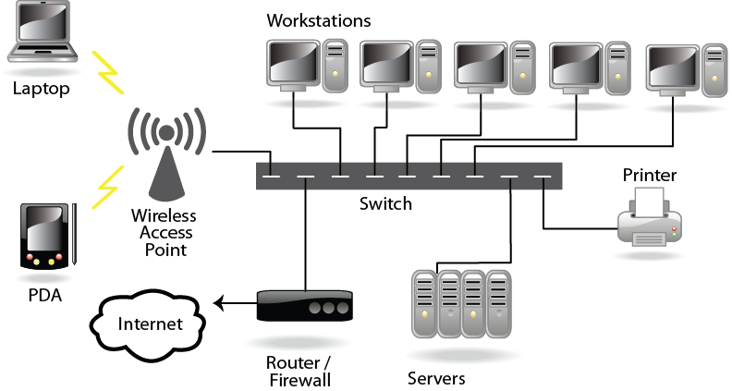
Client-Server

Slide 5
Features of Client Server Network Architecture
Multiple number of networking devices connected to a single server
Organizes network traffic by a client application and by a device
Network clients send messages to a server to make requests of it
Servers respond to their clients by acting on each request and returning results

Slide 6
PROTOCOL FAMILIES
TCP/IP
Transmission Control Protocol/Internet Protocol
Provides End-to-End Connectivity specifying how data should be formatted,addressed,transmitted,routed and received at the destination
Can be used in the Internet and in stand-alone private networks
Is organized into layers

Slide 7
Internet Protocol
Provides a datagram service (Packets are handled and delivered independently)
May lose,reorder or duplicate packets
Each packet must contain an IP address of its destination

Slide 8
ADDRESSES-IPv4 and IPv6
IPv4
32 bits of an IPv4 addresses are broken into 4 octets or 8-bit fields(0-255 in decimal notation)
Contain the network address and host identifier
E.g. 192.168.1.1 // The world may soon run out of Ipv4
IPv6
Contains 128 bits addresses broken into 8 Hex-Fields separated by colon “:”
Modern version of IPv4 addresses
E.g. 2000:2323::1

Slide 9
TCP vs UDP
Both use port numbers(communication endpoint, 16-bit unsigned int,0,65535)
UDP:User Datagram Socket
No acknowledgements,no retransmissions, out of order, duplicates possible,connectionless
TCP:Transmission Control Protocol
In order,no data loss,no duplicates,similar to the file I/O
Flow control
Connection oriented
Bidirectional
TCP used for services with a large data capacity and a persistent connection
UDP more commonly used for quick lookups and single use query-reply actions
E.g. of TCP: HTTP(80),POP3(110) E.g. of UDP:DNS lookup(53)

Slide 10
BERKELEY SOCKETS
Universally known as sockets
An Abstraction through which an application may send and receive data over a network
Standard API for Networking
E .g. TCP/IP

Slide 11
SOCKETS
Uniquely identified by an Internet address,End-to-End Protocol (TCP or UDP),a port number
Two types:DATAGRAM Sockets(UDP) and STREAM Sockets(TCP)
File descriptors for network communication

Slide 12
PROCESSES In Socket Programming
socket() : create a new communication endpoint
bind(): attach a local address to the socket
listen(): invites connections
accept(): accept the connection request
connect(): attempt to establish a connection
send()/sendto(): send data over the connection
recv() /recvfrom(): receive data over the connection
close(): close the connection

Slide 13
HOW TO START A COMMUNICATION?
SERVER CLIENT
Create a socket Create a socket
Bind the socket to a port Establish a connection
Listen for any incoming connections Communicate
Accept the connection Close the connection
Send/Receive Data
Close the connection

Slide 14
OTHER NETWORKING TECHNIQUES
Synchronous I/O Multiplexing for handling multiple clients with a single server-
:Using select() function/ poll() function
Serialization- How to Pack Data: To send binary data across the network using encoding
Broadcast Packets
Non-blocking using timeout functions

Slide 15
GUI(gtkmm)
gtkmm is a C++ wrapper for GTK+ , a library used to create graphical user interfaces.
gtkmm allows you to write code using normal C++ techniques such as encapsulation, derivation, and polymorphism.
Inheritance can be used to derive new widgets. The derivation of new widgets in GTK+ C code is so complicated and error prone that almost no C coders do it. As a C++ developer you know that derivation is an essential Object Orientated technique.
Member instances can be used, simplifying memory management. All GTK+ C widgets are dealt with by use of pointers.

Slide 16
Terminology:
Headers and linking
Widgets
Signals
Buttons
Label
Entry
TreeView
TextView
Dialogs
Timeouts

