Slide 1
PERCEPTRON
1
b
X1
W1
∑
Y
X2
W2
X3
W3

Slide 2
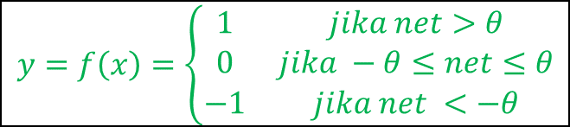
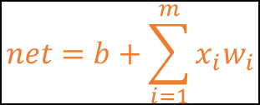
PERCEPTRON
1
b
X1
W1
∑
Y
X2
W2
$$net=b+\sum_{i=1}^{m}{x_{i}w_{i}}$$
$$y=f\left(x\right)=\left\{\begin{matrix}1 & jika net>θ \\ 0 & jika −θ≤net≤θ \\ −1 & jika net <−θ\end{matrix}\right.$$
X3
W3
Inputs
Weights
Summation weights and bias
Activation
Output

Slide 3
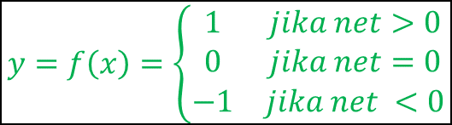
PERCEPTRON
1
b
X1
W1
∑
Y
X2
W2
$$net=b+\sum_{i=1}^{m}{x_{i}w_{i}}$$
$$y=f\left(x\right)=\left\{\begin{matrix}1 & jika net>0 \\ 0 & jika net=0 \\ −1 & jika net <0\end{matrix}\right.$$
X3
W3
Inputs
Weights
Summation weights and bias
Activation
Output

Slide 4
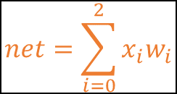
PERCEPTRON
1
0
1
0
∑
Y
1
0
$$net=\sum_{i=0}^{2}{x_{i}w_{i}}$$
$$y=f\left(x\right)=\left\{\begin{matrix}1 & jika net>0 \\ 0 & jika net=0 \\ −1 & jika net <0\end{matrix}\right.$$
Inputs
Weights
Summation weights and bias
Activation
Output

Slide 5
PERCEPTRON
1
b
1
W1
∑
Y
-1
W2
$$net=b+\sum_{i=1}^{m}{x_{i}w_{i}}$$
$$y=f\left(x\right)=\left\{\begin{matrix}1 & jika net>0 \\ 0 & jika net=0 \\ −1 & jika net <0\end{matrix}\right.$$
Inputs
Weights
Summation weights and bias
Activation
Output

Slide 6
PERCEPTRON
1
b
-1
W1
∑
Y
1
W2
$$net=b+\sum_{i=1}^{m}{x_{i}w_{i}}$$
$$y=f\left(x\right)=\left\{\begin{matrix}1 & jika net>0 \\ 0 & jika net=0 \\ −1 & jika net <0\end{matrix}\right.$$
Inputs
Weights
Summation weights and bias
Activation
Output

Slide 7
PERCEPTRON
1
b
-1
W1
∑
Y
-1
W2
$$net=b+\sum_{i=1}^{m}{x_{i}w_{i}}$$
$$y=f\left(x\right)=\left\{\begin{matrix}1 & jika net>0 \\ 0 & jika net=0 \\ −1 & jika net <0\end{matrix}\right.$$
Inputs
Weights
Summation weights and bias
Activation
Output

Slide 8
PERCEPTRON
1
b
X1
W1
∑
Y
X2
W2
…
…
Xm
Wm
Inputs
Weights
Summation weights and bias
Activation
Output

Slide 9
PERCEPTRON
1
∑
Y1
X1
∑
Y2
X2
…
∑
Y_{m}
Xn
Inputs
Weights
Summation weights and bias
Activation
Outputs

