Slide 1
Neural Network Backpropagation Studi Kasus Prediksi Penilaian Kepuasan Penumpang Maskapai Penerbangan
Sugiarto Cokrowibowo

Slide 2

Sugiarto Cokrowibowo
Dosen Program Studi Informatika Universitas Sulawesi Barat
Wakil Dekan 1 Bidang Akademik dan Kemahasiswaan Fakultas Teknik Universitas Sulawesi Barat
S1 Matematika Universitas Hasanuddin
S2 Teknik Elektro Universitas Hasanuddin
Bidang Penelitian: Kecerdasan Artifisial, Soft Computing, Parallel Programming

Slide 3
01
Ringkasan Materi
Prediksi Kepuasan Pelanggan Maskapai Penerbangan menggunakan Algoritma Neural Network Backpropagation

Slide 4
Neural Network Backpropagation
01
02
03
Dataset
Training
Testing
Baca dataset dari file .csv menggunakan Scanner. Split Dataset menjadi data Training dan Data Testing
Proses Training Neural Network Backpropagation untuk membangun Model Neural Network yang terdiri dari Array Bobot V dan W.
Input: Data Training
Output: Array Bobot V dan W
Proses Pengujian menggunakan Data Testing dan Model Neural Network untuk mengetahui akurasi Model yang telah dibangun di proses training.
Input: Data Testing, Aray Bobot V dan W
Output: Akurasi

Slide 5
02
Dataset
Airlines Customer satisfaction

Slide 6
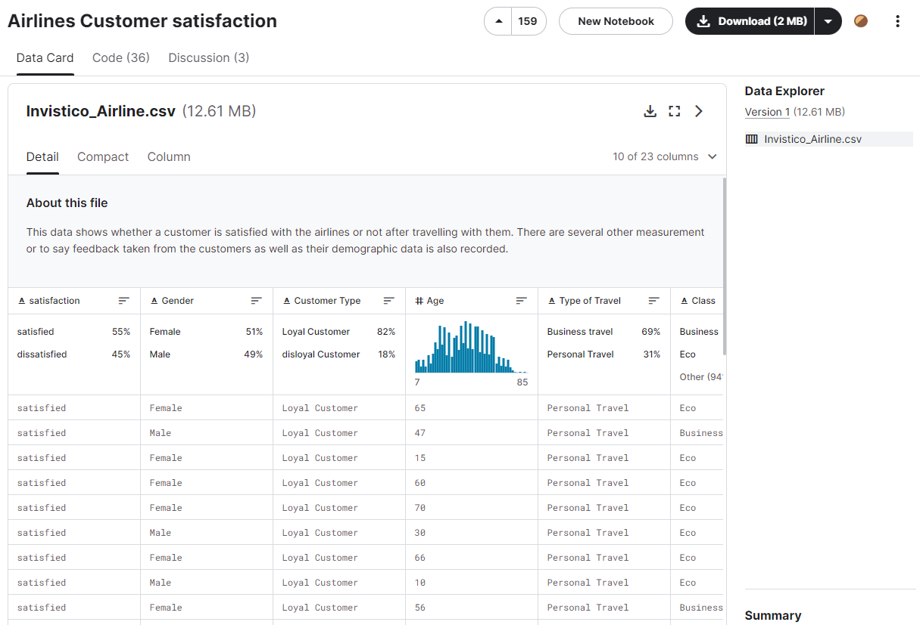
Airlines Customer satisfaction
https://www.kaggle.com/datasets/sjleshrac/airlines-customer-satisfaction

Slide 7
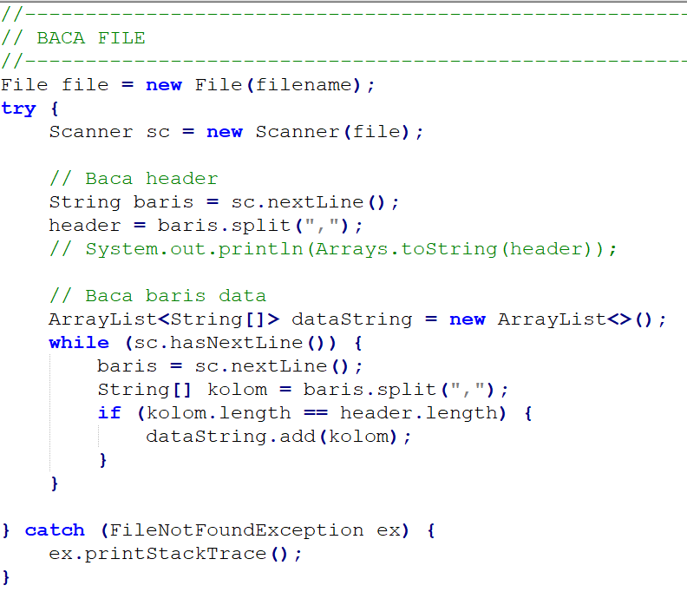
Baca Dataset
String filename = "src/fosalgo/Invistico_Airline.csv";
String[] header = null;
double[][] data = null;

Slide 8
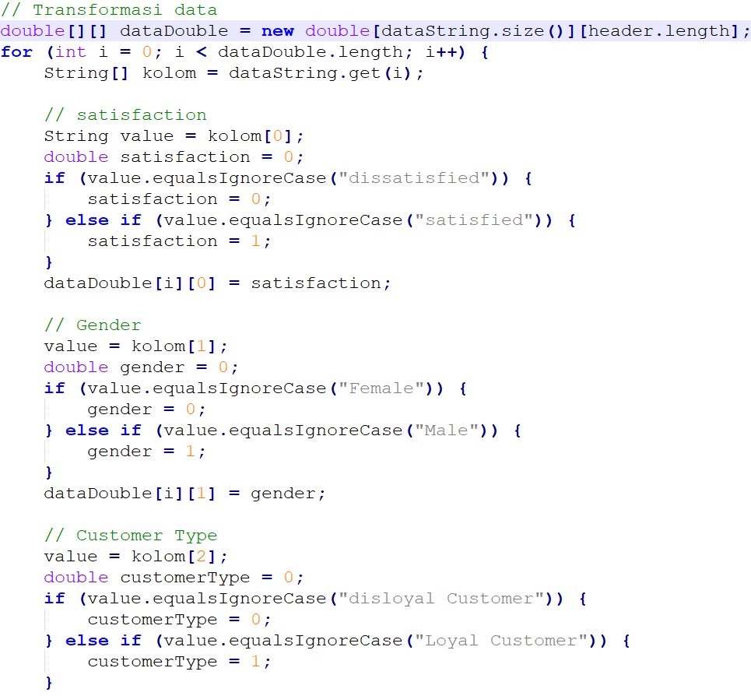
Transformasi Data

Slide 9
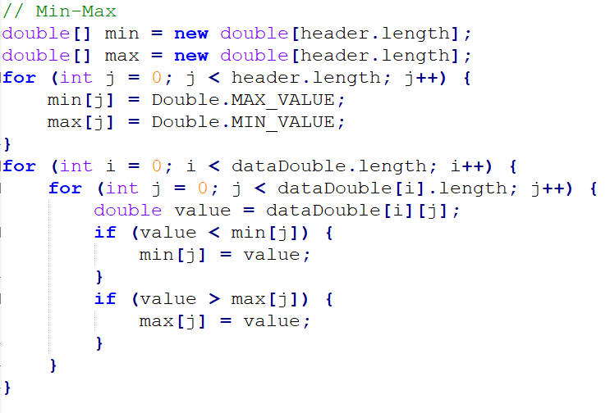
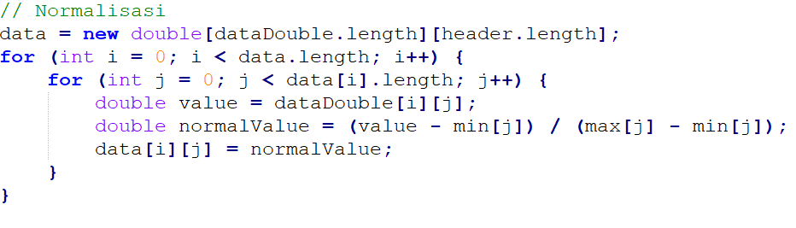
Nilai MIN-MAX

Slide 10
Normalisasi Data

Slide 11
Split Data
01
02
Data Training
Data Testing
-----------------------
-----------------------

Slide 12
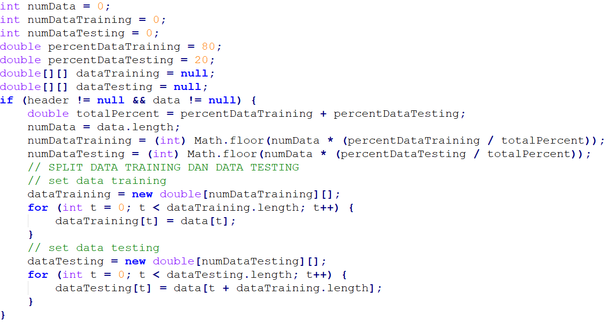
Split Data

Slide 13
03
Arsitektur NN Backpropagation
Arsitektur Neural network Backpropagation

Slide 14
Arsitektur Neural Network Backpropagation

Slide 15
Arsitektur Neural Network Backpropagation
gender
∑ - .
Customer Type
∑ - .
∑ - .
…
…
…
Bobot V
Bobot W
Layer Input
Layer Hidden
Layer Output

Slide 16
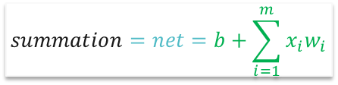
04
Summation
Menghitung Jumlah dari hasil perkalian neuron dan bobot
$$summation=net=b+\sum_{i=1}^{m}{x_{i}w_{i}}$$

Slide 17
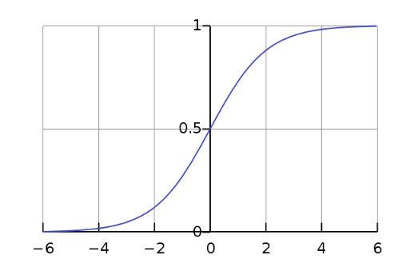


05
Activation
Fungsi Aktivasi Sigmoid Biner
$$Sigmoid Biner=f(x)=\frac{1}{1+e^{−x}}$$
Dengan turunannya:
$$f^{′}(x)=f(x)(1−f\left(x\right))$$

Slide 18
06
Training Backpropagation Neural Network
Proses Training

Slide 19
Training Backpropagation Neural Network
Input Data Training
Feedforward
Output Prediksi
-
Output Target/Truth
Error
Backpropagation

Slide 20
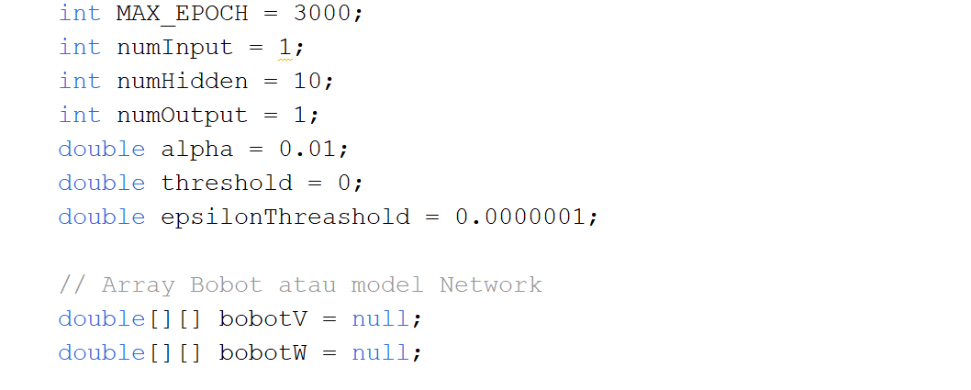
Training - inisialisasi

Slide 21
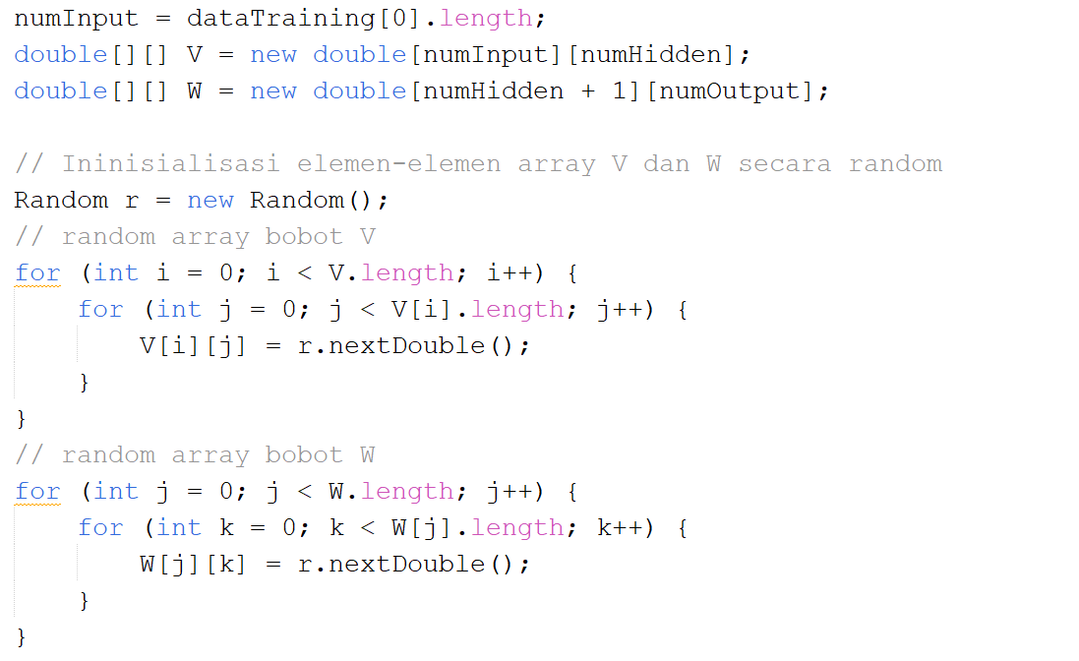
Training - inisialisasi

Slide 22
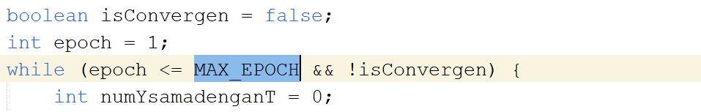
Training – Loop training sebanyak MAX_EPOCH

Slide 23
Training – loop untuk semua data training

Slide 24
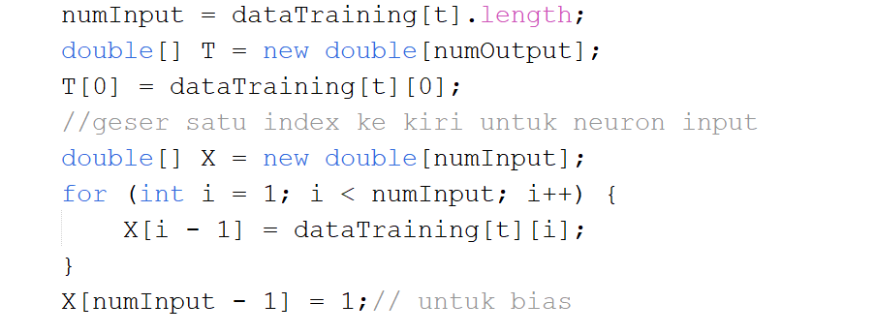
Training – inisialisasi neuron Input dan Target

Slide 25
Feedforward

Slide 26
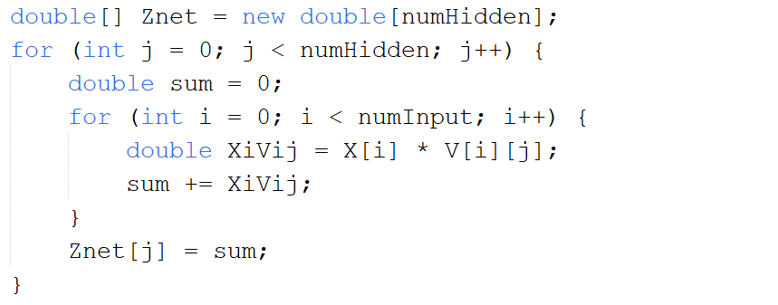
Training – Summation Net-Z

Slide 27
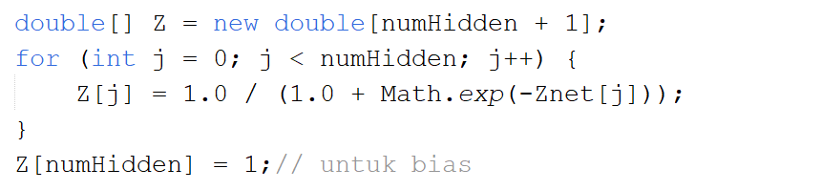
Training – Activation Z

Slide 28
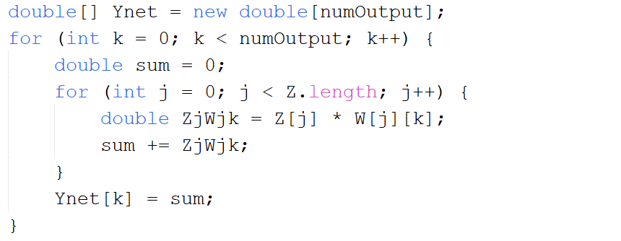
Training – Summation Net-Y

Slide 29
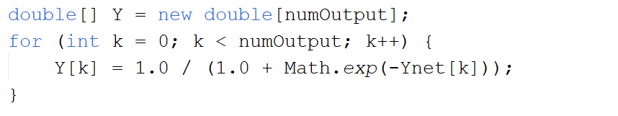
Training – Activation Y

Slide 30
Backpropagation

Slide 31
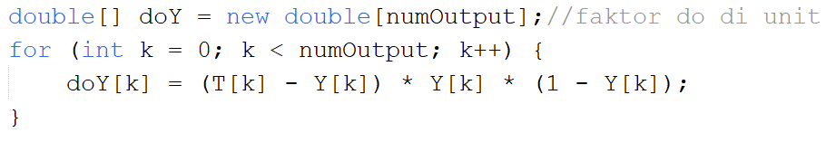
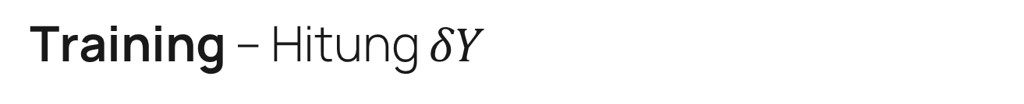
Training – Hitung $δY$

Slide 32
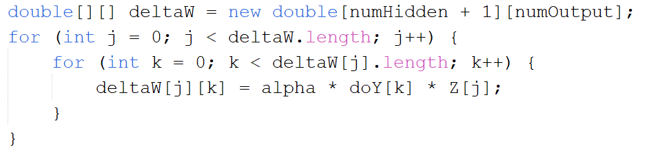
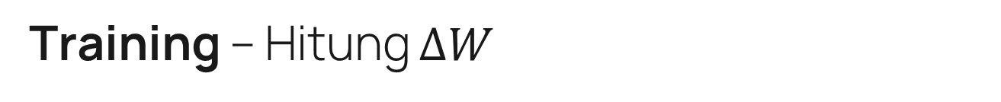
Training – Hitung $∆W$

Slide 33
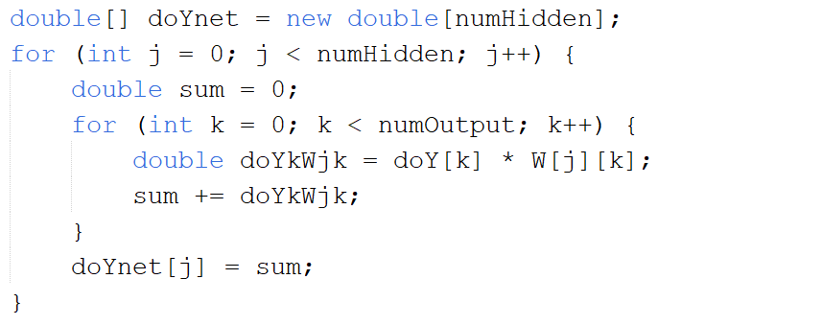
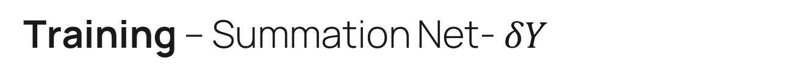
Training – Summation Net- $δY$

Slide 34
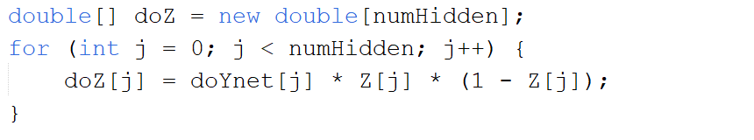
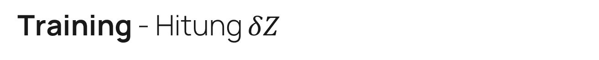
Training - Hitung $δZ$

Slide 35
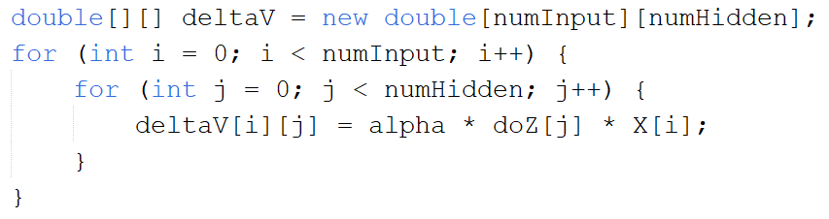
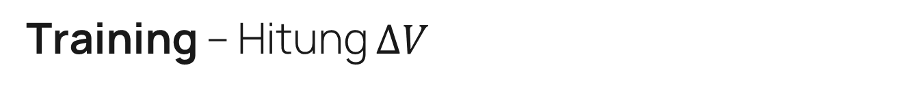
Training – Hitung $∆V$

Slide 36
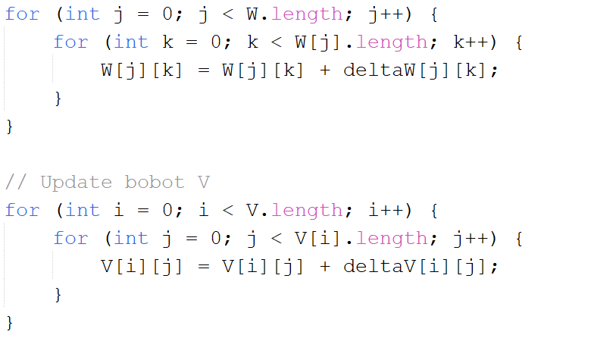
Training – Update Bobot V dan W

Slide 37
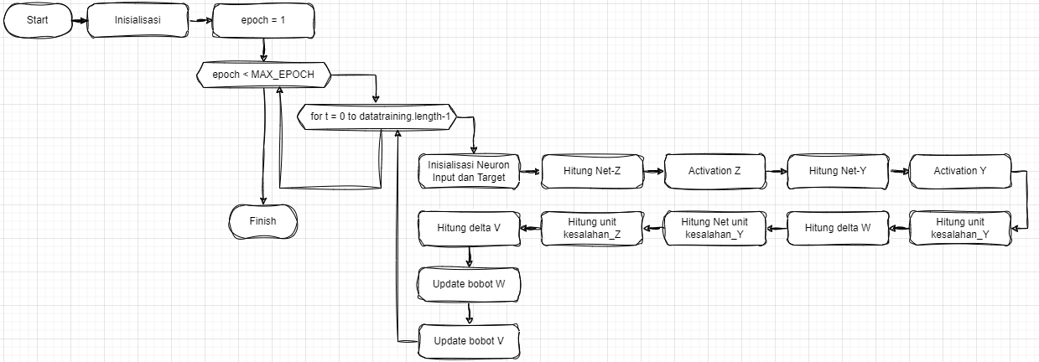
Training - Flowchart

Slide 38
07
Testing Neural Network
Proses Testing

Slide 39
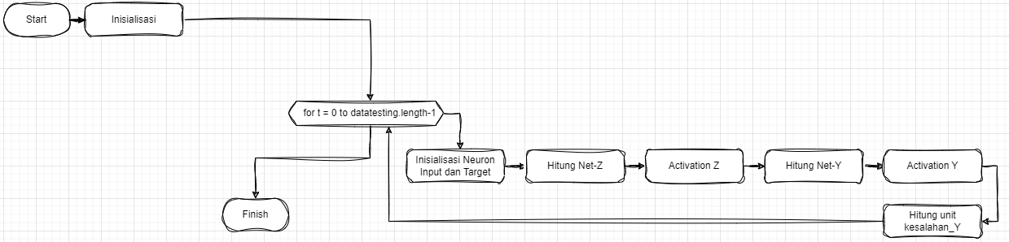
Testing- Flowchart

Slide 40
Thanks
Jangan Lupa LIKE, SHARE, SUBSCRIBE
FOSALGO https://www.youtube.com/@FOSALGO

