Slide 1
DESIGN AND SIMULATION OF
LM555 ASTABLE MULTIVIBRATOR
Using KiCad EDA and Ngspice
Prepared by: Sudeep Singh
Electronics and Communication Engineering
Academic Project — 2026
1

Slide 2
1. Introduction
LM555 is used as an astable multivibrator (free-running oscillator).
The timing network continuously charges and discharges capacitor C1.
The output at Pin 3 switches between HIGH and LOW states.
An LED connected through a 330 Ω resistor indicates the output switching.
The complete design was developed in KiCad and prepared for PCB fabrication.
2

Slide 3
2. Project Objectives
Design an LM555 astable multivibrator using a 5 V supply.
Simulate the circuit using KiCad/ngspice.
Observe the time-domain output.
Design and route a through-hole PCB.
Verify the PCB using Design Rules Checker (DRC).
Generate Gerber and Excellon drill files.
3

Slide 4
3. Project Workflow
Schematic
SPICE
Simulation
Footprint
Assignment
PCB Layout
Routing
DRC
Verification
3D View
Gerber
Files
Complete flow: Design → Simulate → Build PCB → Verify → Prepare for Manufacturing

Slide 5
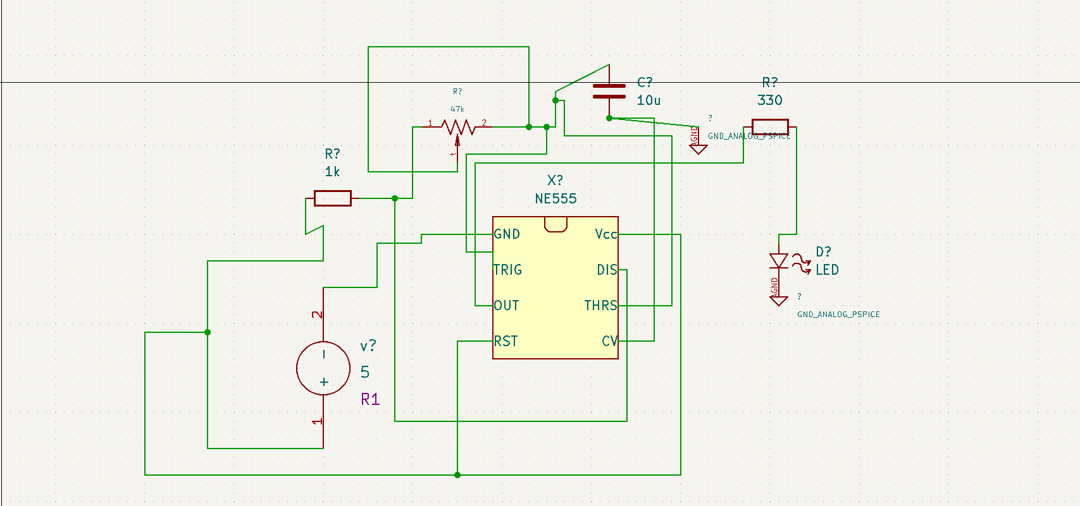
3. Circuit Configuration
Timing network
R1 = 1 kΩ
R2 = 47 kΩ
C1 = 10 µF
Pins 2 and 6 share timing node
LM555xN
Pin 8 → +5 V
Pin 4 → +5 V
Pin 1 → GND
Pin 5 → 10 nF → GND
Output
Pin 3 → R3 = 330 Ω
→ LED → GND
J1: +5 V / GND
Actual KiCad schematic
4

Slide 6
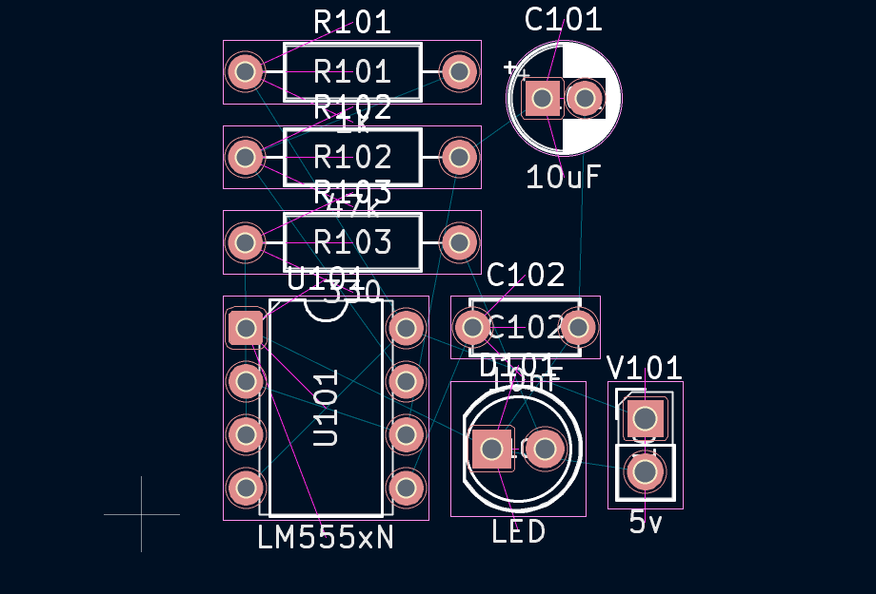
5. Main Components Used
LM555xN
U101
8-pin timer IC
1 kΩ
R101
Timing resistor
47 kΩ
R102
Timing resistor
330 Ω
R103
LED current limiter
10 µF
C101
Timing capacitor
10 nF
C102
Control-voltage bypass
LED
D101
Output indicator
2-pin connector
J1
+5 V / GND input
Actual assigned footprints

Slide 7
4. Working Principle
1. C1 charges through R1 and R2.
2. When C1 reaches the upper threshold, the 555 changes state.
3. The discharge path turns on and C1 discharges through R2.
4. When C1 reaches the lower threshold, the 555 changes state again.
5. The process repeats continuously, producing a periodic output.
6. The LED indicates the HIGH/LOW switching at Pin 3.
5

Slide 8
5. Components and Design Calculation
U101: LM555xN / NE555, DIP-8
R1 = 1 kΩ, R2 = 47 kΩ, R3 = 330 Ω
C1 = 10 µF, C2 = 10 nF
D101: 5 mm LED; J1: 2-pin +5 V/GND connector
Astable period: T = 0.693(R1 + 2R2)C1
Calculated T ≈ 0.659 s → f ≈ 1.52 Hz
6

Slide 9
6. SPICE Simulation
KiCad schematic was simulated using ngspice.
An external NE555 SPICE model was loaded and mapped to the 8-pin symbol.
LED simulation used a diode model.
Transient analysis: 1 ms time step, 2 s final time.
Startup conditions were handled during simulation testing.
Expected output: square-like waveform at Pin 3 and charging/discharging waveform at the timing node.
7

Slide 10
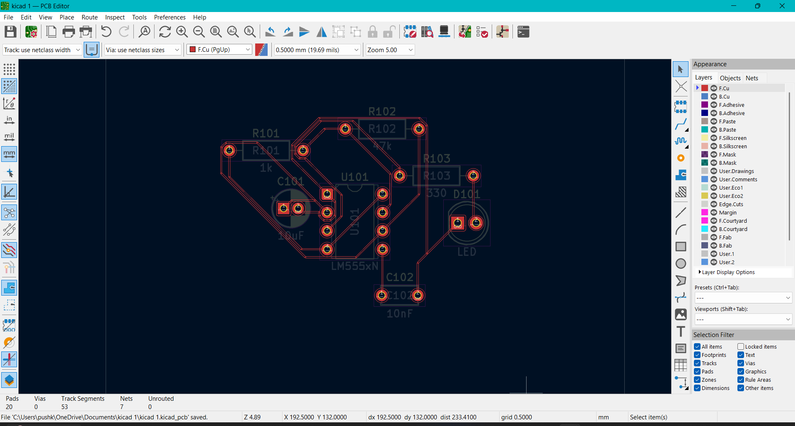
7. PCB Design Workflow
Schematic → footprint assignment → Update PCB from Schematic.
Components placed with timing components close to the 555.
Closed rectangular Edge.Cuts board outline created.
All PCB connections routed.
2-pin power connector added for physical +5 V and GND input.
Final board inspected in KiCad 3D Viewer.
Tip: replace/add your actual KiCad screenshots on this slide for the final submission.
Actual routed PCB layout
8

Slide 11
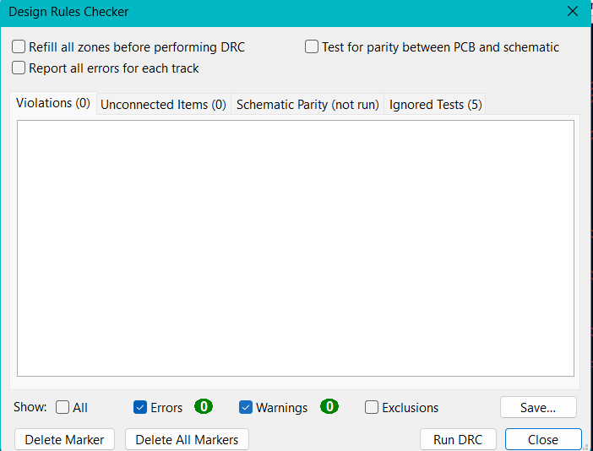
8. PCB Verification
Design Rules Checker (DRC) was run after routing.
Final verification: 0 violations.
Unconnected items: 0.
PCB outline was corrected to a single rectangular Edge.Cuts boundary.
Final 3D view confirmed component placement and board geometry.
Final DRC: 0 violations, 0 unconnected
9

Slide 12
9. Manufacturing Files
Gerber files generated from the completed PCB.
F.Cu and B.Cu — copper layers.
F.Mask and B.Mask — solder-mask layers.
F.Silkscreen and B.Silkscreen — component markings.
Edge.Cuts — board outline.
Excellon drill file — through-hole drill locations.
Files can be packaged as a ZIP for PCB fabrication.
Footprint assignment / component placement
10

Slide 13
10. Applications, Advantages and Limitations
Applications: LED flashers, indicators, clock/pulse generation and timing circuits.
Advantages: simple, low-cost, few external components and easy to prototype.
Frequency can be changed by changing R1, R2 or C1.
Limitations: frequency depends on component tolerances.
LED is an indicator and is not intended to drive a high-power load directly.
Simulation behavior depends on the selected NE555 SPICE model.
11

Slide 14
11. Conclusion
The LM555 astable multivibrator was designed and simulated successfully as a KiCad project.
The PCB was placed, routed and verified with DRC.
Final DRC result: 0 violations and 0 unconnected items.
The board was checked in the 3D Viewer.
Gerber and drill files were generated for possible fabrication.
The project demonstrates a complete schematic-to-PCB design workflow.
12

Slide 15
Thank You
Thank You
Questions?
13

Slide 16
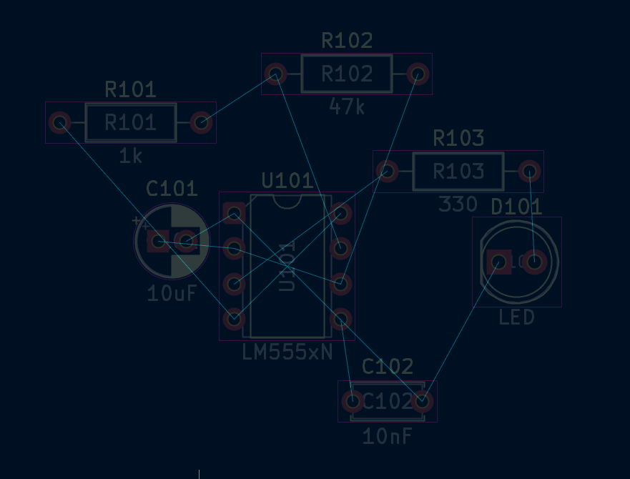
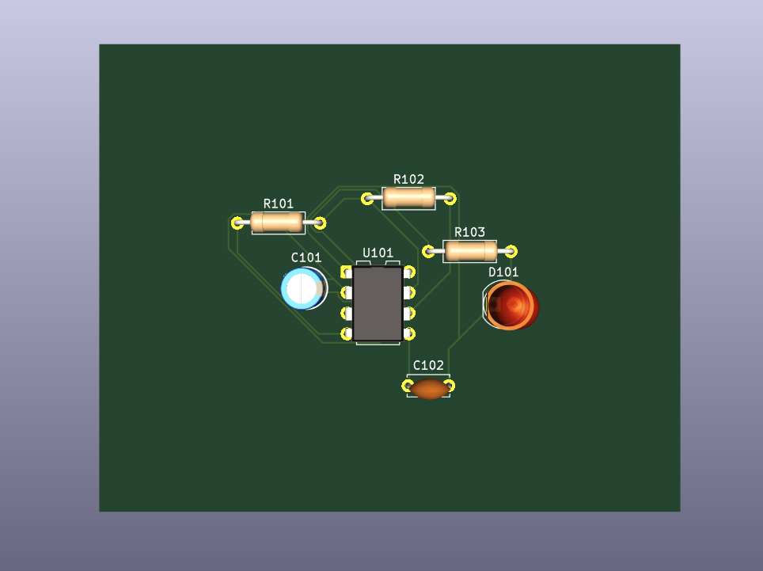
Project Evidence — Actual KiCad Screenshots
1. Schematic
2. Routed PCB
3. Footprints
4. Initial PCB / Ratsnest
5. Final 3D View
6. Final DRC

Slide 17
Final Project Status
✓ Schematic completed
✓ Footprints assigned
✓ PCB routed
✓ Unrouted connections: 0
✓ DRC violations: 0
✓ Final 3D view checked
✓ Gerber and drill files generated
✓ Project ready for presentation / PCB fabrication

