Slide 1
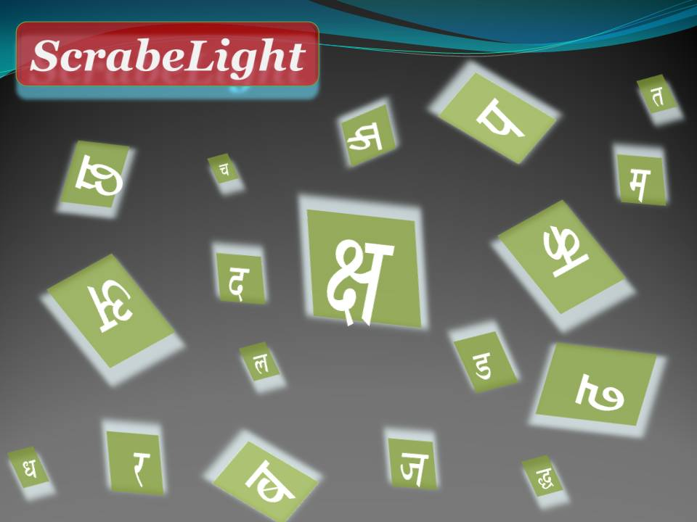
ScrabelLight
ScrabelLight : An edu-game in the language of your choice
An edu-game in the language of your choice
Pooja Tiwari, Priyanka Mudliyar, Archana Harad, Ambuja Salgaonkar

Slide 2
Preamble
Even for the slow learners Edu-games have proved their effectiveness in quick-learning and longer-retention of the objects.
Board-games are portable, their soft-versions are becoming popular.
But they are generally available in English and other European languages .
Exceptionally, Aksharit is available in a few Indian languages.

Slide 3
Motivation
In continuation of my attempts to bring Python in formal education…
An assignment problem: Develop Scrabble for Marathi learners
Scrabble variants including iTune versions exist
Provide scope for formalization of structure and defining a framework for generic applications
Marathi vocab-learning module in IMME is ready
A variant, learn-higher-order-constructions, is proposed for more productive use of the board
Board game for mind-mapping is a novel idea

Slide 4
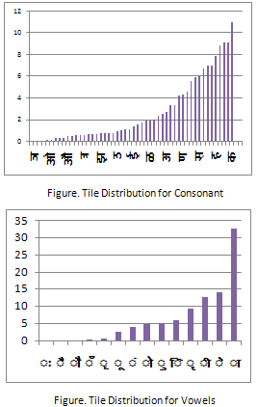
Pre-processing
Tile configuration: Based on the usage frequency distribution of the signs of the language
Weights of the tiles: Tiles are classified into <How many?> categories. The smaller the usage, the higher the weight

Slide 5
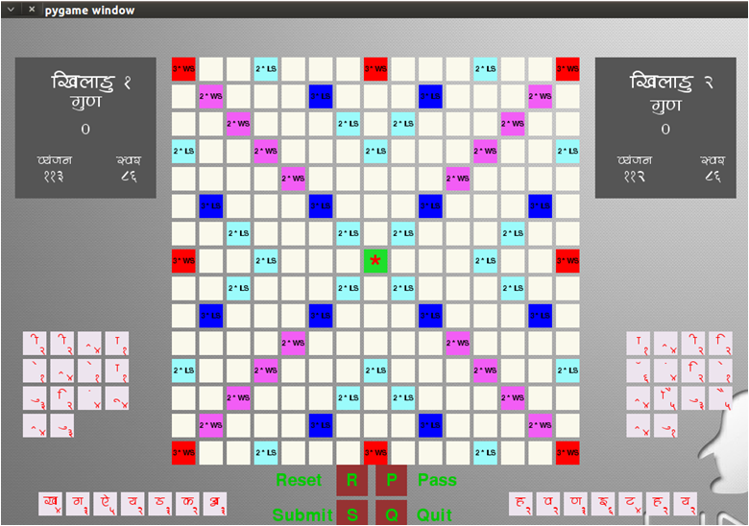
Generating an instance…
User Controls: Board-size, Complexity level,
Objective of the game and Number of players

Slide 6
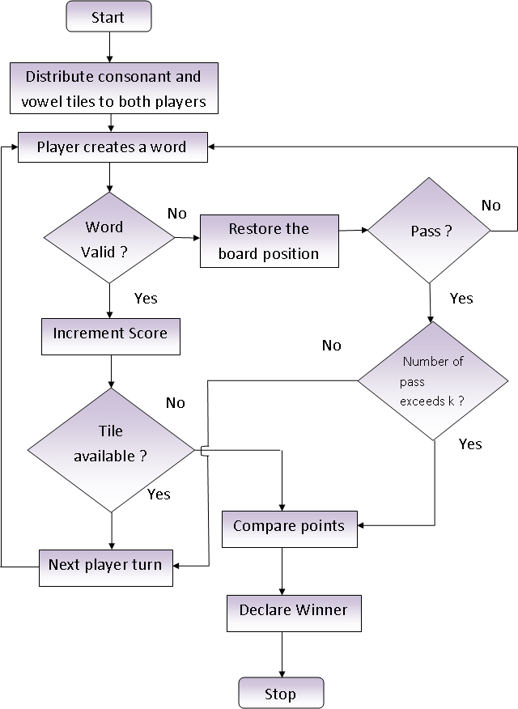
Evaluation

Slide 7
Example Game-rules
Constructions are validated against the (human / digital) language resources.
For instance: Dictionary has been employed for vocabulary learning. Corpora and Wordnet are employed for sentence constructions in the Mindmap modules.
Scoring is dependent of the Game-rules
Example:
The Vocab-learning and Sentence-construction modules follow the rules of standard Scrabble game with a little modifications that prohibit monotony in the articulations and facilitates better utilization of the board space.
Mindmap is a tool for remembering a theme and its logical associates in a structured manner and hence is applicable to learn any subject. Basis of the Mindmap-score is the association weights between the terms.

Slide 8
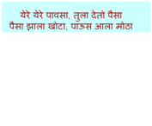
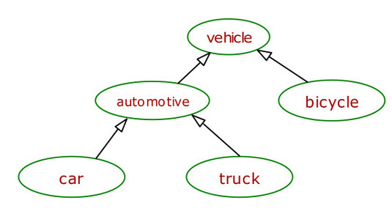
Example Corpora and Wordnet
Edges are labeled with association weights

Slide 9
From Corpus to
User Dictionary:
Identify unique strings
User Corpora:
Collection of K-length strings
User Wordnet:
Generate association weights for the n-near terms

Slide 10
Contributions
A generic framework of game-rules that is adaptable to user’s language, learning objects and purpose.
Subject to the creativity of the teacher, the framework could be molded to fit to the requirement of different learning objects.
Developed using FOSS Python 2.6 (pygame) on Ubuntu 10.04 platform and MySQL 5.1 database and will be available under GPL.
It has opened an avenue in interdisciplinary area of research in Education, Psychology and Technology..

Slide 11
observations
Scrabellight has more promises than to be a tool for learning vocabulary of a language.
Scrablelight considers word associations, Scrabble does not.
It has been experienced that this creative assignment expedited the process of learning programming and the students appreciated utility of the software platform very quickly.
Students learned Python almost without help of the teacher and they enjoyed it.
Study of Pyscrabble helped while writing the code for SrableLight

Slide 12
Status of the work
Marathi vocabulary learning module is ready and tested.
Marathi Corpora and Wordnet extensions are under construction.

Slide 13
References
http://en.wikipedia.org/wiki/Educational_game
http://en.wikipedia.org/wiki/Scrabble#International_versions
http://www.aksharit.com/quickOverview.php
http://www.livemint.com/Leisure/sH8b88CXEzsQ2jZeTADGPI/Devanagari-game-changers.html
http://www.poslfit.com/scrabble/gcg/
http://www.google.com/patents?vid=2752158
http://www.merriam-webster.com/game/scrabble.htm
https://itunes.apple.com/us/app/happy-words-unscramble-your/id528418964?mt=8
https://play.google.com/store/apps/details?id=com.inspifactory.numerabble&hl=en
http://en.wikipedia.org/wiki/Numble
http://pyscrabble.sourceforge.net/
http://en.wikipedia.org/wiki/Mind_map

Slide 14
THANK YOU!...
Questions and queries?
.
.
.
ambujas@gmail.com
poojatiwari0912@gmail.com
piuas28@gmail.com
archu.harad@gmail.com

