Slide 1
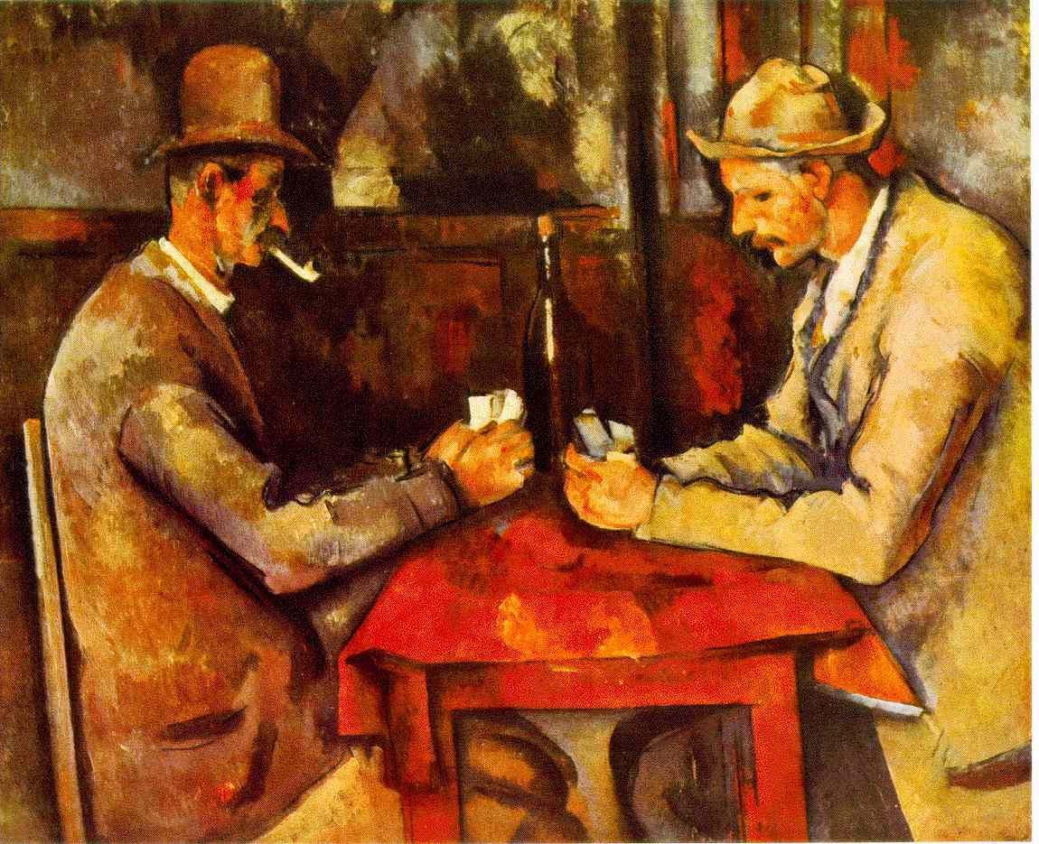
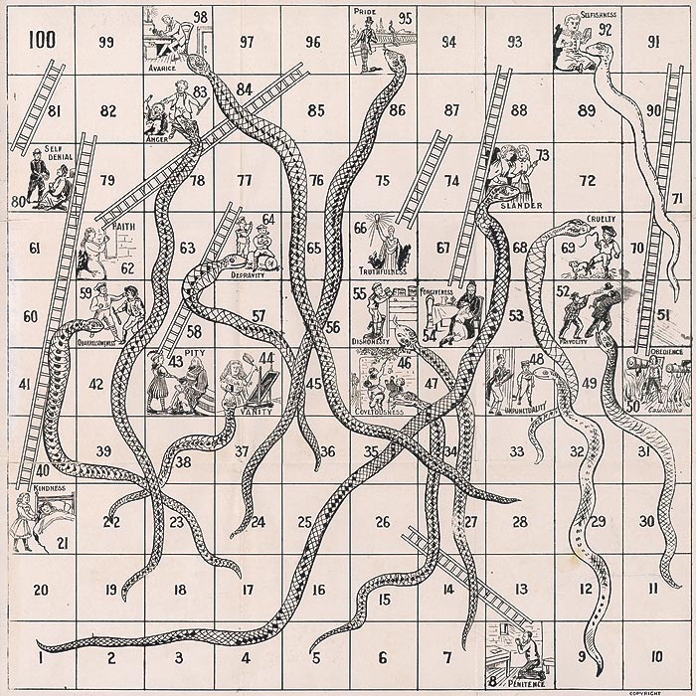
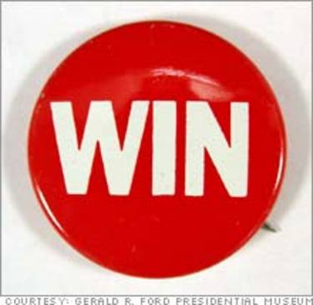
What’s in a Game?
(Formal Elements)

Slide 2
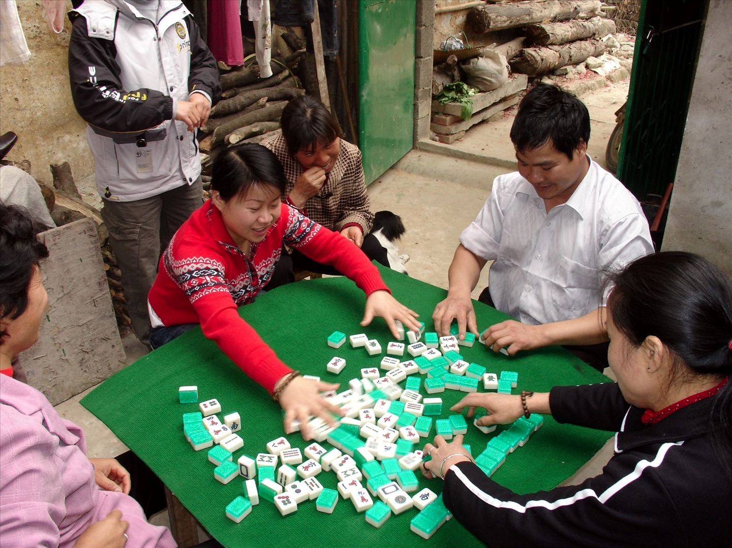
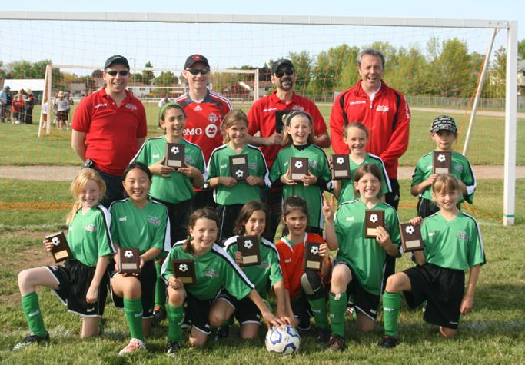
Players
Number
Age
Roles
Notes:
Defining the number, age and roles of game players can be critical choices to a game designer.
Mah Jong image: Happy Majiang / Mahjong Players photo by drs2biz on Flickr
http://www.flickr.com/photos/drs2biz/400704125/
Soccer Team Image North Toronto Soccer.com http://www.ntsoccer.com/
Paul Cezane’s the Cards Players. http://www.ibiblio.org/

Slide 3
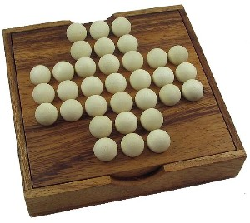
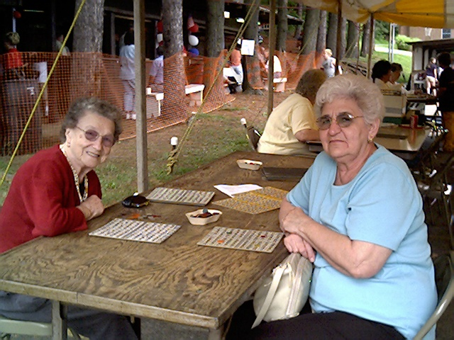
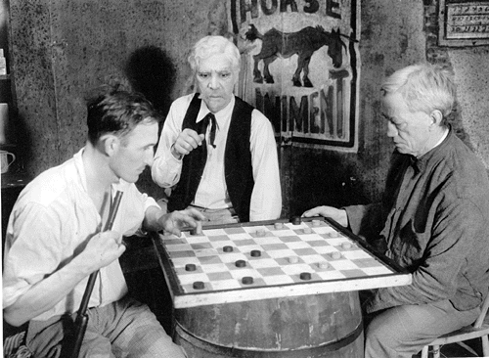

Who Plays Who and How?
(Player Interaction)
Player vs. Game: Solitaire
Players vs. Game: Bingo
One player against the others: Tag
Player vs. Player: Checkers
Notes:
Marble Solitaire Image. http:// Kaboodle.com
Game of Tag Image http://cmtvarok.wordpress.com/tag/education/
Checkers Game http://localism.com
Bingo Image http:/nantyglo.com

Slide 4
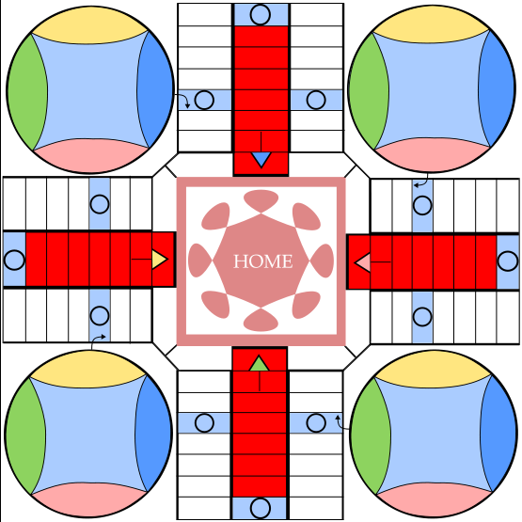
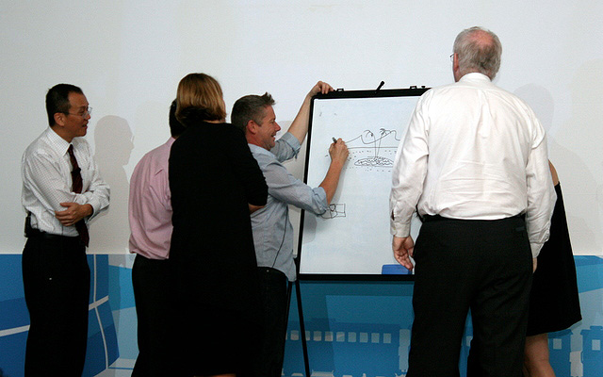
Who Plays Who and How?
(Player Interaction)
Every player for herself:
Parcheesi
Team Competition
Pictionary
Notes:
Parcheesi is an american version of an old game from India, Pachisi game with a long history, it is the foundation for games like “Sorry!” and “Trouble”
Pictionary is a game where teams compete to identify items or events via grawings.
Parcheesi Board Image: http://www.squidoo.com/rocketmoms/hq
Pictionary Payers http://camemberu.com

Slide 5
Goals/Objectives/Win Conditions
Some common ones are..
Capturing Tokens
Chasing Opponents
Racing to the End
Aligning Tokens
Solving Problems
Outwitting Your Opponent

Slide 6
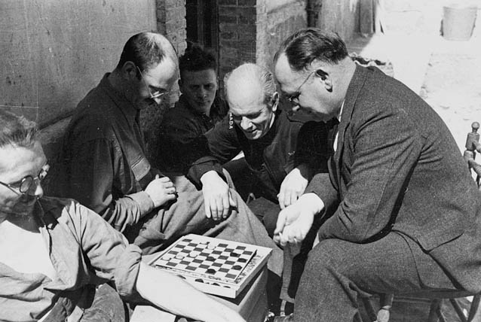
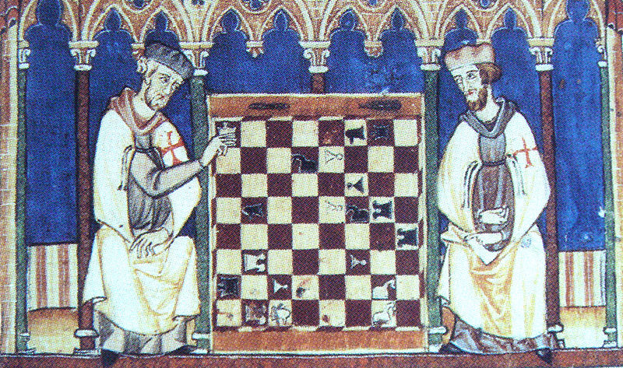
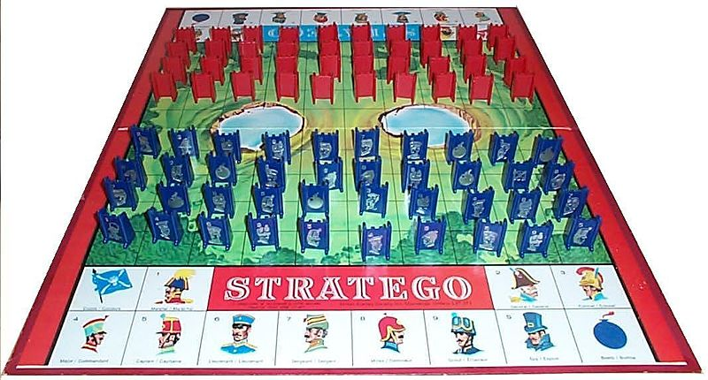
Capture
Notes:
Stratego, Checkers and Chess; Wikimedia Commons
Checkers: Pieces are equal (except if one is Kinged). Goal is to capture all pieces.
Chess: Differentiated tokens with obvious roles. Win condition is capture the King
Stratego: Differentiated tokens with hiddne roles. Win condition is capture the Flag

Slide 7
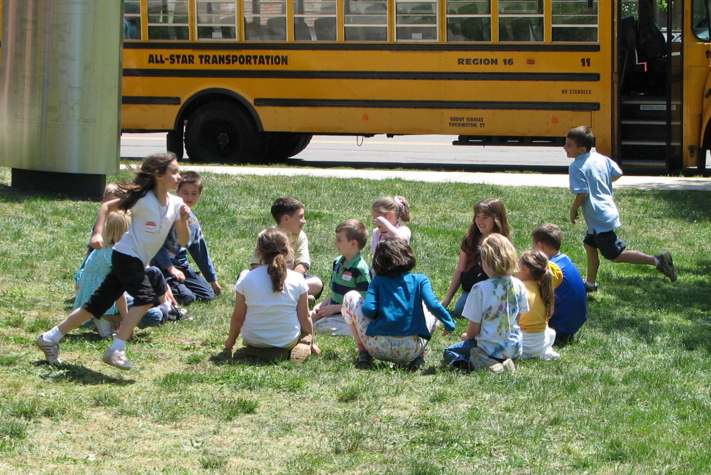
Chase
Notes:
Duck Duck Goose: free-photos.biz

Slide 8
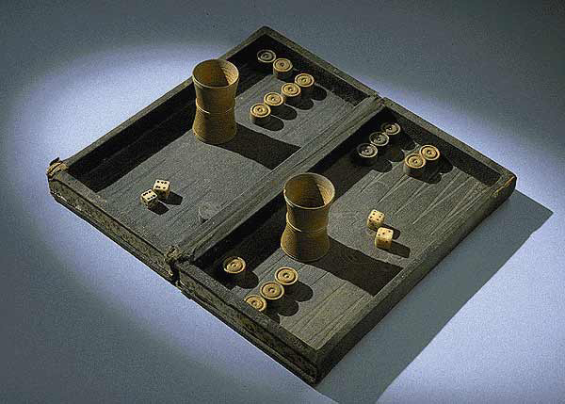
Race
Notes:
Backgammon: Wikimedia Commons.
Win condition is to be the first to move all your pawns off the board
Snakes and Ladders: NAA.gov.
Win condition is to be the first to make it to square 100

Slide 9

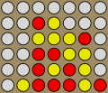
Alignment
Notes:
Tic Tac Toe. Wikimedia Commons.
A version, OXO for the EDSAC mainframe was the first known computer game.
Connect Four. Wikimeida commons. A Tic Tac Toe variant

Slide 10
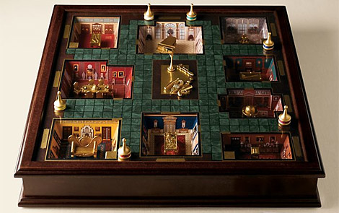
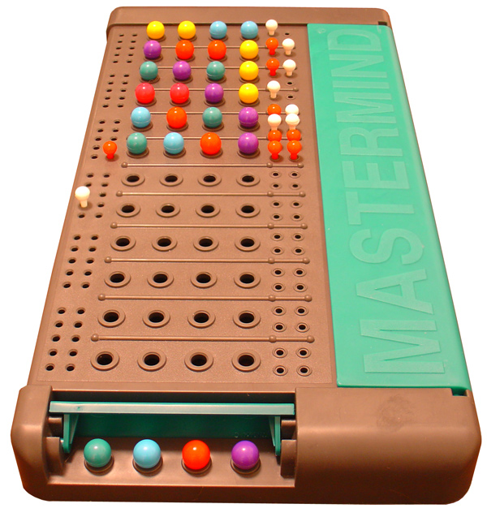
Solution
Notes:
Mastemind: Wikimedia Commons: A code breaking game similar to an old pen and pencil games called cows and bulls. 1 player aligns colored pegs and the other must guess the colors and positions
Clue Premiere Edition: OhGIzmo.com A murder mystery game originally released as Cluedo in the UK

Slide 11
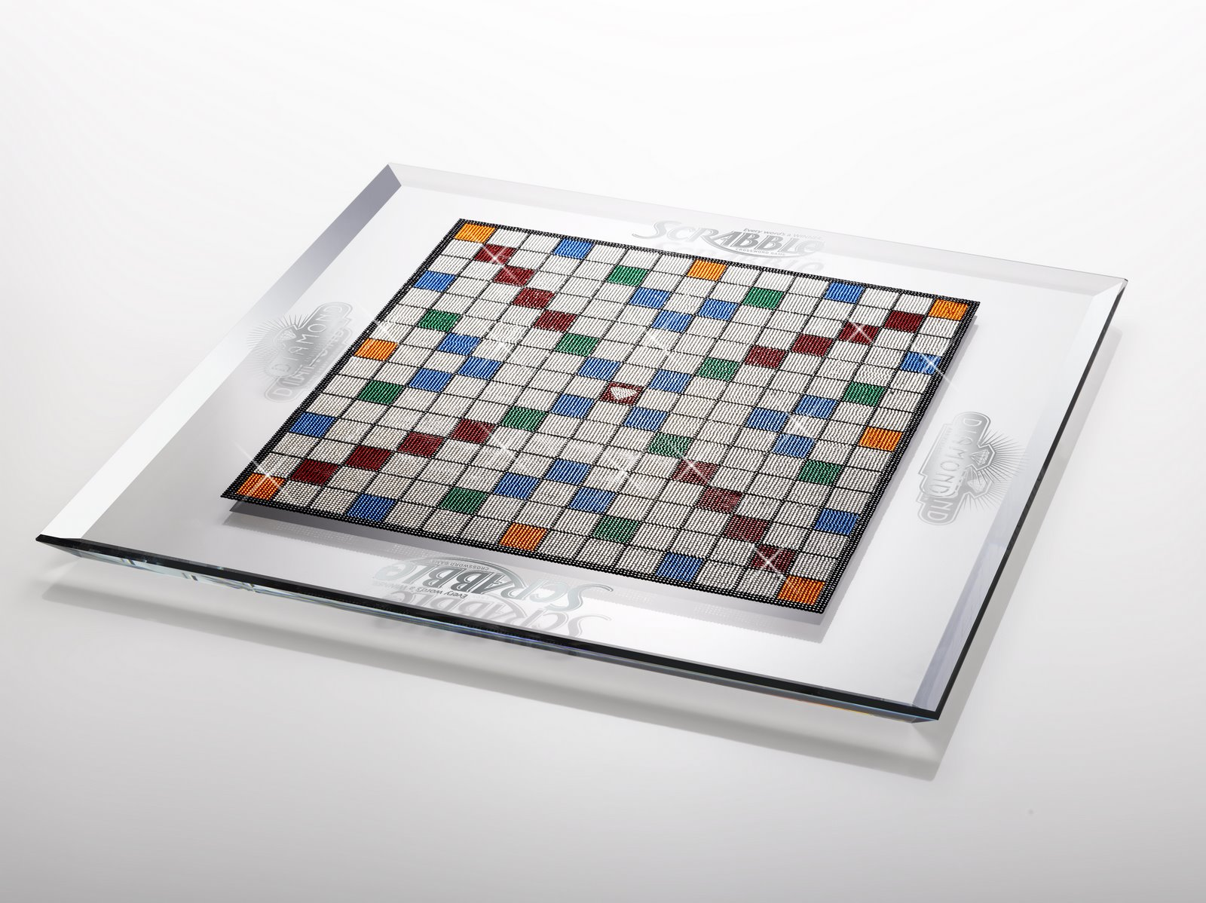
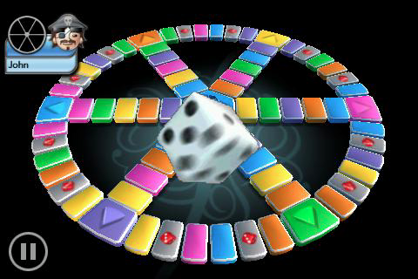
Outwit
Notes:
Scrabble Board: http;luxo.com. One of a kind Savorski Crystal encrusted board for the 60th anniversary of the game. Players vocabularies are critical to winning the game.
Trivial Pursuit: Knowledge of facts. Computer Version: http://img.slidetoplay.com/screenshots/trivial-pursuit_2.jpg

Slide 12
Elements become mechanics
Mechanics are pieces of gameplay arranged to create a more complex game
Objective: Race
Mechanics:
Controlling Space,
Rolling Dice,
Selecting Moves
Moving Tokens
Capturing Pieces
Objective: Outwit
Mechanics:
Controlling Space, Picking and Placing Words for Point Value
Exchanging Letter Tiles

Slide 13
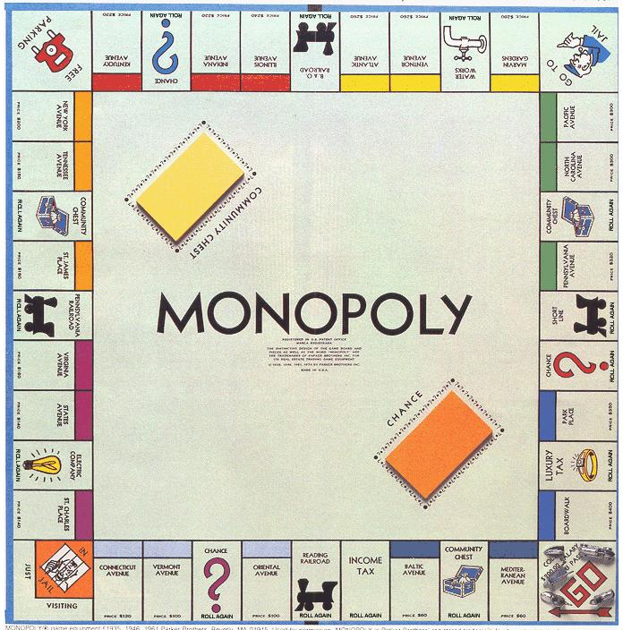
Procedures
Starting
Action
Progression
of Action
Special
Actions
Resolving Actions
Notes:
http://www.free-extras.com/images/monopoly_board-13538.htm

Slide 14
Rules
Which Define Objects and Concepts?
Which Restrict Actions?
Which Determine Effects?
Are there Simplified Rule Sets or House Rules?

Slide 15
Resources
Money
Houses
Hotels
Pawns
Dice
Chance Cards
Community Chest Cards
Deeds
“Streets”/Board
Special Action Spaces

Slide 16
Now What?
Play some Web Games
  The Company of Myself
  Red Remover
  Learn to Fly
Read some reviews
      http://www.gamezebo.com/games/red-remover/review
      http://www.gamezebo.com/games/learn-fly/review
      http://www.associatedcontent.com/article/2428848/review_the_company_of_myself.html

Slide 17
Discuss
How did the reviewers talk about the games? Did they use the vocabulary you’ve just learned?
What were the objectives of the games?
What were the mechanics?
What were the resources you got to use in the games?

Slide 18
What can you read to learn more about games?
Game Design Workshop, Second Edition by Tracy Fullerton
Challenges for Game Designers by Brenda Brathwaite and Ian Schreiber
Game Writing: Narrative Skills for Videogames edited by Chris Bateman
Well Played 1.0, 2.0 and 3.0 by Davidson et al

