Slide 1
FOSS@RIT

Slide 2
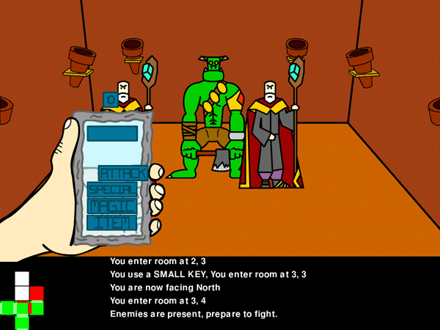
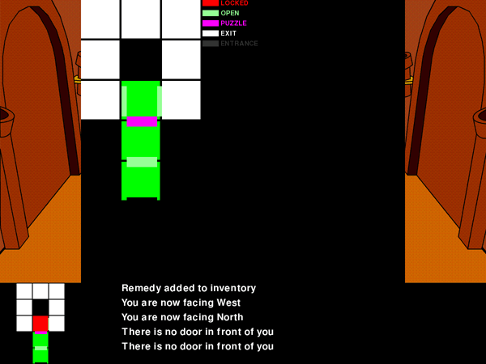
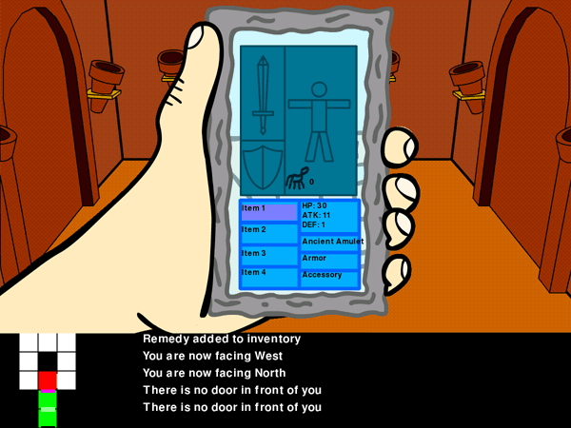
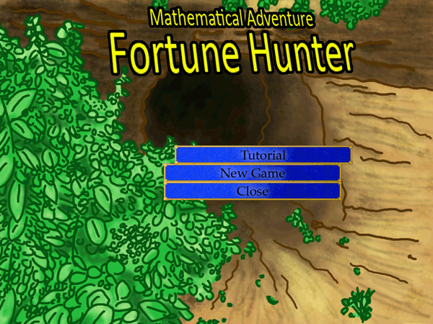

Slide 3
Fortune Engine
Written for Fortune Hunter
Used in other projects including Lemonade Stand
Easy interface to OLPC-friendly pygame functions

Slide 4
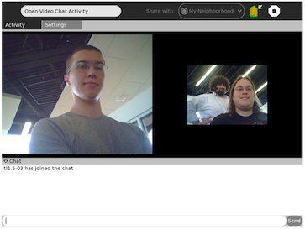

Slide 6
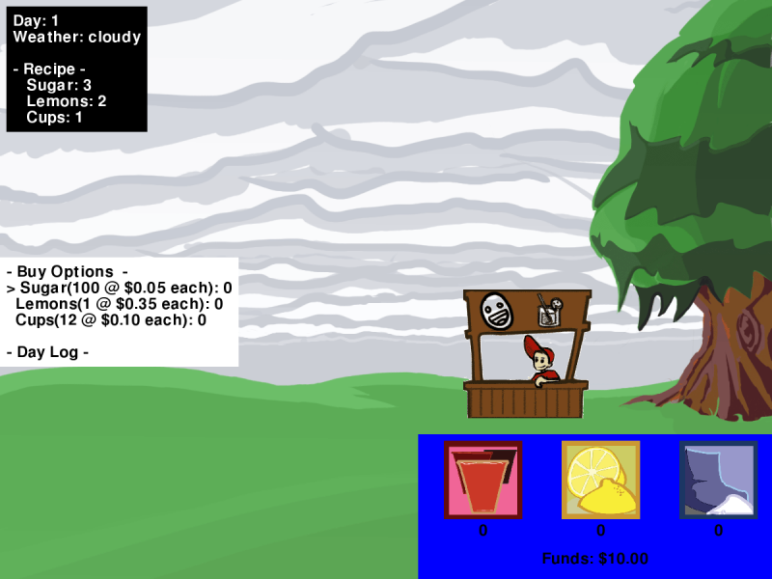

Slide 7
Open Video Chat
Two way video+text chat

Slide 8
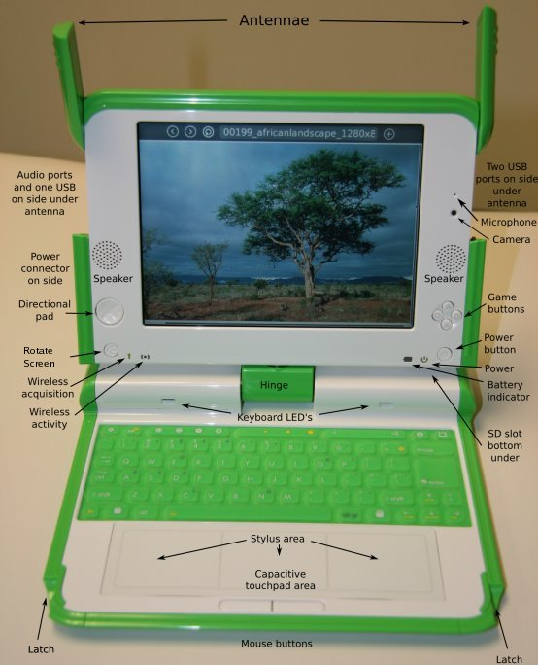

Slide 9
<logos>

