Slide 1


bluedar: Locating Earthquake Victims Using Bluetooth
İlker AVCI (b2210356061)
Buğra Kağan ACAR (b2210356097)

Slide 2
Methodology / Probes
4 ESP32s as Probes
Mosquitto MQTT server
Bluetooth LE

Slide 3
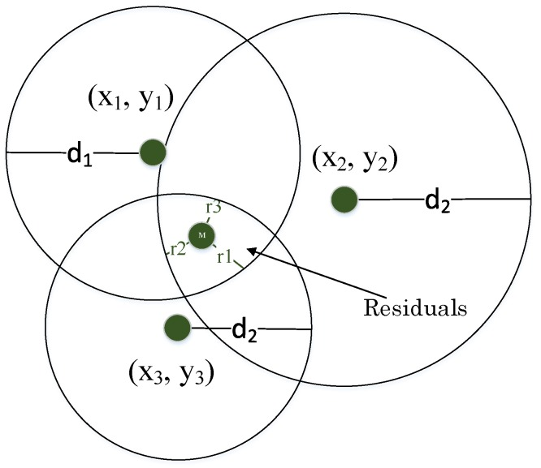
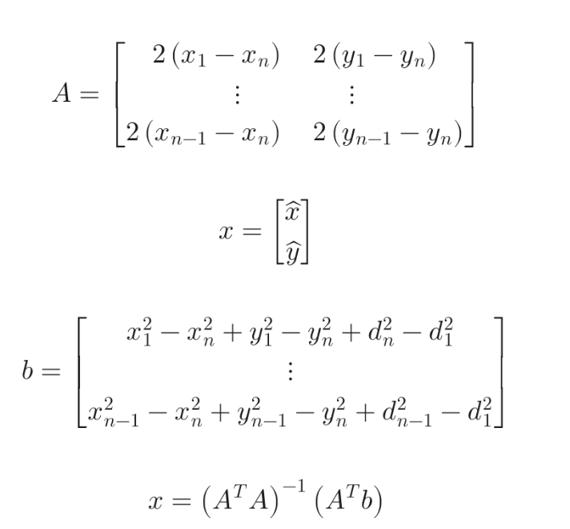
Methodology / Frontend
Multilateration to Radar GUI

