Slide 1

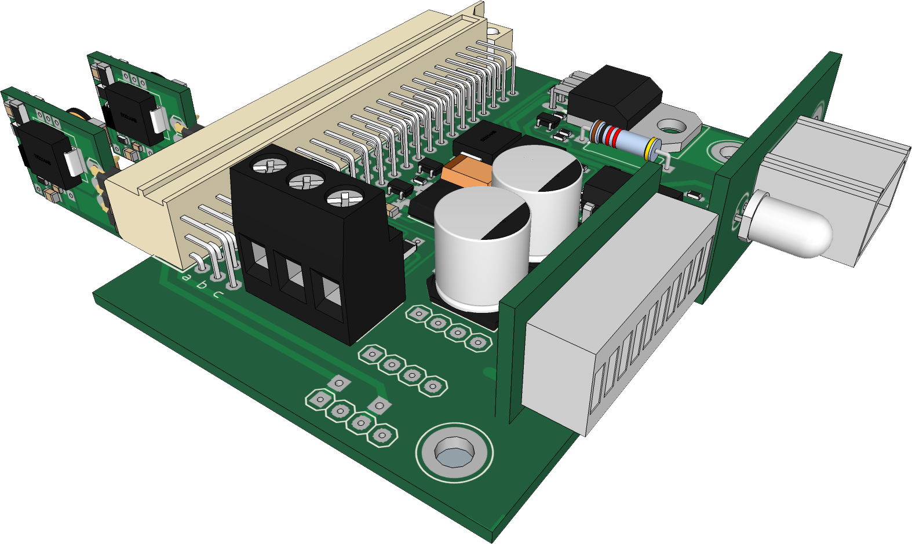
Emergency Backup Power and Wallwarts Eliminator
DC Uninterruptible Power Supply I built for cluster of Modem, router, VoIP etc. It also consolidates the power adaptors.

Slide 2
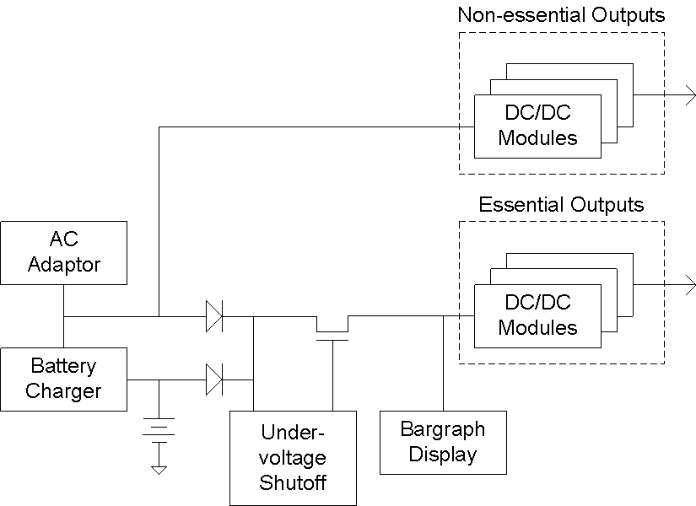
Block Diagram
During a long blackout, the battery life is extended by powering off the
non-essential outputs. The lead acid pack lasts about 4 hours while the NiMH pack lasts about 45 minutes. Either of these packs or the AC source can power the electronics. Additional battery packs can be used by simply adding more OR’ing diode(s) and charger(s).

Slide 3
Current Status
While there are very few blackouts in my area, they do happen. Cell phones might get a busy signal when the cell towers cannot cope with the number of callers during a wide disaster/emergency. So one should always plan for other means of emergency communication.
I use VoIP and internet as my means of communication. The ISP have been adding backup power to their infrastructures.
This project has been in use 24/7 for the last 7-8 years and has been proven to be reliable.

