Slide 1
Data Hazard
0x0 - addi x1, x0, 5
0x4 - add x2, x1, x1
0x8 - add x3, x1, x1
0xC - NOP
0x10 - NOP
0x14 - NOP

Slide 2
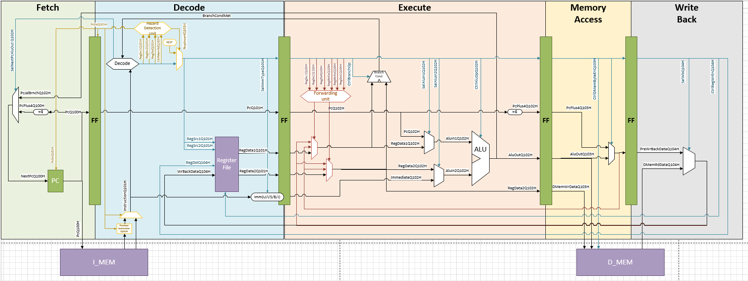

Data Hazard
0x0 - addi x1, x0, 5
0x4 - add x2, x1, x1
0x8 - add x3, x1, x1
0xC - NOP
0x10 - NOP
0x14 - NOP

Slide 3


Data Hazard
0x0 - addi x1, x0, 5
0x4 - add x2, x1, x1
0x8 - add x3, x1, x1
0xC - NOP
0x10 - NOP
0x14 - NOP

Slide 4

Data Hazard
0x0 - addi x1, x0, 5
0x4 - add x2, x1, x1
0x8 - add x3, x1, x1
0xC - NOP
0x10 - NOP
0x14 - NOP

Slide 5

Data Hazard
0x0 - addi x1, x0, 5
0x4 - add x2, x1, x1
0x8 - add x3, x1, x1
0xC - NOP
0x10 - NOP
0x14 - NOP

Slide 6


Data Hazard
0x0 - addi x1, x0, 5
0x4 - add x2, x1, x1
0x8 - add x3, x1, x1
0xC - NOP
0x10 - NOP
0x14 - NOP

Slide 7
Ctrl Hazard
0x0 – jump/Branch 0x10
0x4 - Add x3, x1,x1
0x8 - Add x4, x10, x10
0xC - Add x5, x11, x11
0x10 - Add x6, x12, x12

Slide 8

Ctrl Hazard
0x0 – jump/Branch 0x10
0x4 - Add x3, x1,x1
0x8 - Add x4, x10, x10
0xC - Add x5, x11, x11
0x10 - Add x6, x12, x12

Slide 9



Ctrl Hazard
0x0 – jump/Branch 0x10
0x4 - Add x3, x1,x1
0x8 - Add x4, x10, x10
0xC - Add x5, x11, x11
0x10 - Add x6, x12, x12

Slide 10








Ctrl Hazard
0x0 – jump/Branch 0x10
0x4 - Add x3, x1,x1
0x8 - Add x4, x10, x10
0xC - Add x5, x11, x11
0x10 - Add x6, x12, x12

Slide 11



Ctrl Hazard
0x0 – jump/Branch 0x10
0x4 - Add x3, x1,x1
0x8 - Add x4, x10, x10
0xC - Add x5, x11, x11
0x10 - Add x6, x12, x12

Slide 12


Ctrl Hazard
0x0 – jump/Branch 0x10
0x4 - Add x3, x1,x1
0x8 - Add x4, x10, x10
0xC - Add x5, x11, x11
0x10 - Add x6, x12, x12

Slide 13
Load Hazard
0x0 - LW x1, 0(x2)
0x4 - Add x3, x1,x1
0x8 - Add x4, x10, x10
0xC - Add x5, x11, x11

Slide 14







Load Hazard
0x0 - LW x1, 0(x2)
0x4 - Add x3, x1,x1
0x8 - Add x4, x10, x10
0xC - Add x5, x11, x11

Slide 15




Load Hazard
0x0 - LW x1, 0(x2)
0x4 - Add x3, x1,x1
0x8 - Add x4, x10, x10
0xC - Add x5, x11, x11

Slide 16










Load Hazard
0x0 - LW x1, 0(x2)
0x4 - Add x3, x1,x1
0x8 - Add x4, x10, x10
0xC - Add x5, x11, x11

Slide 17











Load Hazard
0x0 - LW x1, 0(x2)
0x4 - Add x3, x1,x1
0x8 - Add x4, x10, x10
0xC - Add x5, x11, x11

Slide 18


Load Hazard
0x0 - LW x1, 0(x2)
0x4 - Add x3, x1,x1
0x8 - Add x4, x10, x10
0xC - Add x5, x11, x11

