Slide 1
FPGA Final Project
FPGA-based General
Convolutional Neural Network
accelerator
Group 7
Members: E94051047 張正宗 E94051136 黃郁雲 E94056021 郭冠緯

Slide 2
SPEC
1. Q8.12定點數運算
2. 最大127x127圖形輸入
3. 5X5 Convolution kernel , stride = 1
4. 2X2 Max-poolng
5. Fully Connected

Slide 3
系統流程
1. Keras 訓練CNN模型，並儲存
2. 讀取模型參數以及Input pixel，轉為Q8.12定點數
3. 參數、Input、Instruction傳入Block RAM
4. 電路讀取Instruction並執行相對應的運算，
將答案傳回BRAM

Slide 4
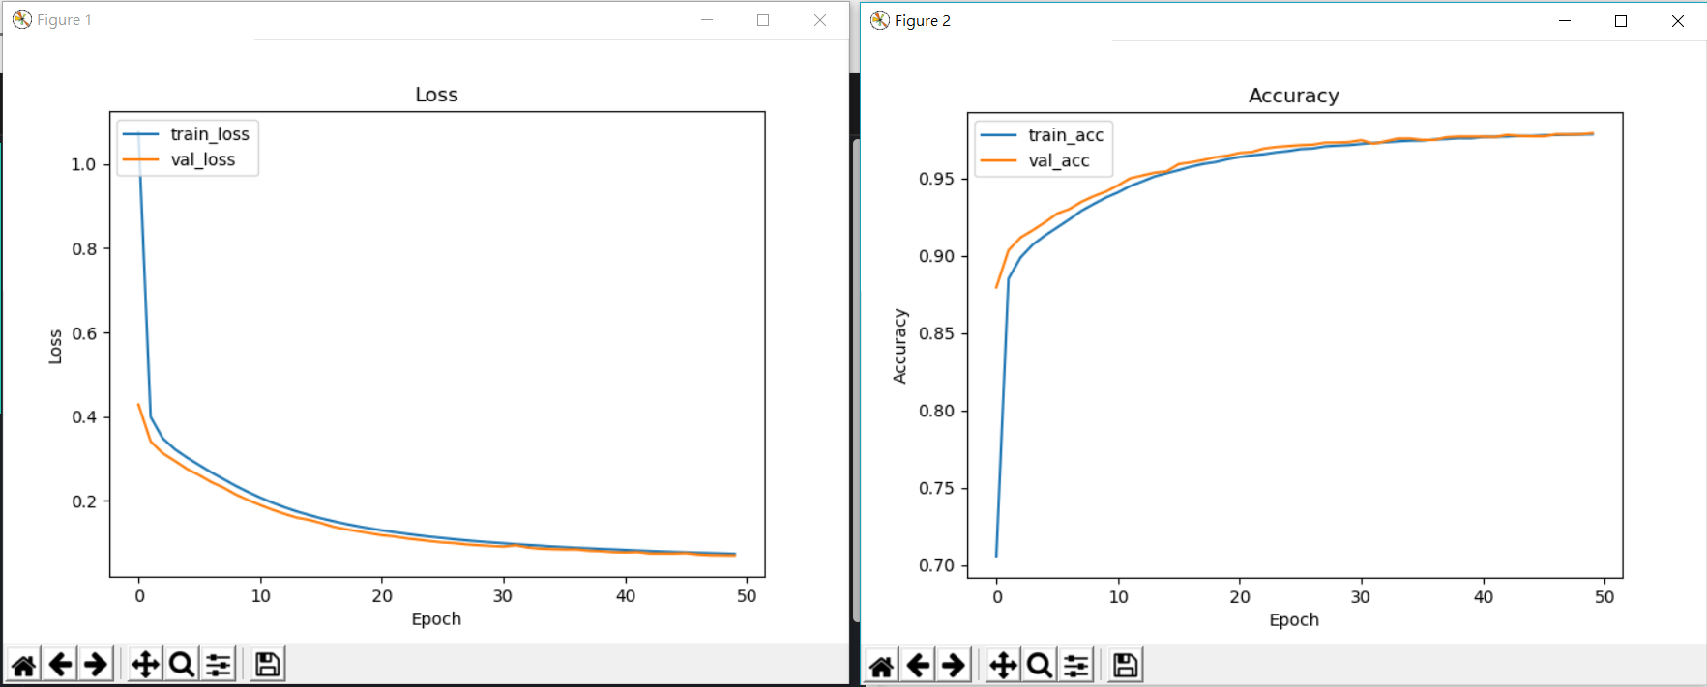
Training MNIST Classifier Using CNN
Input Size : 28x28
一層 CONV :
Kernel size(5x5)* 6 ,
activation = ‘Relu’
一層 MAX POOLING :
Kernel size(2x2)
一層 FULLY CONNECTED :
output 10 classes ,
activation = ‘softmax’

Slide 5
網路架構
Input 28x28
Feature maps 6@24x24
Feature maps 6@12x12
output 10
Conv
Max pooling
Fully connected

Slide 6
Instruction Set
1. Conv1
2. Pooling
3. FC
OP | stride | Kernel_num | Kernel_size | Input_size
19 17
16 14
13 10
9 7
6 0
OP | Kernel_num | Kernel_size | Input_size
19 17
16 13
12 10
9 0
OP | Feature_num | Input_size | Class_num
19 17
16 12
11 8
7 0

Slide 7
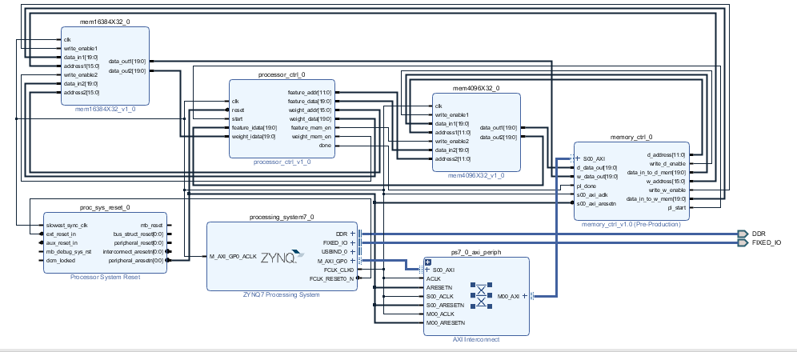
Block Diagram

Slide 8
系統架構
CPU
Control
decoder
BRAM
Pooling
Fully
Connected
MAC Processor
MAC Processor
MAC Processor
MAC Processor
MAC Processor
MAC Processor

Slide 9
MAC Processor
Data Buffer
X
+
X
+
+
MAC Processor
X
ReLU
+
Weight Buffer
+
+
X

Slide 10
ADDR | DATA
0 | Img[0]
1 | Img[1]
. . | . .
28*28-1 | Img[28*28-1]
784 | CNN_Kernel_1_Weight[0]
785 | CNN_Kernel_1_Weight[1]
. . | . .
808 | CNN_Kernel_1_Weight[24]
809 | CNN_Kernel_1_Bias
810 | CNN_Kernel_2_Weight[0]
. . | . .
835 | CNN_Kernel_2_Bias
. . | . .
939 | CNN_Kernel_6_Weight[24]
940 | CNN_Kernel_6_Bias
941 | Fully_connected_weight
942 | Fully_connected_weight
. . | . .
9580 | Fully_connected_weight
Input_Img
[0] | [1] | .. | .. | [27]
[28]
. .
 |  |  |  | [783]
Weight
BRAM
CNN_Kernel_Weight
[0] | [1] |  |  | [4]
[5]
 |  |  |  | [24]

Slide 11
ADDR | DATA
0 | Feature map
1
. .
575
576
577
. .
808
809
810
. .
3455 | Feature map
. . | . .
4093 | Instruction
4093 | Instruction
4094 | Instruction
4095 | Instruction
Feature
BRAM

Slide 12
FSM
Start==1
temp_count==1
idle
fetch
decode
load
load_finish && operation == FC
load_finish
&&
(operation
== CONV1)
load_finish &&
operation == POOLING
load_finish && (operation == CONV1)
Operation==END
conv
pooling
fc
operation == FC && write_data_count==class_num && instruction_finish == 1
finish
write
write_finish == 1 &&
instruction_finish == 0
instruction_finish==1

Slide 13
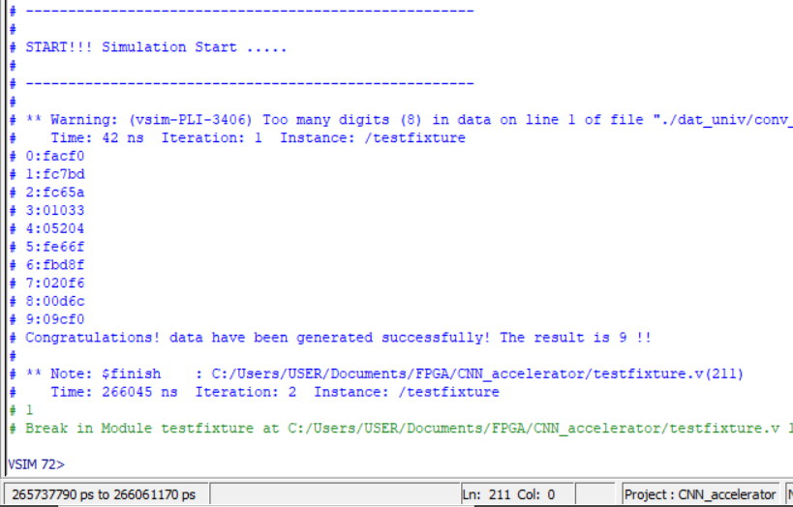

Function Simulation

Slide 14
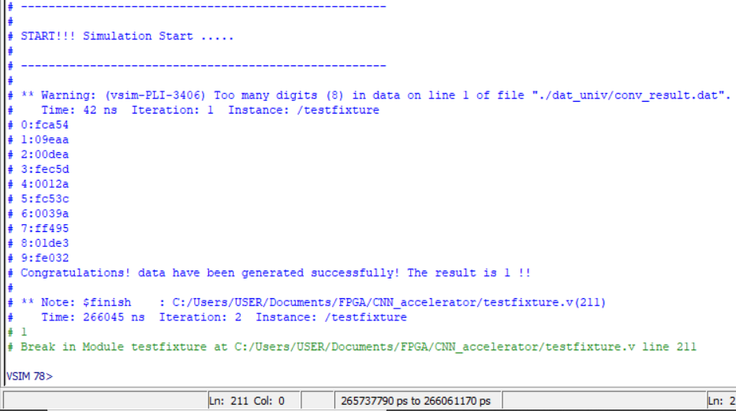
Function Simulation

Slide 15


Function Simulation

Slide 16
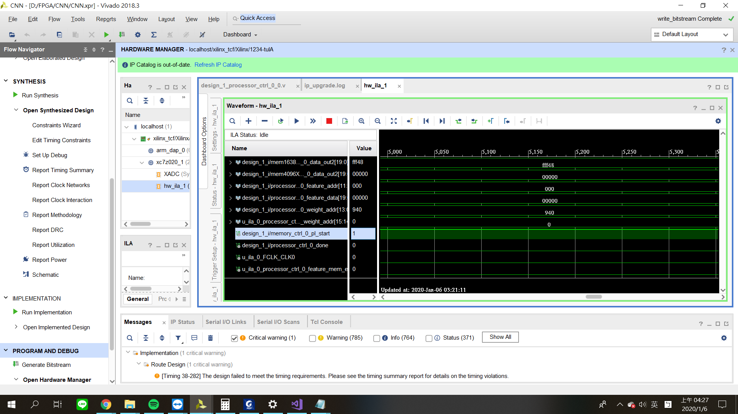
FPGA Verification

Slide 17
謝謝聆聽

