Slide 1
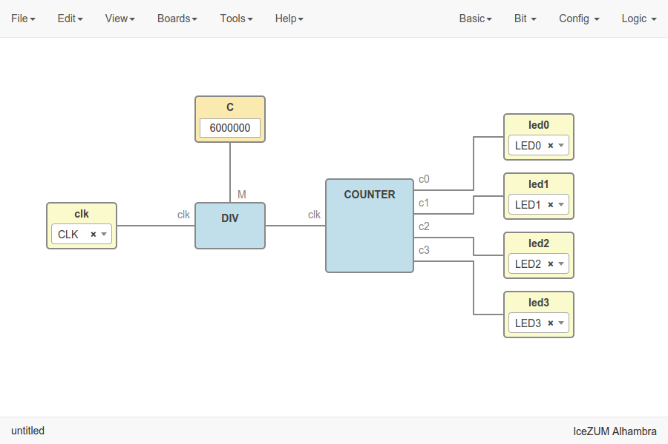



Workshop - Open FPGA tools
Jesús Arroyo Torrens
https://github.com/Jesus89
OurenseMakersLab
December 10, 2016
La Molinera, Ourense
https://github.com/FPGAwars/workshops

Slide 2
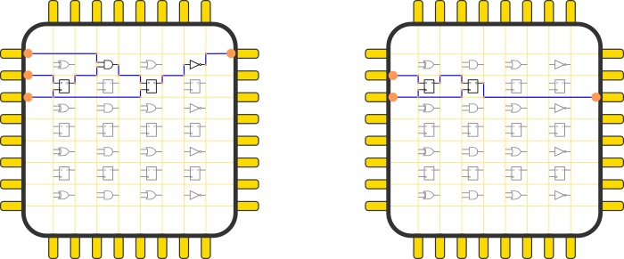
Field Programmable Gate Array

Slide 3
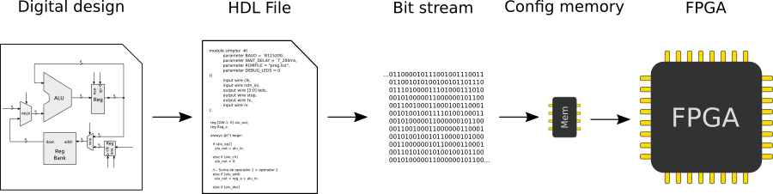
Open FPGA toolchain
IceStorm Project
by Clifford Wolf

Slide 4
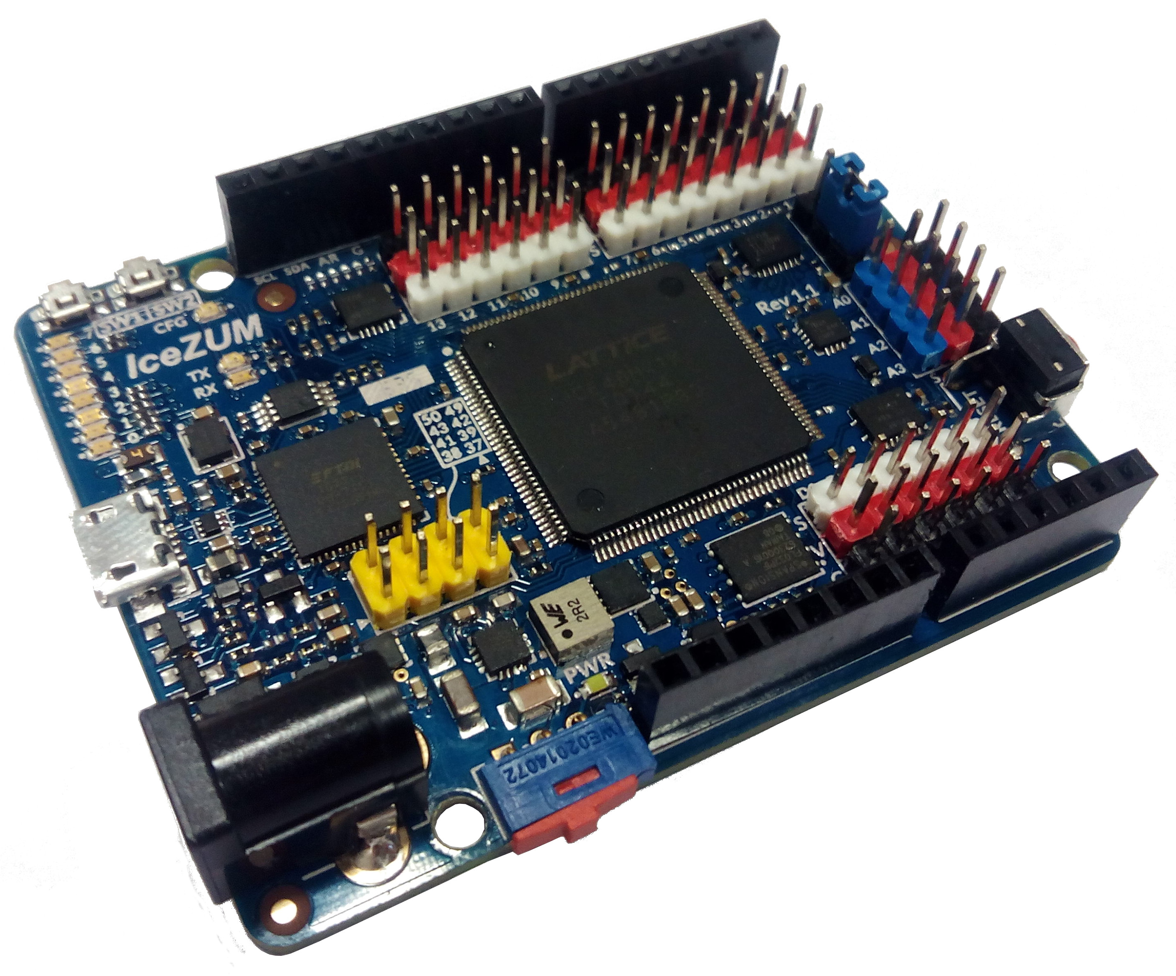
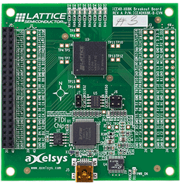

Open FPGA boards
Icestick
iCE40-HX8K Breakout Board
IceZUM Alhambra

Slide 5
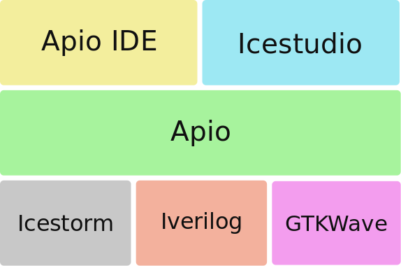
Open FPGA tool stack

Slide 6
Open FPGA tool stack

Slide 7
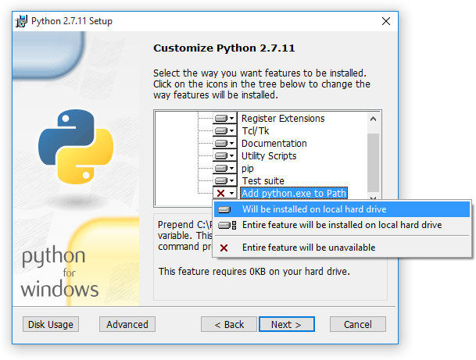
Requirements
1. Python 2.7
https://www.python.org
Windows Users: DON’T FORGET to
select Add python.exe to Path
feature on the “Customize” stage
Check installation: open a console and type python

Slide 8
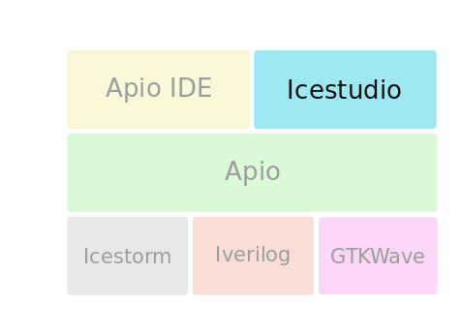
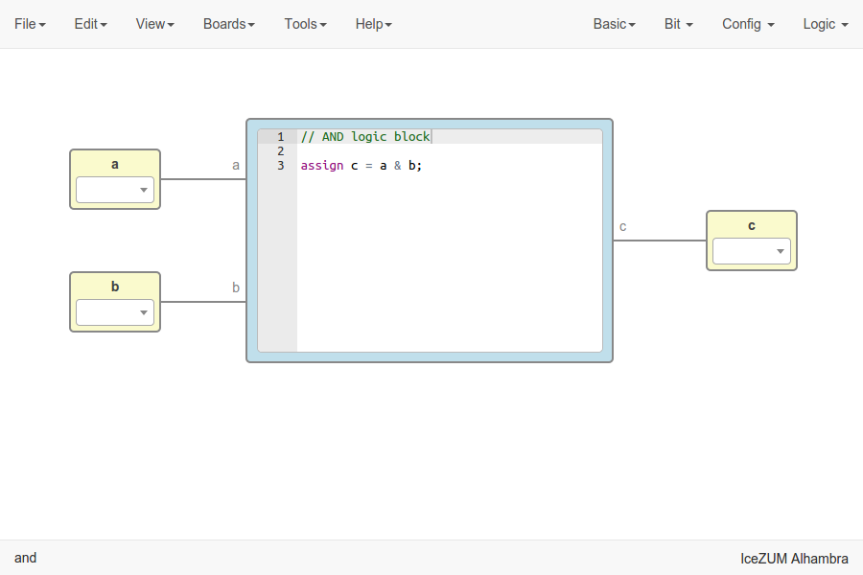
Icestudio
https://github.com/FPGAwars/icestudio
Experimental graphic editor for open FPGAs. Created with HTML and JS

Slide 9
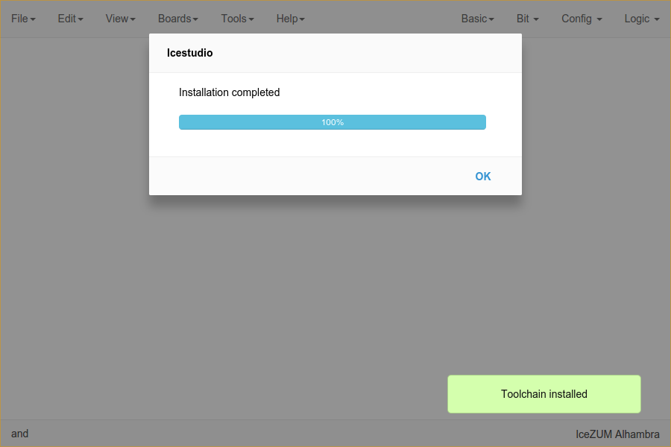
Icestudio
1. Install
Copy icestudio-0.2.4-dev.zip
Unzip the file
Execute icestudio
2. Setup
Install toolchain
Tools > Toolchain > Install
Install drivers
Tools > Drivers > Enable
Drivers configuration requires
administrative privileges
Follow the instructions in each OS

Slide 10
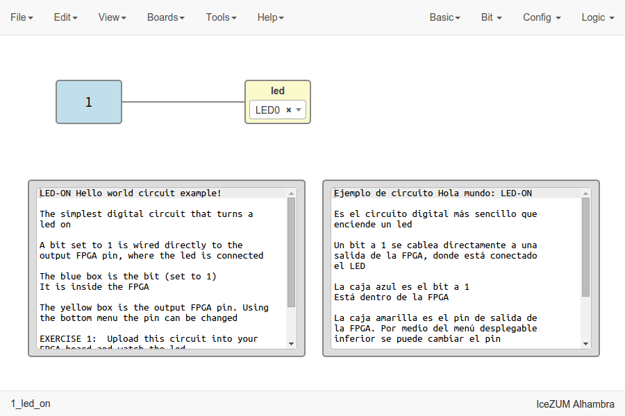
Icestudio
3. Hello, world!
Load example
  1. Basic > 1. Led on
Select board
Board > IceZUM
Select I/O pin
Edit the combo
Upload bit stream
Tools > Upload
Enter in a block and edit a I/O label by double clicking

Slide 11
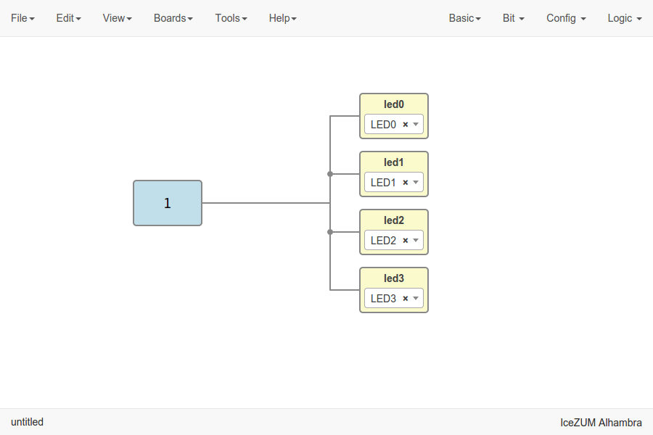
Icestudio
4. More leds on
Create a project
File > New project
Add blocks
Bit > 1
Basic > Output
Connect wires
Upload bit stream
Tools > Upload
Multiple I/O blocks can be created, e.g. “led0, led1, led2”

Slide 12
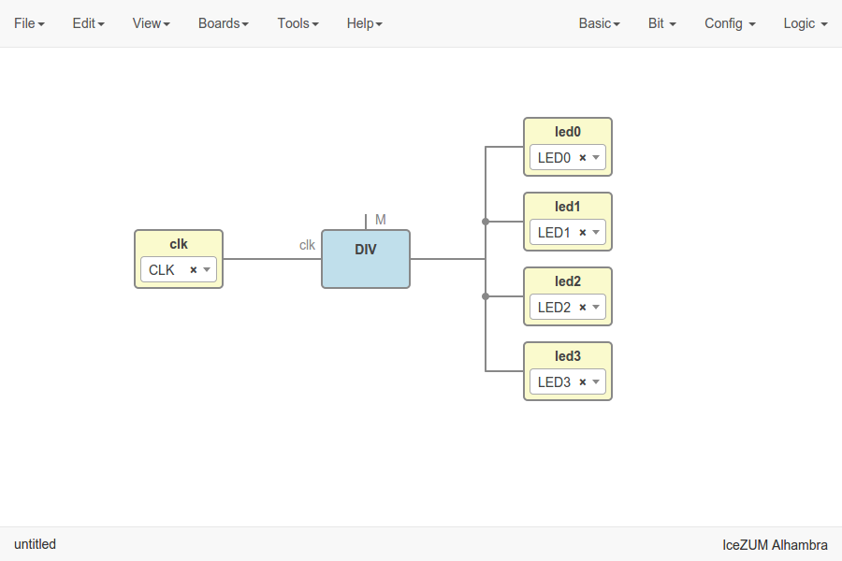
Icestudio
5. Blink
Import DIV block
File > Import block
Add clock input
Basic > Input
Connect wires
Upload bit stream
Tools > Upload
The clock is a 12 MHz signal

Slide 13
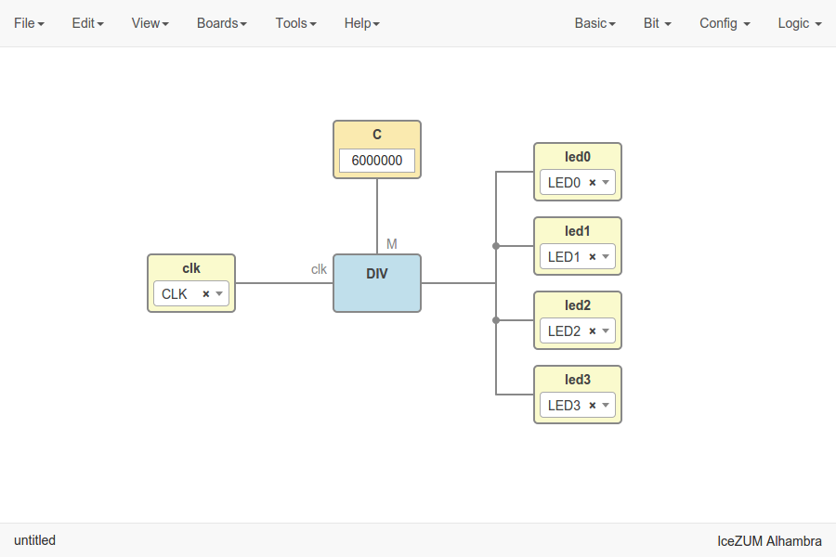
Icestudio
6. Custom blink
Add constant
Basic > Constant
Insert a value
  6000000
Connect wires
Upload bit stream
Tools > Upload
The clock is a 12 MHz signal

Slide 14
Icestudio
7. Counter
Import counter block
File > Import block
Reconnect wires
Upload bit stream
Tools > Upload

Slide 15
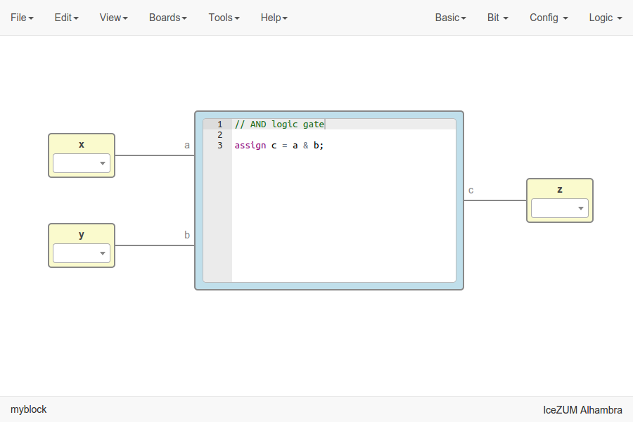
Icestudio
8. Let’s code
Create a project
File > New project
Add blocks
Basic > Code
Basic > Input
Basic > Output
Connect wires
Verify the design
Tools > Verify

Slide 16
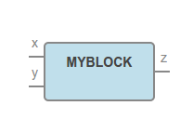
Icestudio
9. Custom block
Load a project
File > Open project
Save project as block
File > Export as block
Input / Output pins will become in/out block ports

Slide 17
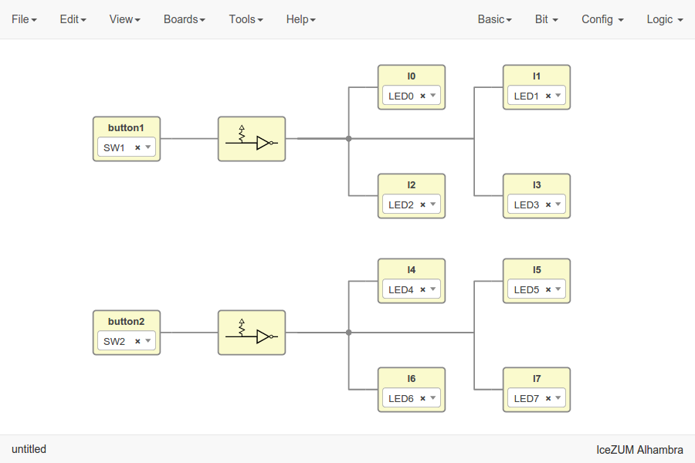
Icestudio
10. Using buttons
Create a project
File > New project
Add blocks
Basic > Input
Basic > Output
  Config > Pull up inv
Connect wires
Upload bit stream
Tools > Upload

Slide 18

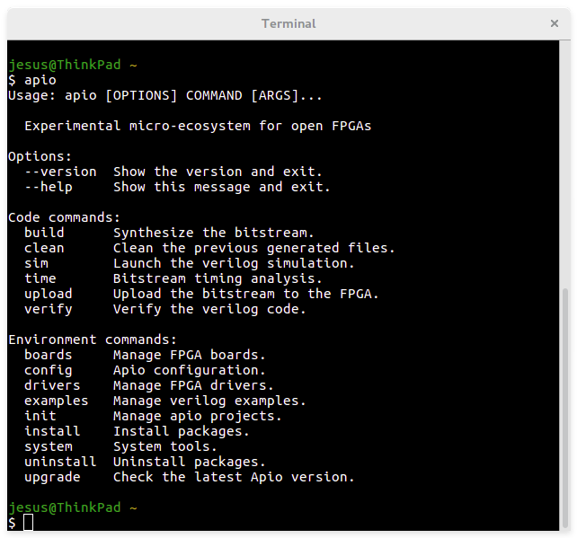
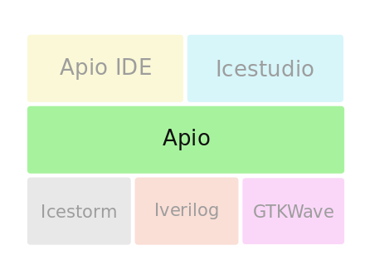
Apio
https://github.com/FPGAwars/apio
Experimental open source ecosystem for open FPGAs. Created with Python

Slide 19
Apio
1. Install
Open the console and execute
  $ pip install -U apio
Check apio
  $ apio
2. Setup
Install toolchain
  $ apio install --all
Install drivers
$ apio drivers --enable
Drivers configuration requires
administrative privileges
Follow the instructions in each OS

Slide 20
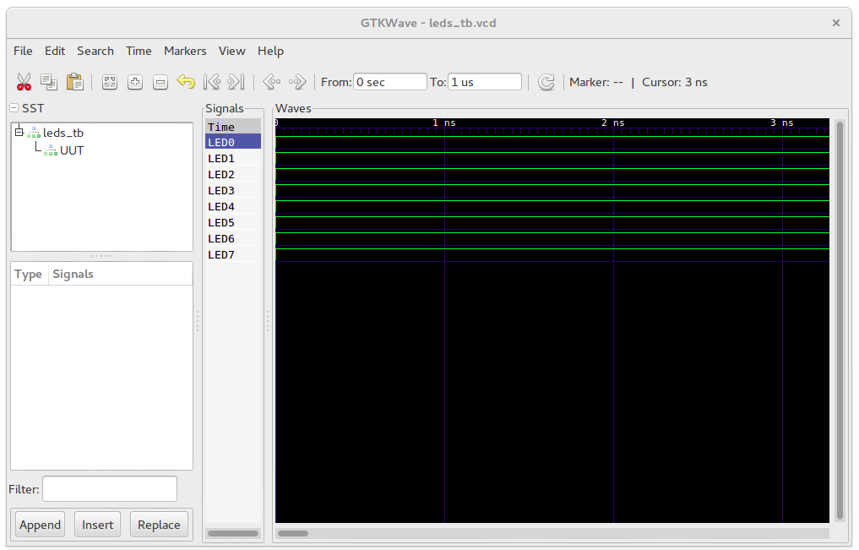
Apio
3. Hello, world!
Load example
$ apio examples -d icezum/leds
Move to example
$ cd icezum/leds
Verify and simulate
$ apio verify $ apio sim
Build and upload
$ apio build $ apio upload
Time analysis and clean
$ apio time $ apio clean

Slide 21
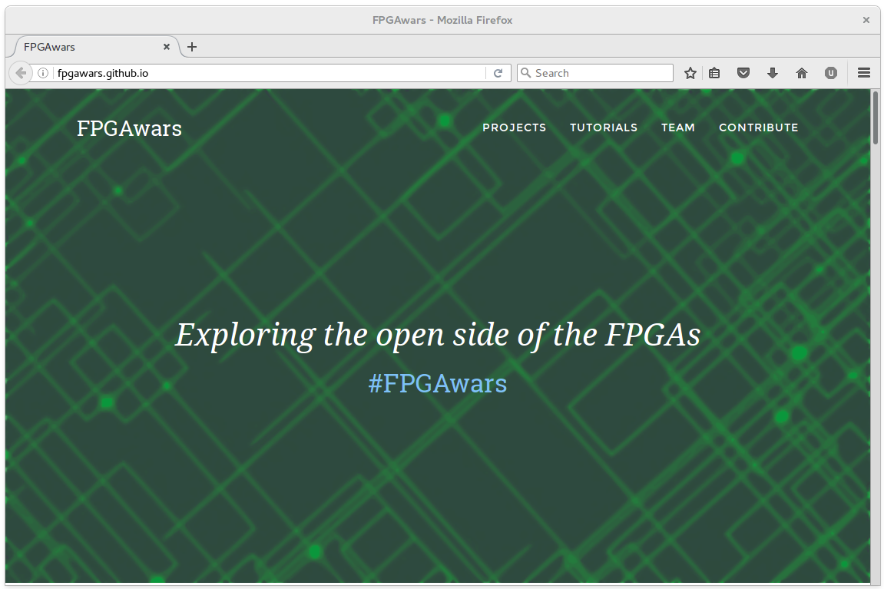
I want more!
http://FPGAwars.github.io

Slide 22
Workshop - Open FPGA tools
Jesús Arroyo Torrens
https://github.com/Jesus89
OurenseMakersLab
December 10, 2016
La Molinera, Ourense
https://github.com/FPGAwars/workshops

