Slide 1
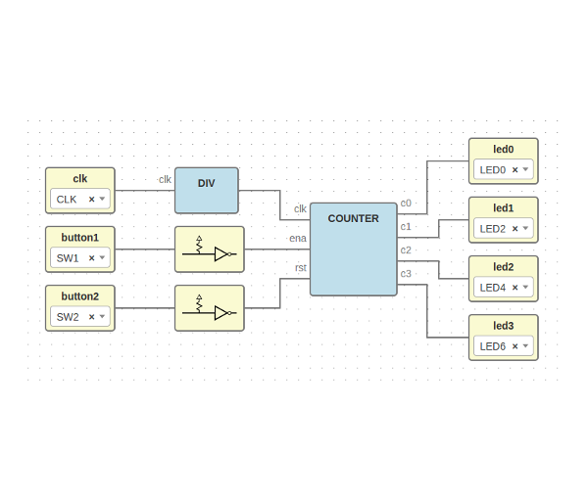



Workshop - Open FPGA tools
Jesús Arroyo Torrens
https://github.com/Jesus89
OSHWDem 16
November 5, 2016
Museo Domus, A Coruña
https://github.com/FPGAwars/workshops

Slide 2
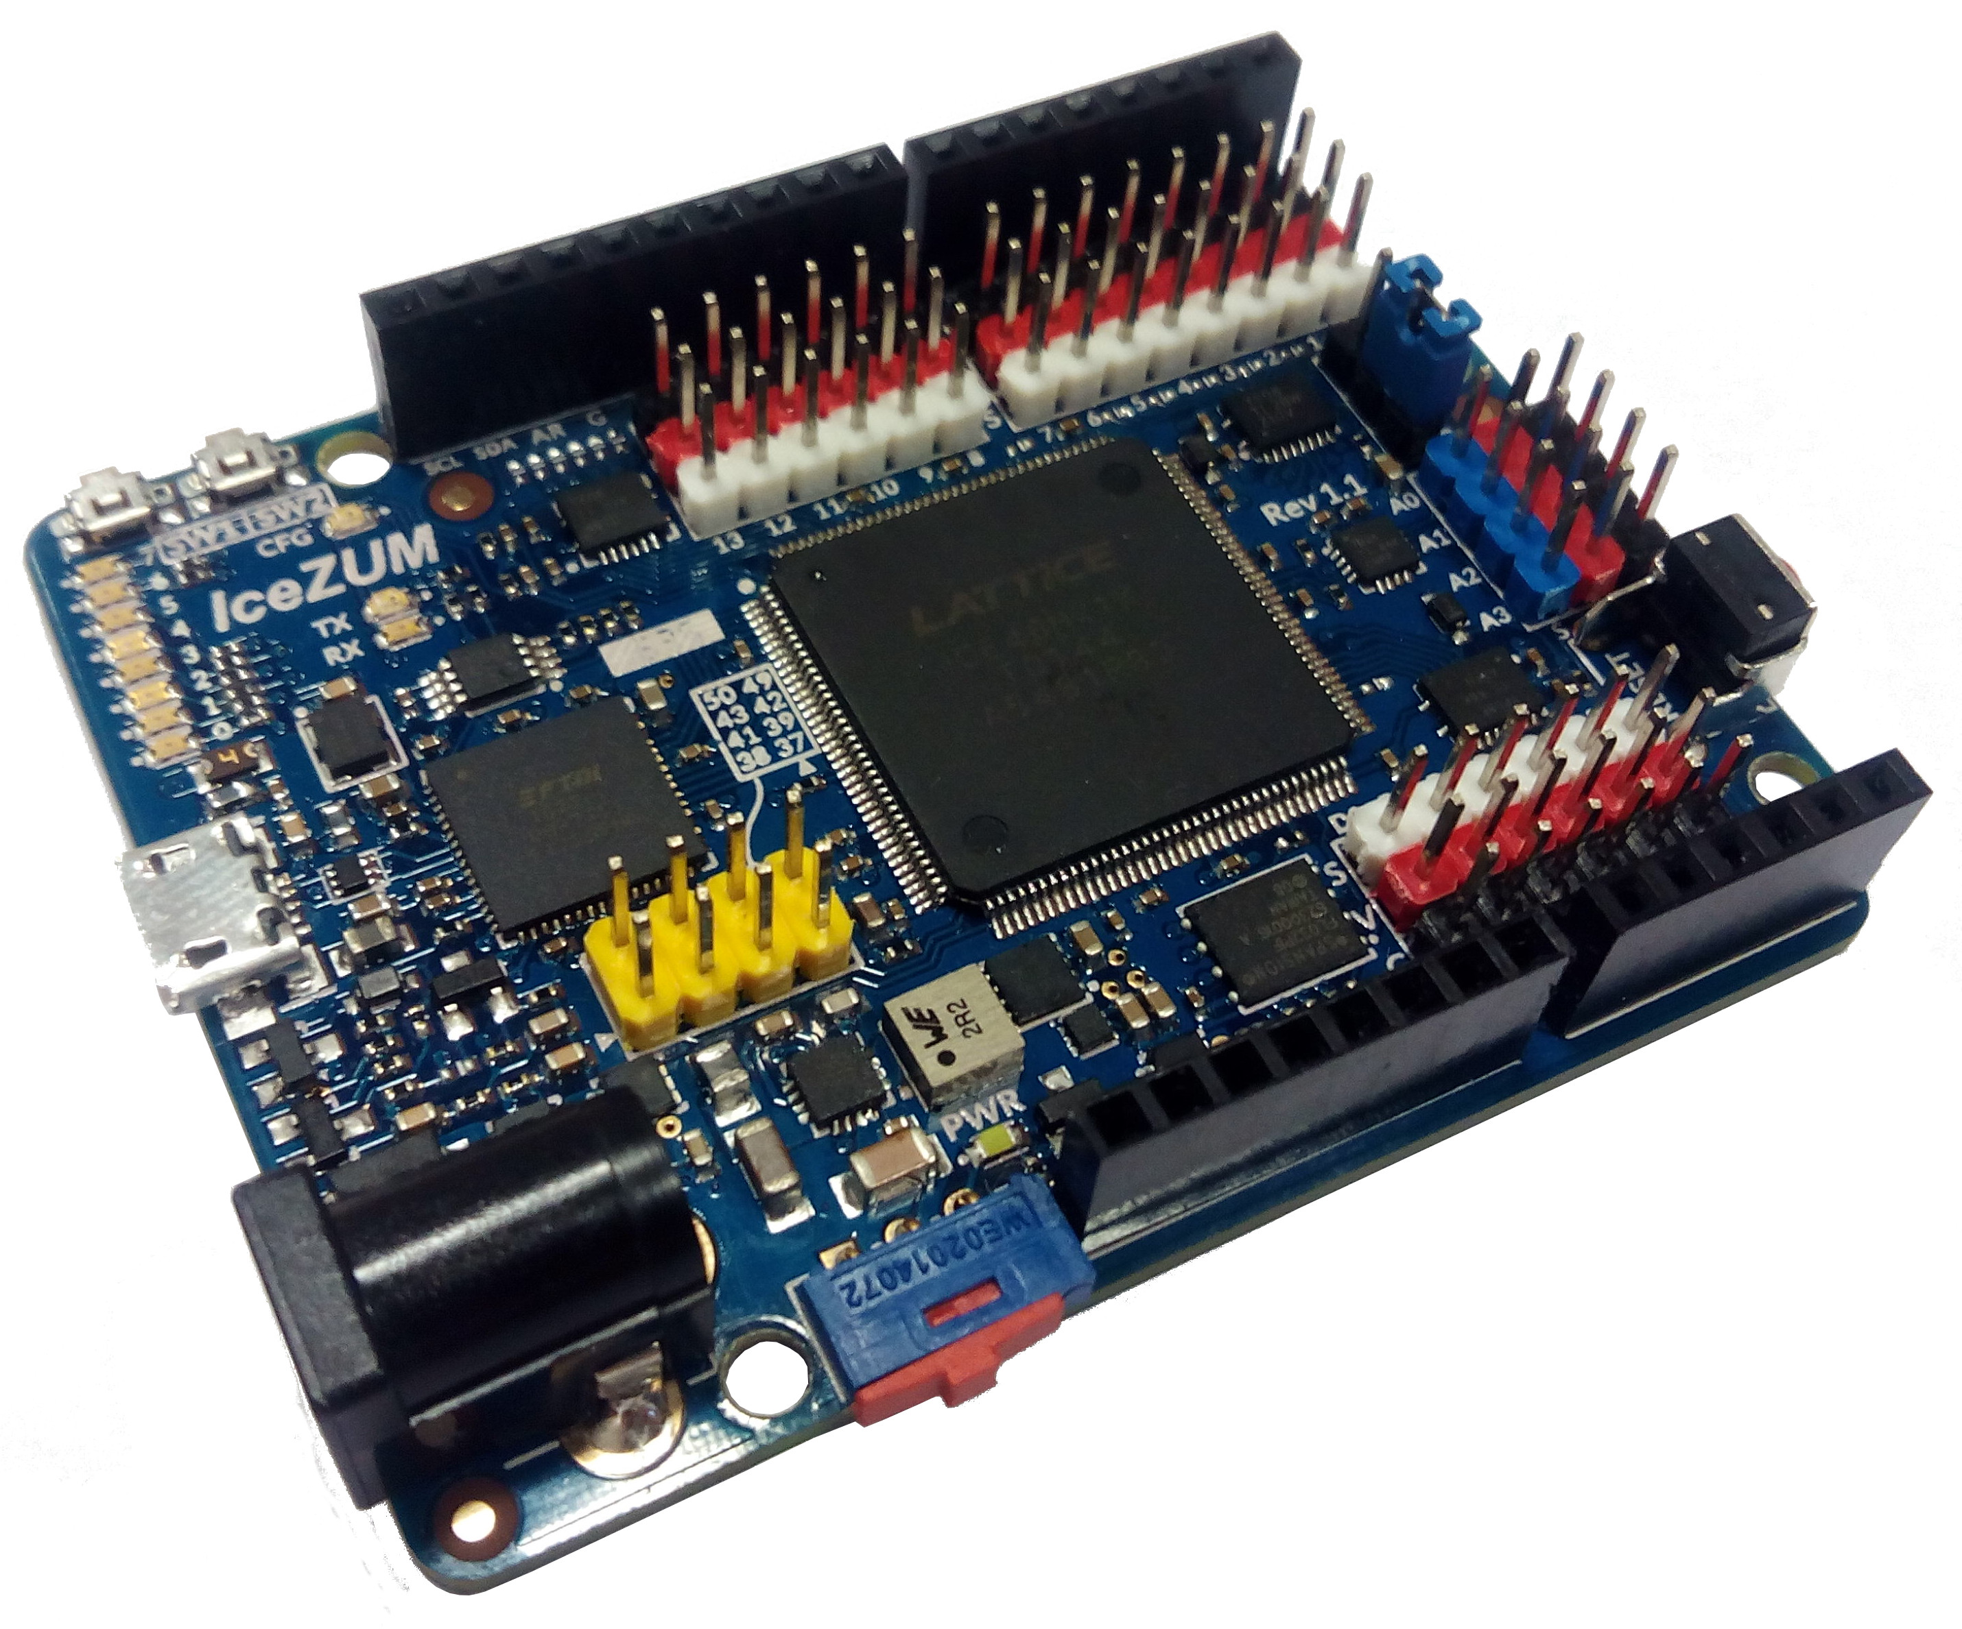
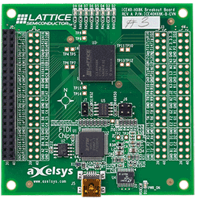

Open FPGA boards
Icestick
iCE40-HX8K Breakout Board
IceZUM Alhambra

Slide 3
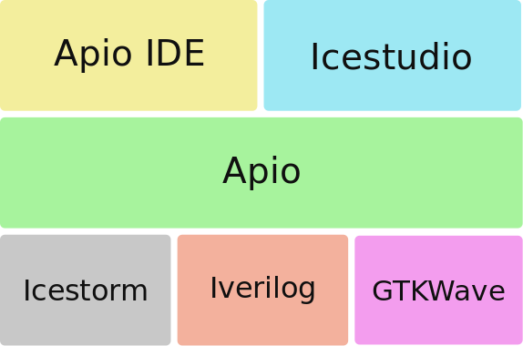
Open FPGA toolchains

Slide 4



Open FPGA stack tools

Slide 5
Open FPGA stack tools

Slide 6
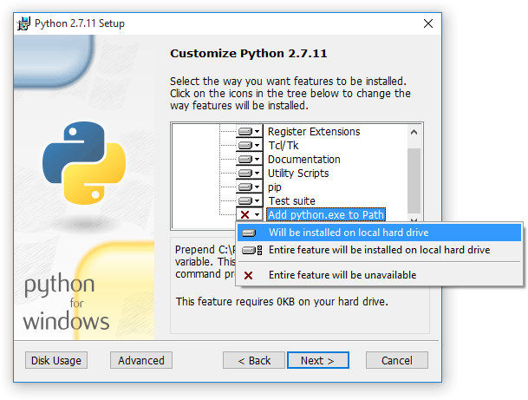
Requirements
1. Python 2.7
https://www.python.org
Windows Users: DON’T FORGET to
select Add python.exe to Path
feature on the “Customize” stage
Check installation: open a console and type python

Slide 7
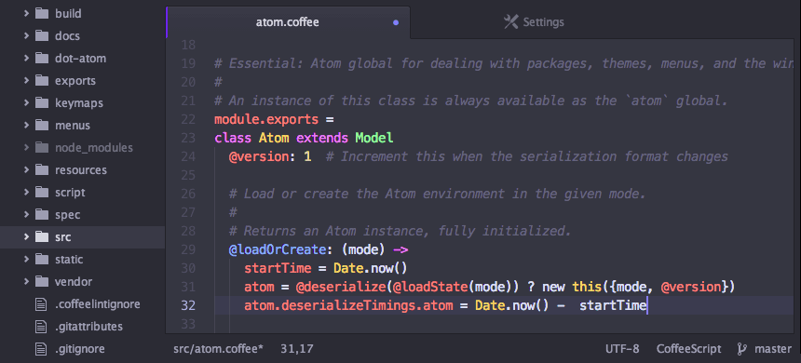
Requirements
2. Atom Editor
https://atom.io

Slide 8
Requirements
3. Apio packages*
https://github.com/FPGAwars/workshops/releases
Copy apio-dir.zip
Copy install.py
Open console and execute
  $ python install.py
  Insert the zip filename: apio-dir-linux64.zip
  Success: .apio dir updated!
* (optional) equivalent to Icestudio Install toolchain or apio install –all.
It is used to save time by downloading the packages

Slide 9
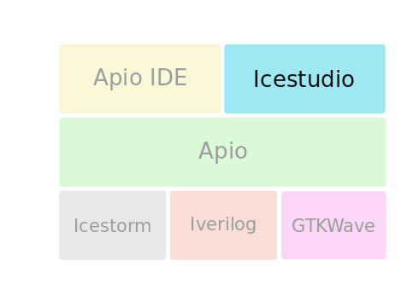
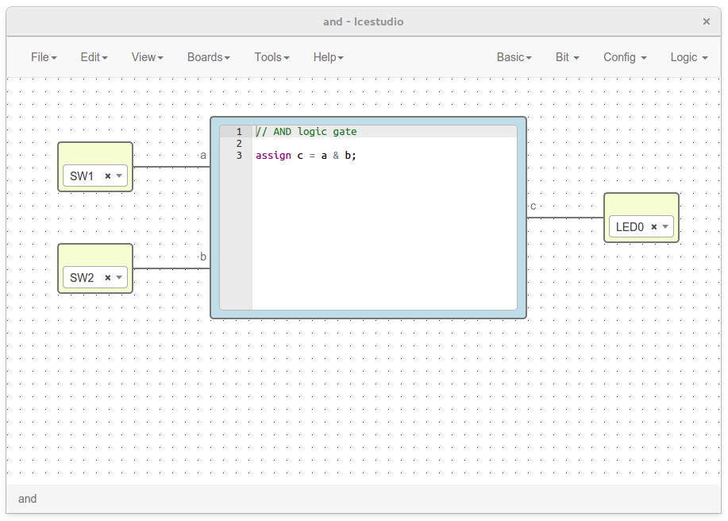
Icestudio
https://github.com/FPGAwars/icestudio
Experimental graphic editor for open FPGAs. Created with HTML and JS

Slide 10
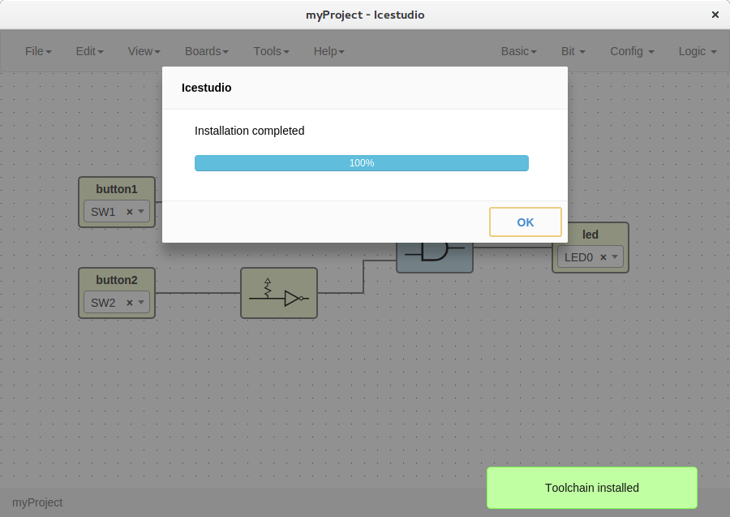
Icestudio
1. Install
Copy icestudio-0.2.2-rc.zip
Unzip the file
Execute icestudio
2. Setup
Install toolchain
Tools > Install/Upgrade toolchain
Install drivers
Tools > Enable drivers
Drivers configuration requires
administrative privileges
Follow the instructions in each OS

Slide 11
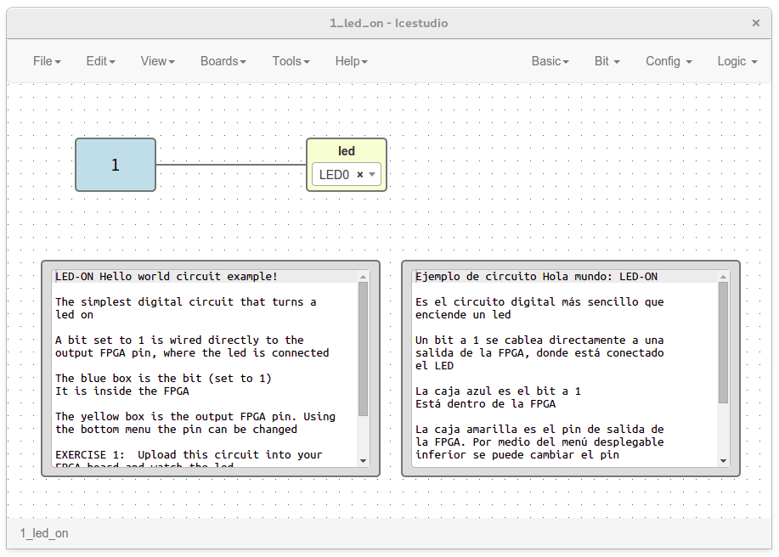
Icestudio
3. Hello, world!
Load example
File > Examples
Select board
Board > IceZUM
Select I/O pin
Edit the combo
Upload bit stream
Tools > Upload
Enter in a block and edit a I/O label by double clicking

Slide 12
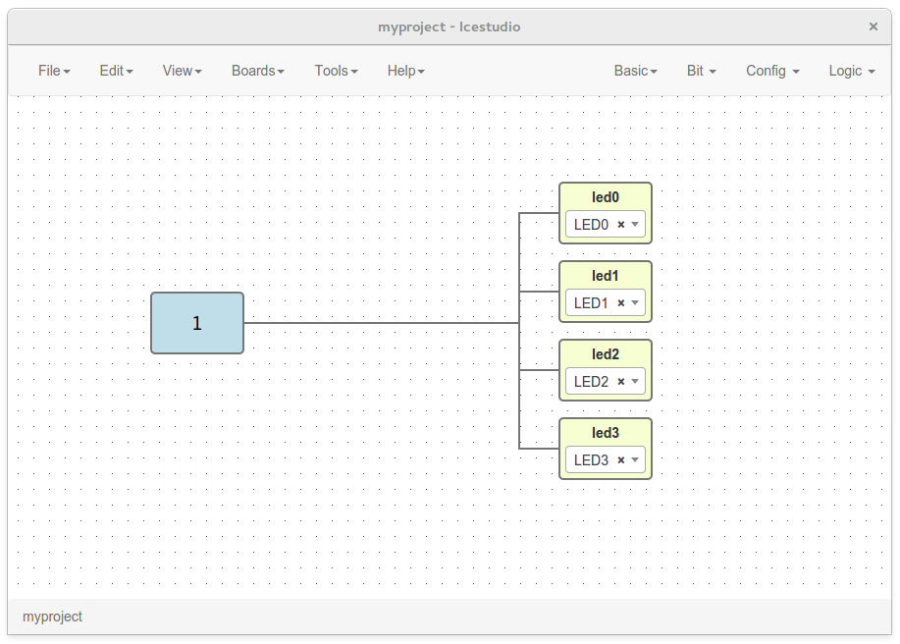
Icestudio
4. More leds on
Create a project
File > New project
Add blocks
Bit > 1
Basic > Output
Connect wires
Upload bit stream
Tools > Upload
Multiple I/O blocks can be created, e.g. “led0␣led1␣led2”

Slide 13
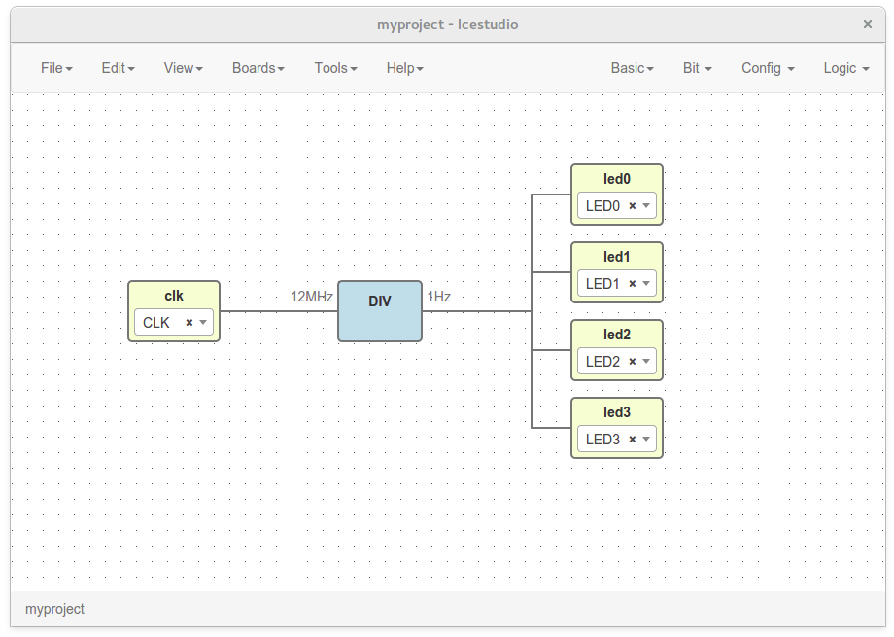
Icestudio
5. Blink
Import DIV block
File > Import block
Add clock input
Basic > Input
Connect wires
Upload bit stream
Tools > Upload

Slide 14
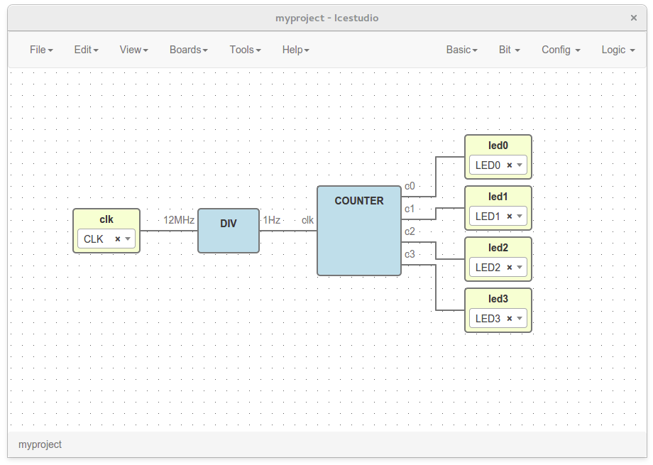
Icestudio
5. Counter
Import counter block
File > Import block
Reconnect wires
Upload bit stream
Tools > Upload

Slide 15
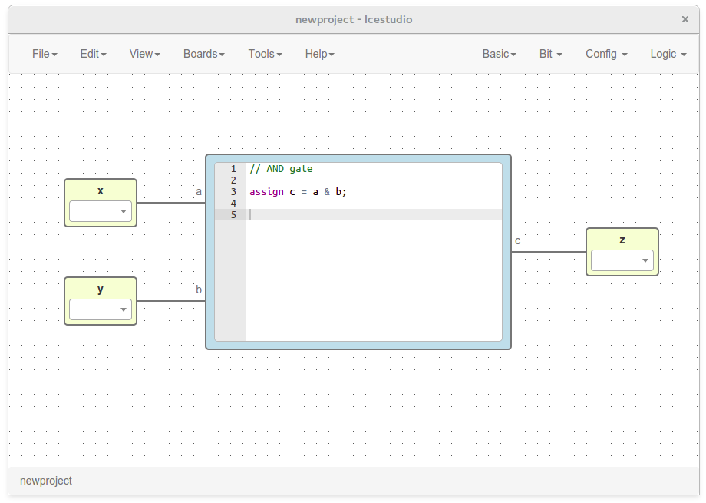
Icestudio
6. Let’s code
Create a project
File > New project
Add blocks
Basic > Code
Basic > Input
Basic > Output
Connect wires
Verify the design
Tools > Verify
Code block ports can be created “in␣out”, e.g. “a,b␣c”

Slide 16
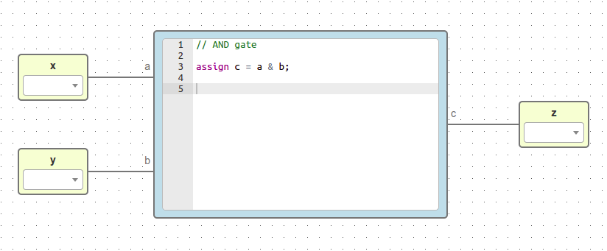
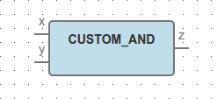
Icestudio
7. Custom block
Load a project
File > Open project
Save project as block
File > Export as block
Input / Output pins will become in/out block ports

Slide 17
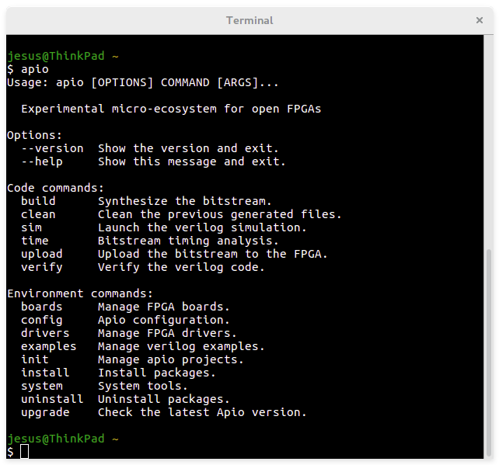
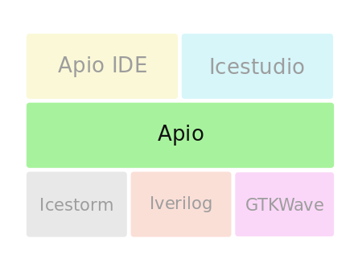
Apio
https://github.com/FPGAwars/apio
Experimental open source ecosystem for open FPGAs. Created with Python

Slide 18
Apio
1. Install
Open the console and execute
  $ pip install -U apio
Check apio
  $ apio
2. Setup
Install toolchain
  $ apio install --all
Install drivers
$ apio drivers --enable
Drivers configuration requires
administrative privileges
Follow the instructions in each OS

Slide 19
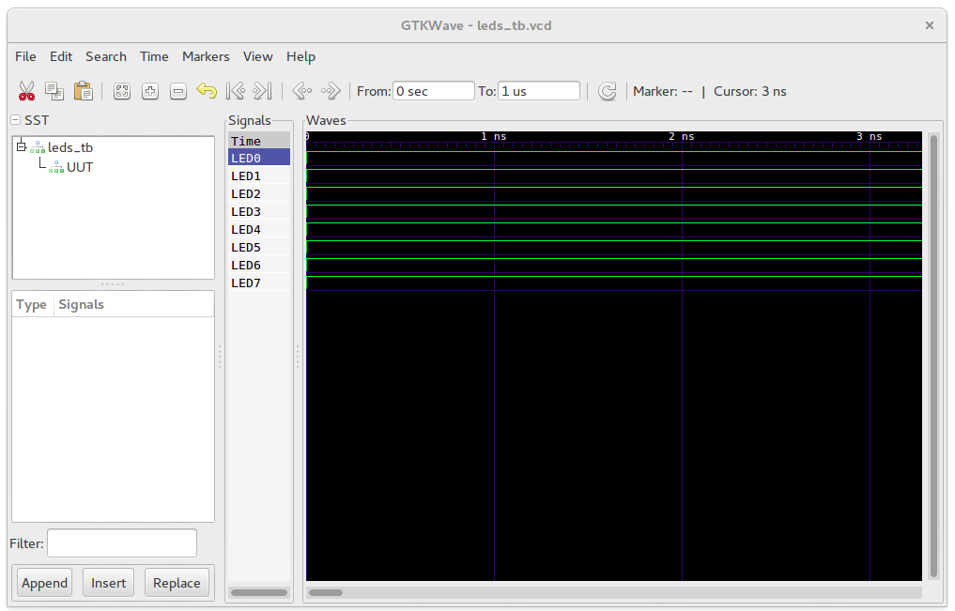
Apio
3. Hello, world!
Load example
$ apio examples -d icezum/leds
Move to example
$ cd icezum/leds
Verify and simulate
$ apio verify $ apio sim
Build and upload
$ apio build $ apio upload
Time analysis and clean
$ apio time $ apio clean

Slide 20
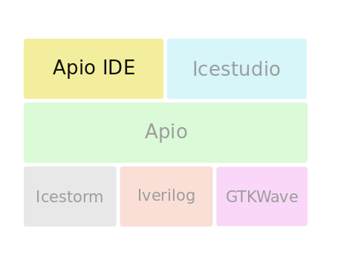
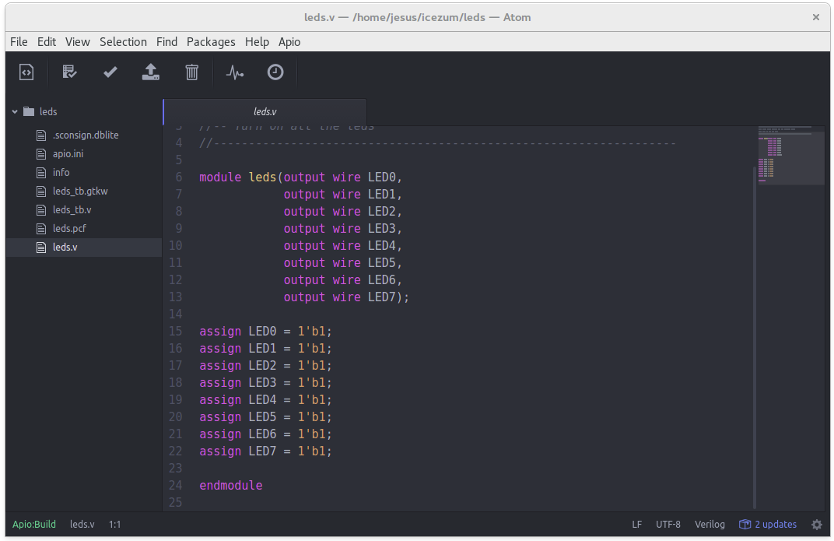
Apio IDE
https://github.com/FPGAwars/apio-ide
Experimental open FPGA IDE using Atom and Apio

Slide 21
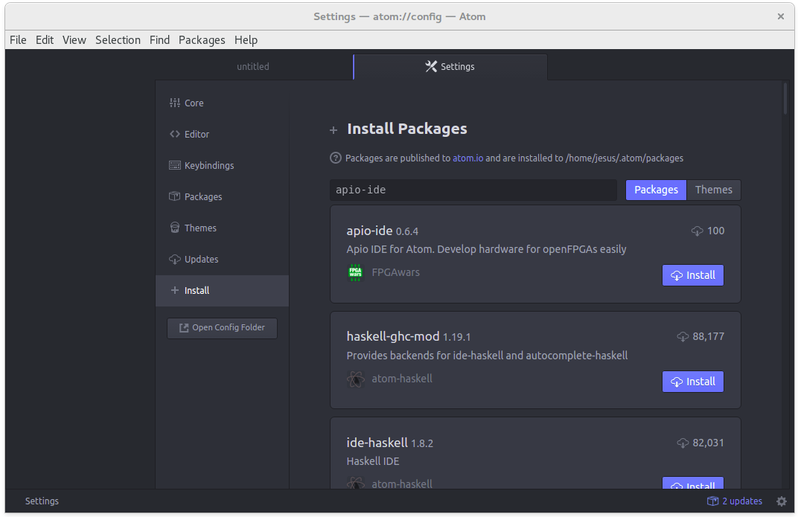
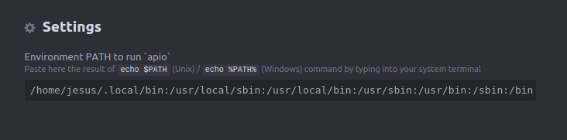
Apio IDE
1. Install
Open Atom
Edit > Preferences
+ Install: apio-ide
Retart Atom
2. Setup
Sometimes Env PATH must be added:
apio-ide > Settings > Env PATH
to allow Atom find apio

Slide 22
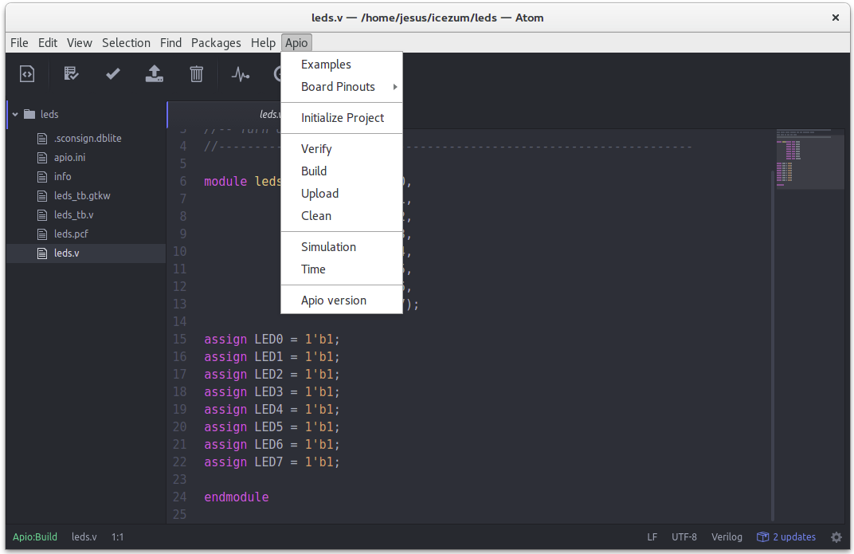
Apio IDE
3. Hello, world!
Open a new window
File > New Window
Load icezum/leds
File > Open Folder...
Load and edit leds.v
Upload bit stream
Toolbar > Upload
Apio menu > Upload
All apio code commands are implemented in the GUI

Slide 23
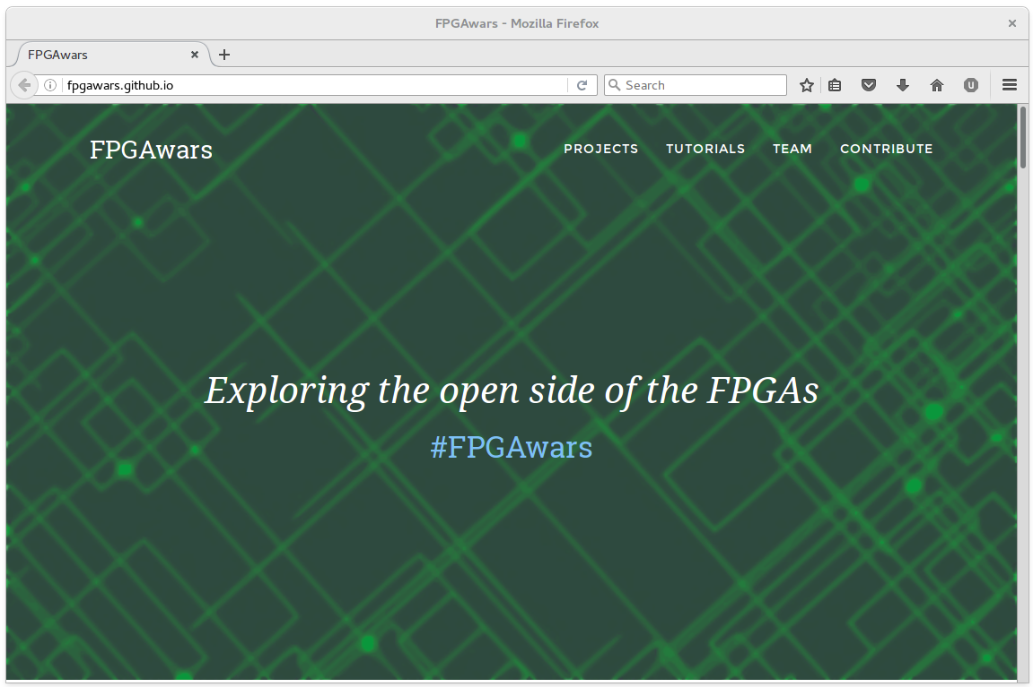
I want more!
http://FPGAwars.github.io

Slide 24
Workshop: open FPGAs tools
Jesús Arroyo Torrens
https://github.com/Jesus89
OSHWDem 16
November 5, 2016
Museo Domus, A Coruña
https://github.com/FPGAwars/workshops

