Slide 1
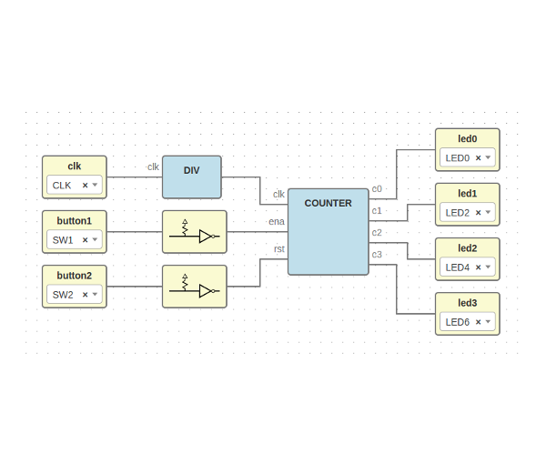



Workshop: open FPGAs tools
Jesús Arroyo Torrens
https://github.com/Jesus89
Reset 2016
28 de Octubre de 2016
ETSII Universidad Politécnica de Madrid
https://github.com/FPGAwars/workshops

Slide 2
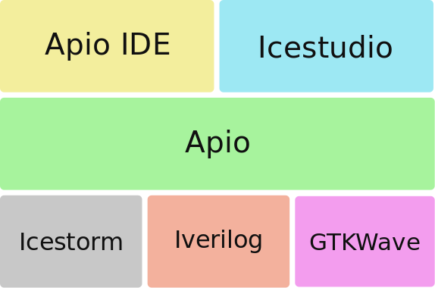
Stack of tools

Slide 3
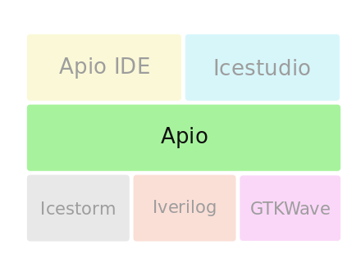

Apio
Micro-ecosystem for open FPGAs
Requirements
Python 2.7
Installation
$ pip install apio
$ apio install –all
Source code
https://github.com/fpgawars/apio
Documentation
http://apiodoc.readthedocs.io/en/stable

Slide 4
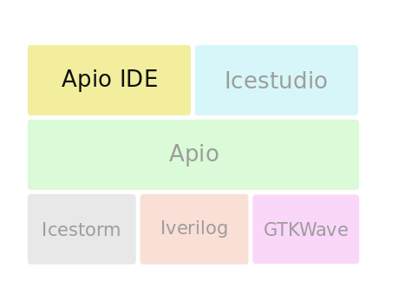

Apio IDE
Development IDE for open FPGAs
Requirements
Apio, Atom
Installation
Preferences > Install
Configure PATH
Source code
https://github.com/fpgawars/apio-ide
Documentation
https://github.com/fpgawars/apio-ide/wiki

Slide 5
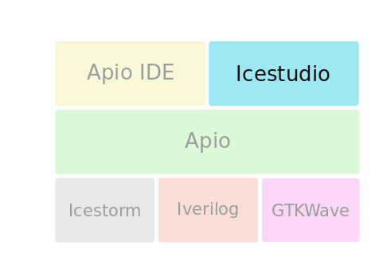

Icestudio
Graphic editor for open FPGAs
Requirements
Python 2.7
Installation
Download and execute
Tools > Install toolchain
Source code
https://github.com/fpgawars/icestudio
Documentation
http://icestudio.readthedocs.io/en/stable

Slide 6
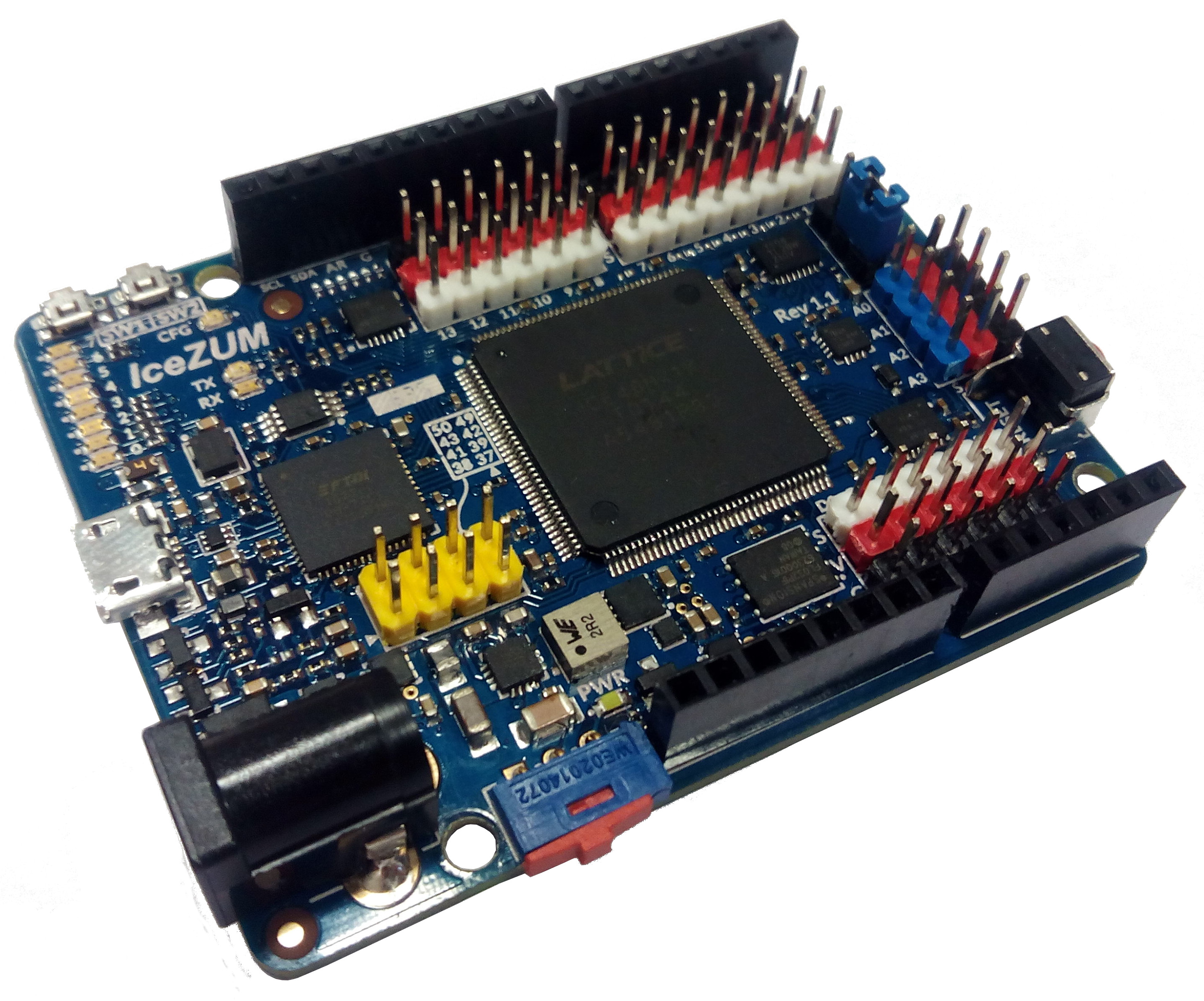
Examples
Verilog
Icestudio
IceZUM Alhambra
https://github.com/FPGAwars/icezum/wiki
Workwhop
https://github.com/FPGAwars/workshops

Slide 7
Challenges
Verilog
Icestudio

Slide 8
Workshop: open FPGAs tools
Jesús Arroyo Torrens
https://github.com/Jesus89
Reset 2016
28 de Octubre de 2016
ETSII Universidad Politécnica de Madrid
https://github.com/FPGAwars/workshops

