Slide 1
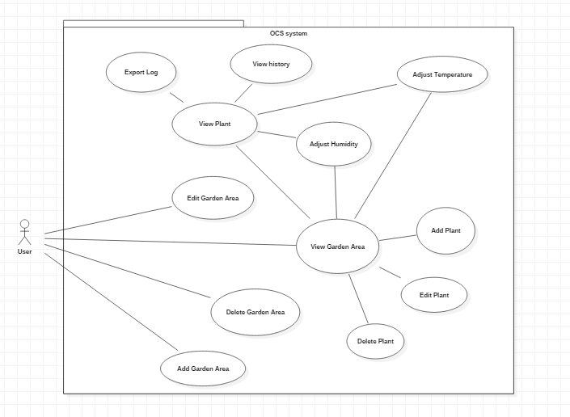
Use Case Diagram

Slide 2
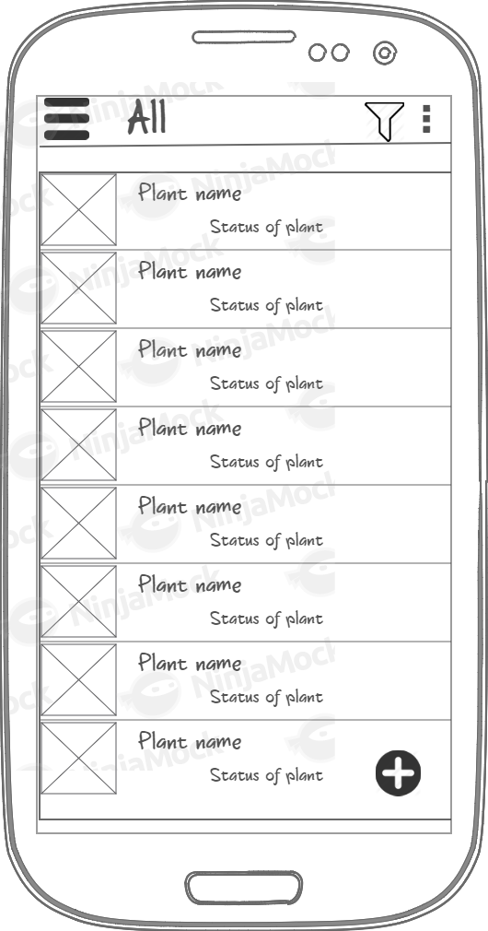
All Plants Screen
Quick Add button
Filter with the condition of plant
Demonstrate crop status and demand in list

Slide 3
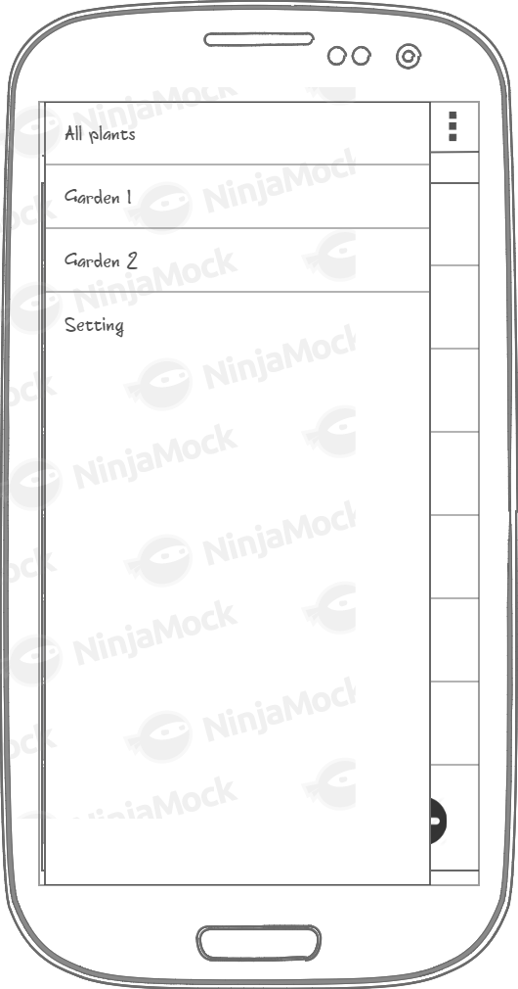
Slide menu
List of garden
Create new garden
Setting
Other features will add later

Slide 4
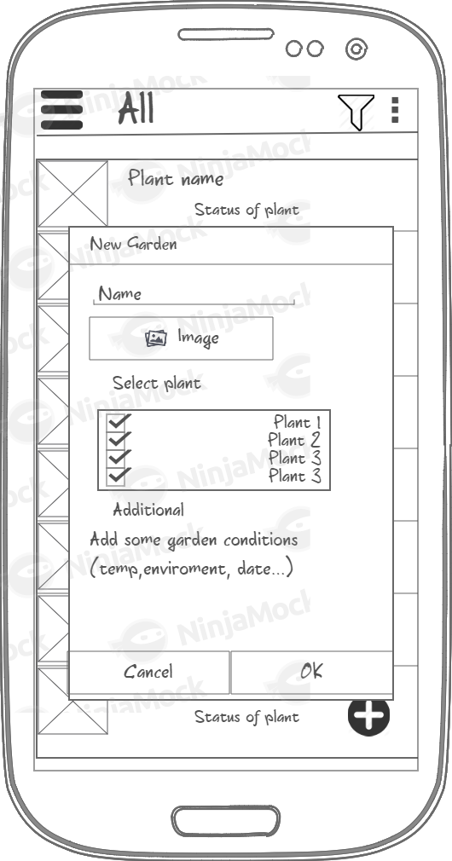
Add New Garden Screen
Add Name, Image (option)
Select plants in list
Add some garden contions: environment(outdoor, indoor), min-max temp, min-max water,…..

Slide 5
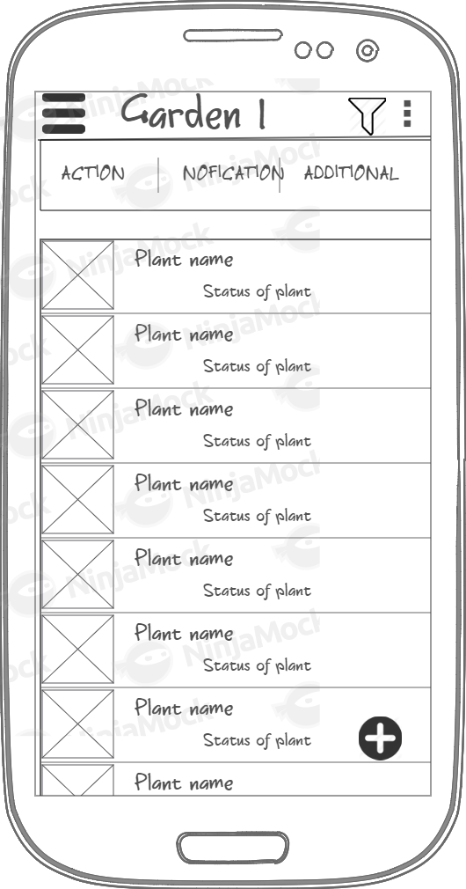
Garden Screen
Quick Add button
Filter with the condition of plant
Setting of garden: Edit, Delete,…
Demonstrate crop status and demand in list
Quick action bar
Notification about the status of garden
Other features will add later

Slide 6
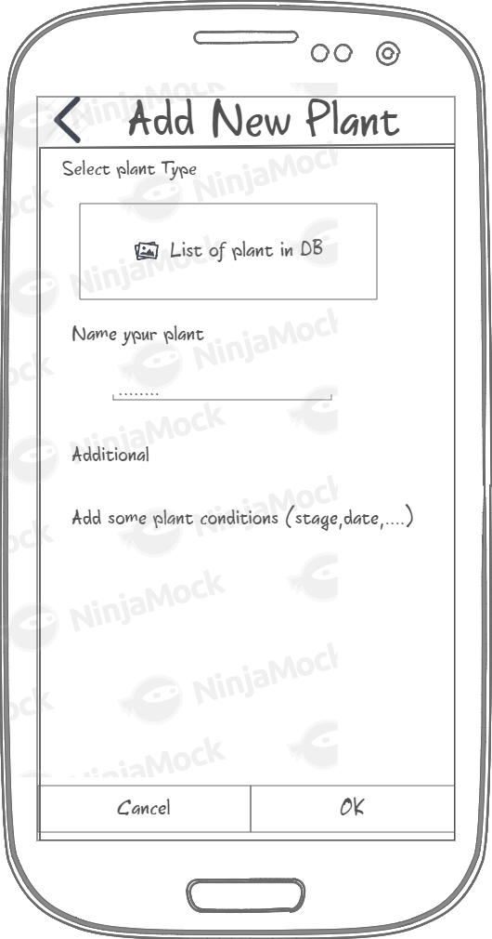
Add New Plant Screen
Can select type of plant in PlantDB
Name of plant
Add other conditions of the plant. (stage, date,…)

Slide 7
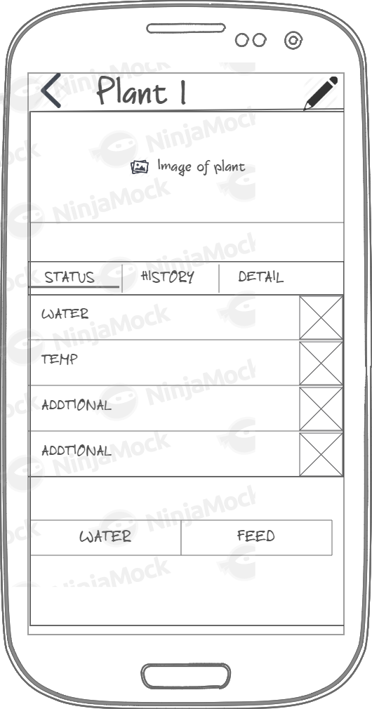
Plant Info Screen
Edit Button
Status of plant ,quick action button
History
Detail (Introduction to plants, how to care.,)

Slide 8
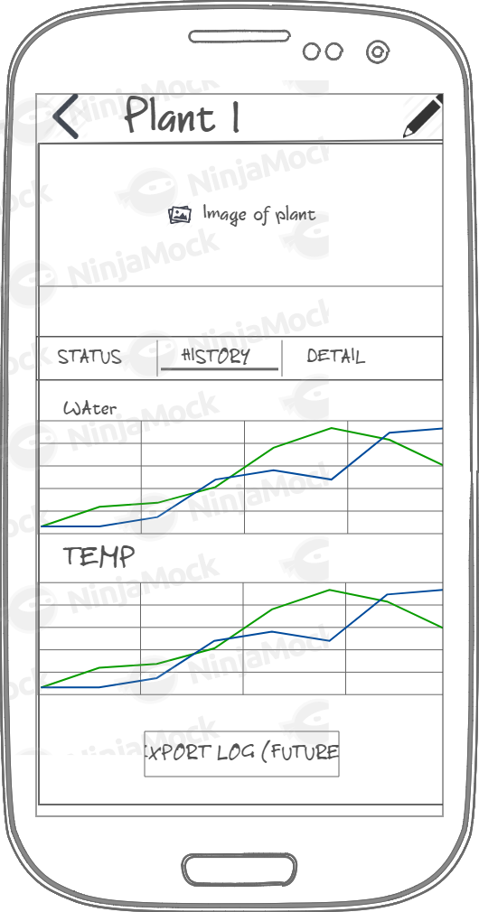
History Screen
Chart (water, temp,…)
Export history button (future)
Statistic about number of time, water,…. (Add later)

