Slide 1
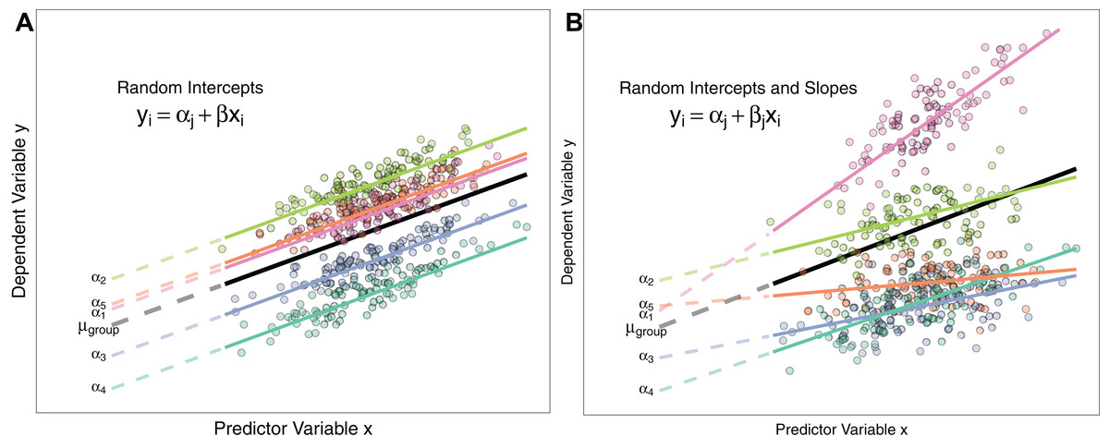
Introduction to:
Linear Mixed Effects models

Slide 2
Linear mixed models
Linear mixed-effects
Multilevel models
Multilevel regression
Multilevel linear modeling
Hierarchical linear models
Random coefficient models

Slide 3

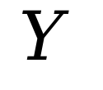
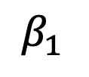
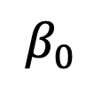

Linear models

Slide 4
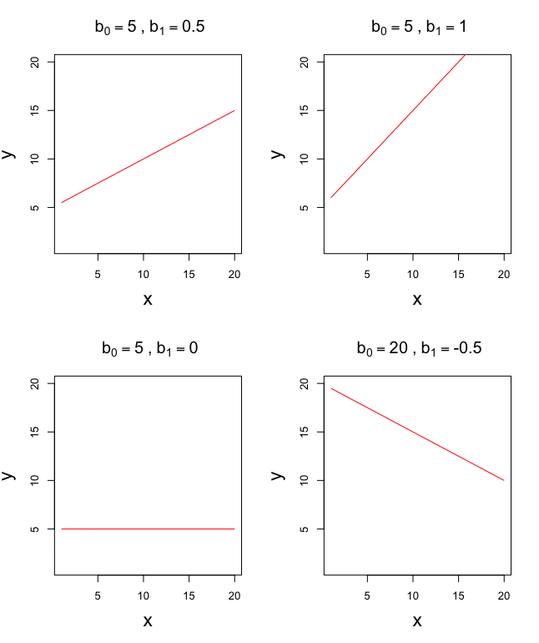

Linear models

Slide 5
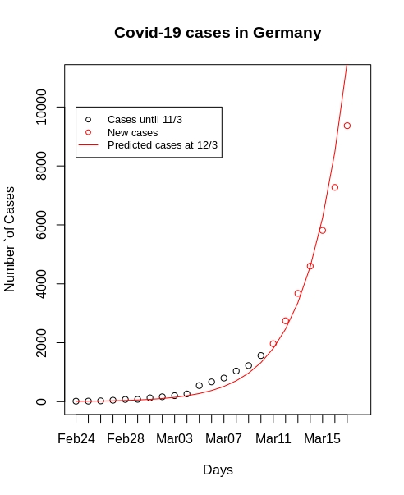
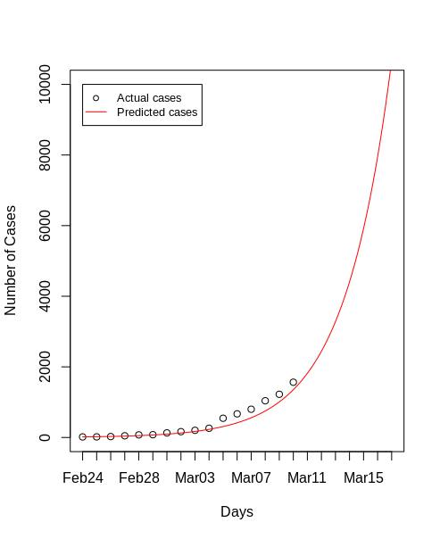


Linear models
It is a linear model because the parameters combine additively;
it is the model that needs to
be linear, not necessarily
the relationship(s)

Slide 6
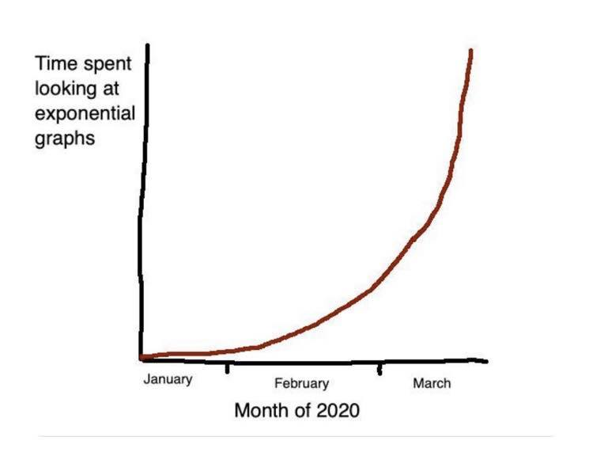

Slide 7

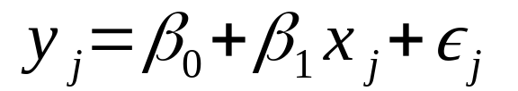
Linear models
Fixed effects: we assume that the model holds true across the entire sample and that for every case of data (participant) in the sample we can predict a score using the same values of the
slope and intercept, plus some random error that represents all factors that might influence the dependent variable other than x.

Slide 8
Linear models
In linear models, the parameters β₀ and β₁ are estimated through OLS.
It minimizes the sum of the squared differences between the observed values of y and the model-predicted values of y across the entire sample.

Slide 9
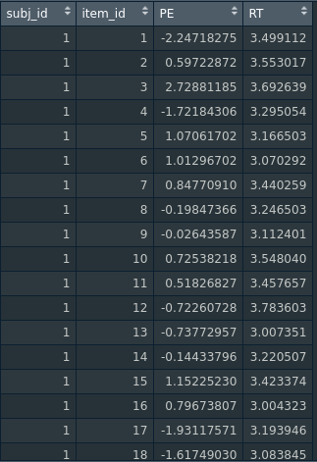
Lmmworkshop.Rmd
```{r simulate Data}
```
Linear models
What if we have variables that vary within-participants?
RT
PE

Slide 10
Linear models
Solution 1: We could fit a OLS regression to the entire
Dataset, without aggregating.
What is the problem with that?
RT
Exactly: it violates the assumptions of indipendence, because participants provide more than one data point. Therefore, their data are correlated (there are clusters in the data).
PE

Slide 11
Linear models
Solution 2: We could aggregate data at the participant level and run OLS regression.
RT
Lmmworkshop.Rmd
```{r aggregate }
```
PE

Slide 12
Linear models
linearmodel<-lm(outcome~predictor,data=df)

Slide 13
LM<-lm(Acc~PE,data=data)
Function that stands for “linear model” and is used in R to calculate regression and its special cases (Anova, multiple regressions, etc.)
Outcome, or dependent variable
On the right side of the ~ symbol there are the predictors (fixed effects)

Slide 14
Linear models
summary(linearmodel)
Call:
lm(formula = RT ~ PE, data = df_agg)
Residuals:
Min 1Q Median 3Q Max
-2.7819 -1.5765 0.0868 0.9321 5.3083
Coefficients:
Estimate Std. Error t value Pr(>|t|)
(Intercept) 8.233 7.024 1.172 0.251
PE -3.730 48.573 -0.077 0.939
Residual standard error: 1.905 on 28 degrees of freedom
Multiple R-squared: 0.0002105, Adjusted R-squared: -0.0355
F-statistic: 0.005897 on 1 and 28 DF, p-value: 0.9393

Slide 15
Linear models
summary(linearmodel)
Call:
lm(formula = RT ~ PE, data = df_agg)
Residuals:
Min 1Q Median 3Q Max
-2.7819 -1.5765 0.0868 0.9321 5.3083
Coefficients:
Estimate Std. Error t value Pr(>|t|)
(Intercept) 8.233 7.024 1.172 0.251
PE -3.730 48.573 -0.077 0.939
Residual standard error: 1.905 on 28 degrees of freedom
Multiple R-squared: 0.0002105, Adjusted R-squared: -0.0355
F-statistic: 0.005897 on 1 and 28 DF, p-value: 0.9393

Slide 16
Linear models
What is the problem with that?

Slide 17

ID 4
ID 3
Between-participant level:
Participants with higher PE on average have slower RT
ID 2
RT
ID 1

Slide 18
ID 4
ID 3
ID 2
Within-participant level:
When participants experienced higher PE their RT are faster
ID 1
RT

Slide 19
Linear models
So what do we do?

Slide 20
Linear mixed models
Random effects: we say that a parameter is random then we assume not that it is a
fixed value, but that its value can vary.
That parameter is also random because we treat it is as being randomly selected from the larger population (Clark, 1973).

Slide 21

Random Intercepts
Category 1
Category 2
Category 3
RT
(i.e., differences in “overall” RT)

Slide 22
Random Slopes, fixed intercepts
Category 1
Category 2
Category 3
RT
(i.e., differences in the effect across categories)

Slide 23
Random Intercepts and Slopes
Category 1
Category 2
Category 3
RT
(i.e., differences in the size of the effect across conditions)
Including random intercepts and slopes allows to control for random variations among items (sampling units)

Slide 24
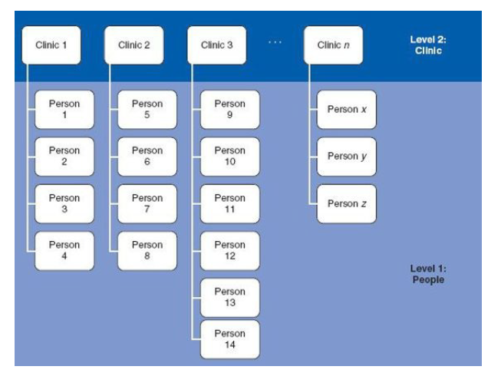
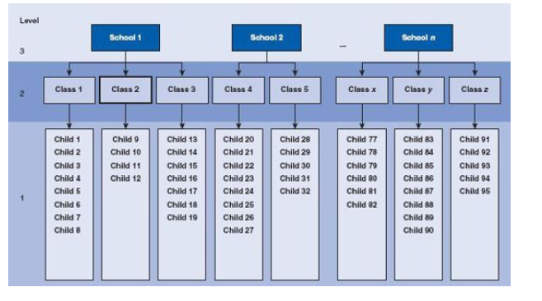
Linear mixed models
Multilevel models
Hierarchical linear models
Nested data

Slide 25
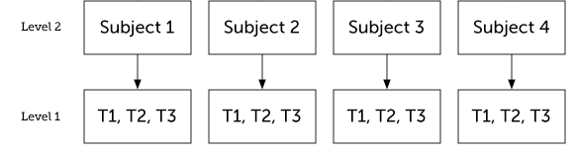
Linear mixed models
Multilevel models
Hierarchical linear models
Nested data
Taking into account within- and between-person variability

Slide 26

ID 4
ID 3
ID 2
ID 1
RT
“The reason for favoring the within-subject level is that omitted and confounding variables are less likely to be a problem when analyses focus on how and why people change over time than on how people differ from one another”.
(Bolger & Laurenceau, Intensive longitudinal methods: An introduction to diary and experience sampling research, 2013).

Slide 27
Random Intercepts and Slopes
Participant 1
Participant 2
Participant 3
Fixed effect (Intercept and slope for the average person)
RT
Check also: http://mfviz.com/hierarchical-models/

Slide 28
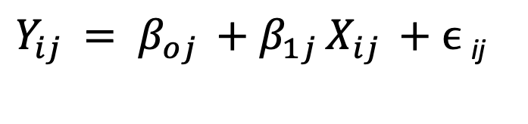
Level 1 - dependent variable Y for observation i for a particular subject j.
The dependent variable Y for subject j for the specific observation i is given by an subject-specific intercept β0j , a subject specific slope β1j, and a within-subject erro term εij.

Slide 29
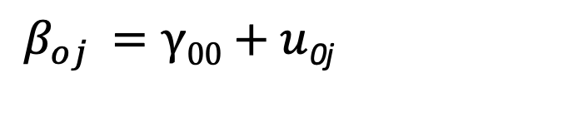
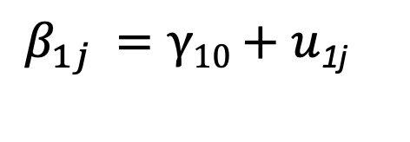
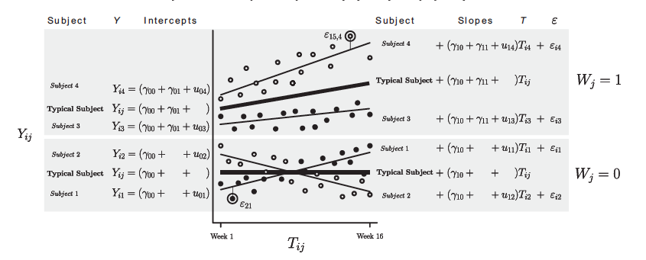
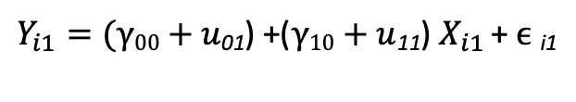


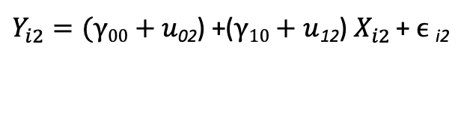

Level 2 ( population level)
u0j is a random effect because it varies from cluster to cluster
Subject 1
Typical person
Subject 2
X

Slide 30


Level 2 (Population level)
Subject 1
Typical person
Subject 2
X
_{1j}

Slide 31
is a within-sbject residual term representing the difference, at a given time point between the predicted Y for a given subject and the actual value.
Level 2 (between-subjects)
Subject 1
Typical person
Subject 2
X

Slide 32



is a within-sbject residual term representing the difference, at a given time point between the predicted Y for a given subject and the actual value.
Level 2 (between-subjects)
X

Slide 33
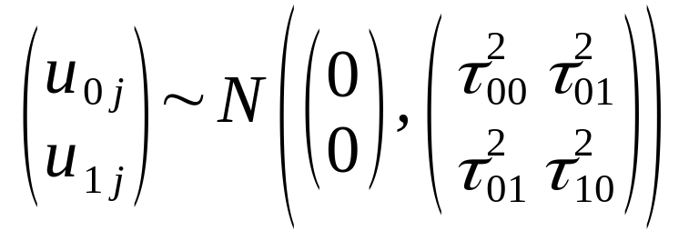
Model formulation
Level 1
Level 2
Variance-covariance matrix
Residuals

Slide 34
How are parameters estimated?
Parameters for mixed models are not estimated through OLS, which is not the optimal approach for complex model. Instead, they are estimated through Maximum Likelihood Estimation (MLE) and Restricted Maximum Likelihood (REML).
MLE search for the population model parameters that maximize the likelihood of obtaining our data. In other words, the parameters obtained should maximize the likelihood of our particular dataset.
It search through candidate parameters in several iterations using nonlinear optimization algorhitms.
RMLE is like MLE, but also takes into account the number of parameters being estimated in the model in order to determine the appropriate degrees of freedom for the estimation of the random components. In contrast, MLE does not account for these. Therefore, it is generally preferred for estimating multilevel models. It is the default for lmer.
What exactly is Maximum Lixelihood? Watch this:
https://towardsdatascience.com/probability-concepts-explained-maximum-likelihood-estimation-c7b4342fdbb1

Slide 35
Let’s do this!
Library = lme4
lmm<-lmer(DV~IV+(1+randomeffect|randomintercept),data=df)
Random, “stochastic” part of the model, with the random effects. On the right of the | symbol there is the clustering variable. On te left side there are the random slopes.
Fixed part of the model

Slide 36


First, let’s fit an unconditional model, a model with only the intercept, to examine the variability in our dependent variable that is between- and within- participant
Relative higher values of ρ indicate that great amount of variation in the outcome measure (DV) is associated with the cluster membership – observation within participants are correlated.
Variance between-participant is higher that within-participant.
This is called intraclass correlation.

Slide 37


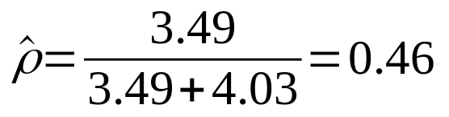
Linear mixed model fit by REML. t-tests use Satterthwaite's method ['lmerModLmerTest']
Formula: RT ~ 1 + (1 | subj_id)
Random effects:
Groups Name Variance Std.Dev.
subj_id (Intercept) 3.493 1.869
Residual 4.030 2.008
Number of obs: 9000, groups: subj_id, 30
Lmmworkshop.Rmd
```{r lmm rand int}
```
46% of the variance in RT is explained by the grouping variable, “Subjects”.

Slide 38
To test whether the addition of the random intercept improves the fit of the model, we can compare a model with random intercept and a model without them
There are several model selection criteria: the most popular ones are:
- Akaine information criterion (AIC)
- Bayes or Schwarz information criterion (BIC)
- Likelihood ratio test
The BIC is known to put a strong penalty on the model complexity for small sample sizes (e.g.,

Slide 39
The anova() function in R allows to carry out a Likelihood ratio test.
In this test, the fit of the full and reduced models are compared.
The lmer effect should be called first. anova(mixmod_unc, mod_unc)
Lmmworkshop.Rmd
```{r lmm rand test sig}
```
Data: df
Models:
mod_unc: RT ~ 1
mixmod_unc: RT ~ 1 + (1 | subj_id)
npar AIC BIC logLik deviance Chisq Df Pr(>Chisq)
mod_unc 2 43566 43580 -21781 43562
mixmod_unc 3 38258 38279 -19126 38252 5310.3 1 < 2.2e-16 ***
---
Signif. codes: 0 ‘***’ 0.001 ‘**’ 0.01 ‘*’ 0.05 ‘.’ 0.1 ‘ ’ 1
If models are not fitted with ML, they are refitted with ML, because it makes them comparable.
The chi square difference test is computed on deviance statistics, which is -2 *LL, and follows a chi-square distribution.

Slide 40
Average reaction time
Fixed effects:
Estimate Std. Error df t value Pr(>|t|)
(Intercept) 7.6947 0.3419 29.0000 22.51 <2e-16 ***
---

Slide 41
Not everyone agrees that testing significance of random effects is a good idea, as the LRT in some cases are conservative
Checkout this:
https://bbolker.github.io/mixedmodels-misc/glmmFAQ.html#testing-significance-of-random-effects
Consider not testing the significance of random effects. If the random effect is part of the experimental design, this procedure may be considered ‘sacrificial pseudoreplication’ (Hurlbert 1984). Using stepwise approaches to eliminate non-significant terms in order to squeeze more significance out of the remaining terms is dangerous in any case.
consider using the RLRsim package, which has a fast implementation of simulation-based tests of null hypotheses about zero variances, for simple tests. (However, it only applies to lmer models, and is a bit tricky to use for more complex models.)
Lmmworkshop.Rmd
```{r exactLRT}
```

Slide 42
Model selection
At this point in time, there is no perfect solution.
1. Keep it maximal: The model should include the maximal random effects structure justified by the design in order to (Barr et al., 2013)
Pro: Avoid the risk of removing variance components (random effects), reducing the possibility of Type I error
Cons: - The most complex model will always provide the besti fit for a given data set; However, there is a risk of ovefitting when model are too complex.
- Reduction in power.
2. Balance: The random effect structure should thus be supported by the data (Matuschek et al., 2017)

Slide 43
Library(”lme4”) maxMod<-lmer(RT~PE+(PE|subj_id), data=data)
Barr et al. (2013): “[T]he maximal random effect structure should be fitted to the data. ...The random effect structure should be reduced if and only if the maximal model does not converge.”
Let’s run the maximal model!
Within brackets there is the “stochastic” part of the model, with the random effects.
On the right of the | symbol there is the clustering variable: in our case is the participant number variable. We are adding random intercepts for participants, meaning that we are considering their variance in relation to the average RT. On the left side of the | symbol there are the random slopes. In this case, we are considering random slopes for PE; this means that we are accounting for participants differences in the effects of this variable on PE.
Function for the linear mixed model. It requires that some random effects are added.
Fixed effects part. Same as the lm one.

Slide 44
Lmmworkshop.Rmd
```{r maximal}
```
Linear mixed model fit by REML. t-tests use Satterthwaite's method ['lmerModLmerTest']
Formula: RT ~ PE + (1 + PE | subj_id)
Data: df
Control: lmerControl(optimizer = "bobyqa")
REML criterion at convergence: 4179.7
Scaled residuals:
Min 1Q Median 3Q Max
-3.3829 -0.6809 0.0004 0.6715 3.6142
Random effects:
Groups Name Variance Std.Dev. Corr
subj_id (Intercept) 2.50371 1.5823
PE 12.62806 3.5536 0.44
Residual 0.08771 0.2962
Number of obs: 9000, groups: subj_id, 30
τ₀₀²
Variation In RT across subjects

Slide 45
Lmmworkshop.Rmd
```{r maximal}
```
Linear mixed model fit by REML. t-tests use Satterthwaite's method ['lmerModLmerTest']
Formula: RT ~ PE + (1 + PE | subj_id)
Data: df
Control: lmerControl(optimizer = "bobyqa")
REML criterion at convergence: 4179.7
Scaled residuals:
Min 1Q Median 3Q Max
-3.3829 -0.6809 0.0004 0.6715 3.6142
Random effects:
Groups Name Variance Std.Dev. Corr
subj_id (Intercept) 2.50371 1.5823
PE 12.62806 3.5536 0.44
Residual 0.08771 0.2962
Number of obs: 9000, groups: subj_id, 30
τ₁₀²
Variation in the effect on PE on RT across subjects

Slide 46
Lmmworkshop.Rmd
```{r maximal}
```
Linear mixed model fit by REML. t-tests use Satterthwaite's method ['lmerModLmerTest']
Formula: RT ~ PE + (1 + PE | subj_id)
Data: df
Control: lmerControl(optimizer = "bobyqa")
REML criterion at convergence: 4179.7
Scaled residuals:
Min 1Q Median 3Q Max
-3.3829 -0.6809 0.0004 0.6715 3.6142
Random effects:
Groups Name Variance Std.Dev. Corr
subj_id (Intercept) 2.50371 1.5823
PE 12.62806 3.5536 0.44
Residual 0.08771 0.2962
Number of obs: 9000, groups: subj_id, 30
τ₀₁²
Correlation betwee randon intercepts and random slopes

Slide 47
Lmmworkshop.Rmd
```{r maximal}
```
Ɣ₁₀
Fixed effect of PE
Fixed effects:
Estimate Std. Error df t value Pr(>|t|)
(Intercept) 7.4325 0.2889 28.9999 25.726 < 2e-16 ***
PE 1.8175 0.6488 29.0001 2.801 0.00897 **
---

Slide 48
We could also have included between-participant effects in the same model,
By using mean centering
Person-mean centering: subtracing the grand mean from the person mean
Grand-mean centering: subtracting the person mean from the grand mean
Lmmworkshop.Rmd
```{r centering}
```

Slide 49
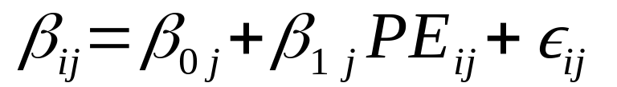
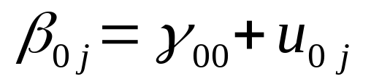
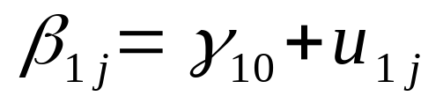
maxMod<-lmer(RT~PE+(PE|subj_id), data=data)
Model formulation
Level 1
Level 2
Variance-covariance matrix - unstructured
Residuals

Slide 50
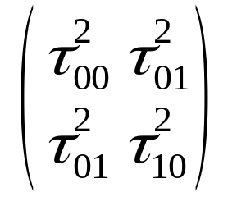
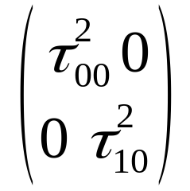
Variance-covariance structures
Unstructured: the covariances can take any value (finite positive)
Diagonal: the variances are assumed to be indipendent, so their covariance is at 0

Slide 51
Model Comparison
Matuschek et al. (2017) : Backward selection.
Start from the most complex model (maximal model) until a further reduction would imply a significant loss in the goodness of fit.
Let’s try it!
Let’s fit a model where the covariance between random effect is set to zero.
Lmmworkshop.Rmd
```{r model selection backward}
```

Slide 52
Model Comparison
Matuschek et al. (2017) : we should not set α = 0.05 as cut-off for choosing models, because it may imply a strong penalty on the model complexity, in favour of the goodness-of-fit.
They suggested a less conservative alpha, α = 0.2
Example of backward model selection
Mod0 = lmer(RT~PE+(PE|subj_id), data=data) maximal
Mod1 = lmer(RT~PE+(PE||subj_id), data=data)
Drop RE covariance
Mod2 = lmer(RT~PE+(1|subj_id), data=data)
Drop random slopes
In order to do forward model selection, just invert the steps!

Slide 53
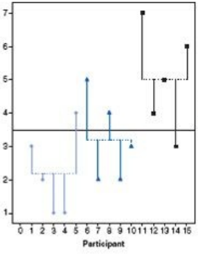
categorical predictor – ANOVA
Lmmworkshop.Rmd
```{r categorical predictor between}
```

Slide 54
categorical predictor – between participants
Coefficients:
Estimate Std. Error t value Pr(>|t|)
(Intercept) 7.9719 0.6100 13.068 3.44e-13 ***
PEbwHighPE -0.4662 0.8627 -0.540 0.593
PEbwLowPE -0.3653 0.8627 -0.423 0.675
β₀ = 7.9719
β₁ = 7.9719 – 0.3653 = 7.607
β₂ = 7.9719 – 0.4662 = 7.506

Slide 55
categorical predictor – between participants
Coefficients:
Estimate Std. Error t value Pr(>|t|)
(Intercept) 7.9719 0.6100 13.068 3.44e-13 ***
PEbwHighPE -0.4662 0.8627 -0.540 0.593
PEbwLowPE -0.3653 0.8627 -0.423 0.675
β₀ = 7.9719
β₁ = 7.9719 – 0.3653 = 7.607
β₂ = 7.9719 – 0.4662 = 7.506

Slide 56
categorical predictor – between participants
We can also setting meaningful contrasts
Lmmworkshop.Rmd
```{r setting contrasts}
```

Slide 57
categorical predictor – between participants
Is it the same if we transform categorical into continuous?
Lmmworkshop.Rmd
```{r continuous predictor between}
```

Slide 58
categorical predictor – within participants
Subject1
Let’s take it EZ!
LowPE
MedPE
HighPE
Lmmworkshop.Rmd
```{r continuous predictor between}
```
Subject2
LowPE
MedPE
HighPE

Slide 59
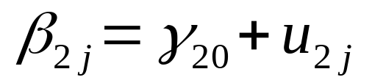
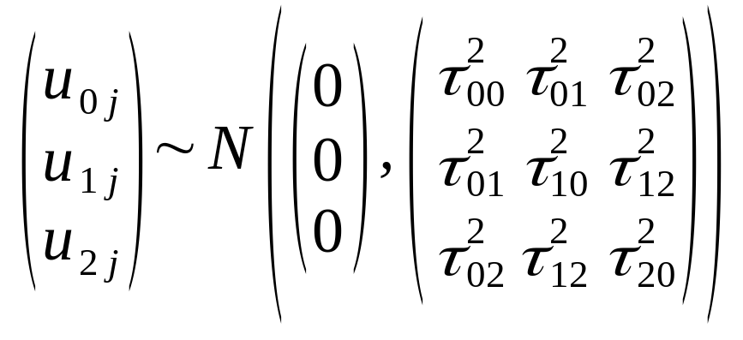
categorical predictor – within participants

Slide 60
To sum up, benefits of using LMM:
Control for random variability between items
Focus on within-participants processes
Separate within-participant from between-participant variability
Account for dependency in the data
Allow to deal with missing data
More reliable estimates, even in the presence of outliers

Slide 61
Reporting:
models were fitted (using the lme4 package version 1.1-13, Bates, Mächler, Bolker, & Walker, 2015; R Core Team, 2014)
Focus on within-participants processes
Separate within-participant from between-participant variability
Account for dependency in the data
Allow to deal with missing data
More reliable estimates, even in the presence of outliers

Slide 62
Recommended readings:
Finch, W. H., Bolin, J. E., & Kelley, K. (2019). Multilevel modeling using R. Crc Press.
Matuschek, H., Kliegl, R., Vasishth, S., Baayen, H., & Bates, D. (2017). Balancing Type I error and power in linear mixed models. Journal of memory and language, 94, 305-315.
Luke, S. G. (2017). Evaluating significance in linear mixed-effects models in R. Behavior research methods, 49(4), 1494-1502.
Account for dependency in the data
Allow to deal with missing data

Slide 63
Please check the practical example in the Lab Tutorials for more on LMM

