Slide 1


MemLear:
Prediction, Memory, and Learning
November, 11, 2021
Lifespan Cognitive and Brain Development (LISCO) Lab
Goethe University Frankfurt
Francesco Pupillo

Slide 2
THEORETICAL BACKGROUND
The human mind constantly tries to form expectations about regularities in the environment, a process called statistical learning (Sherman, Graves, & Turk-Browne, 2020).

Slide 3



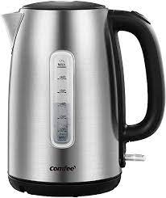

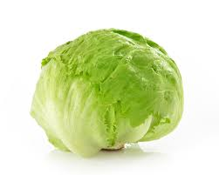


THEORETICAL BACKGROUND
These regularities can organized in schemas: general knowledge that provides expectations about current events based on prior experience (Sakamoto & Love, 2004).

Slide 4


THEORETICAL BACKGROUND
What happens when new information, congruent or incongruent with a previous schema, is introduced?

Slide 5
THEORETICAL BACKGROUND
What happens when new information, congruent or incongruent with a previous schema, is introduced?
Schema aids encoding for schema-congruent information (Bartlett, 1932; van Kesteren et al., 2010; Tse et al, 2007).
Integration-elaboration hypothesis: the target item is assumed to integrate more easily with a congruent context (Depth of processing effect, Craik & Tulving, 1975).
Mismatched expectation could also lead to enhanced episodic encoding, and thus better memory for events that are not fully predicted (Henson & Gagnepain, 2010). Events that violate expectations might be represented more distinctively.

Slide 6





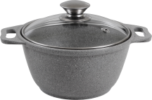
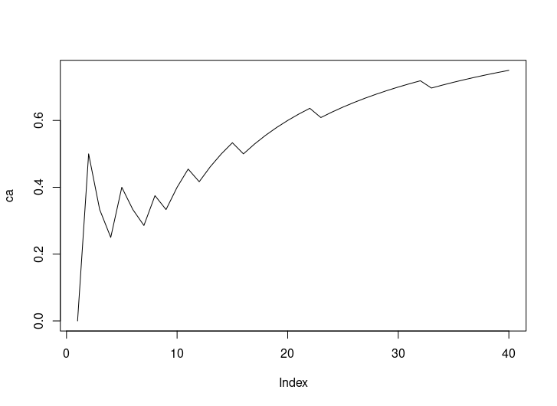



THEORETICAL BACKGROUND
Congruent
Incongruent
.90
.10
Strong Priors
.50
.50
Flat priors
cumAcc
Phase1. Contingency learning
?
0
?
1
0100100101101110111111011111111101111111

Slide 7



THEORETICAL BACKGROUND
Phase1. Contingency learning
Phase2. Encoding
Phase3. Memory test
?
?
Have you seen this object before?
?
?

Slide 8
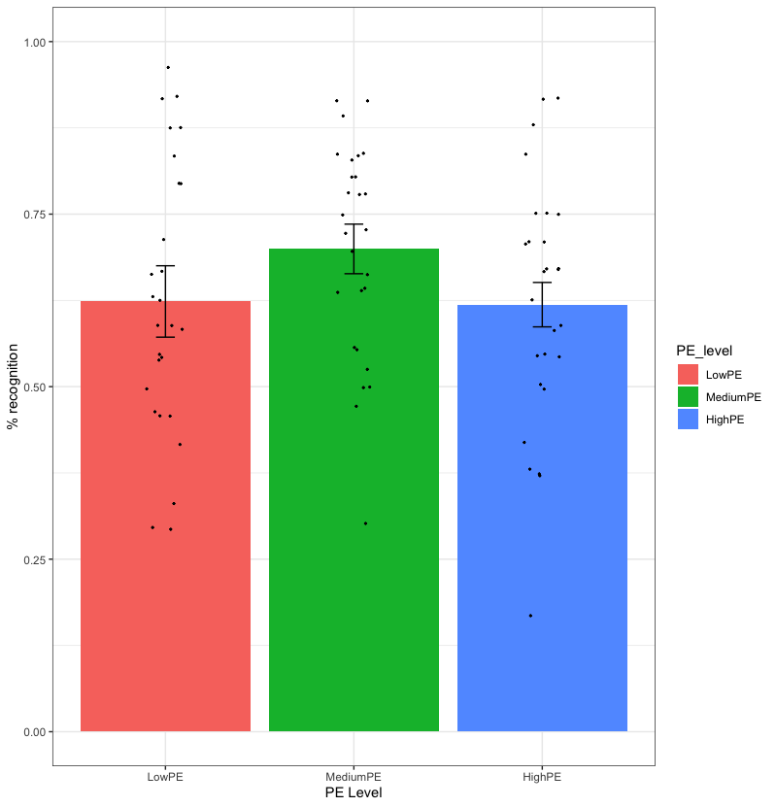
THEORETICAL BACKGROUND
Proposed explanations:
SL-EM trade-off: in flat conditions, attention is driven away from the SL task (predictive mode) and directed towards the object when there is nothing to learn.
Increased uncertainty: increased attention and information seeking in more uncertain context.
Congruent
Flat
Incongruent

Slide 9
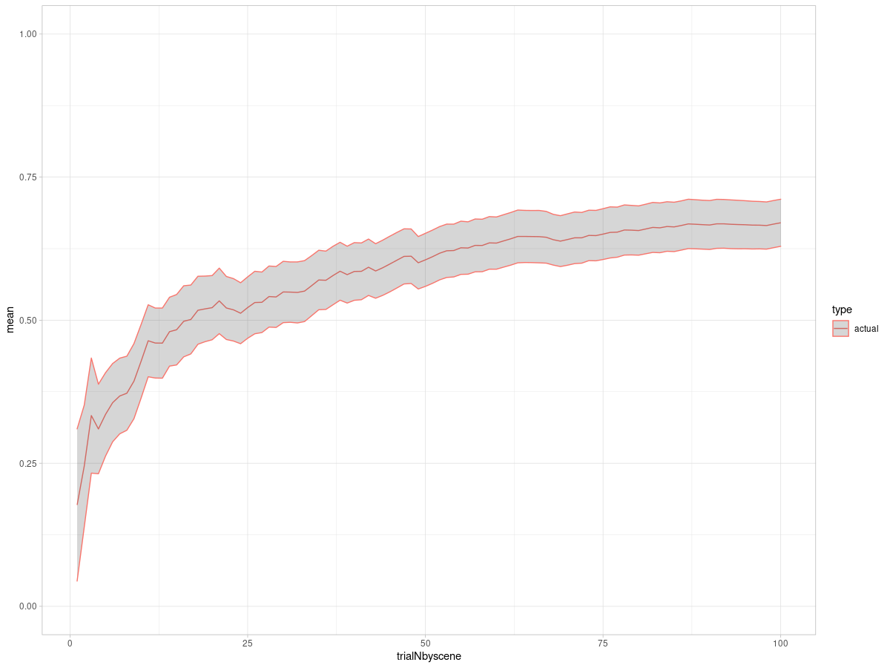
THEORETICAL BACKGROUND
In this previous study, the associations have been already learned before the encoding task.
Learning
Phase
Cum acc
Cum acc
Encoding Phase
Trial N
What it is not clear is what are the consequences of learning new associations – having no priors.
Learning associations vs
Known associations
Strong .90, .10
Flat .50 .50
None - -

Slide 10
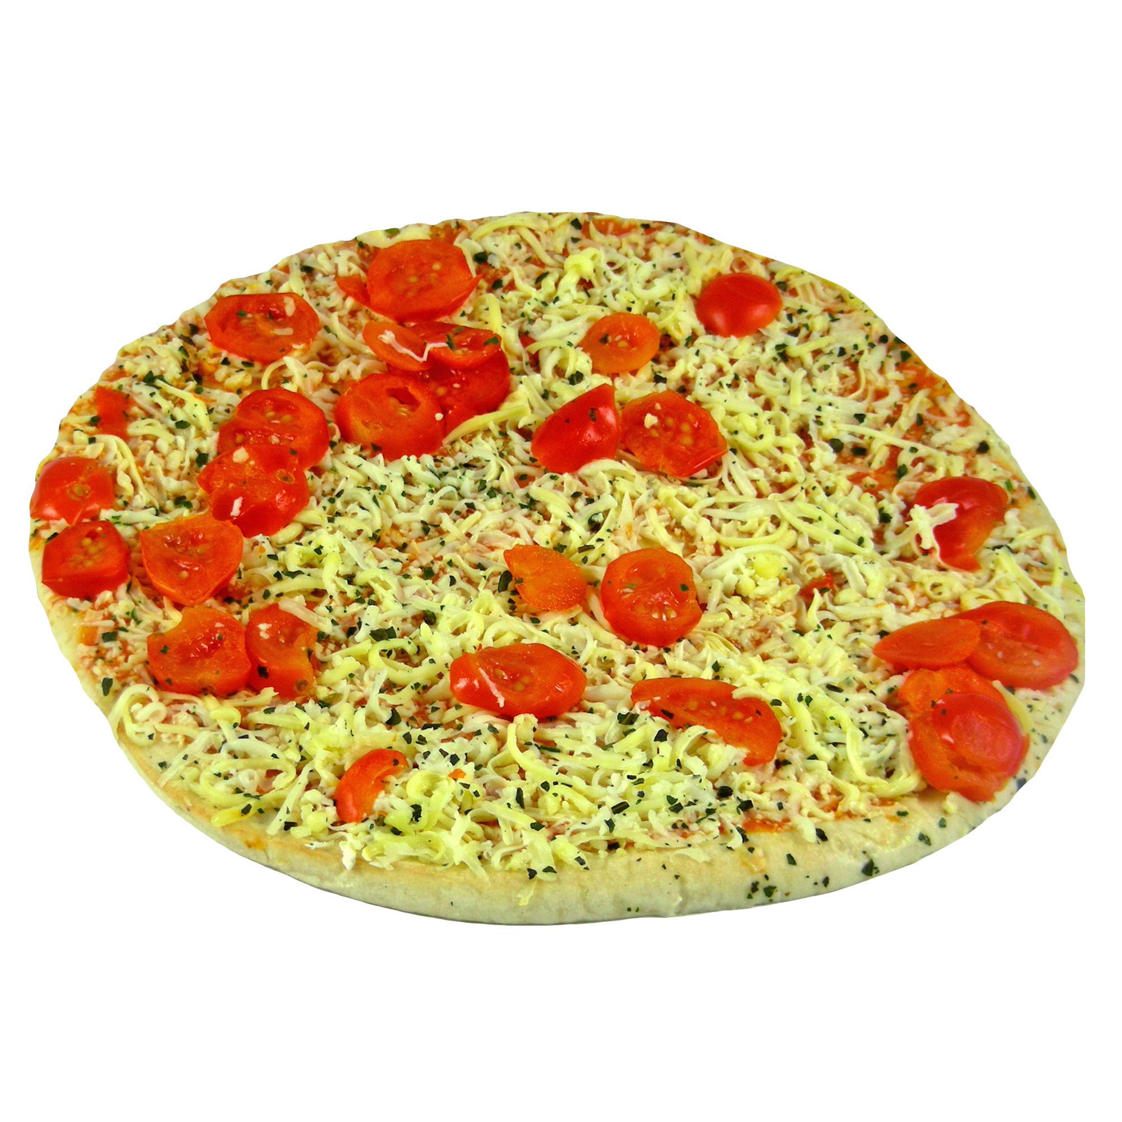
METHODS
+
furniture food utensil toys
1 2 3 4
Furniture food utensil toys

Slide 11
METHODS
Time confound: learning occurs always at the beginning of a session
Encoding
Association
A
Known
Association
B
Learned

Slide 12
METHODS
METHODS
+
0.25s
Feedback only during practice
1 2 3 4
0.50s
Furniture food utensil toys
2
Bank of Standardized Stimuli (BOSS)
Correct
Brodeur, Guerard, Bouras, M. (2014)
1s
1s
Up to 4
0.5s

Slide 13

METHODS
Task structure and instructions.
Recognition
Practice task
Encoding block
Confidence
Old New
1 2 3 4
very very
unsure sure
1 2 3 4
Correct
1 2 3 4
“Every monster has a preference
for one particular object category.
Try to predict what a monster ‘will buy’ every time”. Practice stops after 90% optimal choice in the last 10 trials.
“Just continue what you have been doing so far. There will be new monsters and categories now. For one of the new monsters, the preferred category is x. For the other one, you will have to learn”.

Slide 14
METHODS
Number of trials
Retention interval
Encoding
Retrieval
Distractor task:
Working memory 2-back task or?
Including it as a covariate in analysis

Slide 15
METHODS
Number of trials - counterbalancing
Contingencies: 70 10 10 10
furniture food utensil toys
List 1
42 | 6 | 6 | 6
6 | 6 | 6 | 42
Known
Learned
6 | 6 | 6 | 42
42 | 6 | 6 | 6
Known
List 2
Learned
6 | 42 | 6 | 6
6 | 6 | 42 | 6
Known
List 3
Learned
6 | 6 | 42 | 6
6 | 42 | 6 | 6
Known
List 4
Learned

Slide 16
METHODS
Number of trials
Contingencies: 70 10 10 10
Encoding
Retrieval
furniture food utensil toys
furniture food utensil toys tot
42 | 6 | 6 | 6
6 | 6 | 6 | 42
Old
48 | 12 | 12 | 48
24 | 6 | 6 | 24
120
New
60

Slide 17
RESULTS: Hypotheses
Increased uncertainty, heightened attention, predictive value
HIT Rate
Known
Learned

Slide 18
RESULTS: Hypotheses
Effect of condition and expectancy
HIT Rate
Expected
Unexpected
Known
Learned

Slide 19
Softwares used:
- Stimuli presentation and response recording: Psychopy
- Online testing platform: Pavlovia
- Recruiting platform: SONA System
- Data analysis software: R

Slide 20
Thank you!
Questions?

Slide 21
References
- Bartlett, F.C. (1932) Remembering: A Study in Experimental and Social Psychology, Cambridge University Press.
- Craik F., Tulving E. (1975) Depth of processing and retention of words in episodic memory. Journal of Experimental Psychology-General 104: 268–294.
- Henson, R. N., & Gagnepain, P. (2010). Predictive, interactive multiple memory systems. Hippocampus, 20(11), 1315-1326.
- Rouhani, N., Norman, K. A., & Niv, Y. (2018). Dissociable effects of surprising rewards on learning and memory. Journal of Experimental Psychology: Learning, Memory, and Cognition, 44(9), 1430.
- Sakamoto, Y., & Love, B. C. (2004). Schematic influences on category learning and recognition memory. Journal of Experimental Psychology: General, 133(4), 534.
- Sherman, B. E., Graves, K. N., & Turk-Browne, N. B. (2020). The prevalence and importance of statistical learning in human cognition and behavior. Current opinion in behavioral sciences, 32, 15-20.
- Tse, D. et al. (2007). Schemas and memory consolidation. Science 316, 76–82
- van Kesteren, M.T. et al. (2010). Retrieval of associative information congruent with prior knowledge is related to increased medial prefrontal activity and connectivity. J. Neurosci. 30, 15888–15894

