Slide 1


Prediction, Learning, and Memory:
Ideas for the Expra task
November, 1, 2021
Lifespan Cognitive and Brain Development (LISCO) Lab
Goethe University Frankfurt
Francesco Pupillo

Slide 2
THEORETICAL BACKGROUND
The human mind constantly tries to form expectations about regularities in the environment (Friston et al., 2015).
Expectations can be matched or mismatched by current experience. When they are mismatched, there is enhanced learning that leads to updating of the expectations (Kamin, 1968; Rouhani & Niv, 2020).
Mismatched expectation could also lead to enhanced episodic encoding, and thus better memory for events that are not fully predicted (Henson & Gagnepain, 2010).

Slide 3
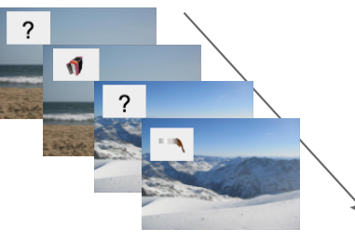
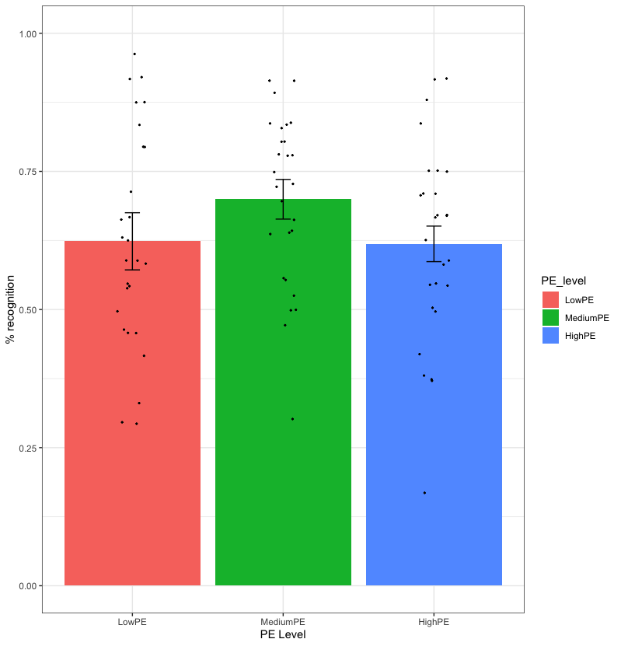
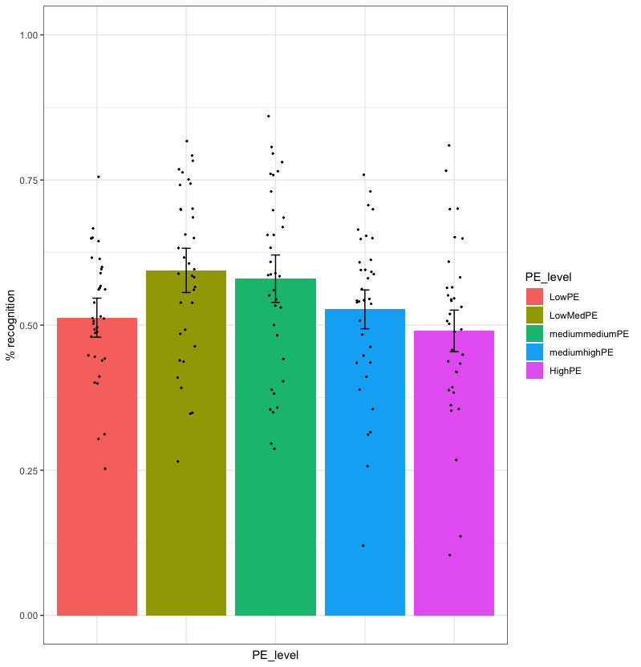
THEORETICAL BACKGROUND
Priors
Learning Phase
Encoding Phase
Strong .90, .10
Weak .70 .30
Flat .50 .50
Matched vs violated
Weak/Flat > Strong
Proposed explanations:
SL-EM trade-off: in weak/flat conditions, attention is driven away from the SL task (predictive mode) and directed towards the object when there is nothing to learn.
Increased uncertainty: increased attention and information seeking in more uncertain context.

Slide 4
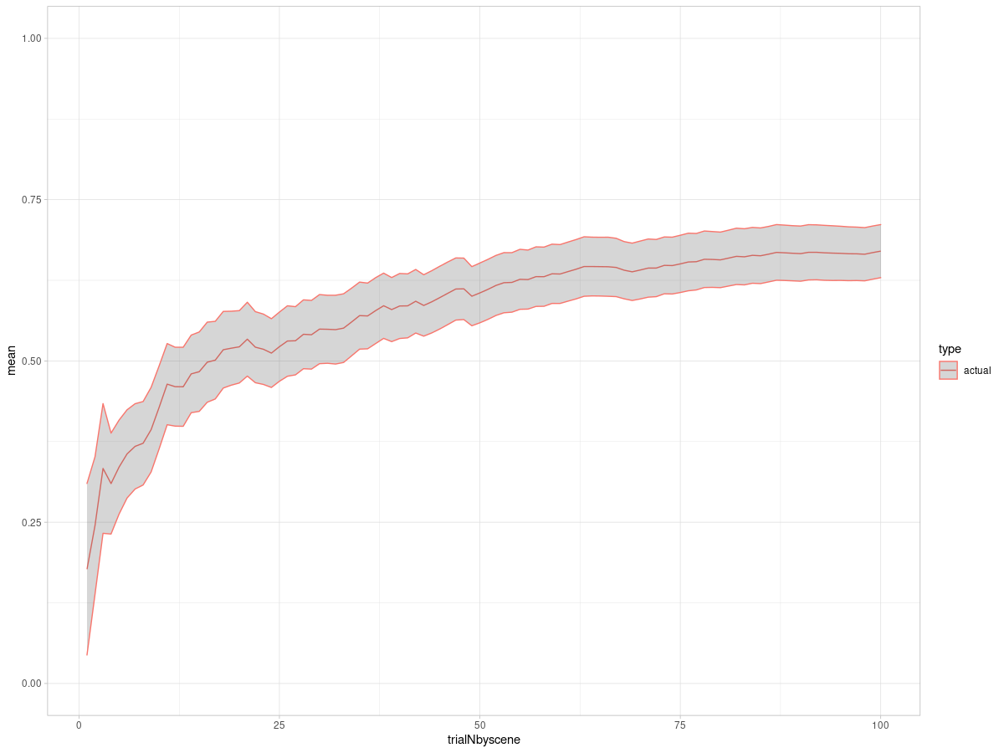
THEORETICAL BACKGROUND
In all these conditions, the associations have been already learned prior to the encoding task.
Learning
Phase
Cum acc
Cum acc
Encoding Phase
Trial N
What it is not clear is what are the consequences of learning new associations – having no priors.
Learning contingencies vs
Established contingencies
Strong .90, .10
Weak .70 .30
Flat .50 .50
None - -

Slide 5
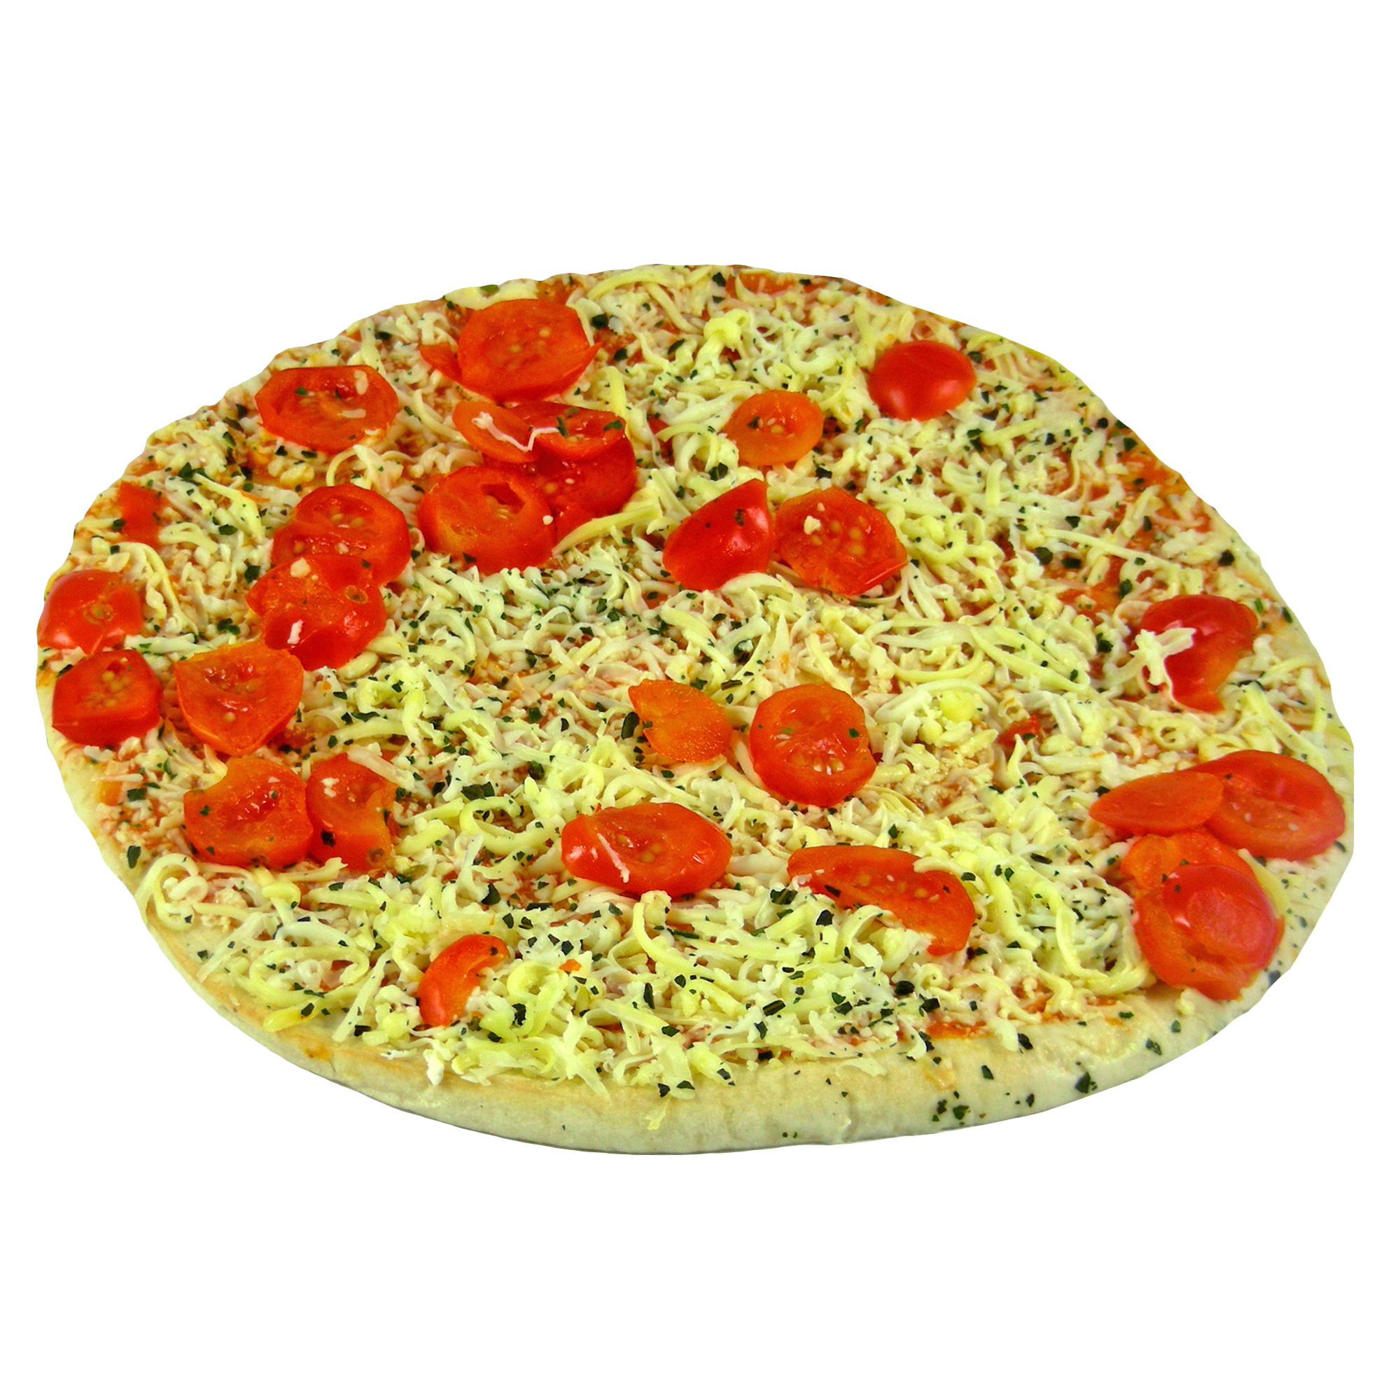
METHODS
furniture food utensil toys
1 2 3 4
Furniture food utensil toys

Slide 6
METHODS
Time confound: learning occurs always at the beginning of a session
Learning
Contingencies
A
Contingencies
B

Slide 7
METHODS
Proposal 1
Learning
Encoding
Contingencies
A
Contingencies
B
Learned
Novel
Learned
Contingencies
C

Slide 8
METHODS
Proposal 1
Learning
Encoding
Contingencies
A: 85-15
Contingencies
B: 60-40
Learned:
high uncertainty
Learned:
low uncertainty
Contingencies
C: 85:15
Novel

Slide 9
METHODS
Learning
furniture food utensil toys
Encoding
furniture food utensil toys

Slide 10
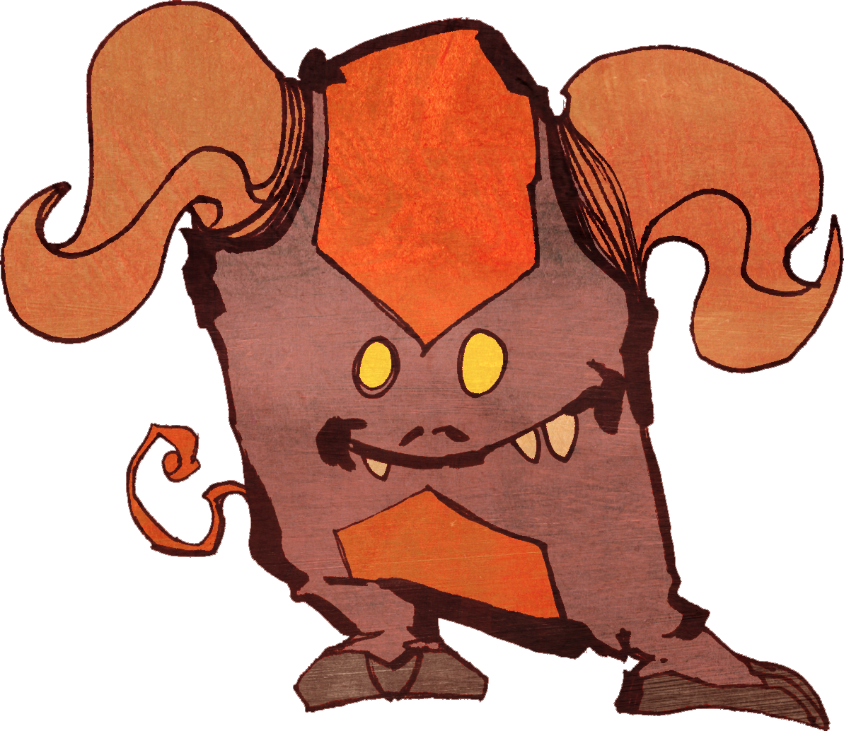
METHODS
Pre-Learning
new
new
furniture food sport electronics
Learning
new
old
toys food utensils sport
Encoding
new
furniture utensils vehicles toys
old

Slide 11
METHODS
Proposal 2
Pre-
Learning
Learning
Encoding
Contingencies
A
Contingencies
B
Learned
Novel
Contingencies
C
Contingencies
D

Slide 12
METHODS
Proposal 2
Pre-
Learning
Learning
Encoding
Contingencies
A: 60/40
Contingencies
B: 85/15
Contingencies
C: 85/15
Learned:
Low uncertainty
Learned:
High uncertainty
Contingencies
D: 60/40
Contingencies
E: 85/15
Novel

Slide 13
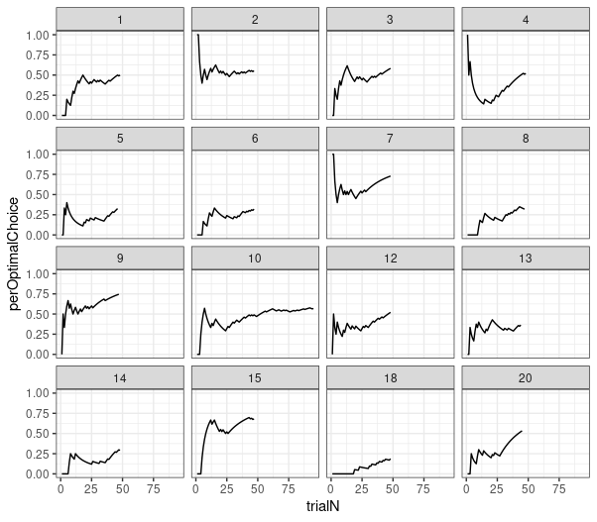
METHODS
Number of trials – 60 per Murks per block (learning, encoding)

Slide 14
METHODS
METHODS
+
0.25s
Feedback only during practice
1 2 3 4
0.25s
Furniture food utensil toys
2
Bank of Standardized Stimuli (BOSS)
Correct
Brodeur, Guerard, Bouras, M. (2014)
1s
1s
Up to 4
1s

Slide 15
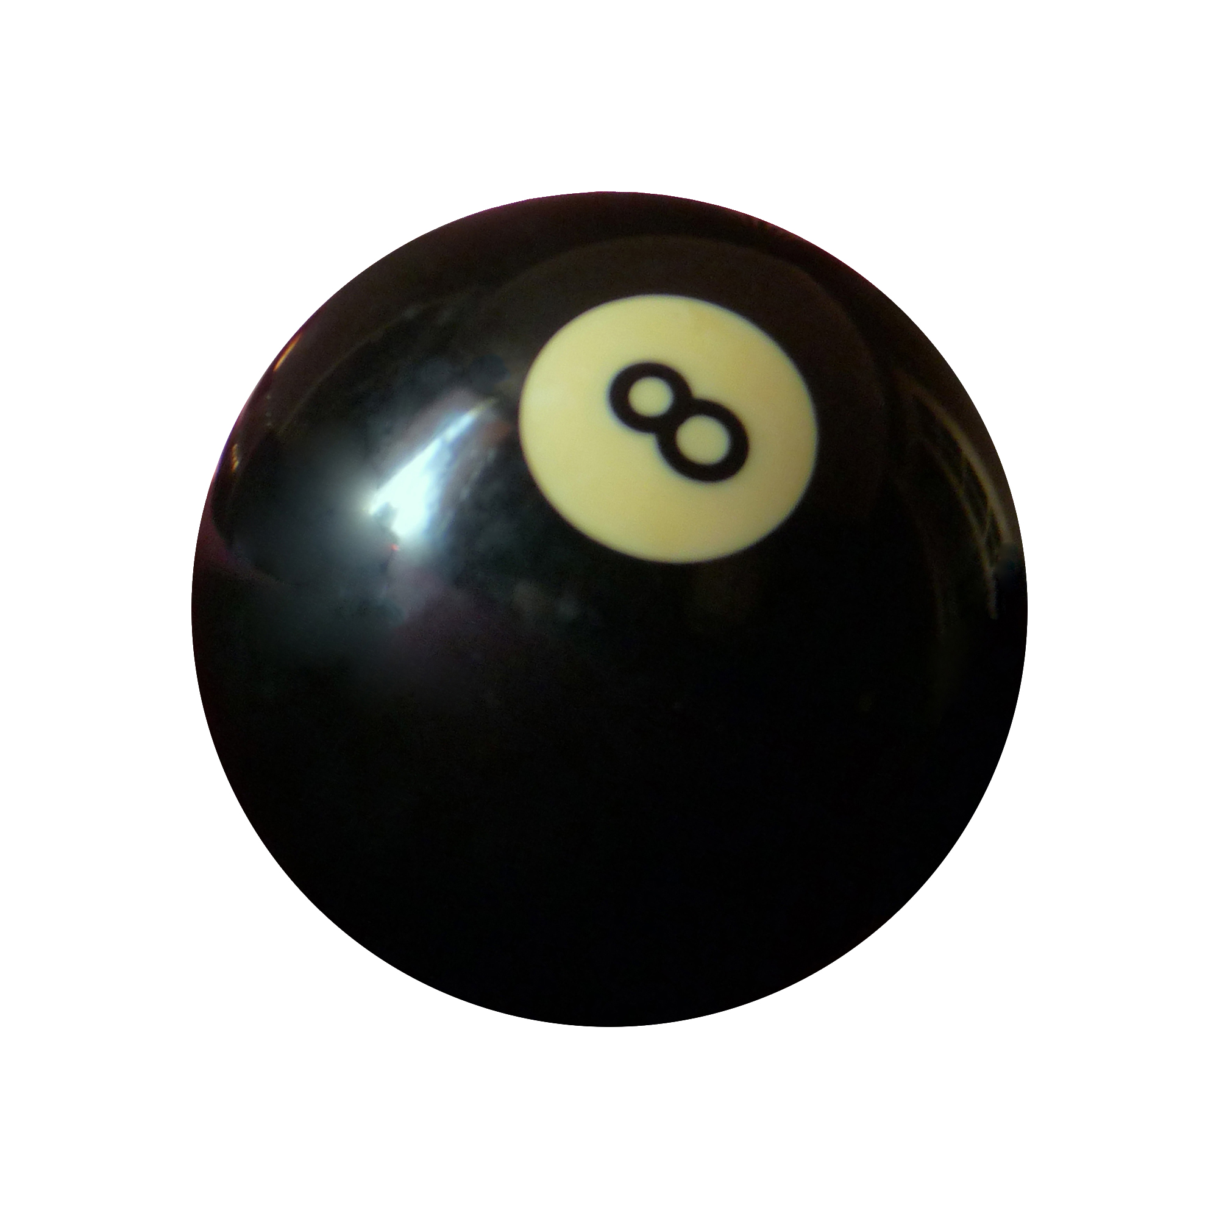
METHODS
Task structure and instructions.
Practice task
Learning block
Encoding block
1 2 3 4
Correct
1 2 3 4
1 2 3 4
“Every monster has a preference
for one particular object category.
Try to predict what a monster ‘will buy’ every time”. Practice stops after 90% optimal choice in the last 10 trials.
“Just continue what you have been doing so far. This time there will be two new monsters and new categories. In addition, feedback will not be shown.”
“Just continue what you have been doing so far. There will be the same monsters and categories as before. In addition, there will be one new monster.”

Slide 16
METHODS
Task structure and instructions.
Recognition
Confidence
Old ? New
1 2 3 4
very very
unsure sure

Slide 17
METHODS
Number of trials
Learning
furniture food utensil toys
furniture food utensil toys
51 | 3 | 3 | 3
8 | 8 | 8 | 36
Retrieval
furniture food utensil toys
Old
51 | 51 | - | 36
26 | 26 | - | 18
Encoding
New
furniture food utensil toys
51 | 3 | 3 | 3
8 | 8 | 8 | 36
3 | 51 | 3 | 3

Slide 18
RESULTS: Hypotheses
Increased uncertainty, heightened attention, predictive value
Learned
Novel

Slide 19
RESULTS: Hypotheses
SL/EM trade-off
Uncertainty effect
Predictive value effect
Learned:LU
Learned:HU
Novel

Slide 20
Thank you for your attention!
Comments? Suggestions?

