Slide 1
In this experiment you will see different characters, like these ones
Press SPACE to continue

Slide 2
+
Every trial will start with a cross followed by
one character.
This character that you see at the beginning of the
trial is the one you must focus on for that trial.
In this example, the red character is presented
Press SPACE to continue

Slide 3
The characters will buy a different object
on every trial. However, each of them will buy
preferably objects of the same category.
Your task will be to predict which kind of object
a character will buy among the four categories
displayed to you
+
1 2 3 4
Furniture food utensil toys
Press SPACE to continue

Slide 4
In order to make your choice, please select the
numbers that appear on the top of each category.
Please use the numbers on the top left of your
keyboard.
Bear in mind that on every trial the position of the
categories will change
+
1 2 3 4
You have up to 4 seconds to make your choice
Furniture food utensil toys
Press SPACE to continue

Slide 5
+
After making your choice, the character will
appear below the category that
you have chose, highlighting your choice.
1 2 3 4
Furniture food utensil toys
Press SPACE to continue

Slide 6
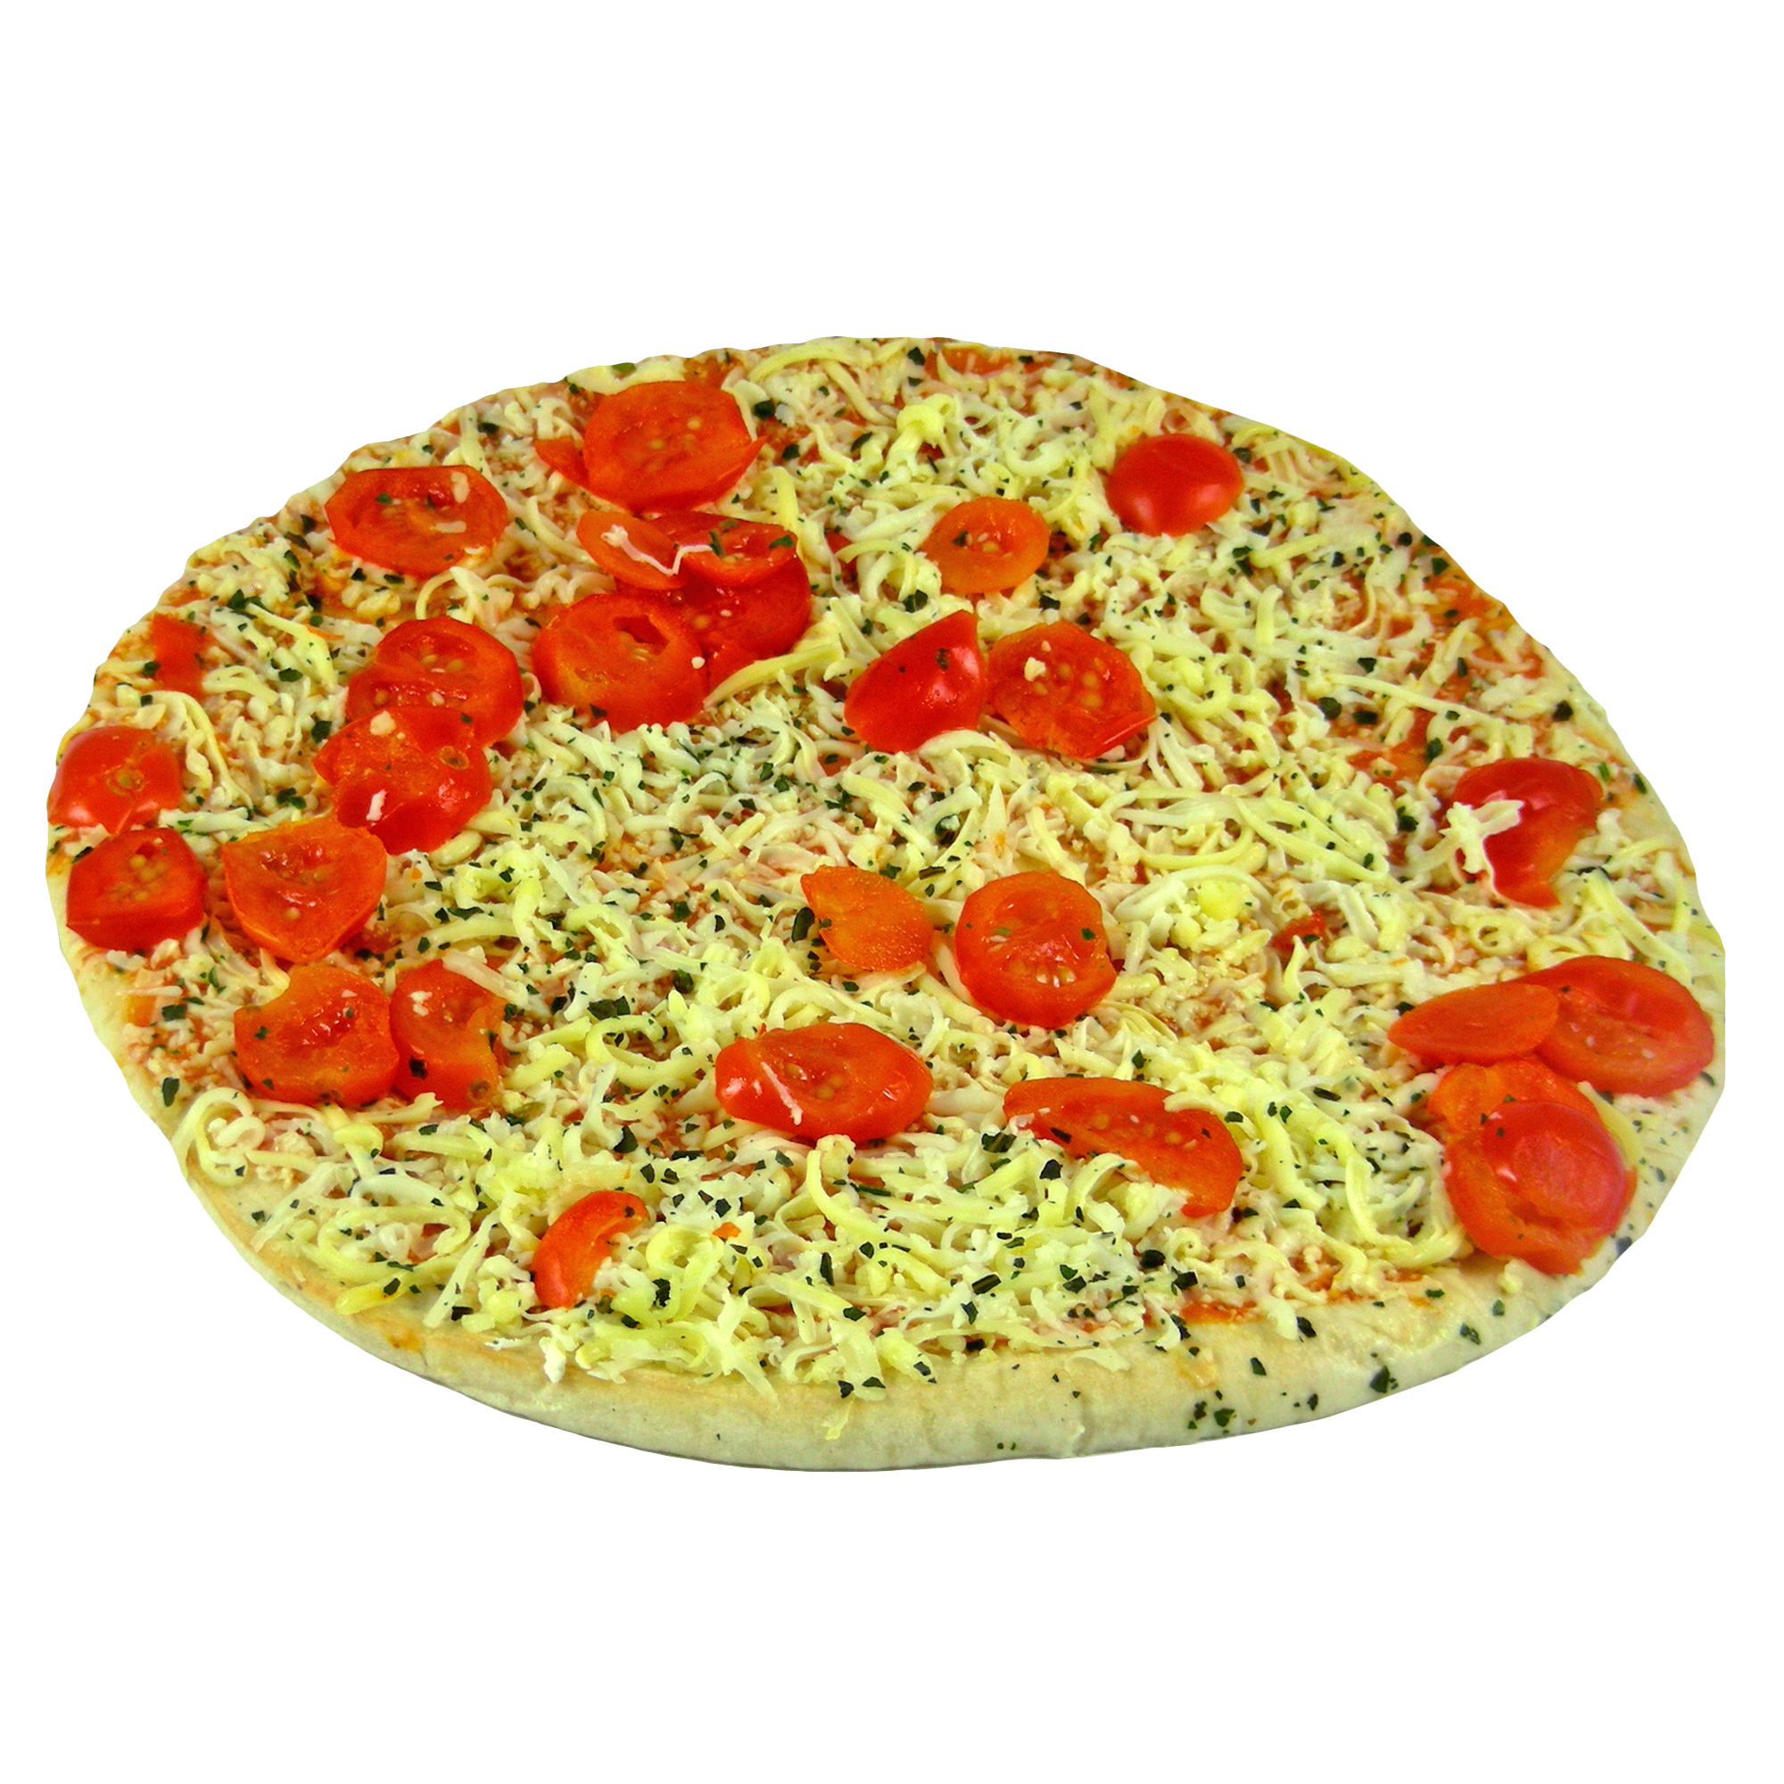
+
Finally, the object that the character buys
will appear on the screen
1 2 3 4
Furniture food utensil toys
Press SPACE to continue

