Slide 1
Bayesian Reinforcement Learning Model

Slide 2
Bayesian Reinforcement Learning Model (from Dorfman et al., 2019)
In this model, the participants have to choose an option
based on the butterfly-flower associations that were observed on the previous trials.
Each option can be correct (r = 1) according to a certain probability
However, a Change Point can intervene P(cp = 1), generating a different a different distribution of correct options.
With probability P(cp = 0), the probability of butterfly n selecting flower j is
With probability P(cp = 1), the butterfly of character n selecting flower j
If there was a change, that probability was no longer true,
and the probability that the butterfly will go to any of the remaining three probabilities is 1/3, since are all three equally possible.

Slide 3
Bayesian Reinforcement Learning Model (from Dorfman et al., 2019)
After choosing an action c_{t} and observing feedback r_{t} on trial t, the estimate of the probability for
Butterfly n and flower c is updated according to a reinforcement learning equation
That incorporates belief about change point occurring or not.
The bayesian update rule is
Where is a parameter representing the learning rate that scales the PE.
The learning rate is based on the beliefs about two sources: the intrinsic contingencies (probability of butterfly n being associated to flower j ) and the probability of a change point occurring. These possibilities determine the degree to which participants update the probability of each butterfly depending on the flower shown.
N^{c}_{t} = sum of past beliefs about CP occurring when the same option was chosen (same flower)

Slide 4
Probability of a change point not occurring, given positive feedback
Belief that choice is correct
1/3
Probability of a change point not occurring, given negative feedback
Probability of that choice being incorrect

Slide 5
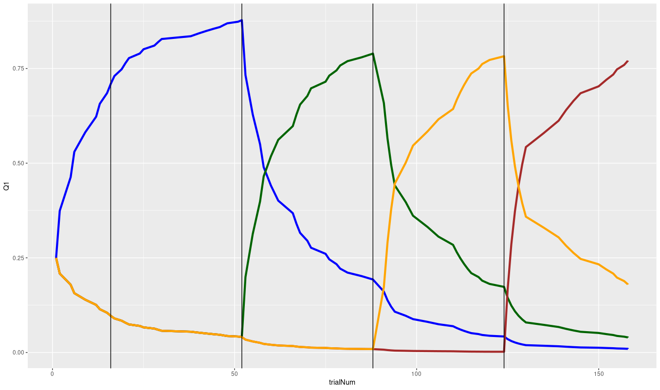
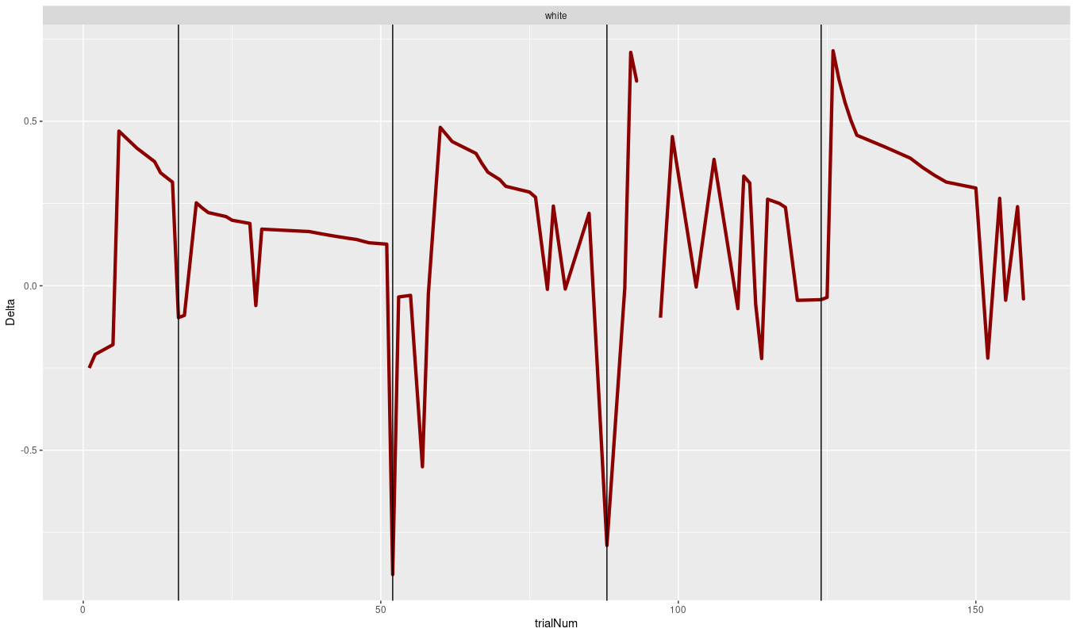
Choice probability
Prediction error

Slide 6
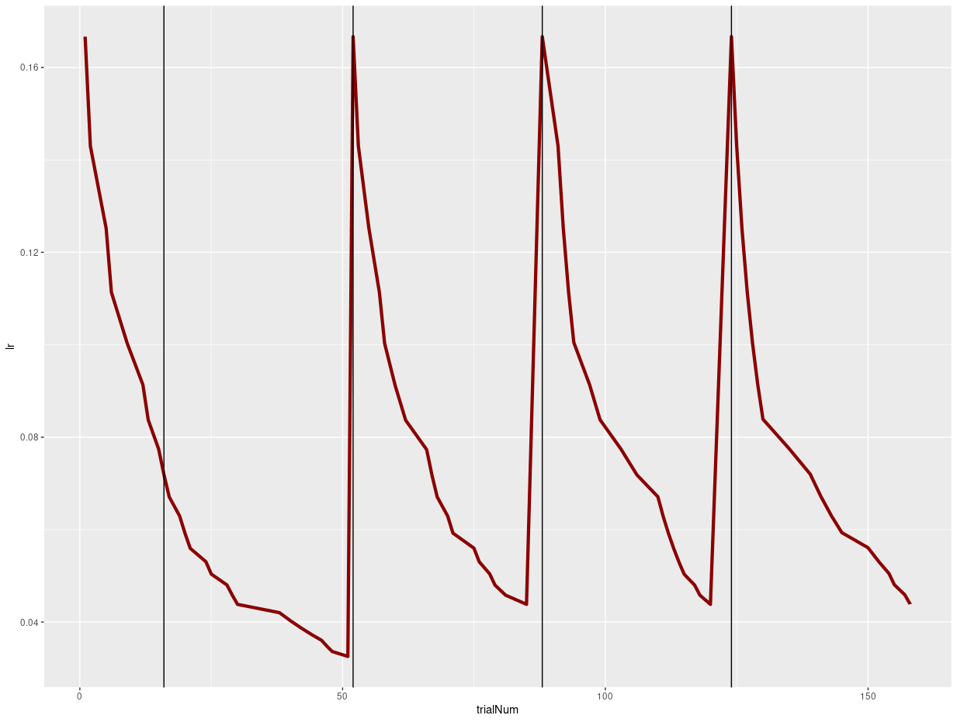

Slide 7
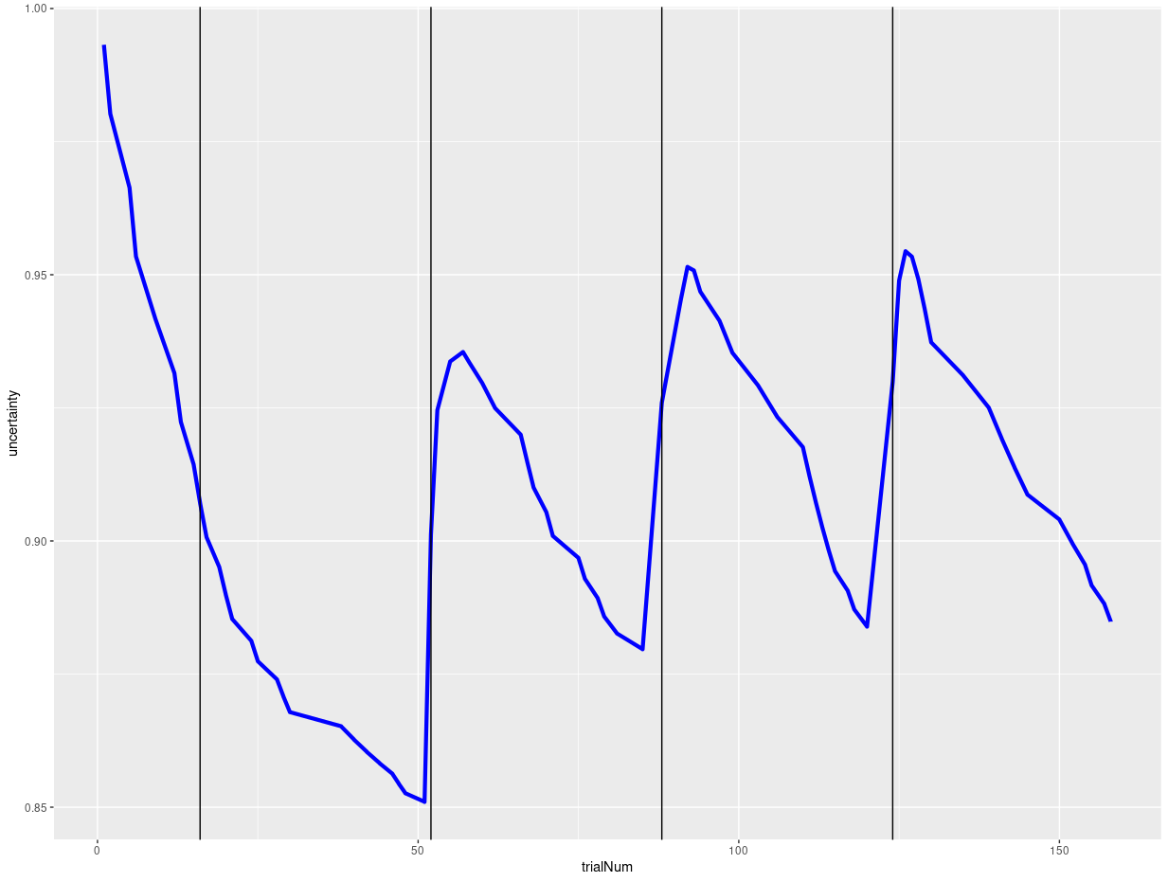
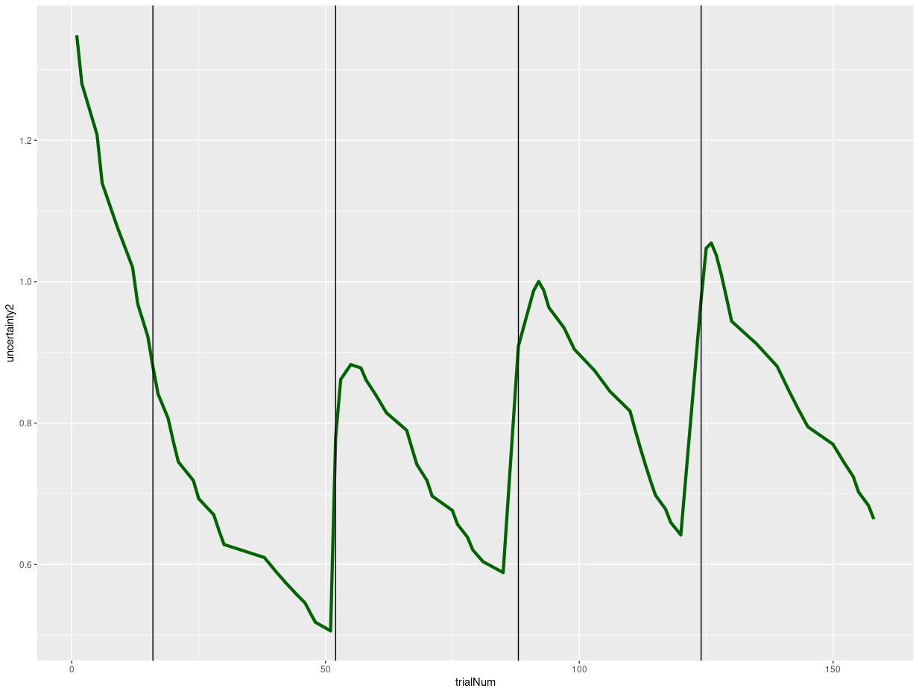

Slide 8
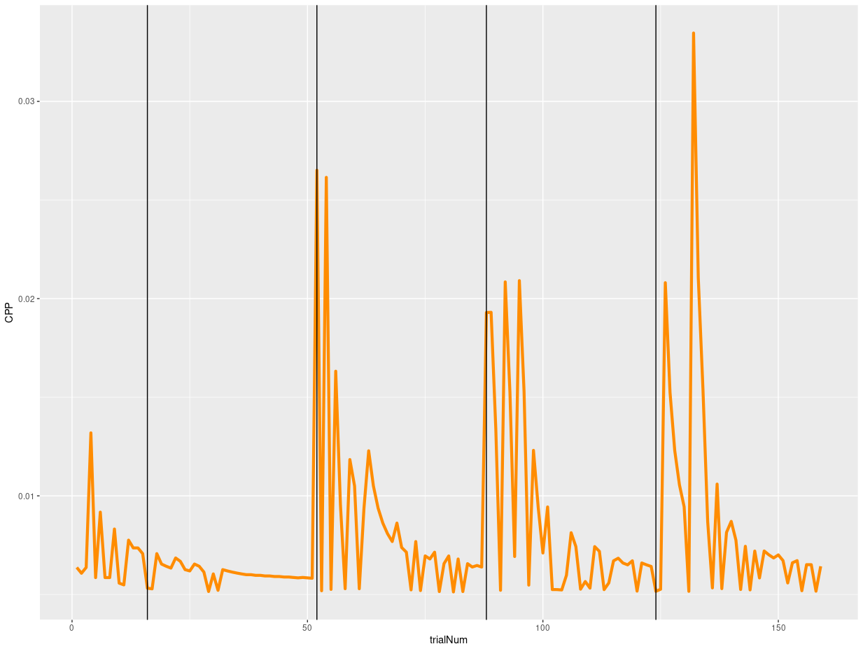
CPP

Slide 9
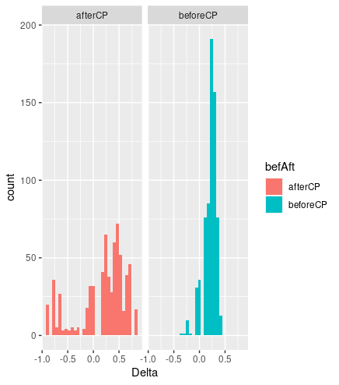
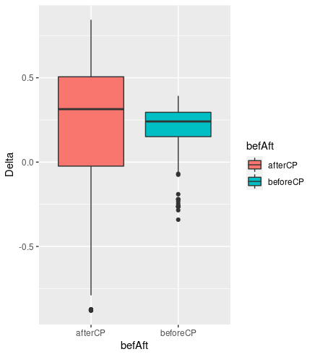

Slide 10
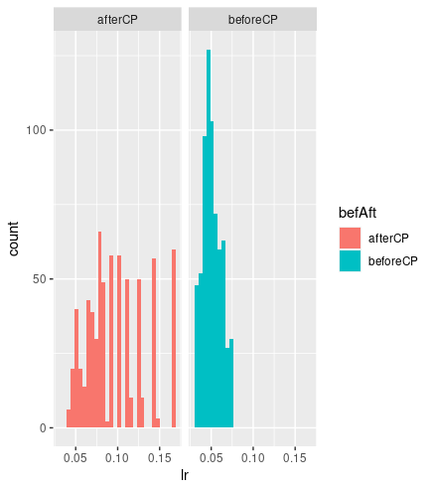
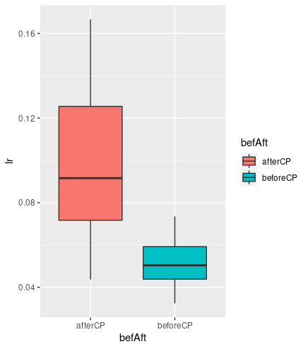

Slide 11
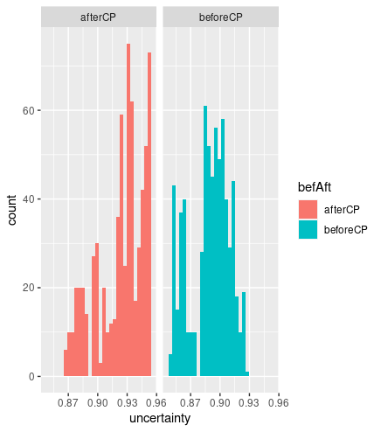
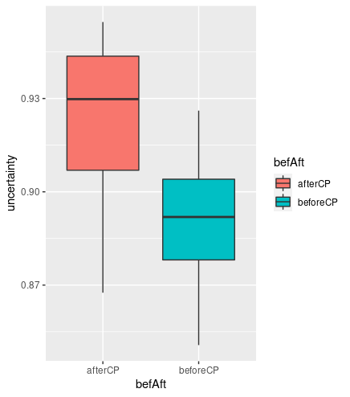

Slide 12
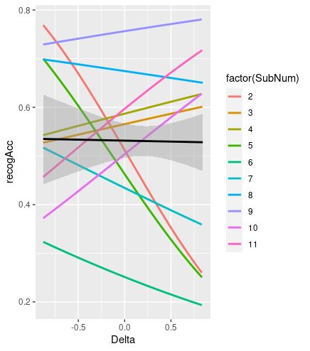

Slide 13
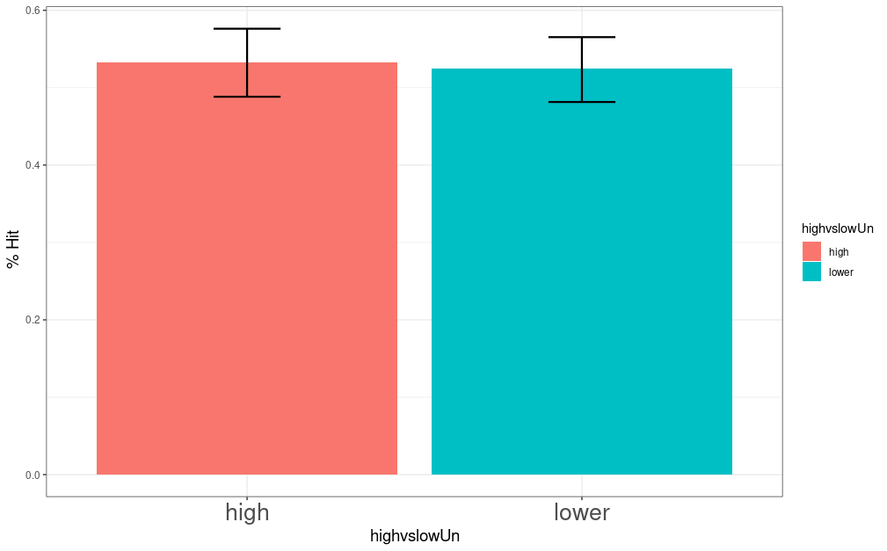

Slide 14
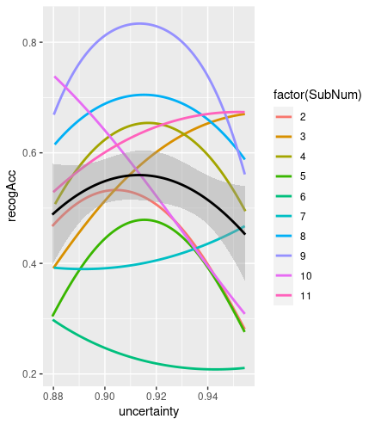

Slide 15
