Slide 1

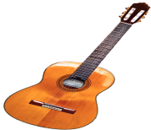

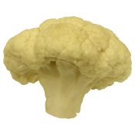

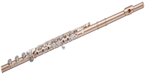
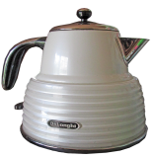
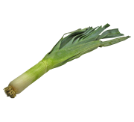

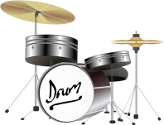
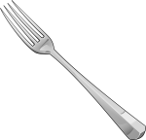
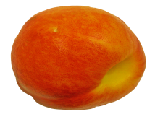

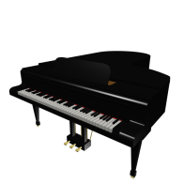
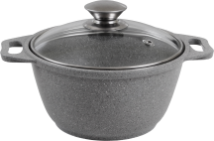


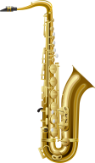

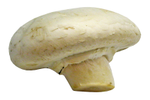

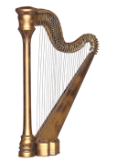

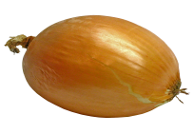
Instruments
Household objects
Fruits/Vegetables
.80
.10
.10
.10
.80
.10
Strong
prior
contexts
.10
.10
.80
.33
.33
.33
.33
.33
.33
Flat
prior
contexts
.33
.33
.33
Instruments
Household objects
.80
.10
.10
.80
.10
.10
.33
.33
.33
.33
.33
.33

Slide 2
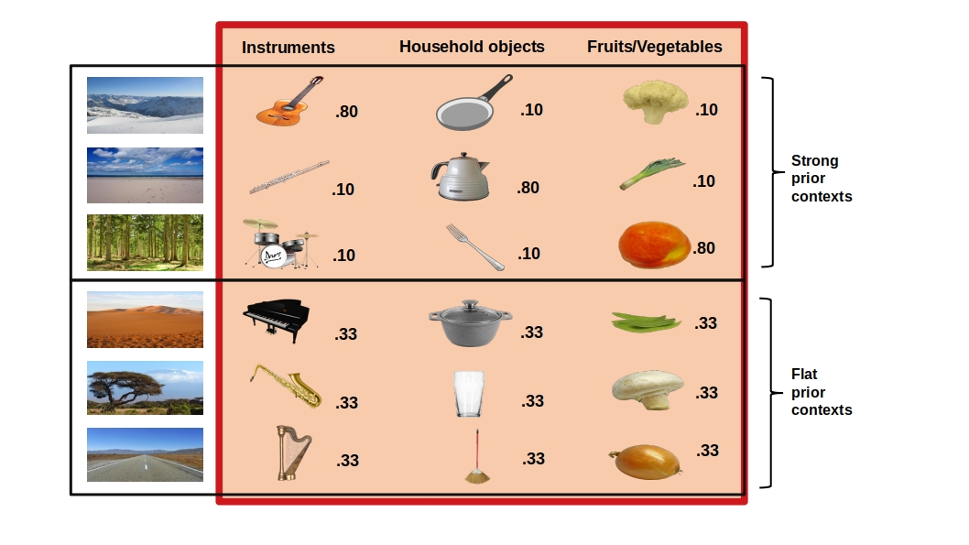


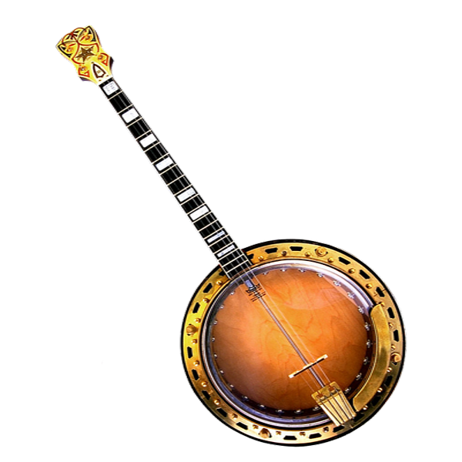


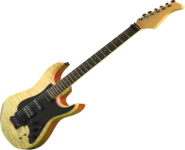
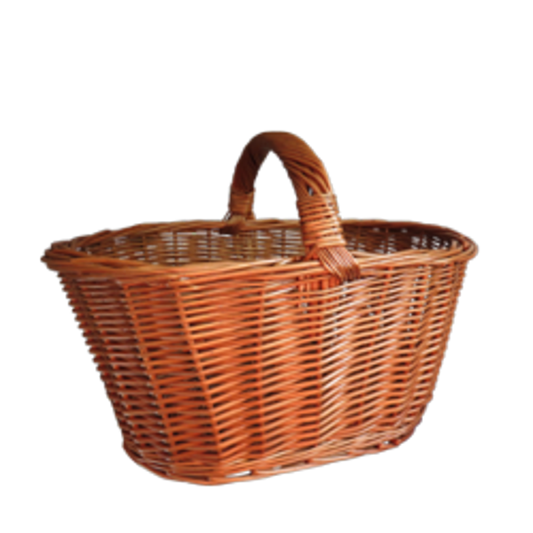

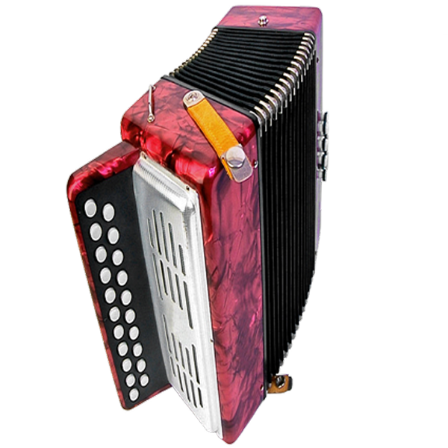

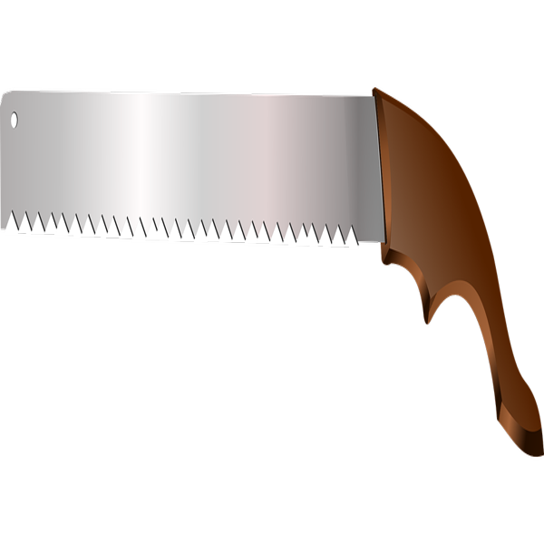
a)
b)
Object Categories
Object Categories
Scene Categories
Scene Categories
Instruments
Instruments
.90
.10
.10
.90
.70
.30
.30
.70
.50
.50
.50
.50
c)
Phase1. Contingency learning
Phase2. Encoding
Phase3. Memory test
?
?
Have you seen this object before?
?
?
?
?

Slide 3
a)
b)
Object Categories
Object Categories
Scene Categories
Instruments
Household objects
Fruits/Vegetables
Scene Categories
Instruments
Household objects
.80
.10
.10
.80
.10
.10
.80
.10
.10
.80
.10
.10
.80
.10
.10
.33
.33
.33
.33
.33
.33
.33
.33
.33
.33
.33
.33
.33
.33
.33
c)
Phase1. Contingency learning
Phase2. Encoding
Phase3. Memory test
?
?
Have you seen this object before?
?
?
?
?

Slide 4
Instruments
Household objects
.90
.10
.10
.90
.70
.30
.30
.70
.50
.50
.50
.50

Slide 5
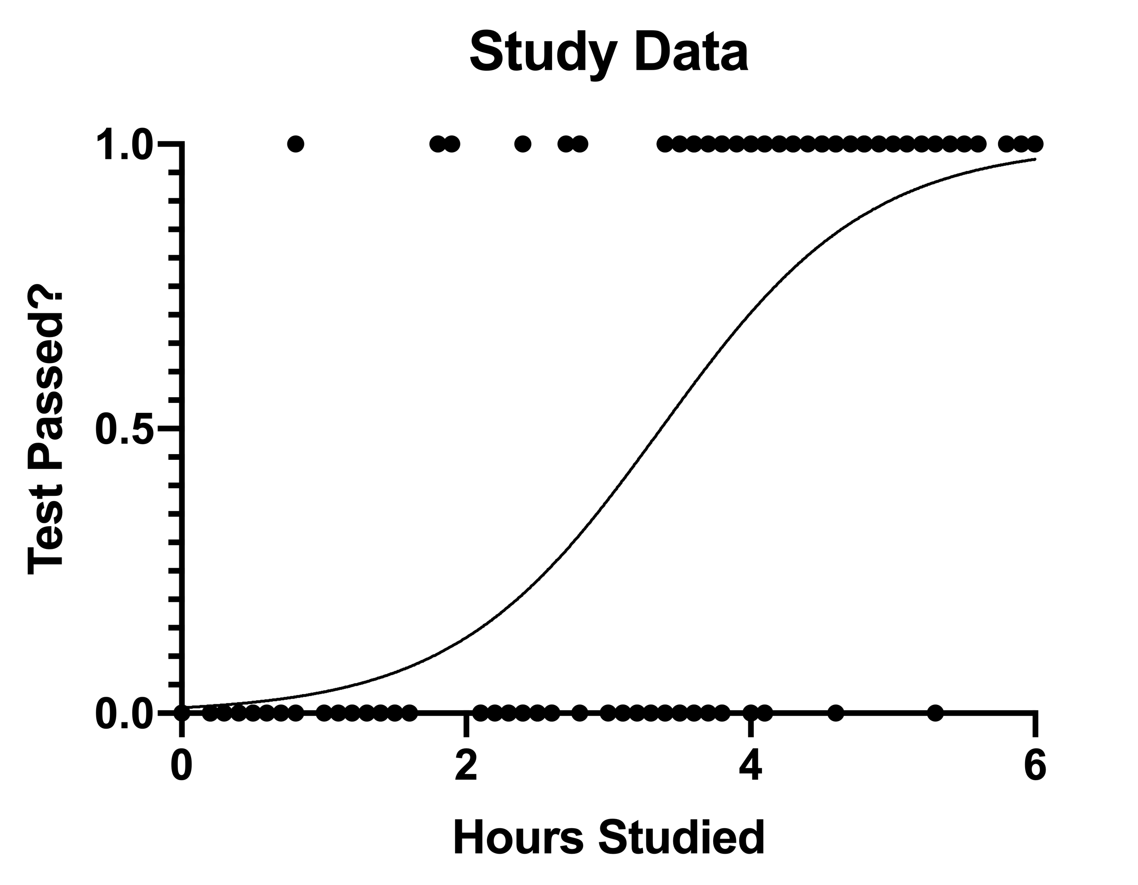
a)
Encoding Phase
Prediction
Choice
Prediction Outcome
?
Musical Instruments
Incorrect
Correct
c)
Prediction Outcome
Incorrect
Correct
b)
0 1
Memory Test
p(Hit)
0 1
0 1
PE
OLD/NEW
Prediction Outcome
Incorrect
Correct
OLD/NEW
p(Hit)
0 1
0 1
PE

Slide 6
Phase2. Encoding
Prediction
Object
Household Object
#
Household Object
?

