Slide 1





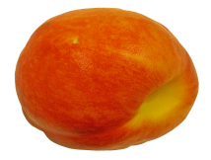



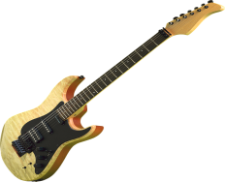

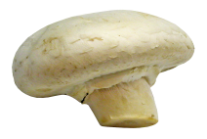
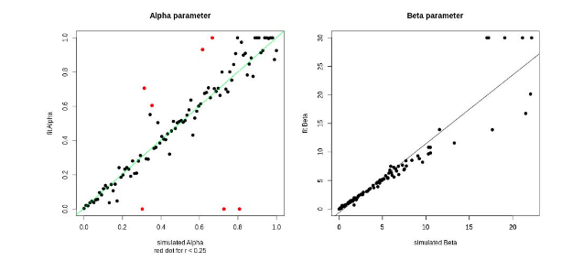
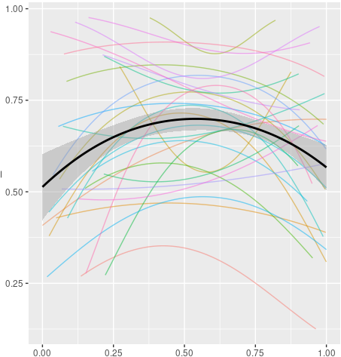
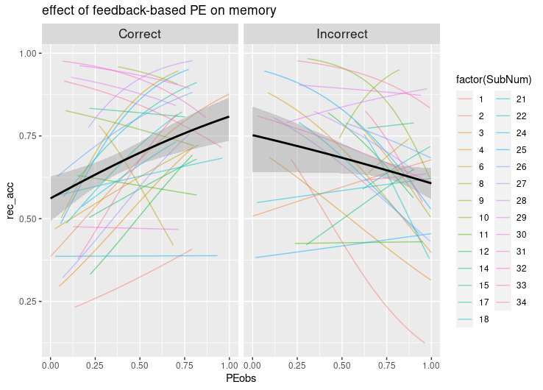
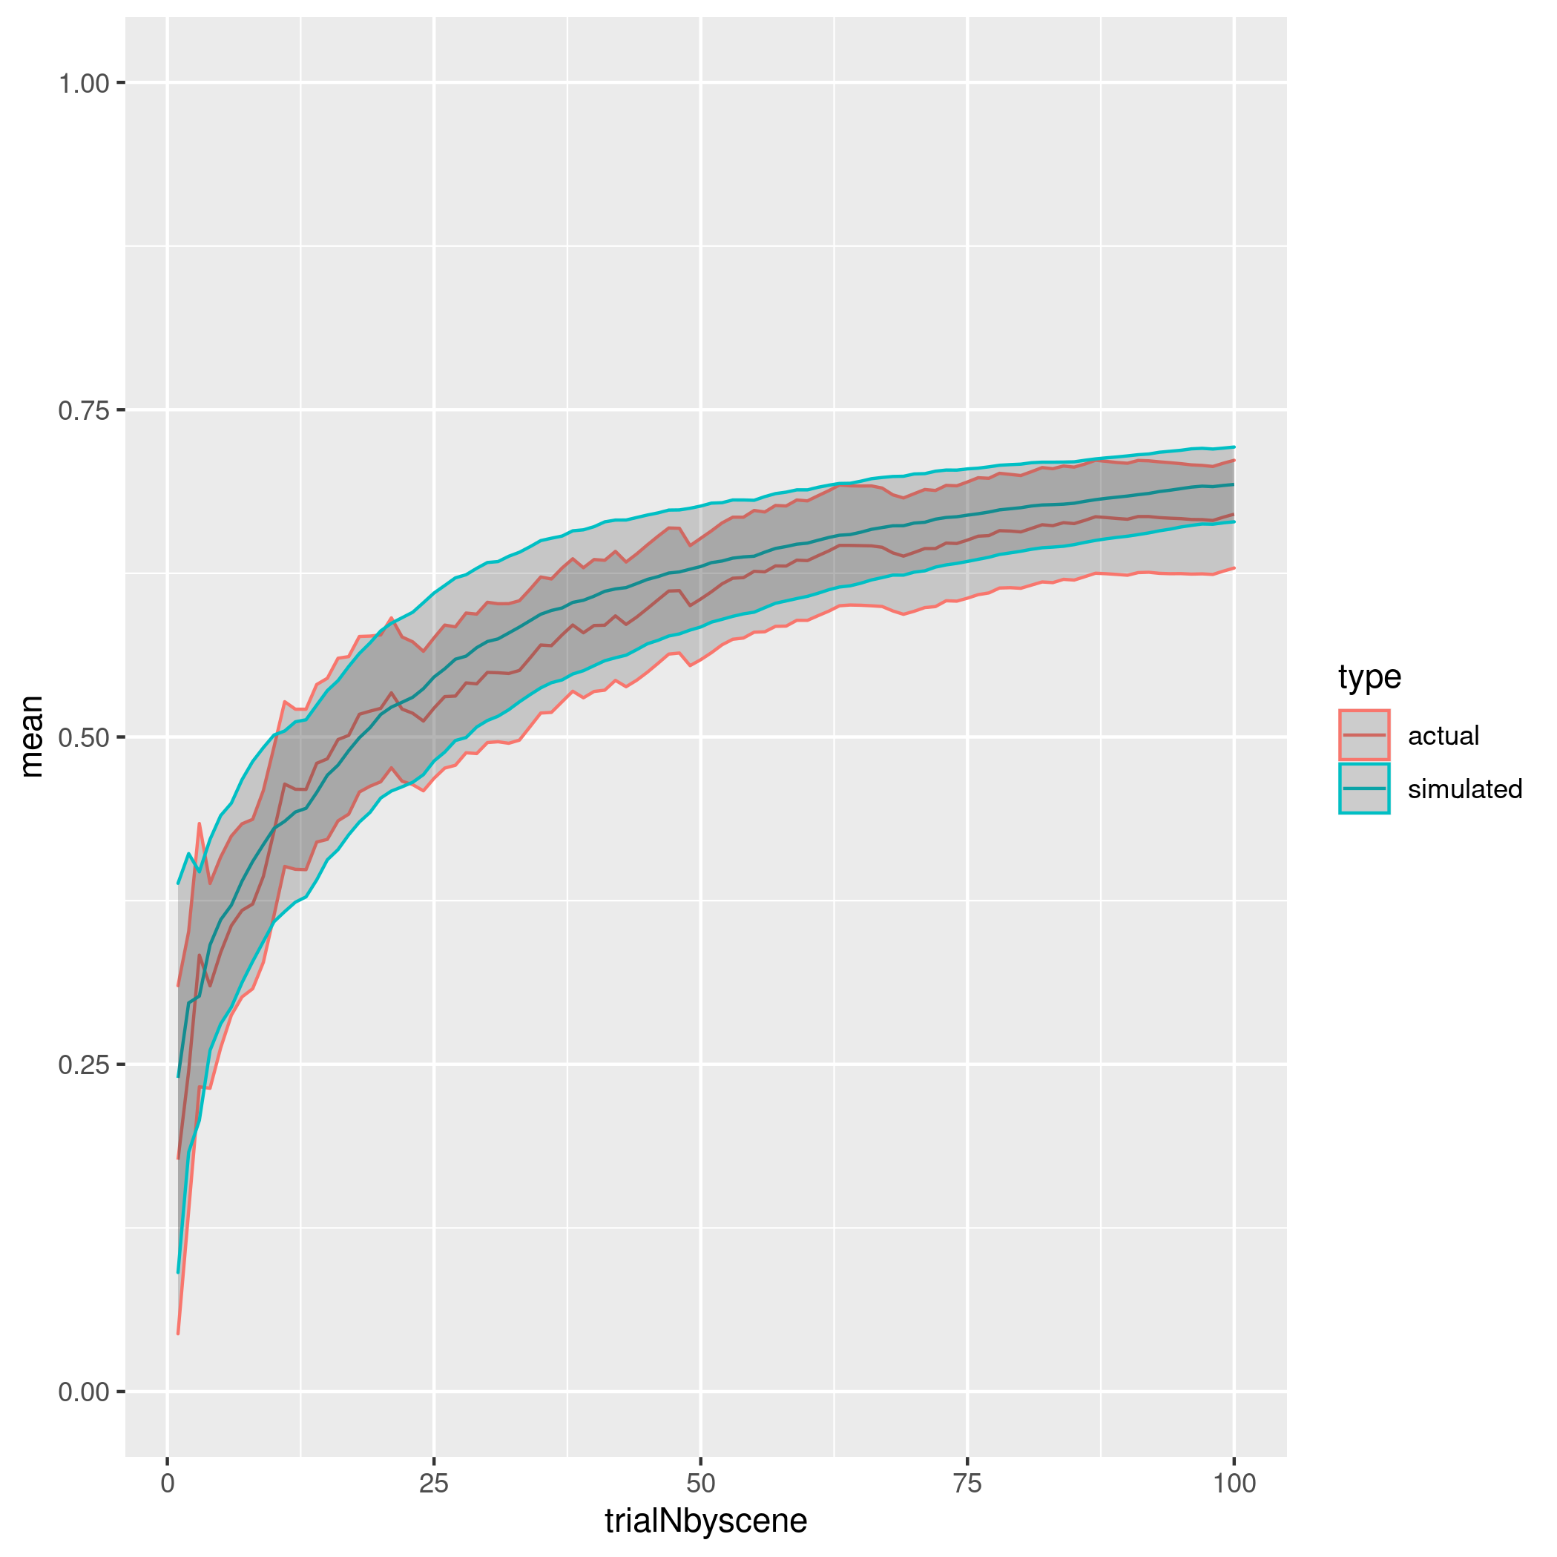
Prediction Error and Memory:
Insights from computational models
Francesco Pupillo¹, Javier Ortiz-Tudela¹, Rasmus Bruckner², Yee Lee Shing¹
¹ Goethe University Frankfurt (Germany); ² Free University of Berlin (Germany); *Contact: pupillo@psych.uni-frankfurt.de
1) INTRODUCTION
2) METHODS
COMPUTATIONAL MODEL
PARADIGM
Prediction Task
$Q_{t+1}^{\left(c,j\right)}=Q_{t}^{\left(c,j\right)}+α⋅{PE}_{t}$
?
${PE}_{t}=r_{t}−Q_{t}$
Strong
prior
contexts
?
r_{t} = 1 , 0
Prediction error occurs when expectations established during previous experiences are violated.
According to theoretical and computational accounts (McClelland et al., 1995; Van Kesteren et al., 2012), events that violate prior expectations should enhance encoding by promoting the formation of more distinct memory traces.
However, empirical evidence is mixed, with some studies finding better memory for prediction-matching (Bein et al., 2015; Brod & Shing, 2019) and other for prediction-violating events (Greve et al., 2017, Kafkas & Montaldi, 2018).
We established strong vs weak expectations by having participants learn associations between scenes and object categories. We then presented them with objects that could either match or violate their expectations, to elicit different degrees of PE.
We used computational models to derive trial-level PE and link it to subsequent memory.
A softmax function was then used to transform the values into probabilities:
Flat
prior
contexts
Surprise recognition test
$P_{j}\left(c=I|Q_{t}^{c}\right)=\frac{exp\left(β⋅Q_{t}^{c}\right)}{\sum_{i=1}^{N_{c}}{exp}\left(β⋅Q_{t}^{c}\right)}$
Have you seen this object before?
Parameter estimation:
Alpha and beta values were estimated at the participant level through ML estimation
$LL=logp\left(d_{1:T}|θ_{m},m\right)$
3) ANALYSES
5) Conclusions
4) RESULTS
Important moderating role of prediction outcome and of considering PE in relation to the task participants are doing.
Results are in line with with studies finding worse memory for unexpected events (Bein et al., 2015; van Kesteren et al., 2013), and with studies finding on reward PE showing enhanced memory for better than expected outcomes (De Loof et al., 2017; Jang et al., 2019).
Strong prediction error in the context of positive feedback might indicate the utility of that item for future predictions.
Strong prediction error in the context of negative feedback in a task where contingencies are stable may signal participants that that choice is not informative.
Parameter Recovery
Across trials
Prediction
Unrelated associations
Data Validation
Memory Accuracy (Probability)
Memory Accuracy (Probability)
6) References
Brod, Garvin, Shing, Yee, L. (2019). A Boon and a Bane: Comparing the Effects of Prior Knowledge on Memory Across the Lifespan.
Greve, A., Cooper, E., Kaula, A., Anderson, M. C., & Henson, R. (2017). Does prediction error drive one-shot declarative learning? Journal of Memory and Language, 94, 149–165.
Kafkas, A., & Montaldi, D. (2018). How do memory systems detect and respond to novelty? In Neuroscience Letters (Vol. 680, pp. 60–68). Elsevier Ireland Ltd.
McClelland, J. L., McNaughton, B. L., & O’Reilly, R. C. (1995). Why there are complementary learning systems in the hippocampus and neocortex: Insights from the successes and failures of connectionist models of learning and memory. Psychological Review, 102(3), 419–457.
Van Kesteren, M. T. R., Ruiter, D. J., Fernández, G., & Henson, R. N. (2012). How schema and novelty augment memory formation. Trends in Neurosciences, 35(4), 211–219.
PE
PE
Quadratic effect: β = - 6.43, p = .006
Interaction: β = -1.94, p = .001
Notes:
1

