Slide 1
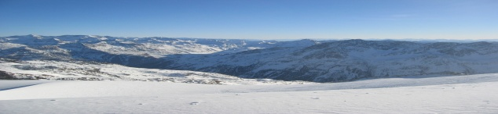
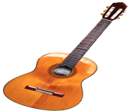

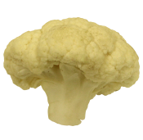

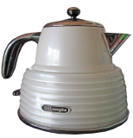
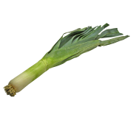

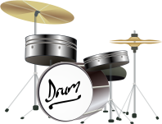
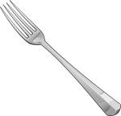
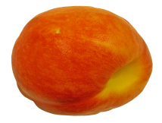

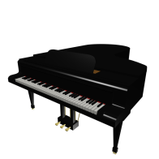
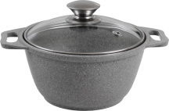
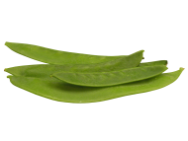

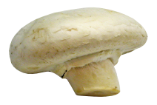
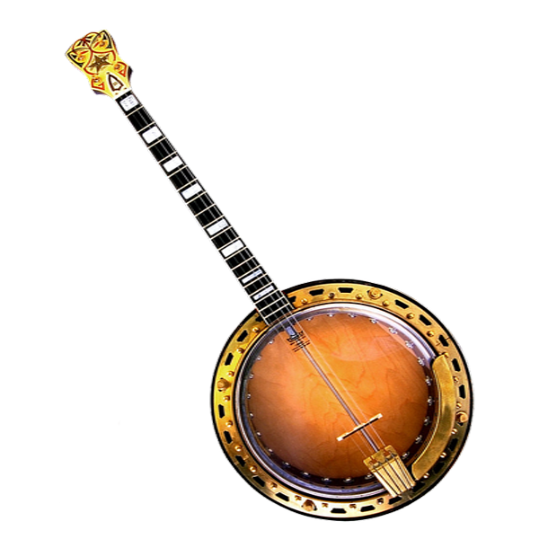

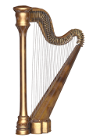

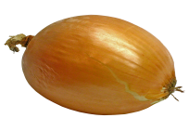
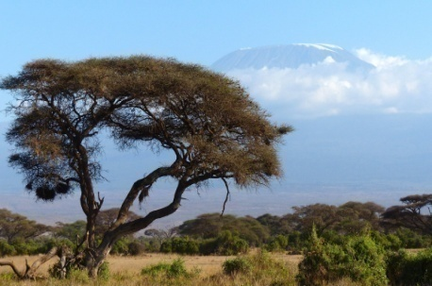

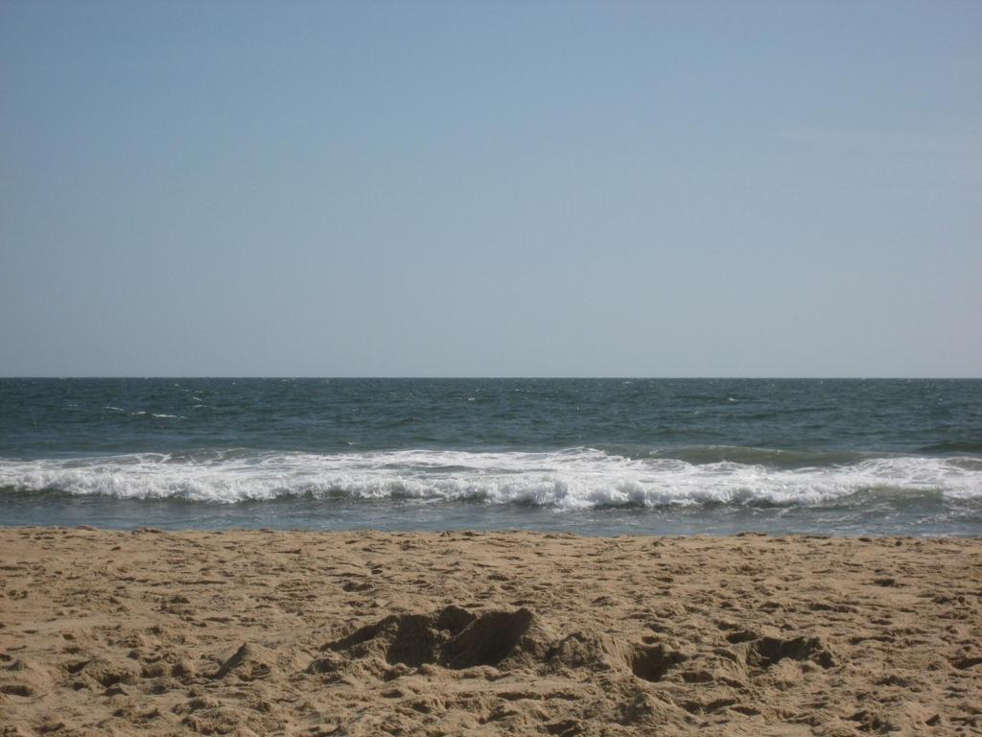
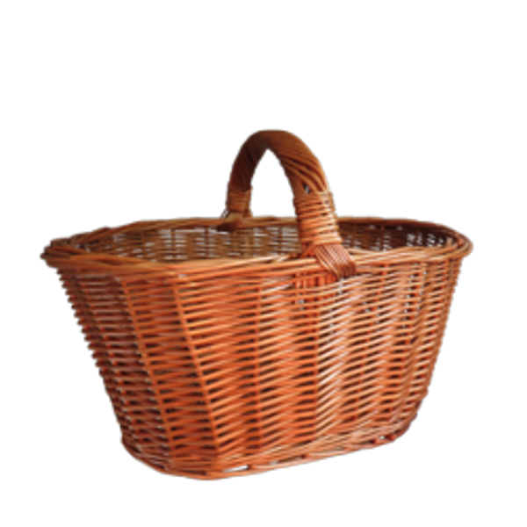


Object Categories
Object Categories
Household objects
Instruments
Fruits/Vegetables
Household objects
Contexts
Contexts
Instruments
.80
.10
.10
.90
.10
.10
.80
.10
.10
.90
.10
.10
.80
.70
.30
.33
.33
.33
.30
.70
.33
.33
.33
.50
.50
.33
.33
.33
.50
.50
?
?
?

Slide 2
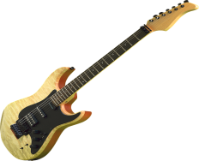
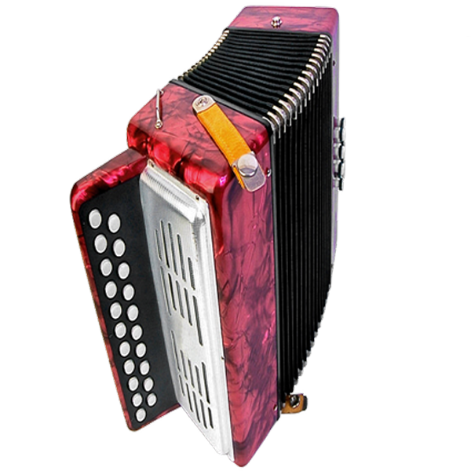
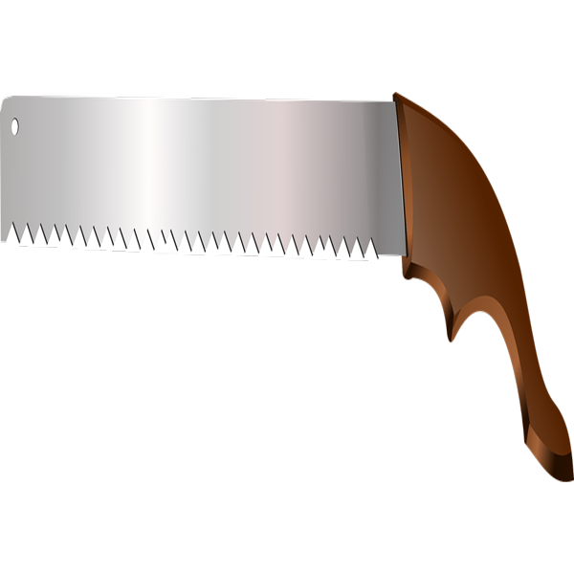
a)
Object Categories
b)
Object Categories
Household objects
Instruments
Fruits/Vegetables
Household objects
Contexts
Contexts
Instruments
.80
.10
.10
.90
.10
.10
.80
.10
.10
.90
.10
.10
.80
.70
.30
.33
.33
.33
.30
.70
.33
.33
.33
.50
.50
.33
.33
.33
.50
.50
c)
Phase1. Contingency learning
Phase2. Encoding
Phase3. Memory test
?
?
Have you seen this object before?
?
?
?
?

Slide 3
Object Categories
Object Categories
a)
Household objects
Fruits/
Vegetables
b)
Household objects
Contexts
Instruments
Contexts
Instruments
.80
.10
.10
.90
.10
.10
.80
.10
.10
.90
.10
.10
.80
.70
.30
.33
.33
.33
.30
.70
.33
.33
.33
.50
.50
.33
.33
.33
.50
.50
c)
Phase 1 - Contingency learning
Phase 2 - Encoding
Phase 3 - Memory test
?
?
Have you seen this object before?
?
?
?
?

Slide 4
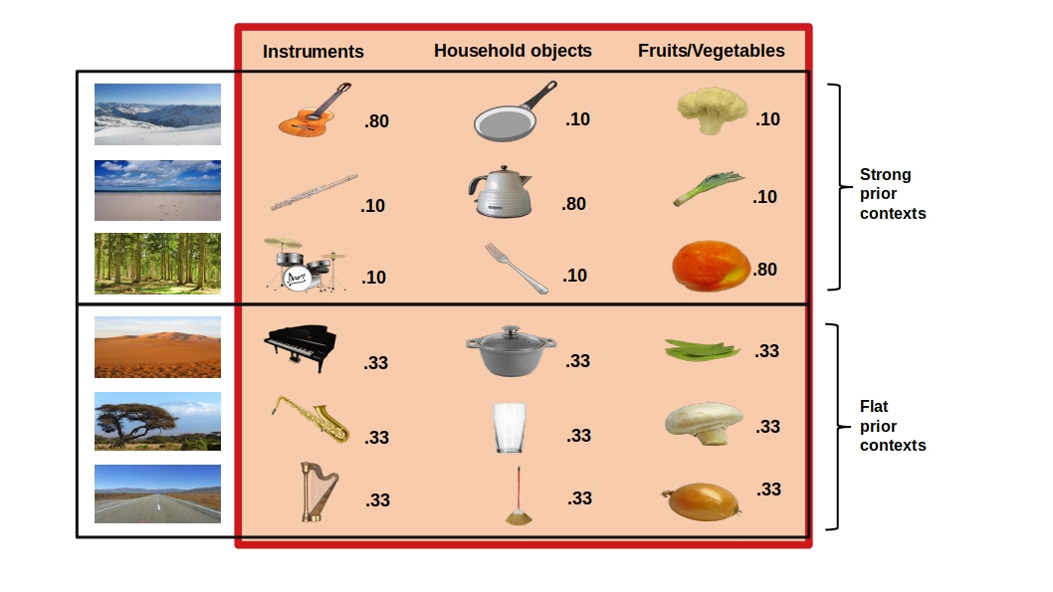
a)
b)
Object Categories
Object Categories
Scene Categories
Scene Categories
Instruments
Instruments
.90
.10
.10
.90
.70
.30
.30
.70
.50
.50
.50
.50
c)
Phase1. Contingency learning
Phase2. Encoding
Phase3. Memory test
?
?
Have you seen this object before?
?
?
?
?

Slide 5
a)
b)
Object Categories
Object Categories
Scene Categories
Instruments
Household objects
Fruits/Vegetables
Scene Categories
Instruments
Household objects
.80
.10
.10
.80
.10
.10
.80
.10
.10
.80
.10
.10
.80
.10
.10
.33
.33
.33
.33
.33
.33
.33
.33
.33
.33
.33
.33
.33
.33
.33
c)
Phase1. Contingency learning
Phase2. Encoding
Phase3. Memory test
?
?
Have you seen this object before?
?
?
?
?

Slide 6
Instruments
Household objects
.90
.10
.10
.90
.70
.30
.30
.70
.50
.50
.50
.50

Slide 7
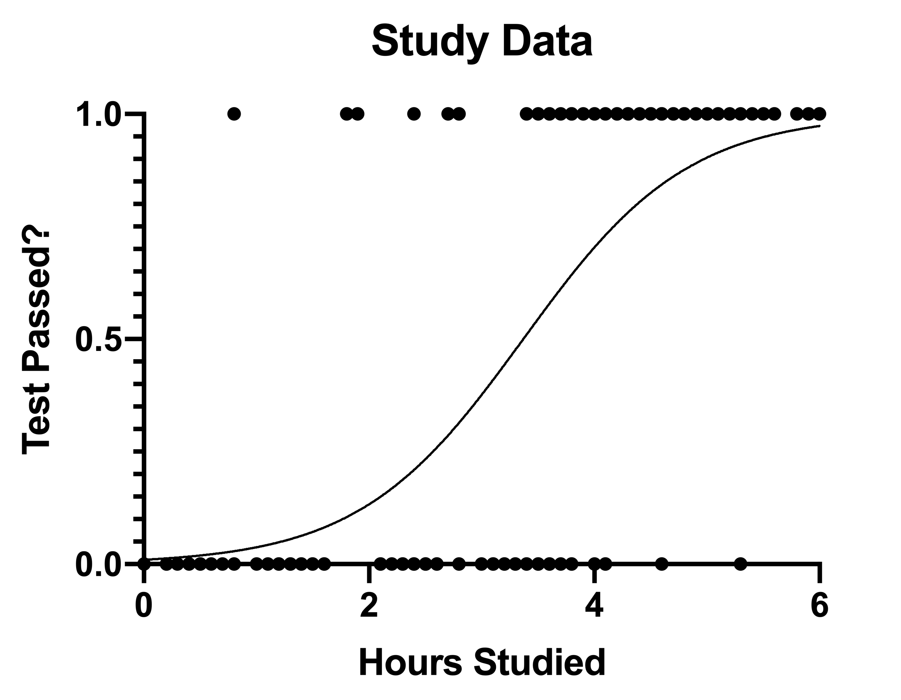
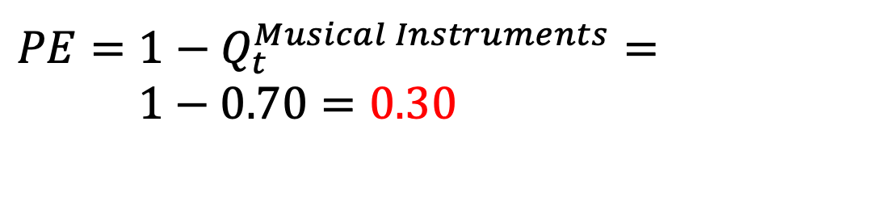

a)
Encoding Phase
Prediction
Choice
Prediction Outcome
$$PE=1−Q_{t}^{Householdobjects}=$$
$$1−0.30=0.70$$
?
Musical Instruments
Incorrect
$$PE=1−Q_{t}^{Musical Instruments}=$$
$1−0.70=0.30$
$$Q_{t}^{MusicalInstruments}=0.70$$
Correct
$$Q_{t}^{Housholdobjects}=0.30$$
Memory Test
Prediction Outcome
b)
c)
Incorrect
Correct
p(Hit)
0 1
OLD/NEW
PE
Prediction Outcome
OLD/NEW
Incorrect
Correct
p(Hit)
0 1
0 1
0 1
0 1
PE

Slide 8
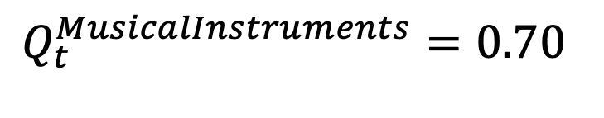
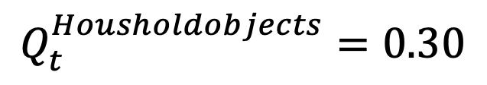
d)
Encoding Phase
Prediction
Choice
Prediction Outcome
Model-derived PE
$$PE=1−Q_{t}^{Householdobjects}=$$
$$1−0.30=0.70$$
?
Musical Instruments
Incorrect
$$PE=1−Q_{t}^{Musical Instruments}=$$
$1−0.70=0.30$
$$Q_{t}^{MusicalInstruments}=0.70$$
$$Q_{t}^{Housholdobjects}=0.30$$
Correct
e)
Prediction Outcome
Prediction Outcome
Incorrect
Correct
Incorrect
Correct
p(Hit)
p(Hit)
0 1
0 1
0 1
0 1
0 1
0 1
Model-derived PE
Model-derived PE
PE
Prediction Outcome
Incorrect
Correct
p(Hit)
0 1
0 1
PE

Slide 9
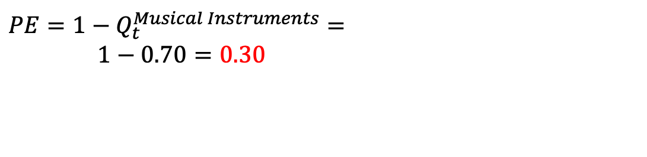
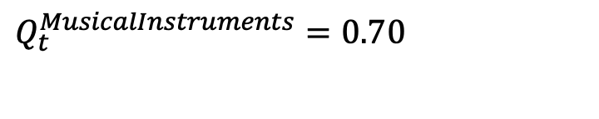


d)
Encoding Phase
Prediction
Choice
Prediction Outcome
Model-derived PE
$$PE=1−Q_{t}^{Householdobjects}=$$
$$1−0.30=0.70$$
?
Musical Instruments
Incorrect
$$PE=1−Q_{t}^{Musical Instruments}=$$
$1−0.70=0.30$
$$Q_{t}^{MusicalInstruments}=0.70$$
$$Q_{t}^{Housholdobjects}=0.30$$
Correct
e)
Prediction Outcome
Prediction Outcome
Incorrect
Correct
Incorrect
Correct
p(Hit)
p(Hit)
0 1
0 1
0 1
0 1
0 1
0 1
Model-derived PE
Model-derived PE
PE
Prediction Outcome
Incorrect
Correct
p(Hit)
0 1
0 1
PE

Slide 10
Phase2. Encoding
Prediction
Object
Household Object
$$PE=1−Q_{t}^{MusicalInstruments}=1−0.70=0.30$$
$$Q_{t}^{MusicalInstruments}=0.70$$
$$PE=1−Q_{t}^{Householdobjects}=1−0.30=0.70$$
$$Q_{t}^{Housholdobjects}=0.30$$
#
Household Object
?
$$Q_{t}^{Householdobjects}=0.70$$
$$PE=1−Q_{t}^{Householdobjects}=1−0.30=0.70$$

