Slide 1



Prediction Error and Memory:
Insights from computational models
Francesco Pupillo
IICCSSS 2021
Notes:
Size 40 header; size 20 body

Slide 2

The brain is a prediction machine, which tries to generate
Predictions based on the extraction of regularities in the environment.
Notes:
Through repeated experiences we develop predictions of what will happen in a specific context.
For example, we may go every day to the same cafe for our morning coffee. As a consequence, we develop a strong expectation of what is going to happen: the taste of the coffee, the furniture, the employees, etc.
But prior expectations could also not be that strong: a cafe could be constantly restructuring and changing the staff, so that our predictions would be rather weak.
The brain is a prediction machine, which tries to generate
Predictions based on the extraction of regularities in the environment.

Slide 3
Notes:
So we may have either a strong prior, with strong expectations of what it is going to happen in one context, and a weak prior, with weaker expectations.

Slide 4
Matched
Violated:
PE
Notes:
These expectations can be either matched violated, causing prediction errors of different degrees.

Slide 5
Violation:
PE
Prior updating
Notes:
Prediction error is responsible for prior updating: changes in the expectations to accommodate the error.
There is a linear relationship between PE strength and prior updating.

Slide 6
Violation:
PE
Prior updating
Memory for the events?
Notes:
But what happens to the events that cause prediction error? Will they be better or worse remembered?

Slide 7
Is memory for the events related to Prediction Error?
Contrasting evidence
Information is better recognized when is congruent with previous schema (e.g., Bein et al., 2015; Brod & Shing, 2019; Craik and Tulving 1975)
Information is better recognized when it is incongruent with previous schema (e.g., Greve et al., 2017; Kafkas & Montaldi, 2018)
Notes:
So far, 2:30 min ca.

Slide 8



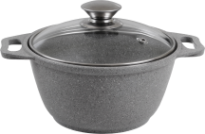
Present study
Strong priors
Weak priors
Notes:
Different levels of priors were created and later violated (PE).
That was achieved by having participants to learn associations between scenes and object categories. Different contingencies, to render different prior strength.

Slide 9

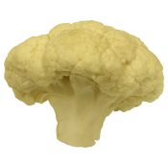
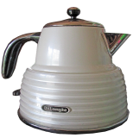
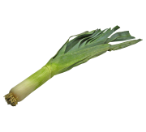
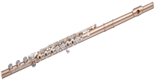



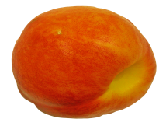

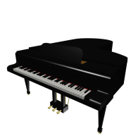




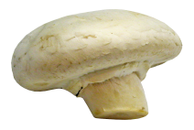

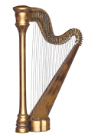

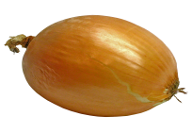
Three object types are presented embedded in each context following certain probability distributions.
Instruments
Household objects
Fruits/Vegetables
.80
.10
.10
Strong
prior
contexts
.10
.80
.10
.10
.10
.80
.33
.33
.33
Flat
prior
contexts
.33
.33
.33
.33
.33
.33
Notes:
There are three object categories, each category associated with a certain contingency with each of 6 scenes.
3 scenes belong to strong prior condition, 3 to weak.

Slide 10
Three object types are presented embedded in each context following certain probability distributions.
Instruments
Household objects
Fruits/Vegetables
.80
.10
.10
Strong
prior
contexts
.10
.80
.10
.10
.10
.80
Low PE
.33
.33
.33
Flat
prior
contexts
.33
.33
.33
.33
.33
.33
Notes:
The design creates three experimentally-manipulated levels of PE: low, high, and medium.
Low PE refers to object categories presented more frequently in the strong prior contexts;

Slide 11
Three object types are presented embedded in each context following certain probability distributions.
Instruments
Household objects
Fruits/Vegetables
.80
.10
.10
Strong
prior
contexts
.10
.80
.10
.10
.10
.80
High PE
.33
.33
.33
Flat
prior
contexts
.33
.33
.33
.33
.33
.33
Notes:
High PE to categories presented less frequently in strong prior contexts

Slide 12
Three object types are presented embedded in each context following certain probability distributions.
Instruments
Household objects
Fruits/Vegetables
.80
.10
.10
Strong
prior
contexts
.10
.80
.10
.10
.10
.80
.33
.33
.33
Medium PE
Flat
prior
contexts
.33
.33
.33
.33
.33
.33
Notes:
Medium PE refers to object categories presented in the flat prior contexts

Slide 13


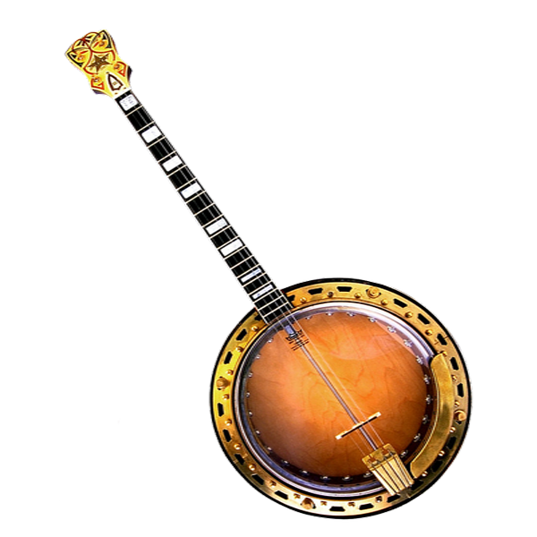


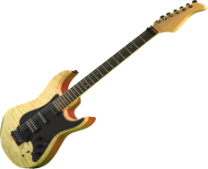

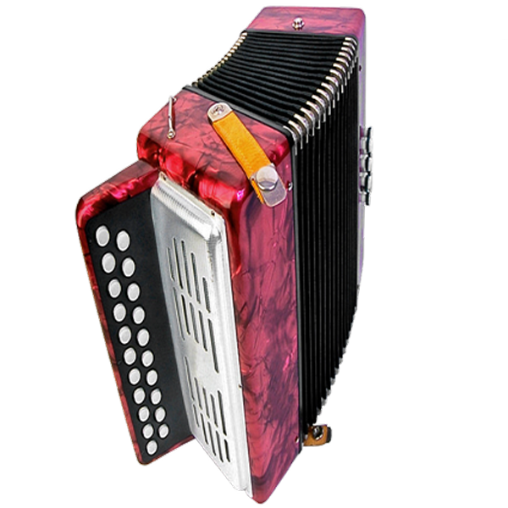



Phase1. Contingency learning
Phase2. Encoding
Phase3. Memory test
?
?
Have you seen this object before?
?
?
?
?
Notes:
Briefly explain the paradigm.(5:30 – 6 ca so far).
Focus on the fact that the images were trial-unique and never seen before.

Slide 14
Reinforcement learning model
Value of object category j for context c
Learning rate
Prediction error
Notes:
Simple RL model based on Rescorla-wagner rule.
Q is the expected strength of the association of a certain category with a context, given the history of the associations.
The learning rate regulates the extend to which evidence on a trial is used to update choice
Prediction error: the extent to which the evidence deviates from the expectations.

Slide 15
Prediction error
r_{t} = 1 , 0
Observation -based - depending on the object category shown
Choice-based – depending on whether the choice was correct or not
Notes:
Prediction error can come from two sources:
The outcome of the choice or
The object category presented, irrespective of the choice.

Slide 16

Observation-based PE:
It depends on the object category displayed, regardless of participants’ choice. It is >=0, inversely proportional to the expected value.
Instruments Household Objects Fruits or Vegetables
Q_{t} = 0.66 0.00 0.00
R_{t} = 0 0 1
δ_{t} = r_{t} – Q_{t} 0-0.66 = -0.66 0-0.00 = 0.00 1-0.00 = 1.00
Q_{t+1} + α · δ 0.66+(0.3·(-0.66))=0.46 0.0+(0.3· 0.00)=0.0 0.00+(0.3·1)=0.30
Notes:
Example of how the two ways of computing prediction error differ
In this case, observation-based is shown.

Slide 17
Choice-Based PE:
If participant predicted Instrument, but another object category, the PE for the category chosen is < = 0. The stronger the belief, the more negative it will be.
Instruments Household Objects Fruits or Vegetables
Q_{t} = 0.66 0.00 0.00
R_{t} = 0 0 1
δ_{t} = r_{t} – Q_{t} 0-0.66 = -0.66 0-0.00 = 0.00 1-0.00 = 1.00
Q_{t+1} + α · δ 0.66+(0.3·(-0.66))=0.46 0.0+(0.3· 0.00)=0.0 0.00+(0.3·1)=0.30
Notes:
Now choice based

Slide 18
Choice-Based PE:
If participant successfully predicted a category, the PE for the category chosen is > = 0. The weaker the belief, the more positive it will be.
Instruments Household Objects Fruits or Vegetables
Q_{t} = 0.66 0.00 0.00
R_{t} = 1 0 0
δ_{t} = r_{t} – Q_{t} 1-0.66 = 0.33 0-0.00 = 0.00 0-0.00 = 0.00
Q_{t+1} + α · δ 0.66+(0.3·(0.33))=0.53 0.0+(0.3· 0.00)=0.0 0.00+(0.3·0)=0.00
Notes:
When Participants’ prediction is correct, the two PEs are the same.
In this example, the participant predicted musical instrument, and a musical instrument was presented.

Slide 19
A softmax function was then used to transform the values into probabilities:
Notes:
We fitted the two parallel models to participants’ data, one with choice-based and one with observation-based PE, to derive the two different PEs.
Softmax distribution was the same for both

Slide 20
A softmax function was then used to transform the values into probabilities:
Parameter estimation:
Alpha and beta values were estimated at the participant level through ML estimation
Notes:
Estimated the alpha and beta parameters at the participant level through ML estimation = finding the two parameters that maximise the likelihood of observing the data.
Than the models with the best fitting parameters were used to derive trial level Expected values and PE.
Finally, we checked whether trial level PE, both observational and choice based, were related to memory, the likelihood of recognizing the

Slide 21
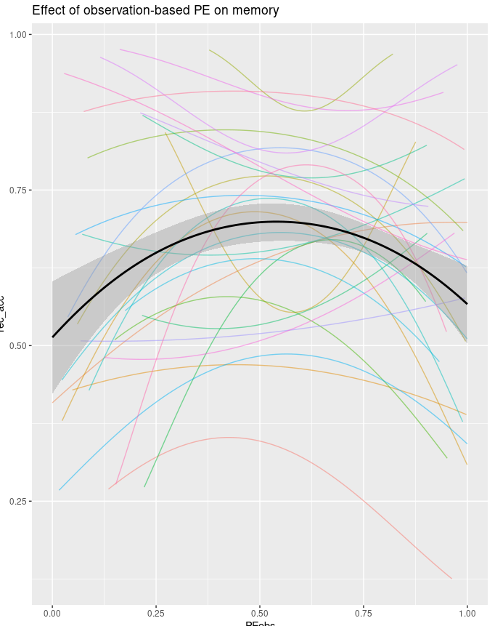
Quadratic effect: β = -6.43, p = 0.006
% Hit
Obs-based PE
Notes:
27 participants: 6 excluded for recognition performance below chance level.
Significant quadratic effect. This effect recapitulates what observed with PE conditions.

Slide 22
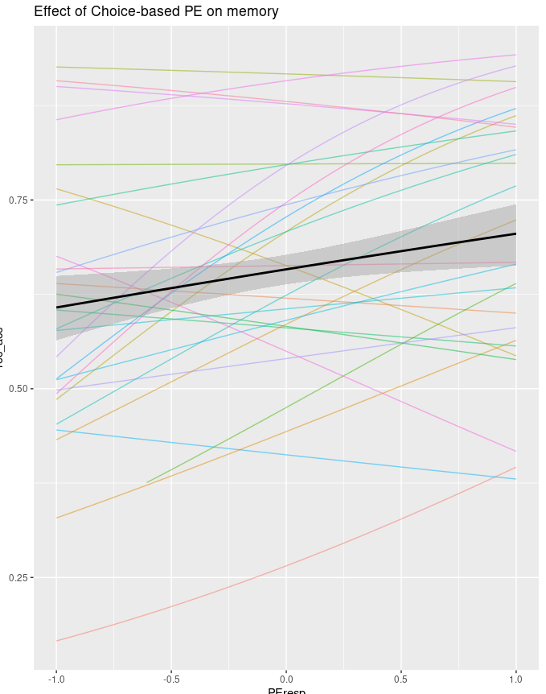
Linear effect: β = 0.28, p = 0.003
% Hit
Choice-based PE
Notes:
This positive linear relationship between choice-based PE and memory shows that stronger prediction error (as an outcome of weak prior) when participants correctly predicted the category led to enhanced memory. In contrast, when participants incorrectly predicted the object category, stronger prediction error (as an outcome of strong prior) led to impaired memory.

Slide 23
Conclusions
Important moderating role of prediction accuracy and of considering PE in relation to task participants are doing.
Similarity between signed PE effects on memory and signed PE effects on prior updating: dopaminergic activity?
Strong prediction error in the context of positive feedback might indicate the utility of that item for future predictions.
Strong prediction error in the context of negative feedback in a task where contingencies are stable may signal participants that that choice is not informative.
Notes:
There is s similarity between effect of signed PE on memory and signed PE effects on prior updating. This might suggest that the memory effects observed rely on phasic activity of dopamine neurons in the midbrain and striatum, which project to hippocampus.
About the utility, Items that were successfully predicted when priors where low might be prioritised because they can be helpful to predict in the future (e.g., Jang et al., 2019, Rohuani et al., 2021).
In the case of negative feedback, the stronger the participant’ prior at some point, the more is the likelihood that that item will be not important, and will not be useful for future choice, and thus they are disregarded as an exception

Slide 24




Thank you!
Javier Ortiz-Tudela
Rasmus Bruckner
Yee Lee Shing

Slide 25
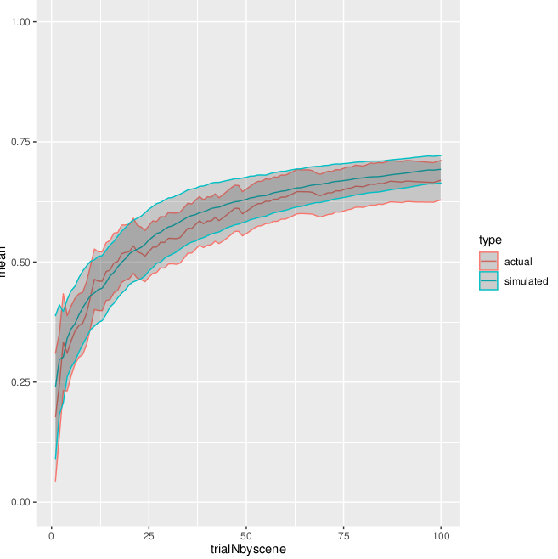
Notes:
Validation: cumulative accuracy for simulated vs empirical

Slide 26
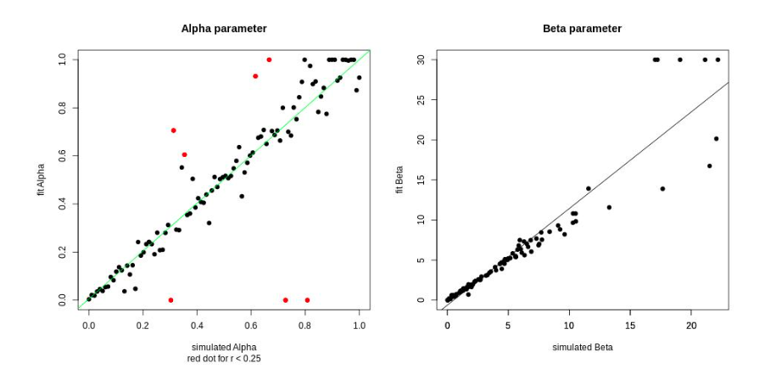
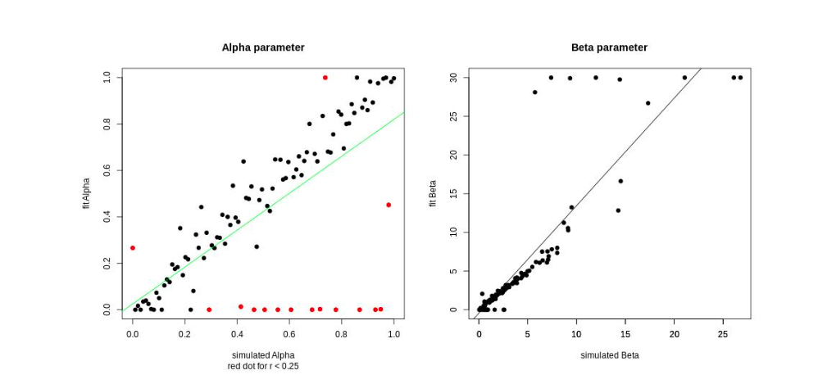
Notes:
Parameter recovery was successful for both models. Beta parameter was constrained between 0 and 10.

Slide 27
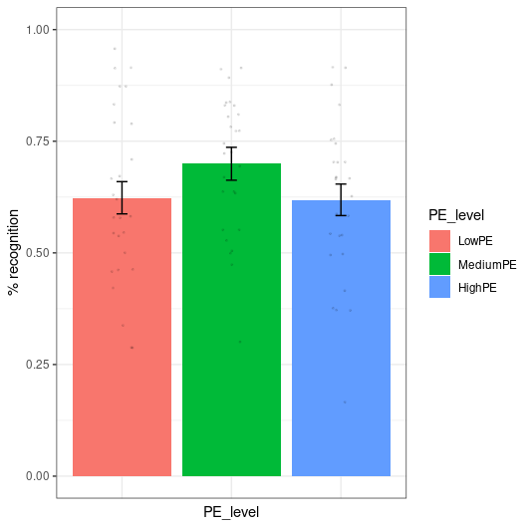
**
**
**
% HIT
Notes:
Behavioural results: better memory for objects presented in the flat prior context (medium PE)

