Slide 1



The effect of prediction error on episodic memory
Gözem Turan, Yee Lee Shing & Sophie Nolden
Supported by the European Research Council (ERC) Starting Grant, PIVOTAL
https://osf.io/wybtn

Slide 2
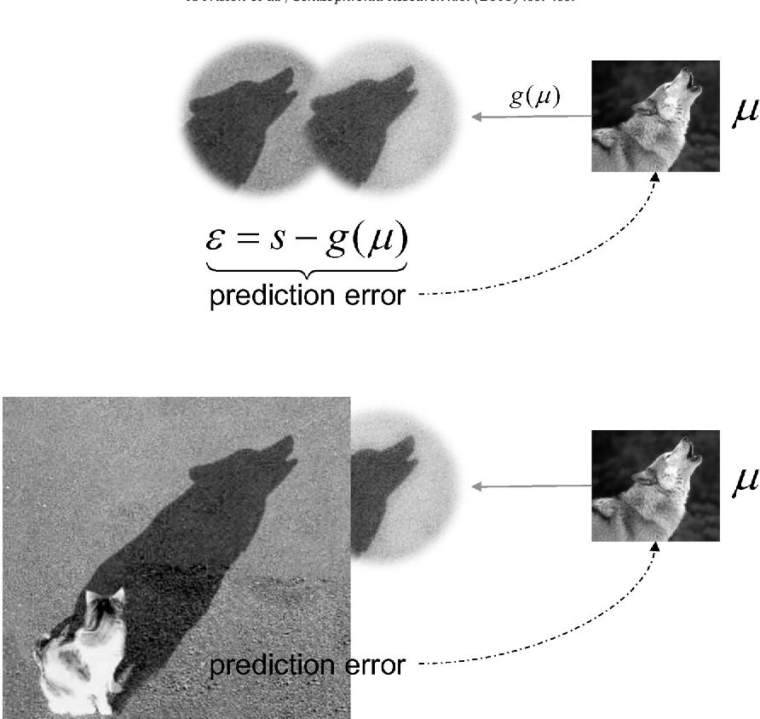

Thank you for listening!
Questions and feedback are welcome!
Supported by the European Research Council (ERC) Starting Grant, PIVOTAL
https://osf.io/wybtn

Slide 3

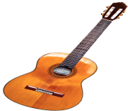

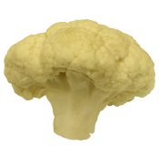

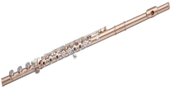
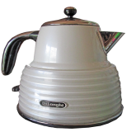
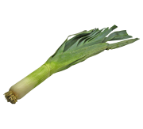



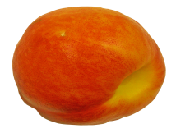

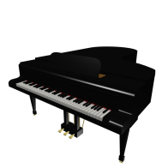
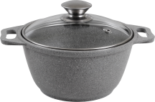
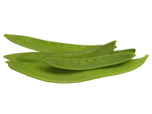



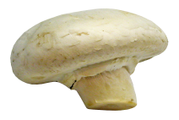

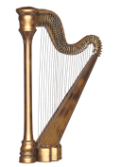

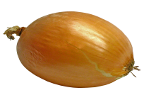
Manipulating prior strength
Three object types are presented embedded in each context following certain probability distributions.
Instruments
Household objects
Fruits/Vegetables
.80
.10
.10
Strong
prior
contexts
.10
.80
.10
.10
.10
.80
.33
.33
.33
Flat
prior
contexts
.33
.33
.33
.33
.33
.33

Slide 4


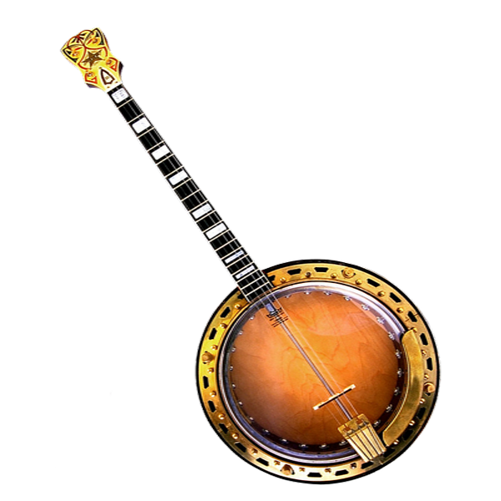


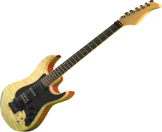
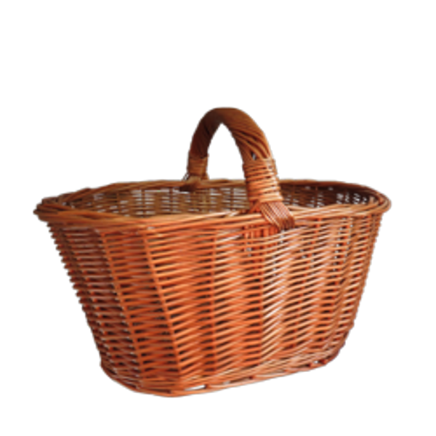
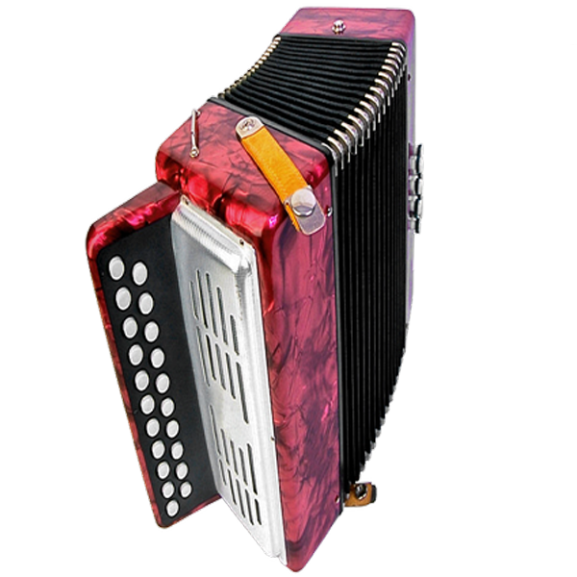
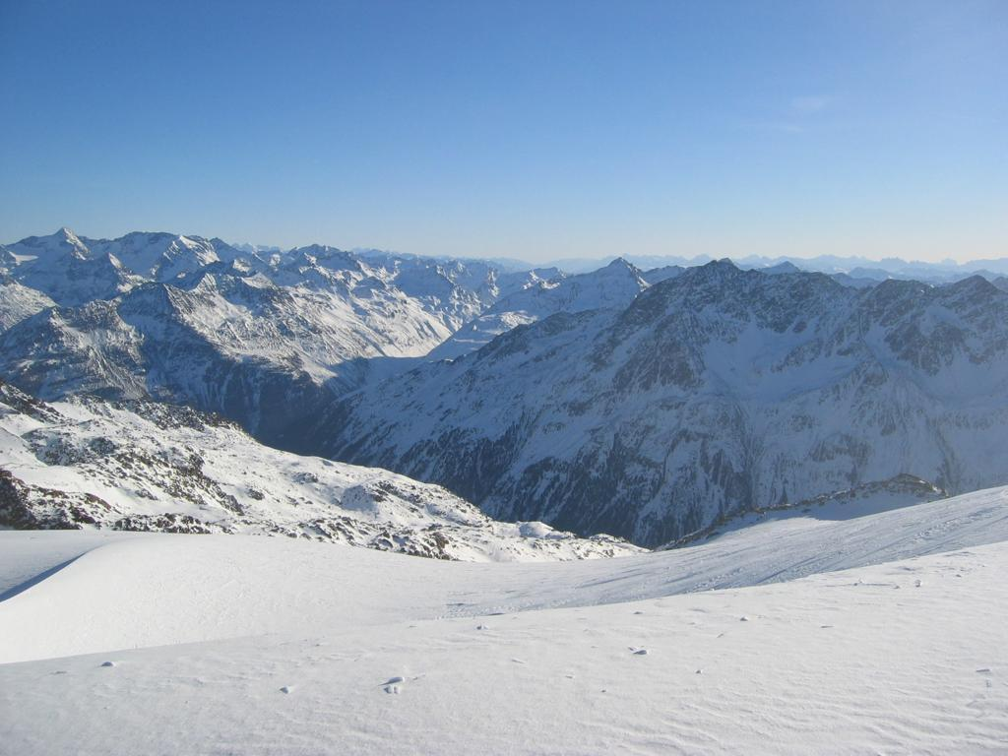


Manipulating prior strength
Phase1. Contingency learning
Phase2. Encoding
Phase3. Memory test
?
?
Have you seen this object before?
?
?
?
?

Slide 5
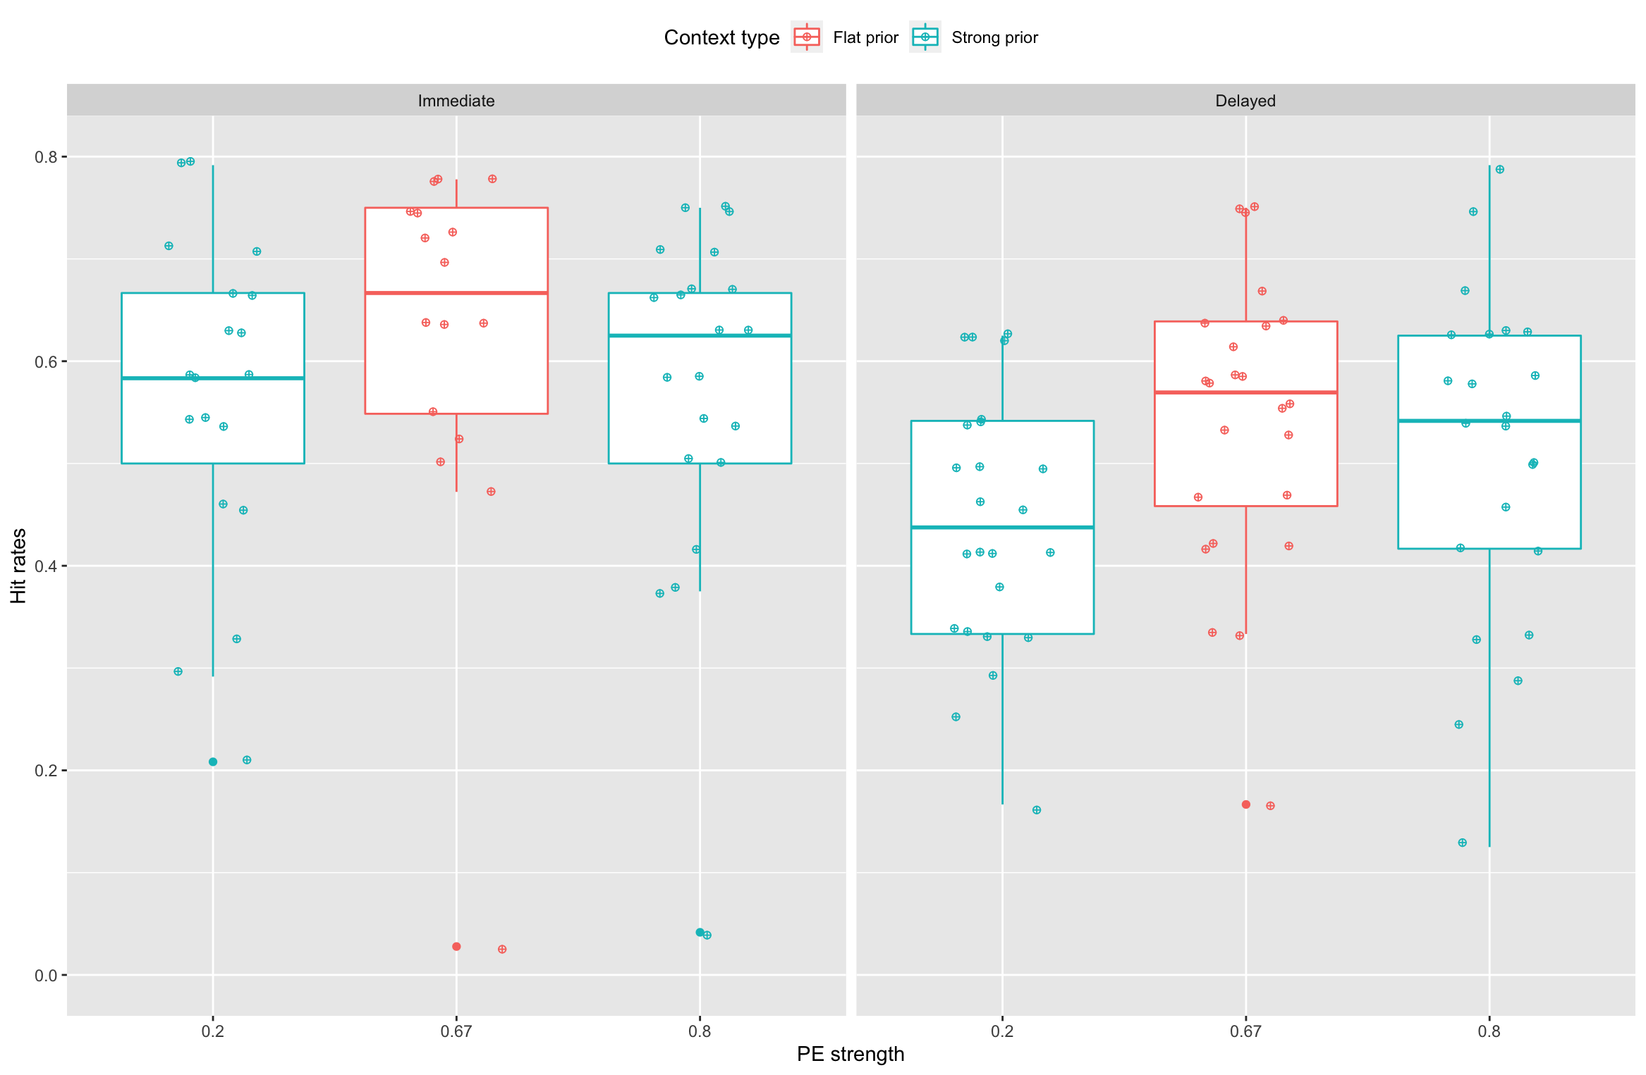
Manipulating prior strength
Results:
GLMM with PE_level, session and interaction as fixed effects and participant's mean recognition as random effect.
hit_rate~PE_strength * session +(1|participant)
PE strength X session interaction (p<.05). Linear component: estimate -0.27413, p=.052
Quadratic component: estimate - 0.16094, p<.05.
The model with the interaction outperformed the model without (p < .05)
The interaction modulated the linear component (p<.05) but not not the quadratic one (p=.39).

Slide 6
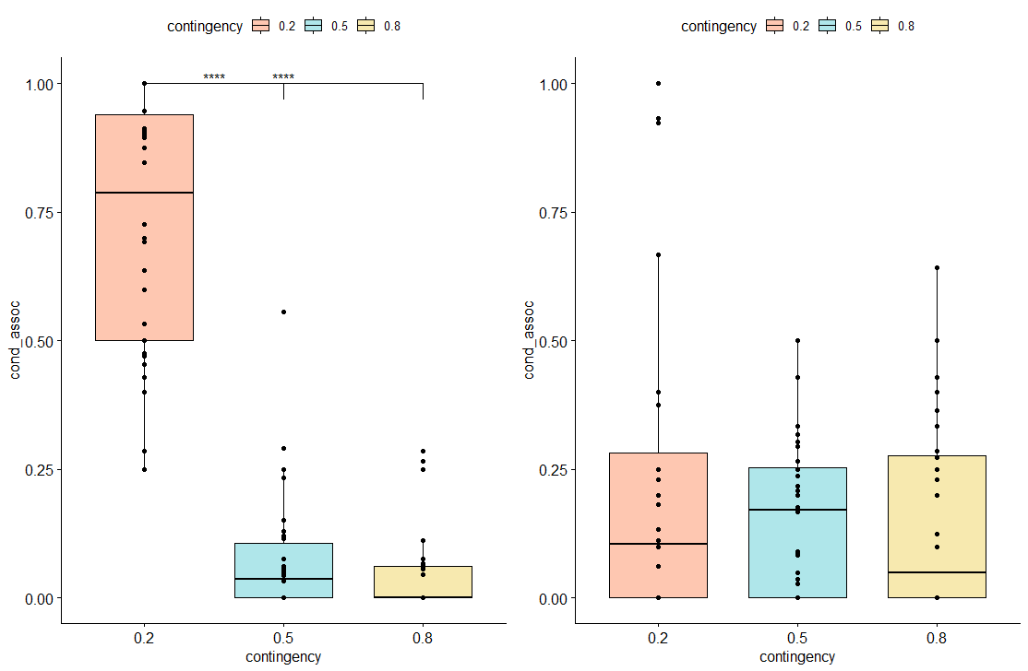
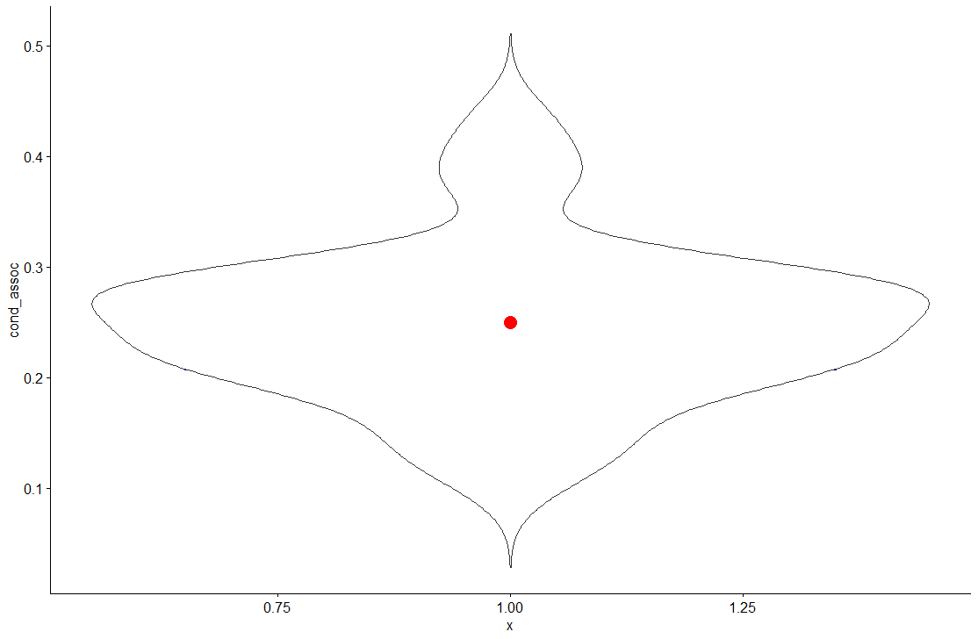
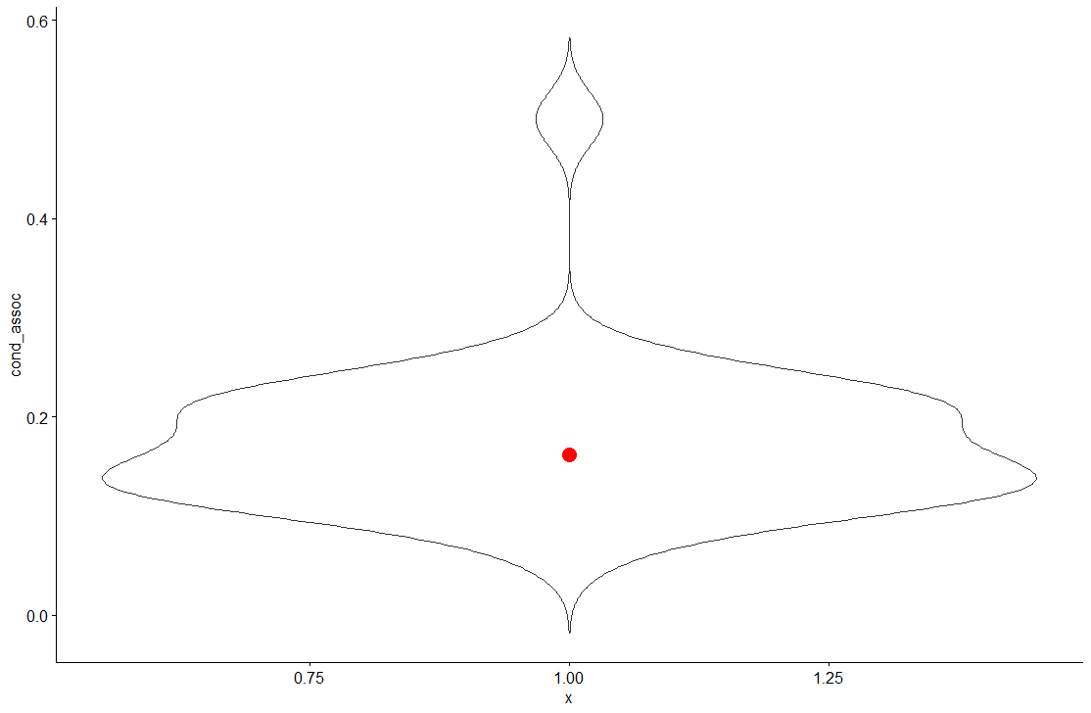
Manipulating prior strength
PREMUP I. Origins> Results > Object-scene association (overall)
Participants rely on their priors to respond on the immediate test. After one week, priors are lost.

Slide 7
Manipulating prior strength
Find all this at https://osf.io/jqfxh
PREMUP II. Flat
Instruments
Household objects
.90
.10
Strong
prior
contexts
.10
.90
.50
.50
Flat
prior
contexts
.50
.50

Slide 8
Manipulating prior strength
Phase1. Contingency learning.
“predict”
Phase2. Encoding
“categorize”
Phase3. Memory test immediate and delayed (24h)
?
Have you seen this object before?
?
?

Slide 9
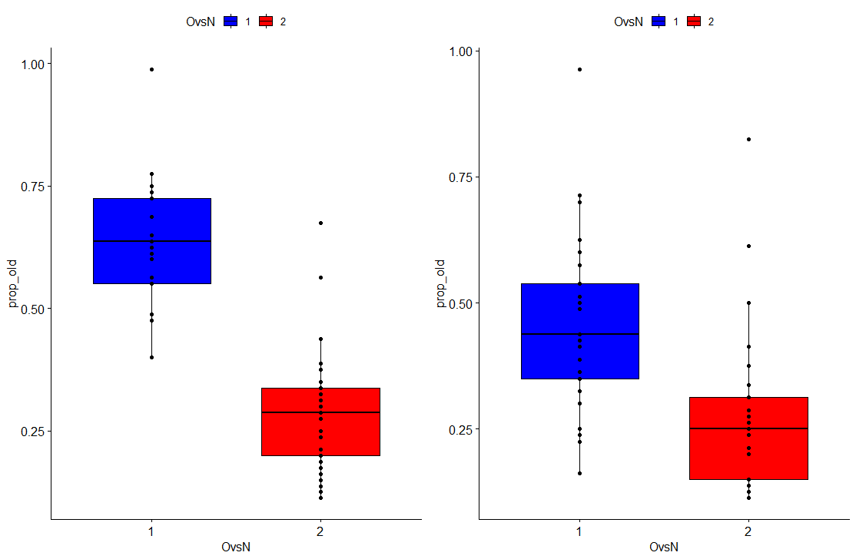
Manipulating prior strength
PREMUP II. Flat> Results > Object identity (overall)

Slide 10
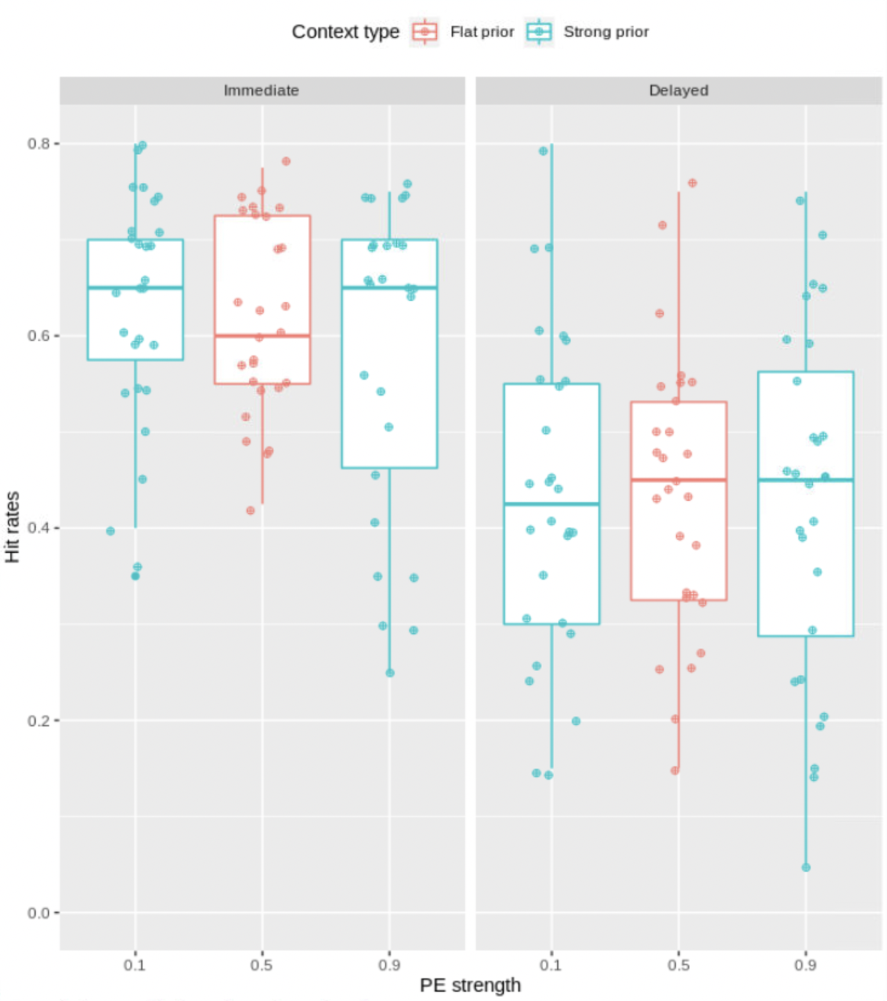
PREMUP: Manipulating prior strength
Results:
GLMM with PE_level and session as fixed effects and participant's mean recognition as random effect.
hit_rate~PE_strength + session +(1|participant)
Main effect of session (p < .001).
Adding the interaction to the model did not improve model fit (p = 0.684)

Slide 11
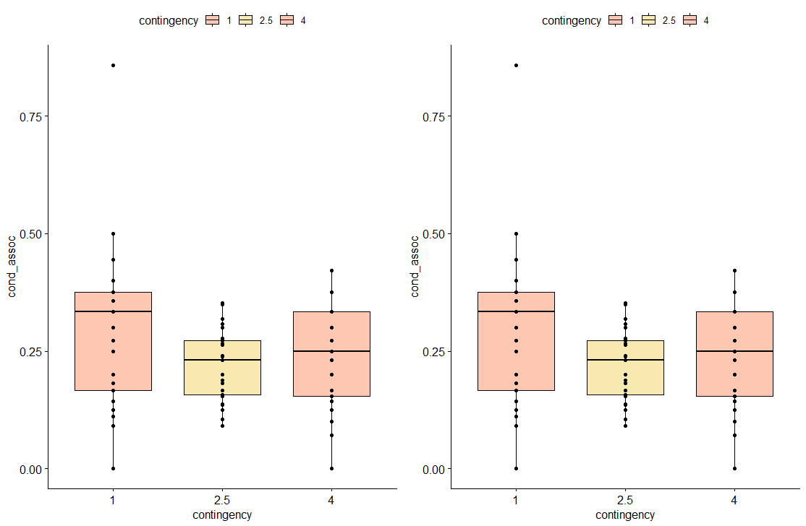
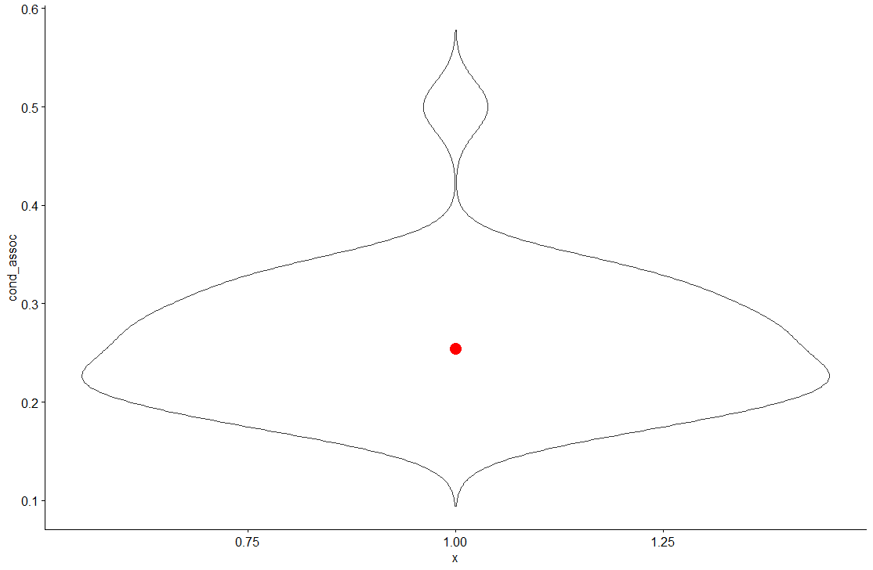
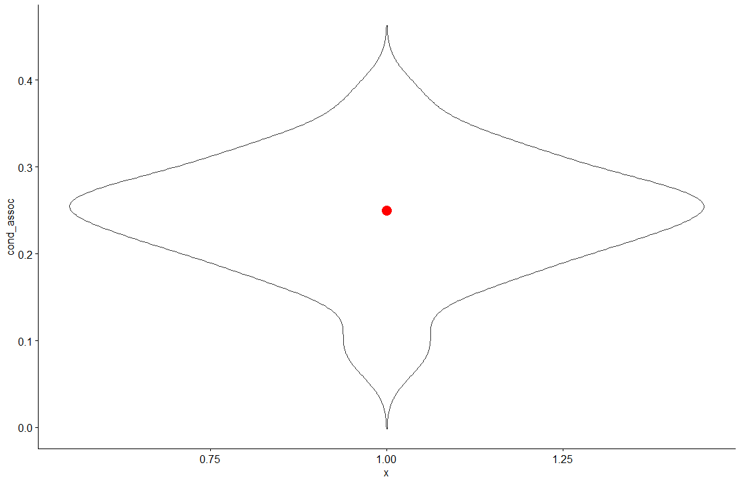
PREMUP: Manipulating prior strength
PREMUP II. Flat> Results > Object-scene association (overall)
Object-scene memory is at chance

Slide 12
PREMUP: Manipulating prior strength to render different levels of PE
Find all this at https://osf.io/v6n2x
PREMUP III. Priors
Instruments
Household objects
.90
.10
Strong
prior
contexts
.10
.90
.70
.30
Weak
prior
contexts
.30
.70

Slide 13
PREMUP: Manipulating prior strength to render different levels of PE
Phase1. Contingency learning.
“predict”
Phase2. Encoding
“categorize”
Phase3. Memory test immediate and delayed (24h)
?
Have you seen this object before?
?
?

Slide 14
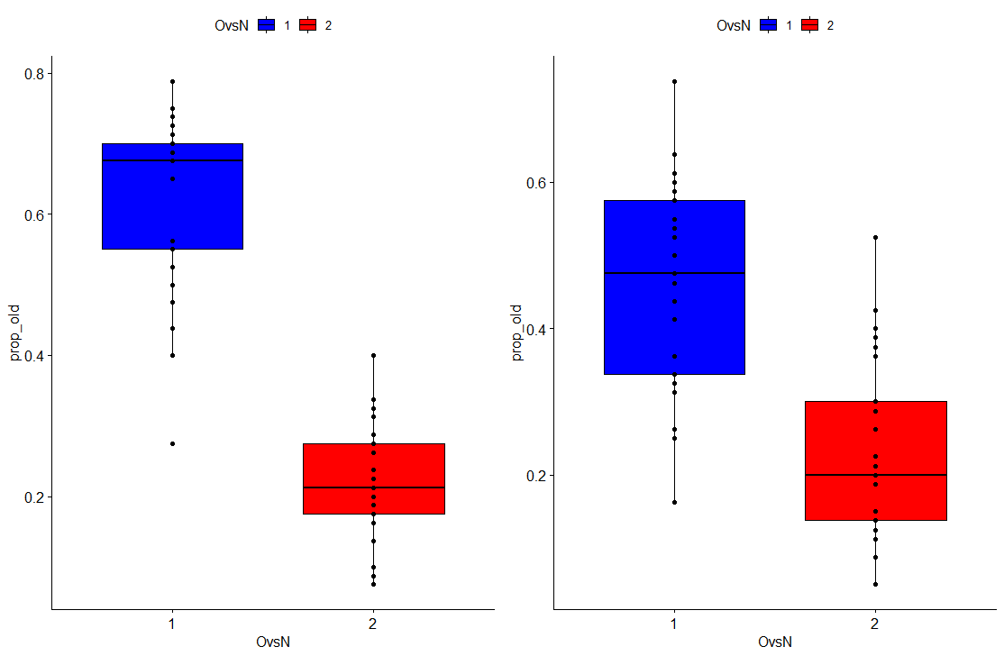
PREMUP: Manipulating prior strength
PREMUP III. Priors> Results > Object identity (overall)

Slide 15
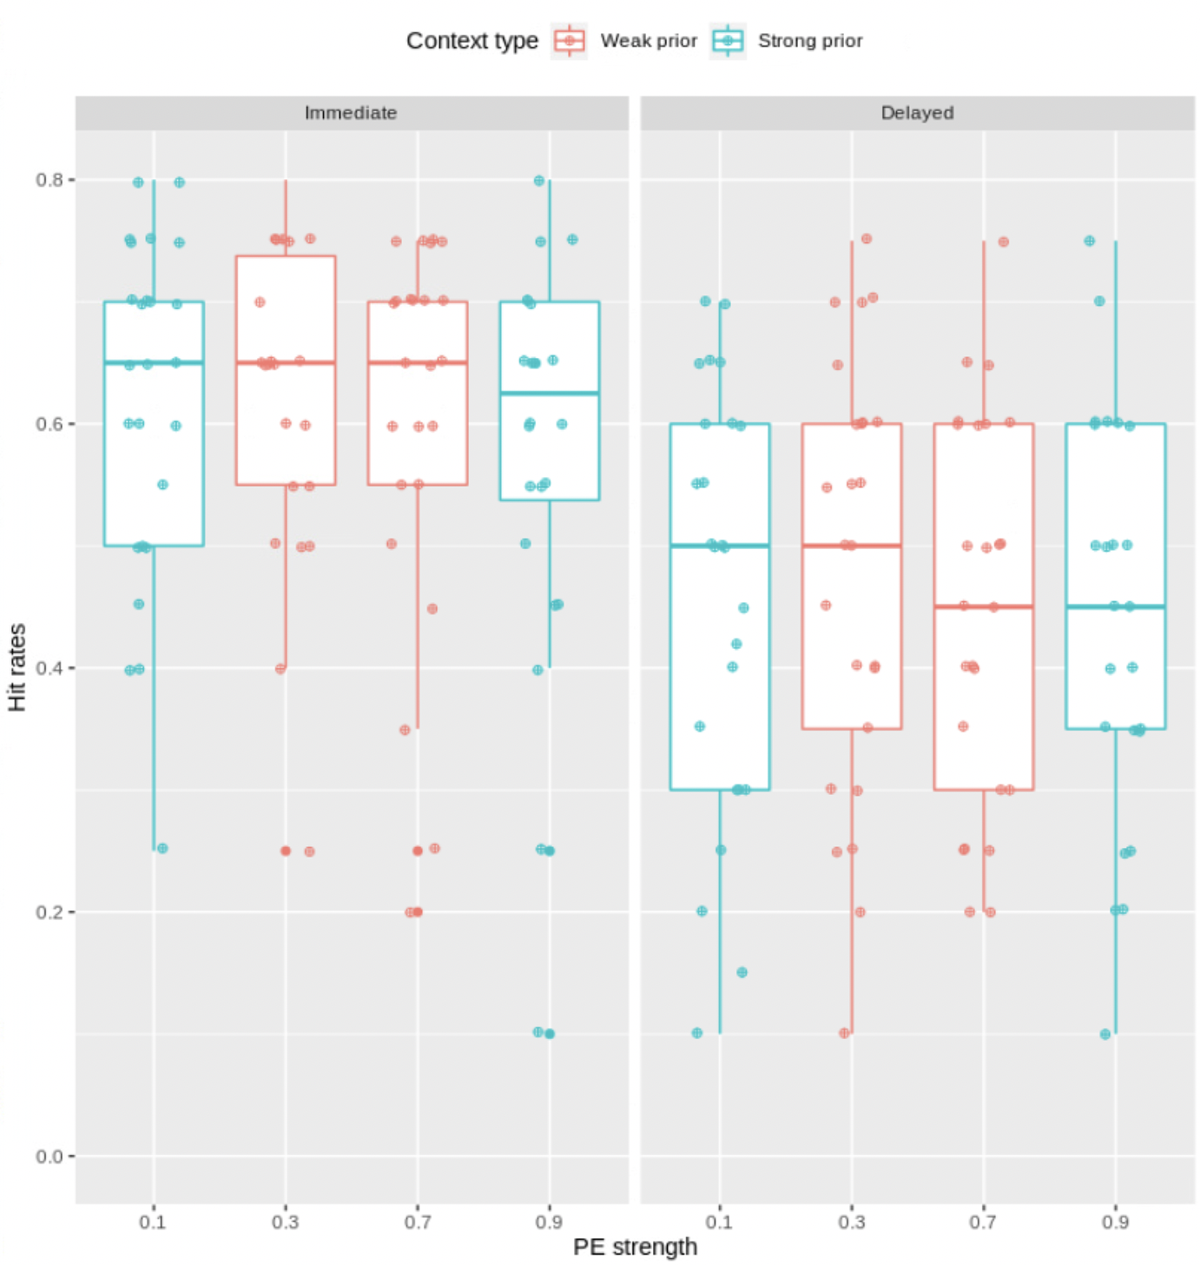
PREMUP: Manipulating prior strength
Results:
GLMM with PE_level and session as fixed effects and participant's mean recognition as random effect.
hit_rate~PE_strength + session +(1|participant)
Main effect of session (p < .001).
Adding the interaction to the model did not improve model fit (p = 0.827)

Slide 16
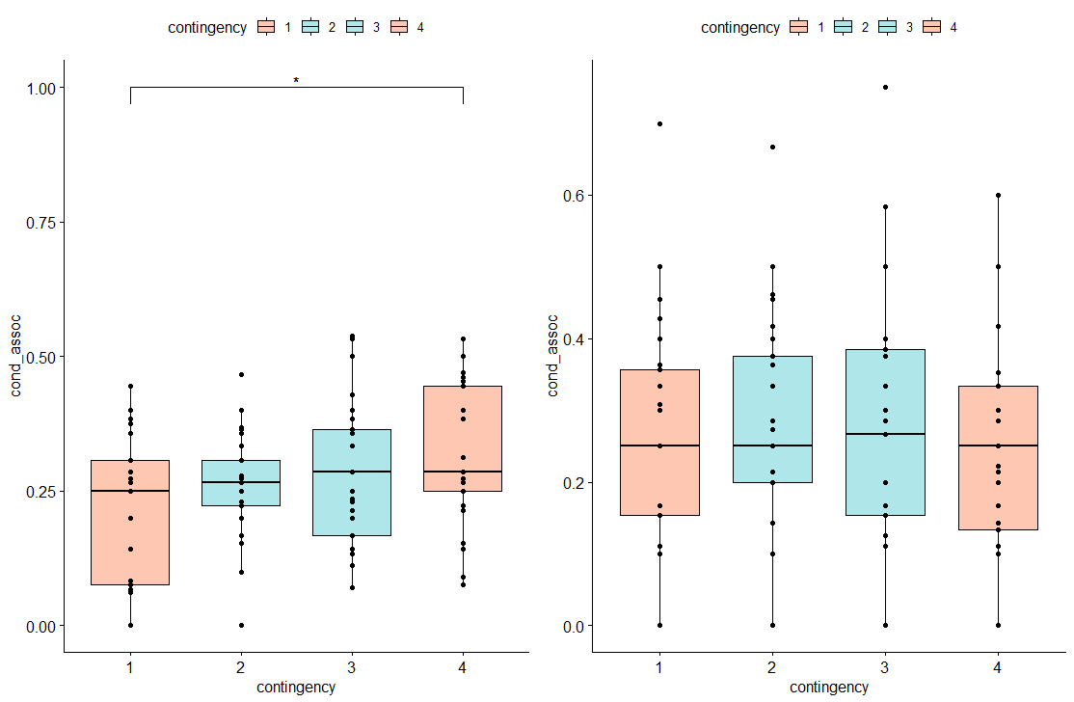
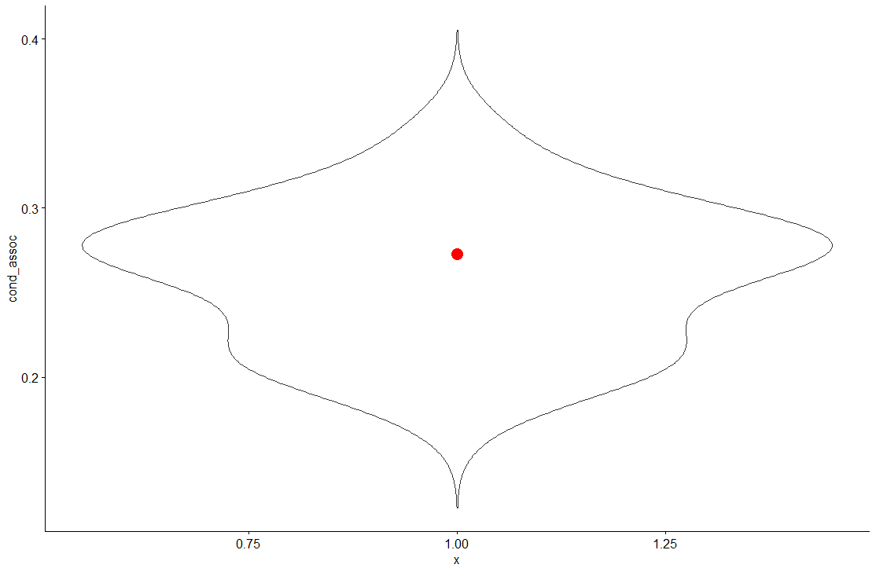
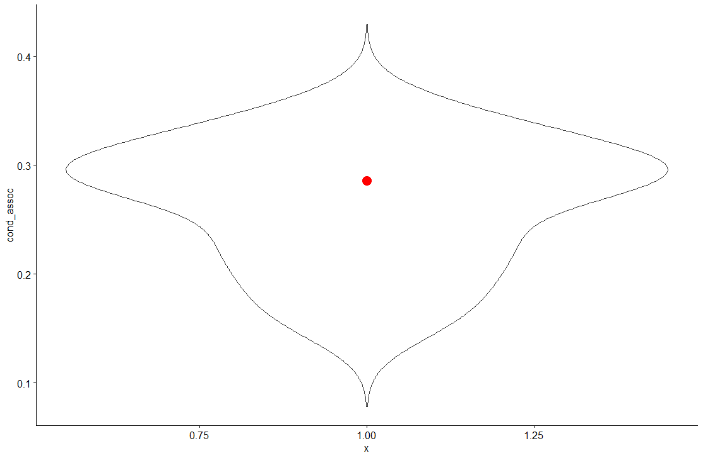
PREMUP: Manipulating prior strength
PREMUP III. Priors> Results > Object-scene association (overall)
Object-scene memory is at chance

Slide 17
PREMUP: Manipulating prior strength. Conceptual replica of first study
Find all this at https://osf.io/kwegs
Instruments
Household objects
.90
.10
Strong
prior
contexts
.10
.90
.70
.30
Weak
prior
contexts
.30
.70
.50
.50
Flat
prior
contexts
.50
.50

Slide 18
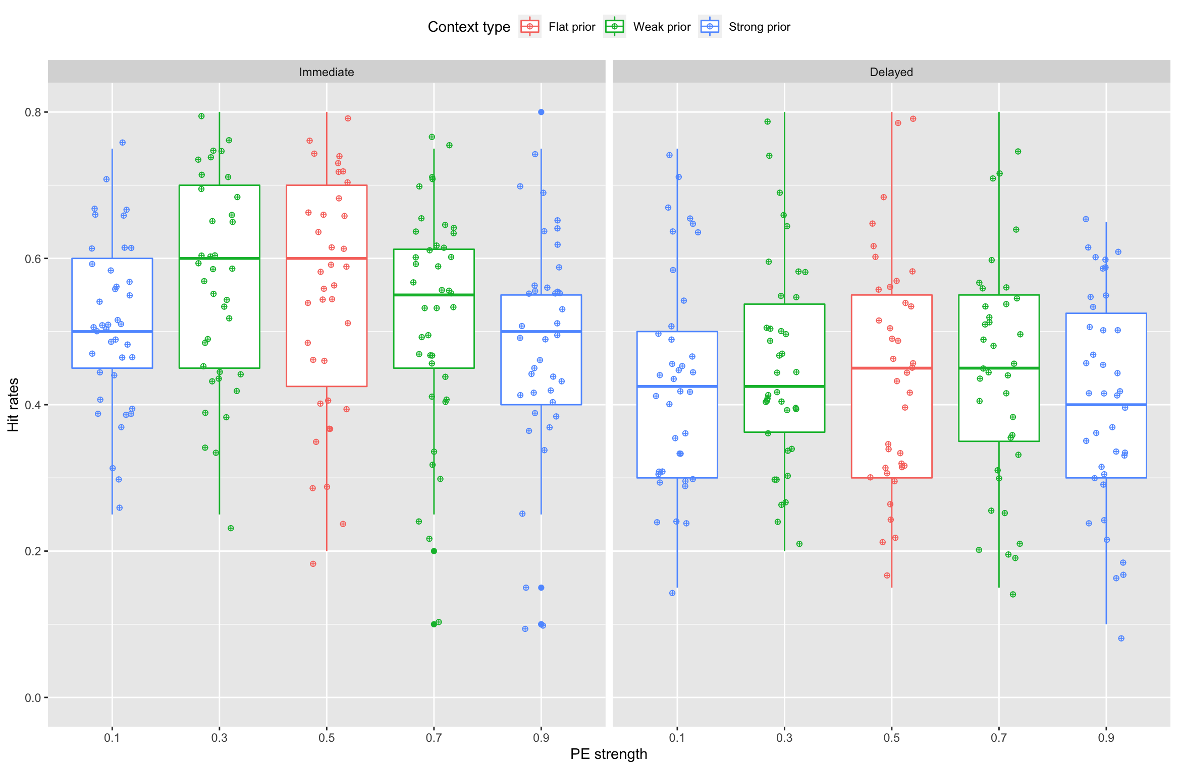
PREMUP: Manipulating prior strength
Results:
GLMM with PE_level and session as fixed effects and participant's mean recognition as random effect.
hit_rate~PE_strength + session +(1|participant)
Main effect of PE strength and session (both p < .001).
Linear component: estimate -0.04217, p=.01
Quadratic component: estimate -0.05804, p<.001.
Adding the interaction to the model did not improve model fit (p = 0.243)

Slide 19
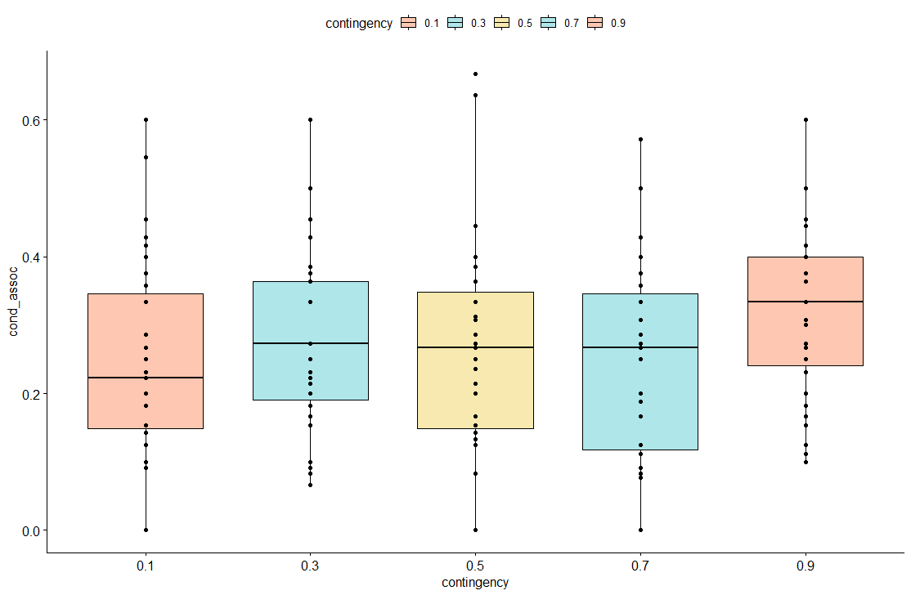
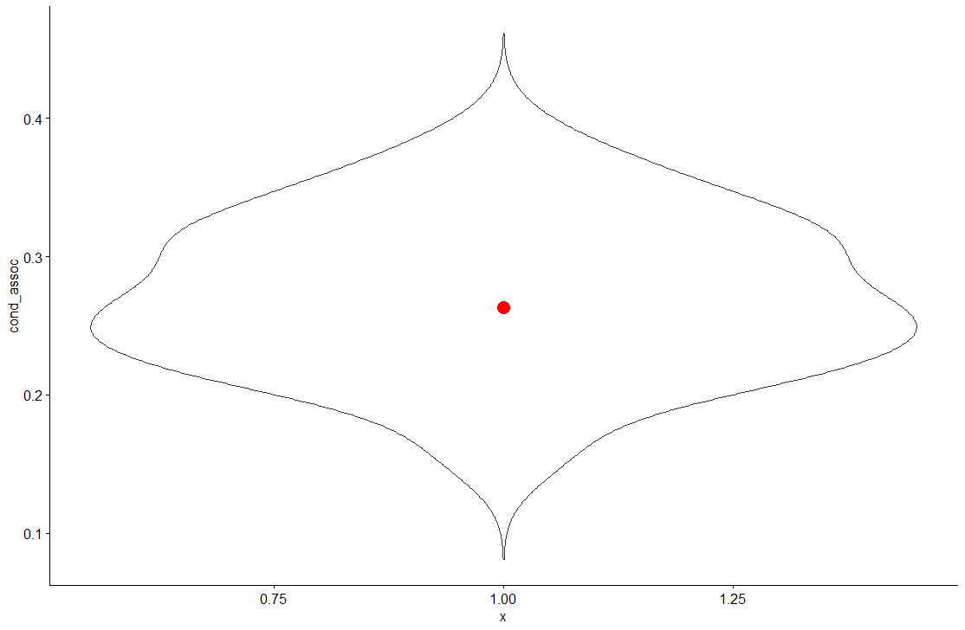
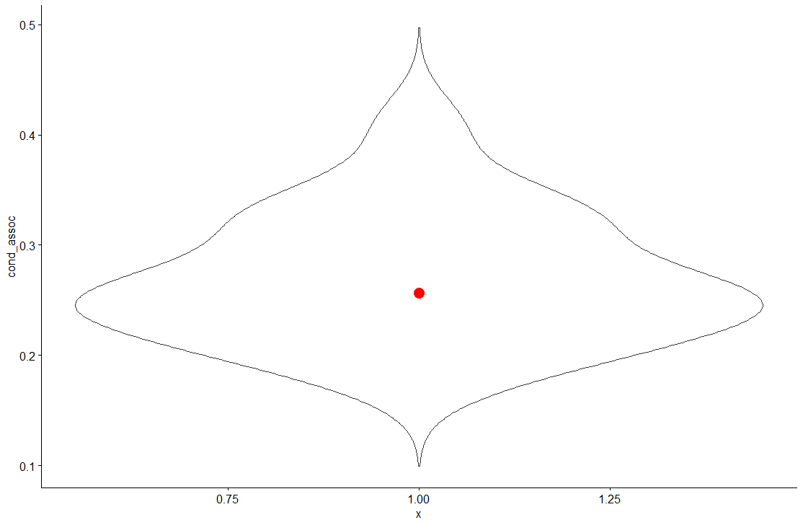
PREMUP: Manipulating prior strength
PREMUP III. Priors> Results > Object-scene association
Object-scene memory is at chance
p=.025

Slide 20
PREMUP: Manipulating prior strength
Summary
Study | Priors | Contingencies at encoding | Encoding task | Delay between memory tests
Pilot | 80-10-10 vs 33-33-33 | 80-10-10 vs 33-33-33 | Prediction | 1 week
Flat | 90-10 vs 50-50 | 50-50 vs 50-50 | Categorization | 24h
Priors | 90-10 vs 70-30 | 50-50 vs 50-50 | Categorization | 24h
Three | 90-10 vs 70-30 vs 50-50 | 90-10 vs 70-30 vs 50-50 | Prediction | 24h (!between)

Slide 21
PREMUP: Manipulating prior strength
Summary
Pilot
Three
Prediction task.
Contingencies mantained at encoding
Categorization task.
Contingencies removed at encoding
Flat
Priors

Slide 22
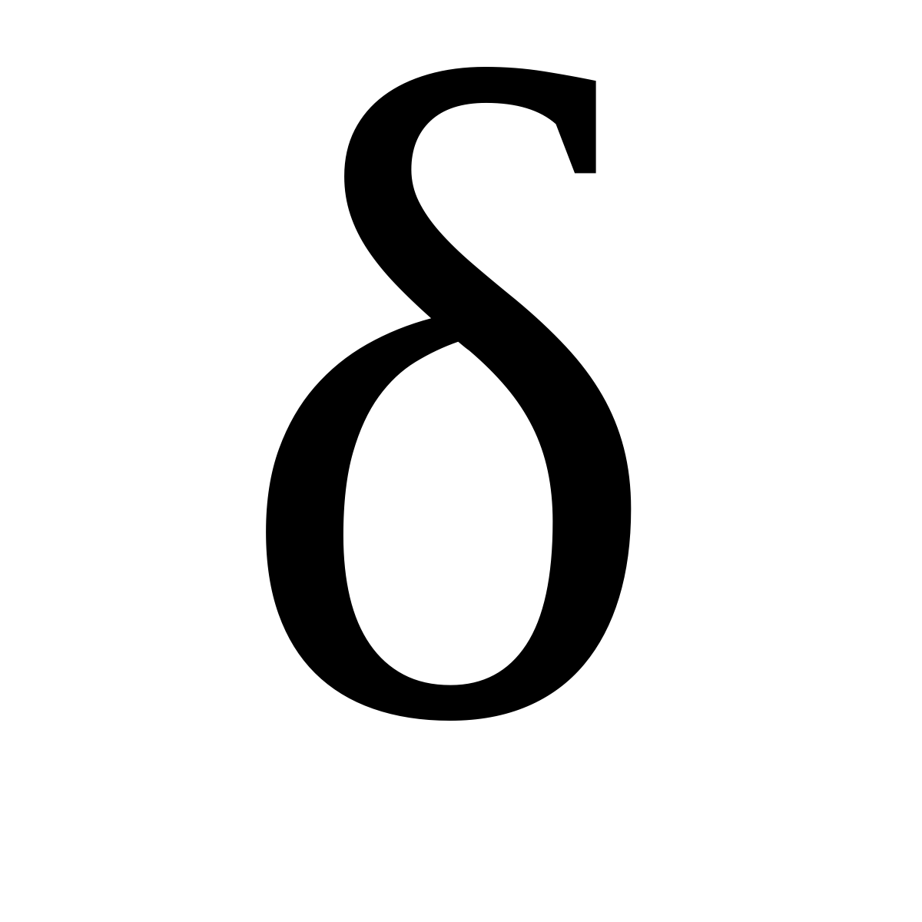
PREMUP: Insights from computational mdels
Supported by the European Research Council (ERC) Starting Grant, PIVOTAL

Slide 23
PREMUP: Why computational models?
Summary
The models allow to quantify trial by trial variables such as:
- The expecations about each object category, for every scene
- Prediction error: difference between what is observed and what is expected
Our specific goal is to link the amount of prediction error estimated by these models on the trial level to the likelihood of remembering a specific item
PE
EM

Slide 24
PREMUP: Reinforcement learning models
In reinforcement learning models, the expected values of events are updated on each trial according to the feedback received.
In PREMUP, we have several scenes that are associated with specific object categories with some probability.
The expected value Q at trial t for each category and scene is updated according to the following formula:
Q_{t +1}= Q_{t} + α · δ_{t}.

Slide 25
PREMUP: Reinforcement learning models
Q_{t +1} = Q_{t} + α · δ_{t}
The value of each category with reference to a scene is updated to the current value plus the δt, the prediction error, multiplied by the learning rate α
α = the extent to which reinforcement
on each trial is used to update choice
δ_{t} = r_{t} - Q_{t}
rº : 1 = shown; 0 = not shown

Slide 26

PREMUP: Reinforcement learning models
Q_{t} (c_{t,} j_{t}) thus refers to how strongly a category c is associated with a scene j at trial t.
Q_{t +1}(I_{t ,}M_{t}) = Q_{t}(I_{t}, M_{t}) + α · δ_{t}
δ_{t =} r_{t} – Q_{t} r_{t} = 1 , 0
α = the extent to which reinforcement
on each trial is used to update choice

Slide 27
Reinforcement learning models: Observational
Instruments Household Objects Fruits or Vegetables
Q_{t} = 0.00 0.00 0.00
r_{t} = 1 0 0
δ_{t} = r_{t} – Q_{t} 1-0.00 = 1.00 0-0.00 = 0.00 0-0.00 = 0.00
Q_{t+1} + α · δ 0.0+(0.3·1)=0.30 0.0+(0.3· 0.00)=0.00 0.00+(0.3· 0.00)=0.00

Slide 28
Reinforcement learning models: Feedback-based
Instruments Household Objects Fruits or Vegetables
Q_{t} = 0.00 0.00 0.00
r_{t} = 1 0 0
δ_{t} = r_{t} – Q_{t} 1-0.00 = 1.00 0-0.00 = 0.00 0-0.00 = 0.00
Q_{t+1} + α · δ 0.0+(0.3·1)=0.30 0.0+(0.3· 0.00)=0.00 0.00+(0.3· 0.00)=0.00

Slide 29
Reinforcement learning models: observational
Instruments Household Objects Fruits or Vegetables
Q_{t} = 0.95 0.20 0.20
R_{t} = 1 0 0
δ_{t} = r_{t} – Q_{t} 1-0.66 = 0.34 0-0.00 = 0.00 0-0.00 = 0.00
Q_{t+1} + α · δ 0.66+(0.3·0.34)=0.7 0.0+(0.3· 0.00)=0.00 0.00+(0.3·0.00)=0.00

Slide 30
Reinforcement learning models: feedback-based
Instruments Household Objects Fruits or Vegetables
Q_{t} = 0.66 0.00 0.00
R_{t} = 1 0 0
δ_{t} = r_{t} – Q_{t} 1-0.66 = 0.34 0-0.00 = 0.00 0-0.00 = 0.00
Q_{t+1} + α · δ 0.66+(0.3·0.34)=0.7 0.0+(0.3· 0.00)=0.00 0.00+(0.3·0.00)=0.00

Slide 31
Reinforcement learning models: observational
Instruments Household Objects Fruits or Vegetables
Q_{t} = 0.66 0.30 0.20
R_{t} = 0 0 1
δ_{t} = r_{t} – Q_{t} 0-0.66 = -0.66 0-0.30 = -0.30 1-0.20 = 0.80
Q_{t+1} + α · δ 0.66+(0.3·(-0.66))=0.46 0.3+(0.3· (-0.30)=0.21 0.2+(0.2·0.8)=0.36

Slide 32
Reinforcement learning models: feedback-based
Instruments Household Objects Fruits or Vegetables
Q_{t} = 0.66 0.30 0.20
R_{t} = 0 0 0
δ_{t} = r_{t} – Q_{t} 0-0.66 = -0.66 0-0.30 = -0.30 0-0.20 = -0.20
Q_{t+1} + α · δ 0.66+(0.3·(-0.66))=0.46 0.3+(0.3· (-0.30)=0.21 0.2+0.3·(-0.2)=0.14

Slide 33
Reinforcement learning models: observational
Choice-Based PE:
If participant predicted Instrument, but another object category is shown, the PE for the category chosen is < = 0. The stronger the belief, the more negative it will be.
Instruments Household Objects Fruits or Vegetables
Q_{t} = 0.66 0.30 0.20
R_{t} = 0 0 1
δ_{t} = r_{t} – Q_{t} 0-0.66 = -0.66 0-0.30 = -0.30 1-0.20 = 0.80
Q_{t+1} + α · δ 0.66+(0.3·(-0.66))=0.46 0.3+(0.3· (-0.30)=0.21 0.2+(0.2·0.8)=0.36

Slide 34
Reinforcement learning models: observational
Observation-based PE:
It depends on the object category displayed, regardless of participants’ choice. It is >=0, inversely proportional to the expected value.
Instruments Household Objects Fruits or Vegetables
Q_{t} = 0.66 0.30 0.20
R_{t} = 0 0 1
δ_{t} = r_{t} – Q_{t} 0-0.66 = -0.66 0-0.30 = -0.30 1-0.20 = 0.80
Q_{t+1} + α · δ 0.66+(0.3·(-0.66))=0.46 0.3+(0.3· (-0.30)=0.21 0.2+(0.2·0.8)=0.36

Slide 35
Reinforcement learning models: observational
Observation-based PE:
It depends on the object category displayed, regardless of participants’ choice. It is >=0, inversely proportional to the expected value.
Instruments Household Objects Fruits or Vegetables
Q_{t} = 0.66 0.30 0.20
R_{t} = 0 0 1
δ_{t} = r_{t} – Q_{t} 0-0.66 = -0.66 0-0.30 = -0.30 1-0.20 = 0.80
Q_{t+1} + α · δ 0.66+(0.3·(-0.66))=0.46 0.3+(0.3· (-0.30)=0.21 0.2+(0.2·0.8)=0.36

Slide 36
Reinforcement learning models: feedback-based
Choice-Based PE:
Same as for the observational model.
Instruments Household Objects Fruits or Vegetables
Q_{t} = 0.66 0.00 0.20
R_{t} = 0 0 0
δ_{t} = r_{t} – Q_{t} 0-0.66 = -0.66 0-0.00 = 0.00 0-0.20 = -0.20
Q_{t+1} + α · δ 0.66+(0.3·(-0.66))=0.46 0.0+(0.3· 0.00)=0.0 0.2+0.3·(-0.2)=0.14

Slide 37
Reinforcement learning models: feedback-based
Observation-based PE:
It depends on the object category displayed, In case of incorrect choice, it is always negative,and it is inversely proportional to the expected value.
Instruments Household Objects Fruits or Vegetables
Q_{t} = 0.66 0.00 0.20
R_{t} = 0 0 0
δ_{t} = r_{t} – Q_{t} 0-0.66 = -0.66 0-0.00 = 0.00 0-0.20 = -0.20
Q_{t+1} + α · δ 0.66+(0.3·(-0.66))=0.46 0.0+(0.3· 0.00)=0.0 0.2+0.3·(-0.2)=0.14

Slide 38
Reinforcement learning models: feedback-based
Observation-based PE:
It depends on the object category displayed, In case of incorrect choice, it is always negative,and it is inversely proportional to the expected value.
Instruments Household Objects Fruits or Vegetables
Q_{t} = 0.20 0.00 0.80
R_{t} = 0 0 0
δ_{t} = r_{t} – Q_{t} 0-0.20 = -0.20 0-0.00 = 0.00 0-0.80 = -0.80
Q_{t+1} + α · δ 0.2+0.3·(-0.2)=0.14 0.0+(0.3· 0.00)=0.0 0.8+0.3·(-0.8)=0.56

Slide 39
PREMUP: Reinforcement learning models
Learning rates that best accounted for behavioural data were estimated for each participant through maximum likelihood estimation, which consists in finding the values that maximize the likelihood of choice probability, given the model and the parameter.
Models with the best fitting learning rate for each participant were fitted to the data to derive trial-level PE.
Notes:
Here a

Slide 40
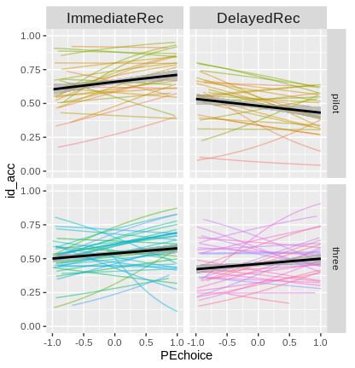
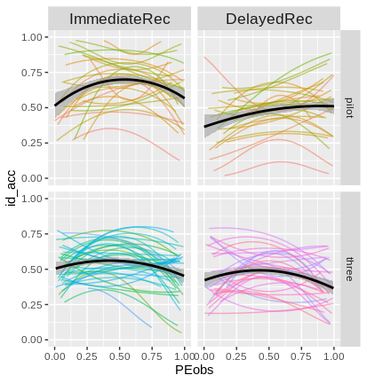
PREMUP: Reinforcement learning models
Choice PE model
Observational PE model
Choice based-PE effect on memory
Observational-PE effect on memory
Notes:
Here a

Slide 41
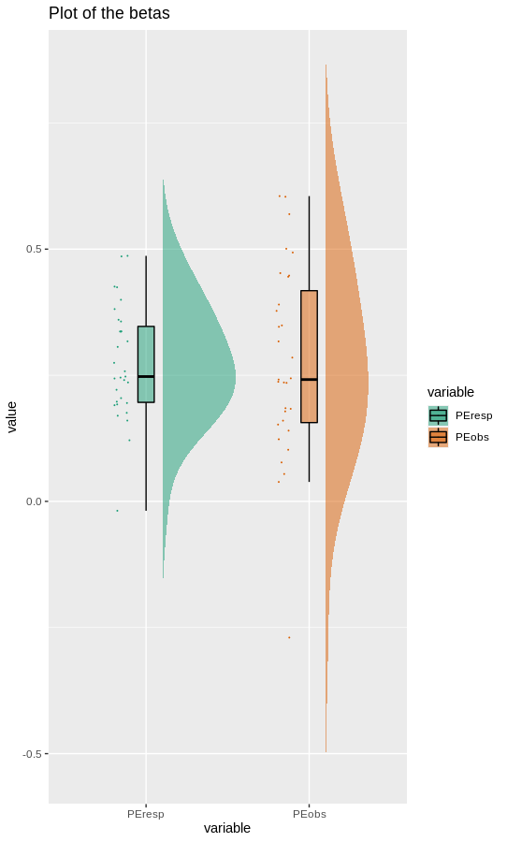
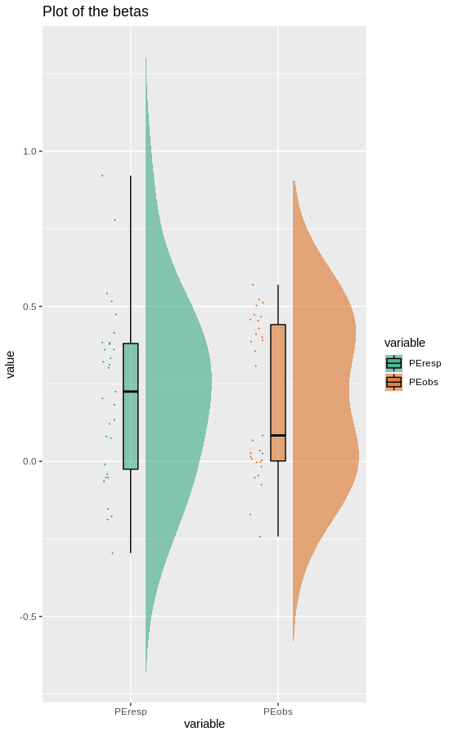
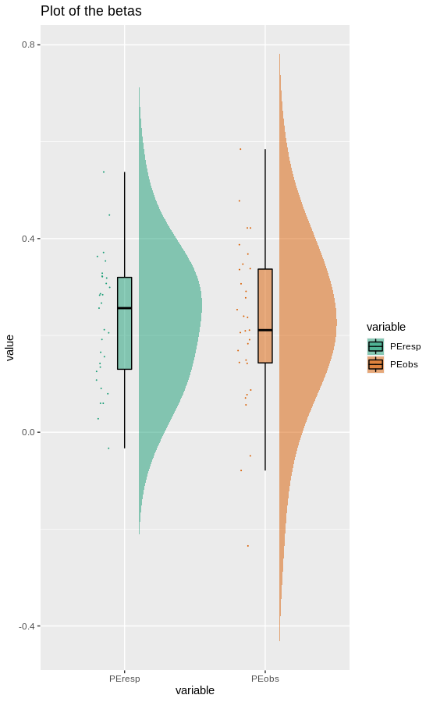
Reinforcement learning models: PILOT
Immediate
Delayed
All
Observational PE
Notes:
Here a

Slide 42
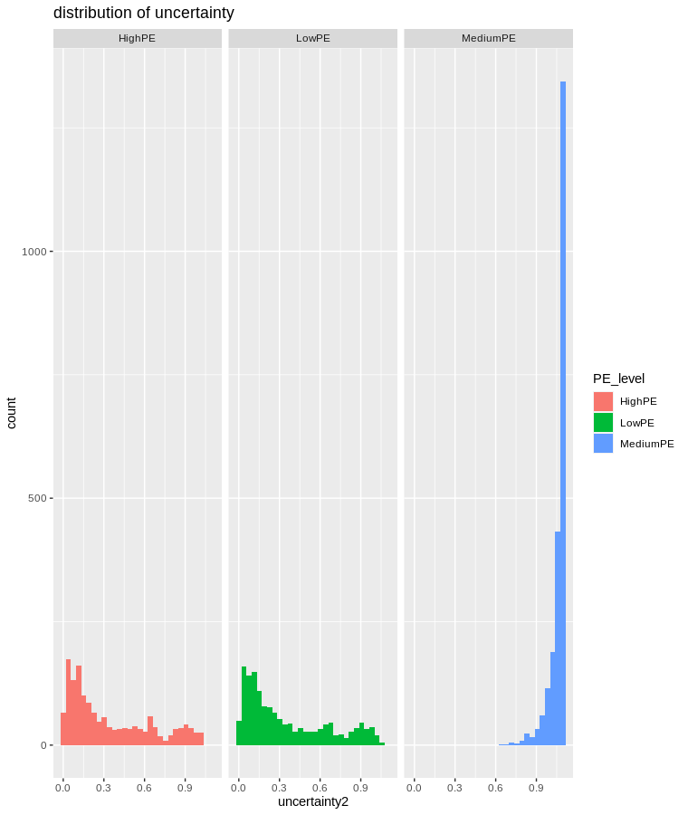
Reinforcement learning models: PILOT
Uncertainty
Notes:
Here a

Slide 43
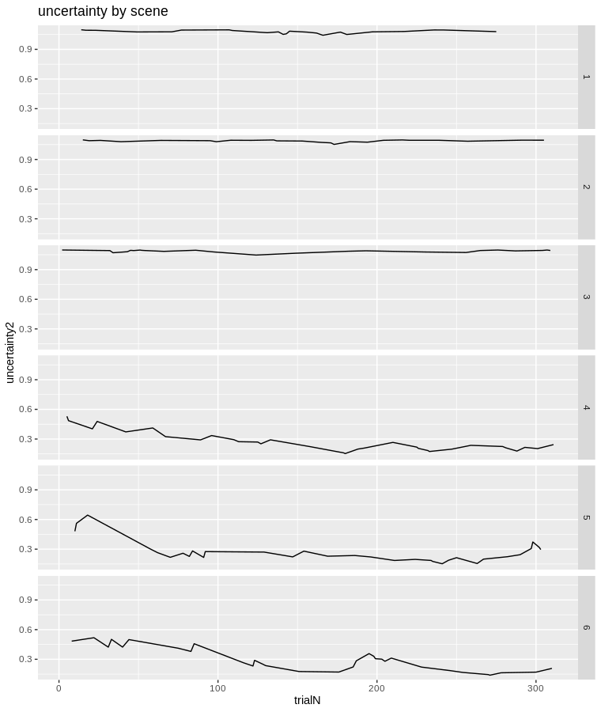
Reinforcement learning models: PILOT
Uncertainty
Notes:
Here a

Slide 44
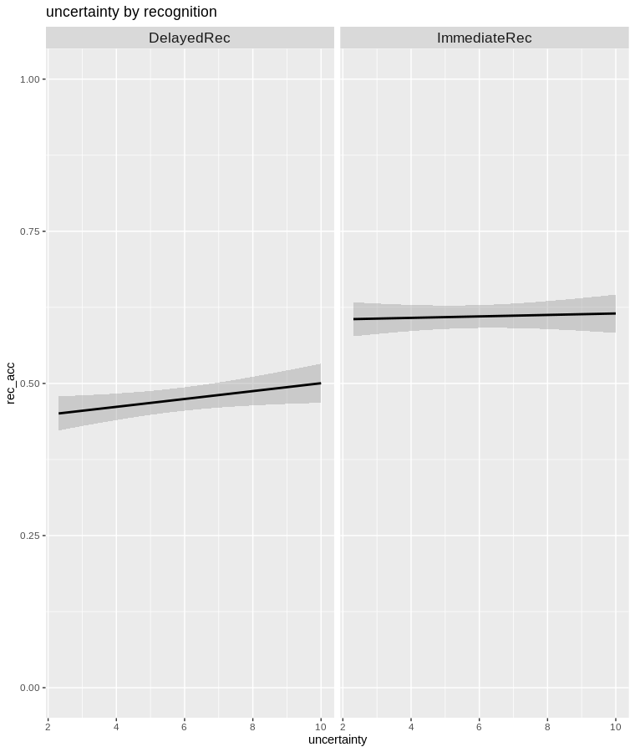
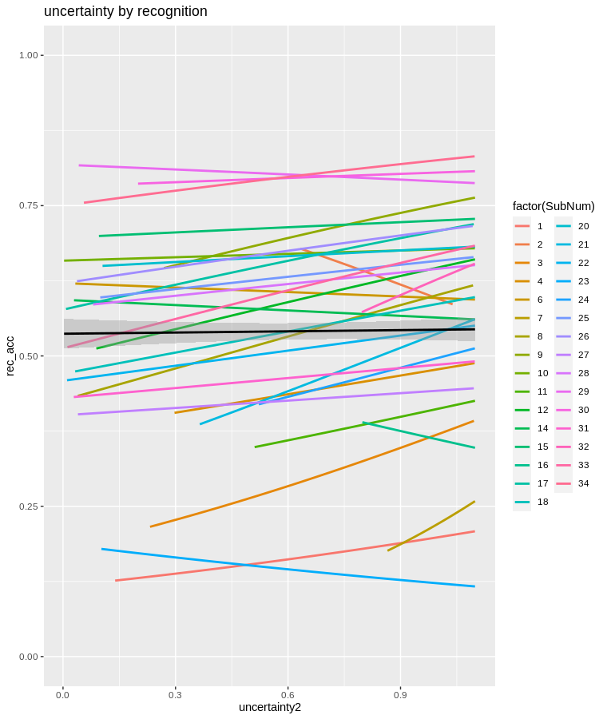
Reinforcement learning models: PILOT
Uncertainty
Fixed effects:
Estimate Std. Error z value Pr(>|z|)
(Intercept) -0.34311 0.16782 -2.045 0.04090 *
uncertainty2 0.30688 0.11243 2.729 0.00634 **
sessionImmediateRec 0.65706 0.15583 4.217 2.48e-05 ***
uncertainty2:sessionImmediateRec -0.02457 0.18850 -0.130 0.89628
---
Notes:
Here a

Slide 45
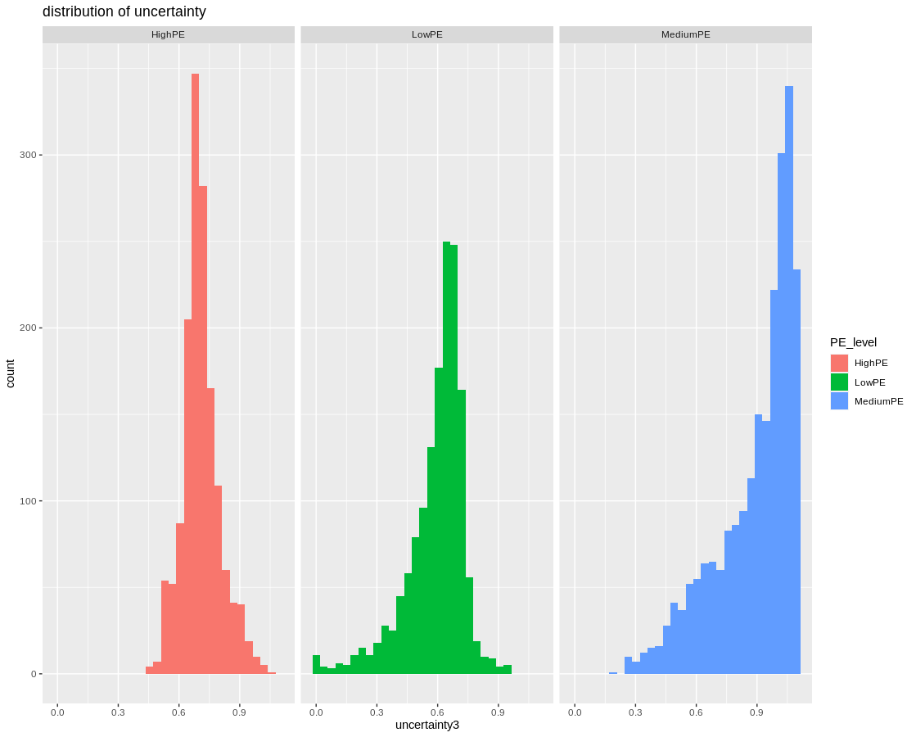
Reinforcement learning models: PILOT
PE_level mean
<fct> <dbl>
1 HighPE 0.708
2 LowPE 0.592
3 MediumPE 0.890
Notes:
Here a

Slide 46
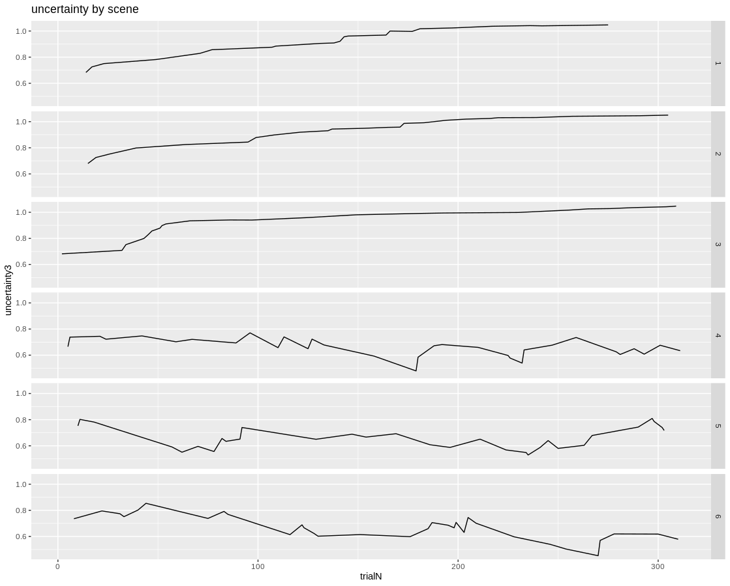
Reinforcement learning models: PILOT
Notes:
Here a

Slide 47
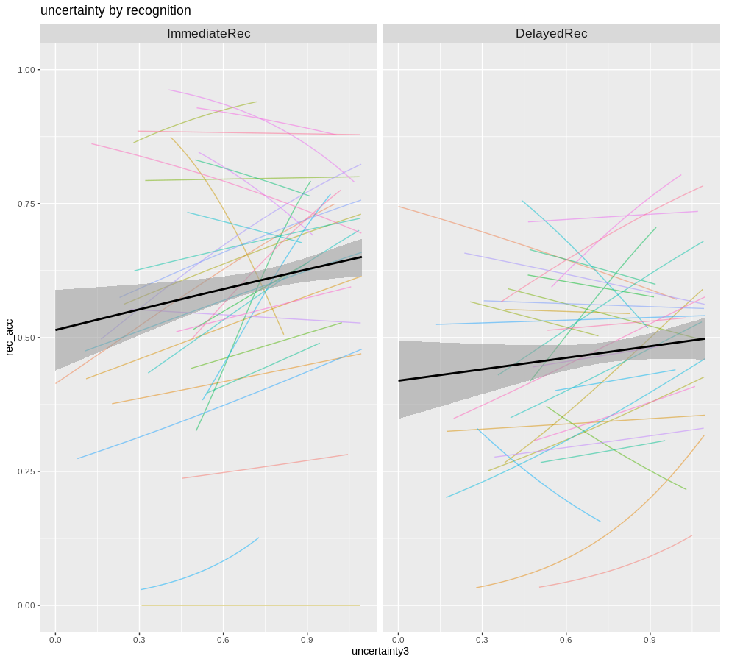
Reinforcement learning models: PILOT
Chisq Df Pr(>Chisq)
uncertainty3 11.1297 1 0.0008496 ***
rec_session 14.3043 1 0.0001555 ***
uncertainty3:rec_session 0.3217 1 0.5706117
(Intercept) 0.55081 0.05763 4736.41732 9.557 <2e-16 ***
uncertainty3 -0.07704 0.10578 603.20038 -0.728 0.4667
PEobs -0.17305 0.10553 177.88065 -1.640 0.1028
uncertainty3:PEobs 0.30881 0.15712 273.21862 1.965 0.0504 .
If we exclude participants (d prime, immediate rec)
Response: rec_acc
Chisq Df Pr(>Chisq)
(Intercept) 73.1253 1 < 2e-16 ***
uncertainty3 0.9042 1 0.34167
PEobs 3.0302 1 0.08173 .
uncertainty3:PEobs 4.7051 1 0.03007 *
Notes:
Here a

Slide 48
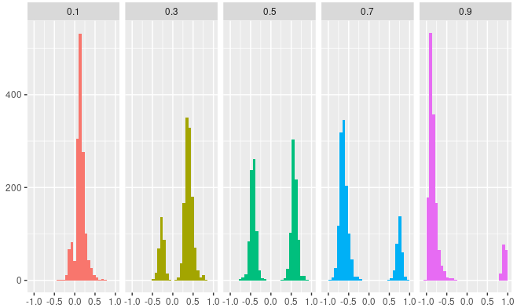
Reinforcement learning models: THREE
Distribution of choice-based PE by condition
Notes:
Here a

Slide 49

Reinforcement learning models: THREE
Session
Effect of Choice-based PE (p < .001).
No interaction between session and PE (p = .702).
Choice-based PE
Notes:
Here a

Slide 50

Reinforcement learning models: THREE
Distribution of observational PE by condition
Notes:
Here a

Slide 51

Reinforcement learning models: THREE
Session
Main effect of Choice-based PE (p < .001). Linear component estimate = -4.28, p = .041; quadratic component estimate = -11.01, p < 0.001.
No interaction between session and PE (p = 0.245).
Observational PE
Notes:
Here a

Slide 52



Reinforcement learning models: THREE
Immediate
All
Delayed
Observational PE
Notes:
Here a

Slide 53

Reinforcement learning models: THREE
Peobs vs PEchoice
Notes:
Here a

Slide 54

Reinforcement learning models: THREE (obs)
Peobs vs PEchoice
Notes:
Here a

Slide 55

Reinforcement learning models: THREE
Peobs vs PEchoice
Notes:
Here a

Slide 56


Reinforcement learning models: THREE
Uncertainty
Observational PE
Notes:
Here a

Slide 57

Reinforcement learning models: THREE
Uncertainty
Estimate Std. Error z value Pr(>|z|)
(Intercept) -0.3685 0.1016 -3.628 0.000286 ***
uncertainty2 0.3774 0.1787 2.112 0.034647 *
sessionImmediateRec 0.2857 0.1383 2.066 0.038807 *
uncertainty2:sessionImmediateRec 0.3108 0.2463 1.262 0.206994
---
Notes:
Here a

Slide 58
Reinforcement learning models: THREE
Uncertainty
Estimate Std. Error z value Pr(>|z|)
(Intercept) -0.3685 0.1016 -3.628 0.000286 ***
uncertainty2 0.3774 0.1787 2.112 0.034647 *
sessionImmediateRec 0.2857 0.1383 2.066 0.038807 *
uncertainty2:sessionImmediateRec 0.3108 0.2463 1.262 0.206994
---
Notes:
Here a

Slide 59


PREMUP: Computational model
Summary Choice-based PE
Pilot
Three
Prediction task.
Contingencies mantained at encoding

Slide 60




PREMUP: Computational model
Summary Observational PE
Pilot
Three
Prediction task.
Contingencies mantained at encoding
Categorization task.
Contingencies removed at encoding
Flat
Priors

Slide 61
PREMUP: Manipulating prior strength
Summary
I.a) Attention-detraction hypothesis. In situations under which predictions cannot be established (i.e., around intermediate levels of contingency), attention gets diverted from the main prediction task and towards the objects themselves. On doing so, encoding of those items gets improved and so does recognition memory for the object identity. If this were true, one might argue that memory for the object-scene associations should follow a similar (but inverted) pattern: memory for those objects for which the associated scene was remembered, were more often missed in the memory test.
I.b) Statistical learning vs episodic encoding. This would be the same as above but framing it from the opposite perspective. Akin to the Sherman & Turk-Browne (2020, PNAS), when predictions can be properly made (i.e., when a predictive model of the situation is available) there's little reason to acquire new information; however, in the absence of such a model, information still needs to be gathered. If this were true, then we might expect memory for the objects to decay as a function of time during the learning phase; however, we only have memory for the encoding phase in which the model has (supposedly) already been built; this would be tricky to measure (please, share any ideas here). In addition, we would also probably expect object-scene association memory to follow the same pattern (i.e., better for intermediate PE levels) since participants would still be in "encoding mode".
II) Feedback-based PE. In situations in which a discrete prediction has been made (in our task we are forcing participants to collapse their prior distributions into one response), the outcome of your prediction has a positive (when the response is correct) or negative (when the response is incorrect) effect on the encoding of the item. Critically, this effect is modulated by the likelihood of getting a correct or an incorrect response. Namely, an unlikely correct response gets (rewarded and) better encoded than a likely correct one; conversely, a likely incorrect response gets (less punished and) better encoded than an unlikely incorrect one. All this can be summarized with the feedback-based PE that Francesco has used before by saying that signed PE is positively related to episodic memory encoding. This is also related to this paper (https://link.springer.com/article/10.3758/s13415-014-0333-4) linking pupil dilation to PE as a function of task performance.

