Slide 1


Reversal learning and episodic memory as a function of prediction error valence and depressive and anhedonic symptoms
Stefanie Türk
Supervisor: Francesco Pupillo

Slide 2
Outline
Background
Aims
Method
Hypotheses
Data analysis
Results of pilot data
Open questions/issues

Slide 3
Outline
Background
Aims
Method
Hypotheses
Data analysis
Results of pilot data
Open questions/issues

Slide 4

Background
Depressed individuals show altered learning from reward/punishment (e.g., Eshel & Roiser, 2010; Mukherjee et al., 2020; Levy-Gigi & Kéri, 2015)
Hypersensitivity to negative outcomes and hyposensitivity to positive outcomes are often reported (Eshel & Roiser, 2010), but inconsistencies remain (Mukherjee et al., 2020)
Blunted reward sensitivity in depressed individuals has been connected to the severity of anhedonic symptoms (Pizzagalli et al., 2008), while depression in general has been connected to higher sensitivity to punishment (Kim et al., 2021)
PE processing in depressed individuals is connected to neuronal anomalies in connection with altered functioning of dopaminergic systems, especially the striatum (e.g., Eshel & Roiser, 2010; Gradin et al., 2011; Keren et al., 2018; Robinson et al., 2012)
Negative beliefs about the environment are not updated properly in depression after novel positive experiences (“cognitive immunization”) (e.g., Kube et al., 2020)
Notes:
Mukherjee et al., 2020 report blunted learning form reward AND punishment (no hypersensitivity to punishment). This might be due to a lack of controlling for anhedonia in their study (they did measure anhedonia with the SHAPS, but do not include this in the analyses) → their participants might just be very anhedonic

Slide 5
Background
Healthy individuals show higher learning rates from positive PE, however, this might be a consequence of confirmation bias rather than a true effect of PE valence (Palminteri et al., 2017)
Valence biases also modulate subsequent episodic memory: Those individuals who prioritized worse-than-expected outcomes also show better memory for images paired with negative outcomes and vice versa (Rosenbaum et al., 2022)
Findings regarding episodic memory have been mixed with enhanced memory being reported for positive (Jang et al., 2019; Rouhani et al., 2018), negative (Kalbe & Schwabe, 2019) or unsigned PE (Rouhani & Niv, 2021)
Notes:
Confirmation bias in healthy individuals potentially relies on task structure: In a task in which the goal is to maximize gain, higher positive learning rate is a more optimal strategy, while the opposite should be true in a task in which the goal is to minimize losses.

Slide 6
Outline
Background
Aims
Method
Hypotheses
Data analysis
Results of pilot data
Open questions/issues

Slide 7
Aims
Disentangle effects of depression and anhedonia on reward and punishment learning
Investigate biases in healthy individuals using a paradigm that might alleviate confirmation bias (Chabon et al., 2020)
Investigate the role of positive and negative prediction errors on episodic memory in relation to depressive and anhedonic symptoms

Slide 8
Outline
Background
Aims
Method
Hypotheses
Data analysis
Results of pilot data
Open questions/issues

Slide 9
Method
Participants
Community sample (age: 18-35 years, not medicated, not in treatment for depression)
Sample sizes range greatly from 27 to 568 (e.g., Levy-Gigi & Kéri, 2015; Mukherjee et al., 2021; Robinson et al., 2012; Wilkinson et al., 2021)
G*Power: Calculation for an F-test with two groups with Cohen’s f = 0.688 (Robinson et al., 2010):30 individuals
Recruit via Prolific
Notes:
We use a dimensional approach testing a community sample of individuals with no current medication or treatment of depression → more or less depressive/anhedonic persons
I took a medium effect size from Robinson et al. (2010), however, it should be noted that their effect sizes are extremely large

Slide 10
Method
Structure
Scales
Reversal Learning (RL) experiment
Surprise memory test

Slide 11
Method
Scales
Factors:
Anhedonia: Snaith-Hamilton Pleasure Scale (SHAPS; Snaith et al., 1995)
Depressive symptoms: Beck-Depression Inventory II (BDI-II; Beck et al., 1996)
Covariates
Positive/negative affect: Possitive and Negative Affect Schedule (PANAS; Watson et al., 1988)
Anxiety: State-Trait-Anxiety Inventory for Adults (STAI-AD; Spielberger, 1983)
Notes:
Factors:
Anhedonia
General depressive symptoms (also measures anhedonia (“loss of pleasure”) with one item
Co-variates:
PANAS: current positive and negative affective state (“moment instruction”, Watson et al., 1988)
Anxiety: Xia et al., 2021 → anxiety is related to reduced sensitivity for negative feedback and consequently poorer performance in reversal learning; anxiety shows a high comorbidity with depression, therefore, we control for it in the inferential statistical analyses
Scales are presented in randomized order

Slide 12
Method
Scales
Control questions
Type I: “If you are still attentive to the test, please press the number 1.”
Type II: Inversed items (e.g., “I don’t feel calm” for item “I feel calm” of the STAI state questionnaire)

Slide 13
Method
Material
Four randomly selected pairs of Japanese symbols (ｺ - ｵ, ｲ - ｷ, ｼ - ﾌ)
256 object images (O-MINDS software, Duncan Lab, https://github.com/DuncanLab/OMINDS): 128 for encoding phase, 128 for retrieval phase; matched for nameability, memorability and emotionality

Slide 14
Method
Procedure – Reversal learning
Probabilistic reversal learning paradigm with four blockwise conditions: reward condition, reversal reward-to-punishment, punishment condition, reversal punishment-to-reward
Counterbalanced order (reward fist or punishment first)
Contingencies: 75% / 25%
32 trials per block → 128 trials in total

Slide 15
Method
Procedure – Reversal learning
ｺ
ｵ
ｺ
ｵ
Will the highlighted symbol lead to a positive (+0.10€, -0€) or a negative (-0.10€, +0€) outcome?
See also Robinson et al., 2010, 2012
Notes:
Presentation of two symbols
After 1 second, one of the symbols is highlighted with a black box
From the timepoint of highlighting, the participant has 1.5 seconds to make a prediction of whether the highlighted symbol will lead to a positive or a negative outcome. The positive outcome is either winning 10 cents (reward condition) or losing nothing (punishment condition) and the negative outcome is either winning nothing (reward condition) or losing 10 cents (punishment condition)

Slide 16
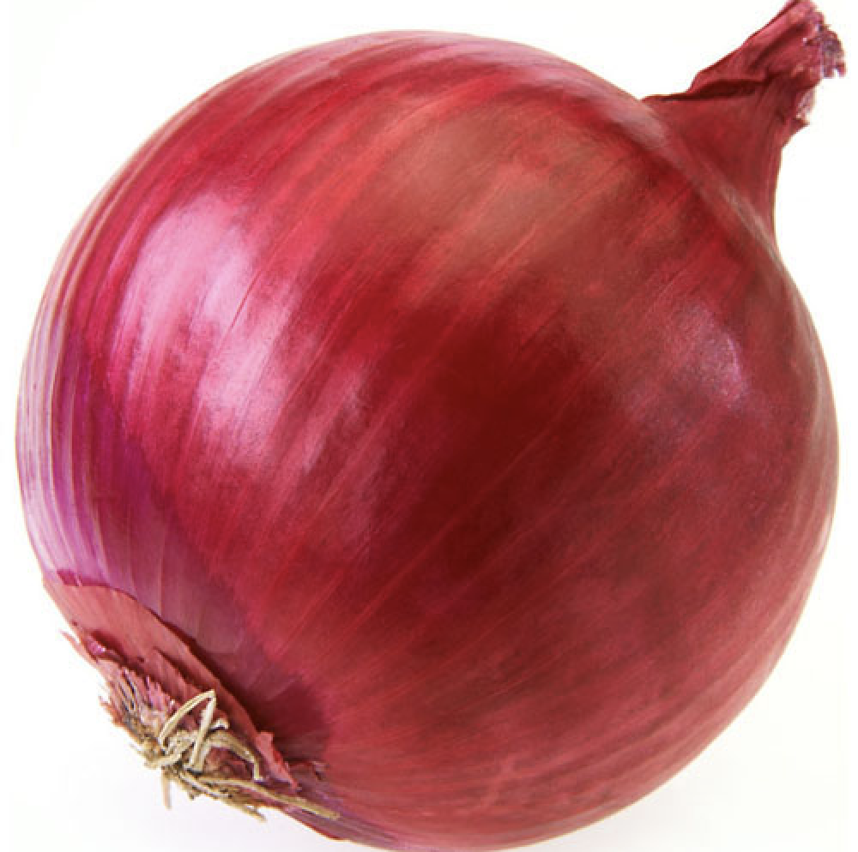
Method
Procedure – Reversal Learning
+ 0.10€
Your prediction:
+ 0.10€
Participant’s prediction
Actual outcome
Notes:
After a prediciton has been given, the participant is shown their prediction and afterwards the actual outcome associated with the highlighted symbol
A trial-unique object is presented with the outcome
Prediction should be updated based on the congruency between prediction and actual outcome

Slide 17
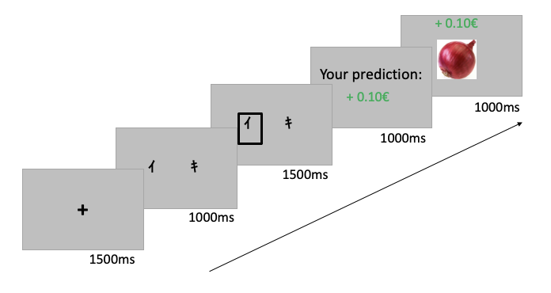
Method
Procedure – Reversal Learning
Notes:
Demonstration of experiment via Pavlovia

Slide 18
Method
Procedure – Memory experiment
Surprise memory test
256 object images (128 old, 128 new) in randomized order
Old/new rating
Certainty rating

Slide 19
Method
Procedure - Memory experiment
1 = Sure new 2 = Maybe new 3 = Guess new 4 = Guess old 5 = Maybe old 6 = Sure old
Is this object old or new? How sure are you?

Slide 20
Outline
Background
Aims
Method
Hypotheses
Data analysis
Results of pilot data
Open questions/issues

Slide 21
Hypotheses
More anhedonic individuals show higher error rates/higher reaction times for trials in the reward condition compared to trials in the punishment condition
More depressive individuals show lower error rates/lower reaction times for trials in the punishment condition compared to trials in the reward condition
After a switch from punishment to reward, more anhedonic individuals show higher error rates due to failed updating of negative predictions
After a switch from reward to punishment, more depressive individuals show lower error rates due to congruency with negative prediction bias
Biases in the learning phase modulate subsequent memory performance

Slide 22
Outline
Background
Aims
Method
Hypotheses
Data analysis
Results of pilot data
Open questions/issues

Slide 23
Data analysis
Hypothesis testing
Logistic mixed effects model with BDI, SHAPS and block condition as fixed effects and by-subject (and by-image) random intercepts
Covariates
PANAS
STAI
Education (years of schooling)

Slide 24
Outline
Background
Aims
Method
Hypotheses
Data analysis
Results of pilot data
Open questions/issues

Slide 25
Pilot data
Participants
N = 5 (4 female), aged between 18 and 35
Scale results
participant | BDI | SHAPS | PANAS_pos | PANAS_neg | STAI_state | STAI_trait
1 | 9 | 1 | 21 | 17 | 33 | 45
2 | 1 | 1 | 40 | 20 | 20 | 21
6 | 13 | 0 | 19 | 28 | 62 | 57
9 | 27 | 4 | 22 | 32 | 57 | 56
11 | 4 | 1 | 29 | 15 | 25 | 35
Notes:
BDI: range 0-63; 0-8: no depression; 9-13: minimal depression; 14-19: slightly depressed; 20-28: medium depression; 29+: very depressed
SHAPS: range 0-14; higher values = higher anhedonia; cutoff: 3
PANAS: range: 10-50; higher values = higher levels of current affective state
STAI: range: 20-80; higher values = higher anxiety; STAI scores are commonly classified as “no or low anxiety” (20-37), “moderate anxiety” (38-44), and “high anxiety” (45-80).

Slide 26
Pilot data
Repetition of practice loop:
Overall errors in RL task:
Participant | nReps
1 | 3
2 | 2
6 | 2
9 | 1
11 | 2
Mean | 2
Participant | Error rates
1 | 39.58%
2 | 52.08%
6 | 42.71%
9 | 42.71%
11 | 34.83%
Mean | 42.29%
Notes:
Participants have to achieve a minimum of 70% correct predictions on congruent trials to continue with the main experiment; the maximum number of reps is 4
All participants but one had to repeat the practice loop; one participant repeated twice
Overall error rates in the reversal learning task was around 40% for the majority of participants; one participants scored more than 50% erros (worse than chance level)
Task in general rather difficult; compared to Robinson et al. (2010, 2012) error rates are much higher in our task → maybe symbols are the problem?

Slide 27
Pilot data
Error rates per block condition:
Participant | Reward | Punishment | R-to-P | P-to-R
1 | 25.00% | 50.00% | 45.83% | 37.50%
2 | 41.67% | 58.33% | 58.33% | 50.00%
6 | 41.67% | 37.50% | 45.83% | 45.83%
9 | 29.17% | 75.00% | 37.50% | 29.17%
11 | 25.00% | 29.17% | 54.17% | 29.17%
Mean | 32.50% | 50.00% | 48.33% | 38.33%
Notes. R-to-P: switch-trials from reward to punishment condition, P-to-R: switch-trials from punishment to reward condition.
Notes:
Note: only congruent trials were analyzed
Overall, error rates were higher for the punishment condition and the switch from reward to punishment → unexpected punishment did not change the prediction in the same way as unexpected reward did

Slide 28
Pilot data
GLM for error rates:
Full model: accuracy ~ PANAS_pos + PANAS_neg + STAI_state + STAI_trait + SHAPS*BDI*Block_cond + (1|participant)
Run models:
errors ~ BDI*Block_cond + (1|participant)
Significant main effect of Block condition (W(3) = 9.812, p = .020), tendency toward a significant interaction between BDI and Block condition (W(3) 7.392, p = .060)
errors ~ SHAPS*Block_cond + (1|participant)
Significant main effect of Block condition (W(3) = 9.270, p = .026), significant interaction between SHAPS and Block condition (W(3) = 10.100, p = .018)
Notes:
I ran a logistic mixed effects model with accuracy (0 and 1)
The full model resulted in singular fit → there is not enough data to run the full model; dropping the covariates did not help; a model with SHAPS and BDI did also result in a singular fit
Subsequent inferential statistical analysis was not possible due to singular fit
Pairwise comparisons of error rates between Block conditions were not significant after Bonferroni correction

Slide 29
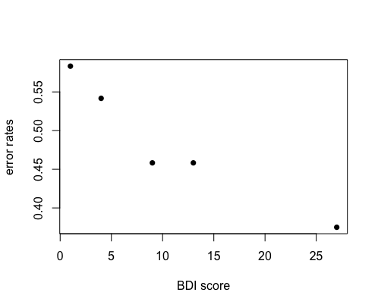
Pilot data
Significant main effect of Block condition (W(3) = 9.812, p = .020), tendency toward a significant interaction between BDI and Block condition (W(3) 7.392, p = .060)
BDI scores significantly predicted errors in reward to punishment trials (r = -0.952, p = .013) → higher BDI scores are connected to better performance in reward to punishment trials
No other results were significant
→ higher depressive values are connected to better performance in switching from reward to punishment
In accordance with higher sensitivity to negative outcomes

Slide 30
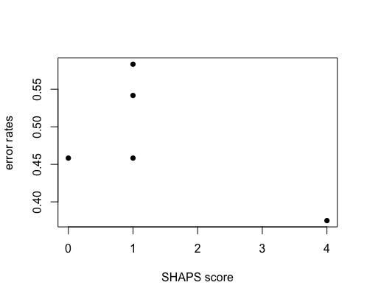
Pilot data
Significant main effect of Block condition (W(3) = 9.270, p = .026), significant interaction between SHAPS and Block condition (W(3) = 10.100, p = .018)
SHAPS scores were slightly correlated with error rates in punishment trials (r = 0.805, p = .100)
→ higher anhedonic values are connected to higher error rates in punishment trials

Slide 31
Pilot data
Error rates per block condition:
Participant | Reward | Punishment | R-to-P | P-to-R | BDI | SHAPS
1 | 25.00% | 50.00% | 45.83% | 37.50% | 9 | 1
2 | 41.67% | 58.33% | 58.33% | 50.00% | 1 | 1
6 | 41.67% | 37.50% | 45.83% | 45.83% | 13 | 0
9 | 29.17% | 75.00% | 37.50% | 29.17% | 27 | 4
11 | 25.00% | 29.17% | 54.17% | 29.17% | 4 | 1
Mean | 32.50% | 50.00% | 48.33% | 38.33% | 10.8 | 1.4
Notes:
The correlation between SHAPS and errors in punishment condition is likely to be due to an outlier: participant 9, who happens to have the highest SHAPS value, was exceptionally bad in the punishment condition
On the other hand there might be something to the correlation between BDI and switching from reward to punishment, as the relationship is there across all participants

Slide 32
Pilot data
Overall errors in memory task:
Participant | Overall error rates | False positives | False negatives
1 | 36.33% | 10.75% | 89.25%
2 | 28.13% | 77.78% | 22.22%
6 | 19.92% | 21.57% | 78.43%
9 | 29.30% | 36.00% | 64.00%
11 | 37.89% | 17.53% | 82.47%
Mean | 30.32% | 31.19% | 68.81%
Notes:
Looking more closely at the mistakes:
False positives = new items that were erroneously categorized as old
False negatives = old items that were erroneously categorized as new
→ mistakes mostly consisted in fals negatives, i.e., old items that were not correctly recognized

Slide 33
Pilot data
Error rates of old items per block condition:
Participant | Reward | Punishment | R-to-P | P-to-R
1 | 71.86% | 62.50% | 71.86% | 53.13%
2 | 3.13% | 18.75% | 25.00% | 3.13%
6 | 25.00% | 31.25% | 34.38% | 34.38%
9 | 28.13% | 59.38% | 37.50% | 25.00%
11 | 56.25% | 56.25% | 75.00% | 62.50%
Mean | 36.88% | 45.63% | 48.75% | 35.63%
Notes:
Overall, error rates were higher for the punishment condition and the switch from reward to punishment → items were better remembered when they were shown with a positive outcome; in accordance with learning data

Slide 34
Pilot data
GLM for error rates:
Full model: errors ~ PANAS_pos + PANAS_neg + STAI_state + STAI_trait + SHAPS*BDI*Block_cond + (1|participant) + (1|image)
Run models:
errors ~ BDI*Block_cond + (1|participant) + (1|image)
Significant main effect of Block condition (W(3) = 9.576, p = .023), tendency toward a significant interaction between BDI and Block condition (W(3) = 6.398, p = .094)
errors ~ SHAPS*Block_cond + (1|participant)
Significant main effect of Block condition (W(3) = 9.308, p = .026), tendency toward a significant interaction between SHAPS and Block condition (W(3) = 6.669, p = .083)
Notes:
Full model did not converge, reduced models did also not converge, except for run models
Significant difference between R-to-P and P-to-R after Bonferroni correction (p = .044)

Slide 35
Pilot data
Significant main effect of Block condition (W(3) = 9.576, p = .023), tendency toward a significant interaction between BDI and Block condition (W(3) = 6.398, p = .094)
Subsequent analyses did not show significant effects of BDI score on error rates in either of the block conditions
Significant main effect of Block condition (W(3) = 9.308, p = .026), tendency toward a significant interaction between SHAPS and Block condition (W(3) = 6.669, p = .083)
Subsequent analyses did not show significant effects of SHAPS score on error rates in either of the block conditions

Slide 36
Pilot data
Participant | Reward | Punishment | R-to-P | P-to-R | BDI | SHAPS
1 | 71.86% | 62.50% | 71.86% | 53.13% | 9 | 1
2 | 3.13% | 18.75% | 25.00% | 3.13% | 1 | 1
6 | 25.00% | 31.25% | 34.38% | 34.38% | 13 | 0
9 | 28.13% | 59.38% | 37.50% | 25.00% | 27 | 4
11 | 56.25% | 56.25% | 75.00% | 62.50% | 4 | 1
Mean | 36.88% | 45.63% | 48.75% | 35.63% | 10.8 | 1.4
Notes:
No significant effects are probably due to high error rates of participants 1 and 11 who score at a medium level in BDI and SHAPS

Slide 37
Outline
Background
Aims
Method
Hypotheses
Data analysis
Results of pilot data
Open questions/issues

Slide 38
Open questions/issues
Further analyses of learning data, e.g. ”Win-stay / lose-shift” behavior (den Ouden et al., 2013; Robinson et al. 2010)
Analyze reaction times
Further analyses of memory data, e.g. Did prediction or actual outcome or the congruency between them influence episodic memory?
Look at certainty ratings
Computational model

Slide 39
References
Beck, A. T., Steer, R. A., & Brown, G. (1996). Beck Depression Inventory–II (BDI-II) [Database record]. APA PsycTests.
Chambon, V., Théro, H., Vidal, M., Vandendriessche, H., Haggard, P., & Palminteri, S. (2020). Information about action outcomes differentially affects learning from self-determined versus imposed choices. Nature Human Behaviour, 4(10), 1067–1079. https://doi.org/10.1038/s41562-020-0919-5
Eshel, N., & Roiser, J.P. (2010). Reward and Punishment Processing in Depression. Biological Psychiatry, 68(2), 118-124. https://doi.org/10.1016/j.biopsych.2010.01.027
Gradin, V.B., Kumar, P., Waiter, G., Ahearn, T., Stickle, C., Milders, M., Reid, I., Hall, J., & Steele, J. D. (2011). Expected value and prediction error abnormalities in depression and schizophrenia. Brain, 134, 1751-1764. https://doi.org/ 10.1093/brain/awr059
Jang, A. I., Nassar, M. R., Dillon, D. G., & Frank, M. J. (2019). Positive reward prediction errors during decision making strengthen memory encoding. Nature Human Behaviour, 3(7), 719–732. https://doi.org/10.1038/s41562-019-0597-3.
Kalbe, F., & Schwabe, L. (2019). Beyond arousal: Prediction error related to aversive events promotes episodic memory formation. Journal of Experimental Psychology: Learning, Memory, and Cognition, 46 (2), 234–246. http://dx.doi.org/10.1037/xlm0000728

Slide 40
Keren, H., O’Callaghan, G., Vidal-Ribas, P., Buzzell, G.A.,Brotman, M. A., Leibenluft, E., Pan, P. M., Meffert, L., Kaiser, A., Wolke, S., Pine, D. S., & Stringaris, A. (2018). Reward Processing in depression: A conceptual and meta-analytic review across fMRI and EEG studies. American Journal of Psychiatry, 175(11), 1111-1120. https://doi.org/10.1176/appi.ajp.2018.17101124
Kim, D., Lam, J., Kutz, A., & Yoon, K. L. (2021). Punishment sensitivity and risk taking in depressed mood. Motivation and Emotion, 45(1), 122–130. https://doi.org/10.1007/s11031-020-09860-4
Kube, T., Schwarting, R., Rozenkrantz, L., Glombiewski, J. A., & Rief, W. (2020). Distorted cognitive processes in major depression: a predictive processing perspective. Biological Psychiatry, 87, 388–398. https://doi.org/10.1016/j.biopsych.2019.07.017
Mukherjee, D., Filipowicz, A. L. S., Vo, K., Satterthwaite, T. D., & Kable, J. W. () Reward and punishment reversal learning in major depressive disorder. Journal of Abnormal Psychology, 129(8), 810-823. https://doi.org/10.1037/abn0000641
Palminteri S., Lefebvre G., Kilford E. J., & Blakemore S.-J. (2017). Confirmation bias in human reinforcement learning: Evidence from counterfactual feedback processing. PLoS Computational Biology, 13(8), e1005684. https://doi.org/10.1371/ journal.pcbi.1005684
Pizzagalli, D. A., Iosifescu, D., Hallett, L. A., Ratner, K. G., & Fava, M. (2008). Reduced hedonic capacity in major depressive disorder: Evidence from a probabilistic reward task. Journal of Psychiatric Research 43, 76–87. https://doi.org/10.1016/j.jpsychires.2008.03.001
Robinson O. J., Frank, M. J., Sahakian, B. J., & Cools, R. (2010). Dissociable responses to punishment in distinct striatal regions during reversal learning. NeuroImage, 51(4-4), 1459–1467. https://doi.org/10.1016/j.neuroimage.2010.03.036

Slide 41
Robinson, O. J., Cools, R., Carlisi, C. O., Sahakian, B. J.,. Drevets, W. C. (2012). Ventral striatum response during reward and punishment reversal learning in unmedicated Major Depressive Disorder. American Journal of Psychiatry, 169(2), 152–159. https://doi.org/10.1176/appi.ajp.2011.11010137
Rosenbaum, G. M., Grassie, H. L., & Hartley, C. A. (2022). Valence biases in reinforcement learning shift across adolescence and modulate subsequent memory. eLife, 11, e64620. https://doi.org/10.7554/eLife.64620
Rouhani, N., & Niv, Y. (2021). Signed and unsigned reward prediction errors dynamically enhance learning and memory. eLife, 10, e61077. https://doi.org/10.7554/eLife.61077
Rouhani, N., Normana, K. A., & Niv, Y. (2018). Dissociable effects of surprising rewards on learning and memory. Journal of Experimental Psychology: Learning, Memory, and Cognition, 44(9), 1430–1443. https://doi.org/10.1037/xlm0000518
Snaith, R., Hamilton, M., Morley, S., Humayan, A., Hargreaves, D., & Trigwell, P. (1995). A Scale for the Assessment of Hedonic Tone the Snaith–Hamilton Pleasure Scale. The British Journal of Psychiatry, 167(1), 99-103. https://doi.org/10.1192/bjp.167.1.99
Spielberger, C. D. (1983). State-Trait Anxiety Inventory for Adults (STAI-AD) [Database record]. APA PsycTests.
Watson, D., Clark, L. A., & Tellegen, A. (1988). Development and validation of brief measures of positive and negative affect: the PANAS scales. Journal of Personality and Social Psychology, 54(6), 1063. https://doi.org/10.1037//0022-3514.54.6.1063

