Slide 1
Brain Tumor (Glioblastoma) Segmentation using Neural Networks
MIDS
Team 10
Fides, Jaya, Satvik, Tego

Slide 2
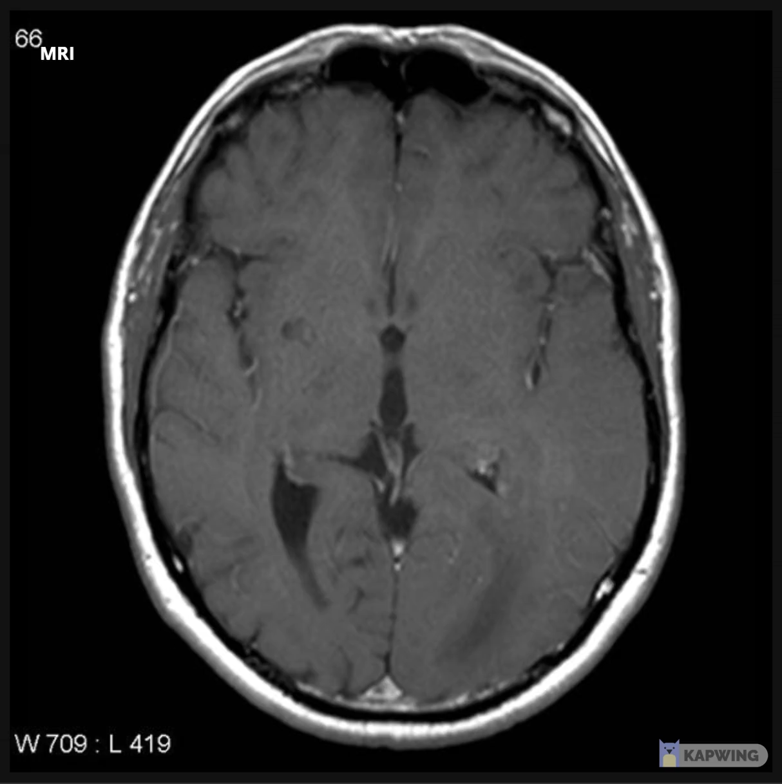

Why we do it?
Background
Motivation
Glioblastoma multiforme (GBM) is a WHO grade IV brain tumor with a 5-year survival rate of only 7.2%.
The first line therapy is MRI-guided surgery
Relies on the ability of the surgeon to distinguish the tumor tissue from healthy brain tissue.
Eliminate the gap between radiologists and neurosurgeons.
Radiologists are used to seeing 2D images in sequence and transforming them into a 3D image in their head;
Neurosurgeons are used to seeing and touching the actual tumor tissue.
Images above are from: https://radiopaedia.org/?lang=us

Slide 3
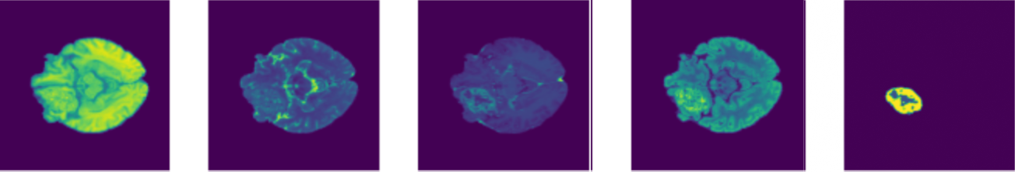


Image Segmentation for Brain Tumor
T1
T2
T1 - post-contrast
T2 - FLAIR
Segmentation
As the BraTS dataset is 150GB in total, we stored it in Google Drive.
Mount Drive to Colab Pro and train model with GPU.
$$\begin{matrix}0 & 0 & 0 \\ 0 & 2 & 2 \\ \begin{aligned}0 \\ 2 \\ 2 \\ 2 \\ 2 \\ 0\end{aligned} & \begin{aligned}4 \\ 4 \\ 2 \\ 2 \\ 2 \\ 0\end{aligned} & \begin{aligned}4 \\ 1 \\ 4 \\ 2 \\ 2 \\ 0\end{aligned}\end{matrix}$$
$$\begin{matrix}0 & 0 & 0 \\ 2 & 0 & 0 \\ \begin{aligned}4 \\ 1 \\ 4 \\ 2 \\ 2 \\ 0\end{aligned} & \begin{aligned}2 \\ 4 \\ 2 \\ 2 \\ 2 \\ 0\end{aligned} & \begin{aligned}0 \\ 0 \\ 0 \\ 2 \\ 0 \\ 0\end{aligned}\end{matrix}$$
0: Healthy brain tissue
1: Necrosis zone
2: Edema zone
4: Enhancing tumor

Slide 4
U-Net
4
4
(channels)
5
(voxels of width and height; slices: 155)
240
240
8
8
240
3D imaging U-Net
Skip-layer for voxel-level border identification
Loss function:
Dice
Cross-entropy
Batch size 4, 20 epochs
Batch normalization
Evaluation metric
Dice similarity
120
120
16
16
60
60
32
32
30
30
64
64
15
15
128
8
3x3x3 Conv – stride 1,1,1 – ReLU – BatchNorm
3x3x3 Conv – stride 2,2,2 – ReLU – BatchNorm
3x3x3 Transpose Conv – stride 2,2,2 – ReLU – BatchNorm
Softmax
Skip layer

Slide 5
Transfer Learning
4
4
5
240
240
8
240
8
Encoder
120
120
Challenges:
3D image data augmentation (rotating, flipping, etc.) – not many reference resources found
The dataset and ground truth both needs to be augmented at the same time
Current status:
Solving the overfitting issue
MSE on the validation dataset is too high
Part of the future work
16
16
60
60
32
32
30
30
64
64
15
15
128
8
3x3x3 Conv – stride 1,1,1 – ReLU – BatchNorm
3x3x3 Conv – stride 2,2,2 – ReLU – BatchNorm
3x3x3 Transpose Conv – stride 1,1,1 – ReLU – BatchNorm
3x3x3 Transpose Conv – stride 2,2,2 – ReLU – BatchNorm

Slide 6
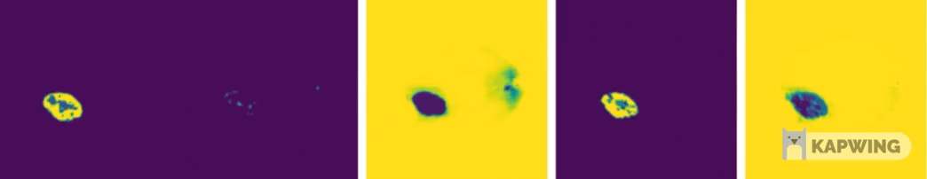

Results
 | ET | TC | WT | Average
U-Net
Encoder + U-Net
Benchmark (BraST Winner) | 89.82 | 94.03 | 94.58 | 92.81
Segmentation
Entropy Loss (argmax)
Entropy Loss (healthy)
Dice (argmax)
Dice (healthy)

Slide 7

Thank you
Comments appreciated!

