Slide 1
Brain Tumor (Glioblastoma) Segmentation using Neural Networks
MIDS
Team 10
Fides, Jaya, Satvik, Tego

Slide 2
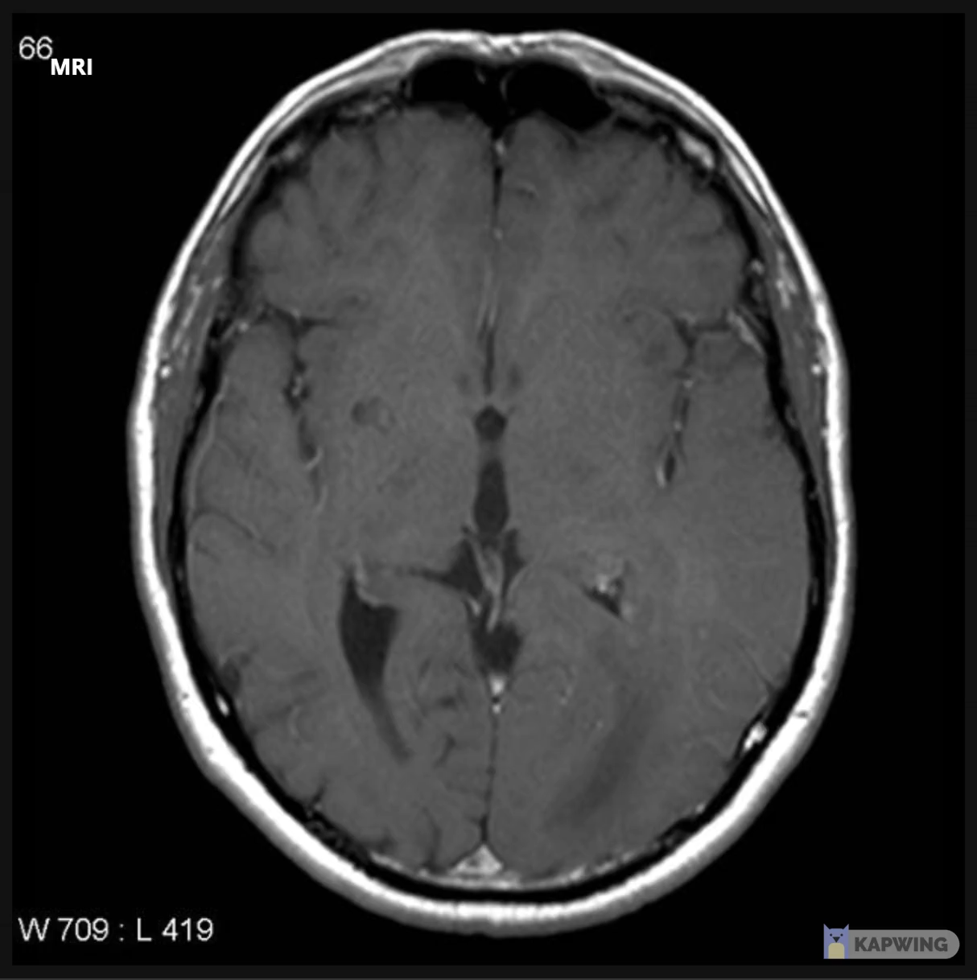

Why we do it?
Background
Motivation
Glioblastoma multiforme (GBM) is a WHO grade IV brain tumor with a 5-year survival rate of only 7.2%.
The first line therapy is MRI-guided surgery
Relies on the ability of the surgeon to distinguish the tumor tissue from healthy brain tissue.
Eliminate the gap between radiologists and neurosurgeons.
Radiologists are used to seeing 2D images in sequence and transforming them into a 3D image in their head;
Neurosurgeons are used to seeing and touching the actual tumor tissue.
Images above are from: https://radiopaedia.org/?lang=us

Slide 3
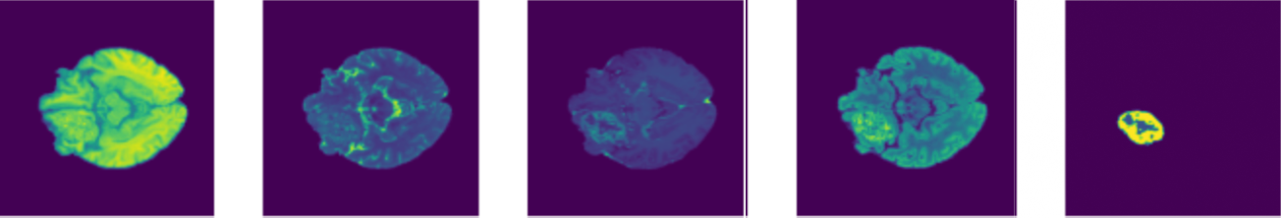


Image Segmentation for Brain Tumor
T1
T2
T1 - post-contrast
T2 - FLAIR
Segmentation
As the BraTS dataset is 150GB in total, we stored it in Google Drive.
Mount Drive to Colab Pro and train model with GPU.
$$\begin{matrix}0 & 0 & 0 \\ 0 & 2 & 2 \\ \begin{aligned}0 \\ 2 \\ 2 \\ 2 \\ 2 \\ 0\end{aligned} & \begin{aligned}4 \\ 4 \\ 2 \\ 2 \\ 2 \\ 0\end{aligned} & \begin{aligned}4 \\ 1 \\ 4 \\ 2 \\ 2 \\ 0\end{aligned}\end{matrix}$$
$$\begin{matrix}0 & 0 & 0 \\ 2 & 0 & 0 \\ \begin{aligned}4 \\ 1 \\ 4 \\ 2 \\ 2 \\ 0\end{aligned} & \begin{aligned}2 \\ 4 \\ 2 \\ 2 \\ 2 \\ 0\end{aligned} & \begin{aligned}0 \\ 0 \\ 0 \\ 2 \\ 0 \\ 0\end{aligned}\end{matrix}$$
0: Healthy brain tissue
1: Necrosis zone
2: Edema zone
4: Enhancing tumor

Slide 4
U-Net
4
4
(channels)
5
240
240
8
8
240
(240, 240, 155)
3D imaging U-Net
Skip-layer for voxel-level border identification
Loss function:
Dice
Cross-entropy
Batch size 4, 20 epochs
Batch normalization
Evaluation metric
Dice similarity
120
120
16
16
60
60
32
32
30
30
64
64
15
15
128
8
3x3x3 Conv – stride 1,1,1 – ReLU – BatchNorm
3x3x3 Conv – stride 2,2,2 – ReLU – BatchNorm
3x3x3 Transpose Conv – stride 2,2,2 – ReLU – BatchNorm
Softmax
Skip layer

Slide 5

Transfer Learning using Auto-Encoder
(240, 240, 155, 4)
(240, 240, 155, 4)
(8, 8, 5, 128)
Dimensionality Reduction
Data compression
Feature Learning
Useful properties
Current status:
Dice score on the validation dataset is too high
Latent Space Representation
Input = X
Output = X’
ENCODER
DECODER
Feed forward neural network
Useful properties store in Latent Space
Output is predicted only from latent space
Denoise data
Notes:
In order to improve the accuracy of U-net model, we have also used Auto encoder. Since it also uses data compression and that is why it is more likely to capture even the subtle variations in tumors.
From the architecture standpoint, auto encoder is an unsupervised machine learning technique that comprises of encoder and decoder. Encoder helps in compressing an image into a latent space and Decoder helps in predicting the output by retrieving the useful information from the compressed image.
As a loss function, we have used Dice score coefficient. However, even after hyper parameter tuning, we haven’t been able to reduce the validation loss, and currently it is leading to an overfitting problem. During the model training, we also tried implementing distributed model training using tensorflow framework However, because of memory issues in Colab, we couldn’t leverage cloud interface and its benefits which is another reason why training a model on this high dimensional dataset was challenging. Nonetheless, we still look forward to implementing this model as a next step in out future work.

Slide 6
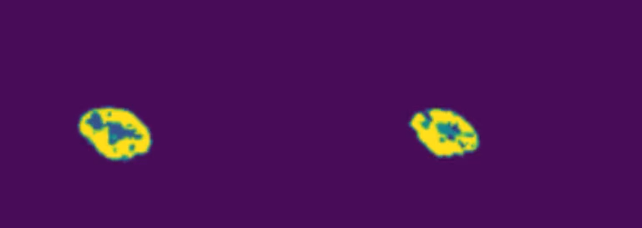
Results – Dice Similarity Score
Ground Truth
Proposed Segmentation
 | Healthy Tissue (0) | Tumor Core (1) | Whole Tumor (2) | Enhancing Tumor (4) | Average
U-Net – Entropy Loss | 99.87 | 15.12 | 50.88 | 15.39 | 27.13
U-Net – Dice | 99.83 | 7.96 | 52.53 | 2.59 | 21.03
Benchmark (BraST Winner) | N/A | 94.03 | 94.58 | 89.82 | 92.81
Unit in %
Notes:
1. Proposed method approaching the ground truth, though we can still find some difference in segmenting the tumor core
2. Original motivation, identifying tumor cells from the heathly cells, the circle columns, we have a reasonable performance in identifying

Slide 7

Thank you
Comments appreciated!

