Slide 1

XReality Augmented | Virtual | Mixed
Lukas Garcia
Rachel St. Claire, Gwen Field,
Tony Stracuzzi, Vinny Macri

Slide 2
Table of Contents
What is XReality?
What is Augmented Reality?
What is Virtual Reality?
What is Mixed Reality?
MR & Psychonautics
Project Lead: Rachel St. Claire
Stress in Virtual Reality
Project Lead: Toni Stracuzzi
Empathy in Virtual Reality
Project Lead: Gwen Field
Educational Mixed Reality
Project Lead: Vinny Macri
Future Augmented Everything
Project Lead: Lukas Garcia
Emotions in XReality
Project Lead: Lukas Garcia

Slide 3
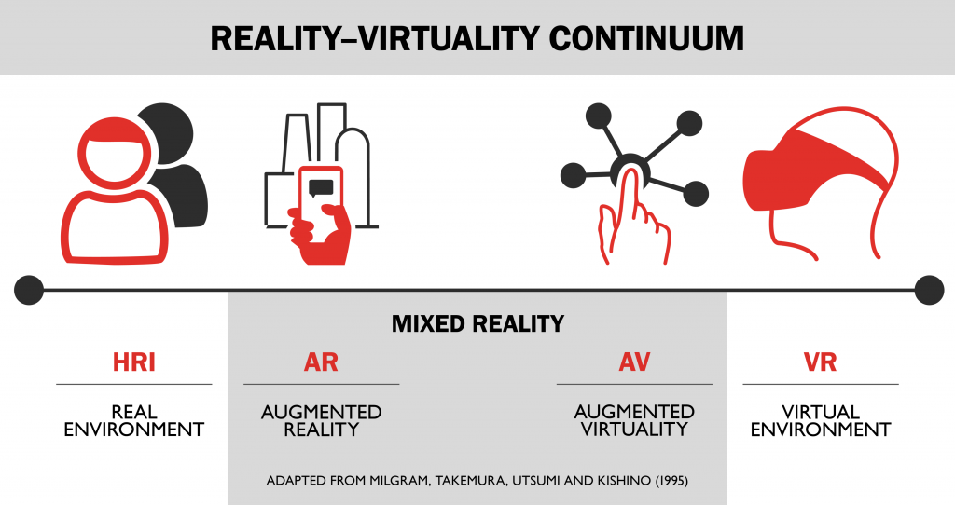
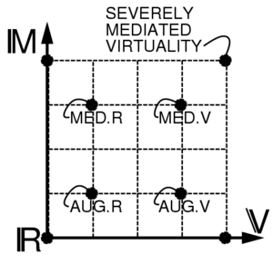
What is XReality (XR)?
The Reality-Virtuality Continuum
An umbrella that holds it all together
A scale that ranges from the completely real to the completely virtual.
Concept proposed by Paul Milgram¥

Slide 4
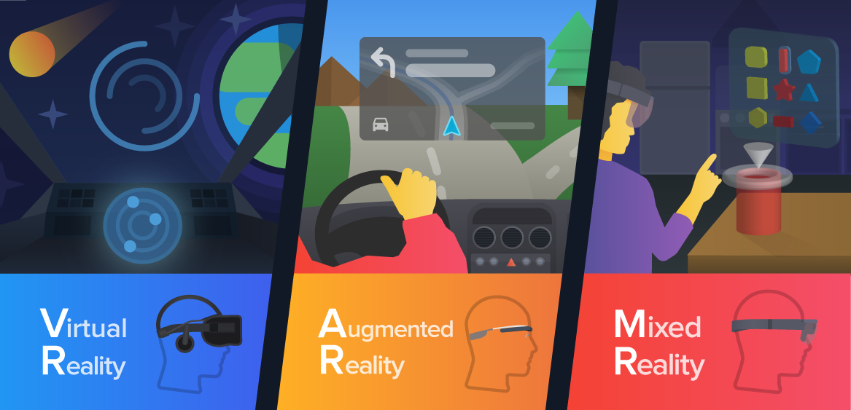
What is the biggest difference?
Depends on how the user is interacting with the different reality compared to the real world.
How does the user interact with the virtual? The objects?
Environment, objects, NPCs, the 5 senses, etc.

Slide 5
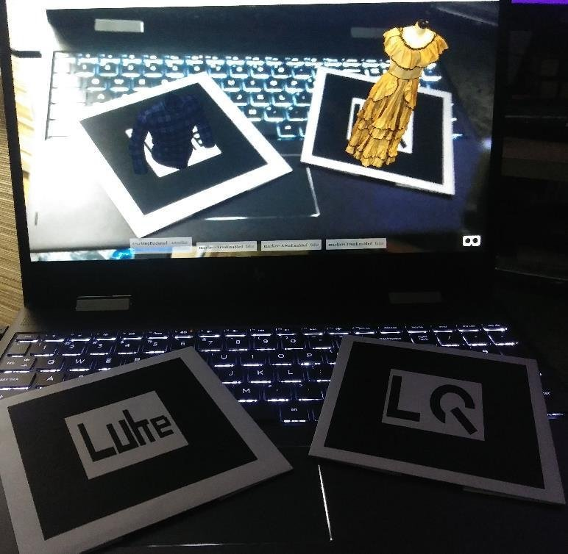
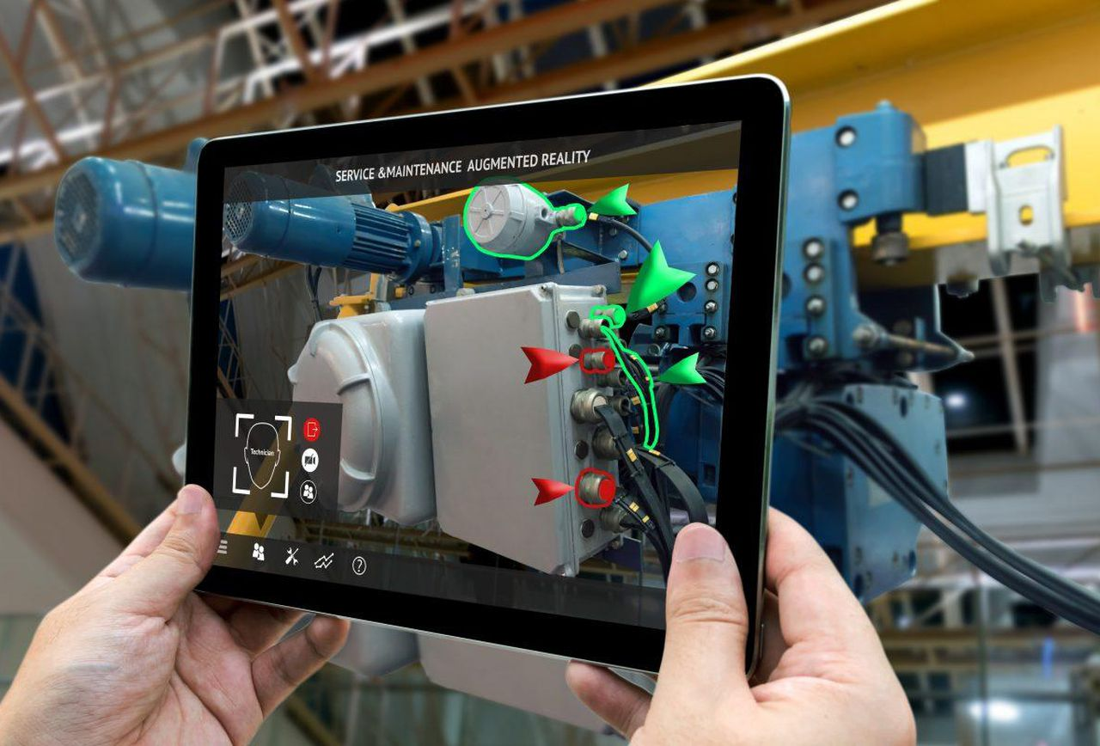
What is Augmented Reality (AR)?
A reality where computer generated models are overlapped into a user’s view of the real world.
User can interact with the model, but via the use of a marker, or through the use of the viewport.
Business card project: https://tinyurl.com/yccu8l35
Examples: Help Lightning, Continental HUD, I-Mechanic

Slide 6
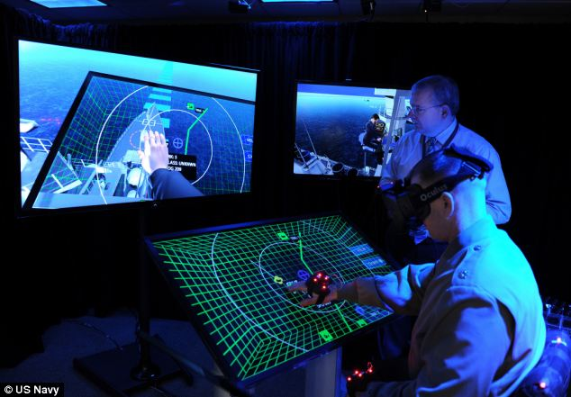
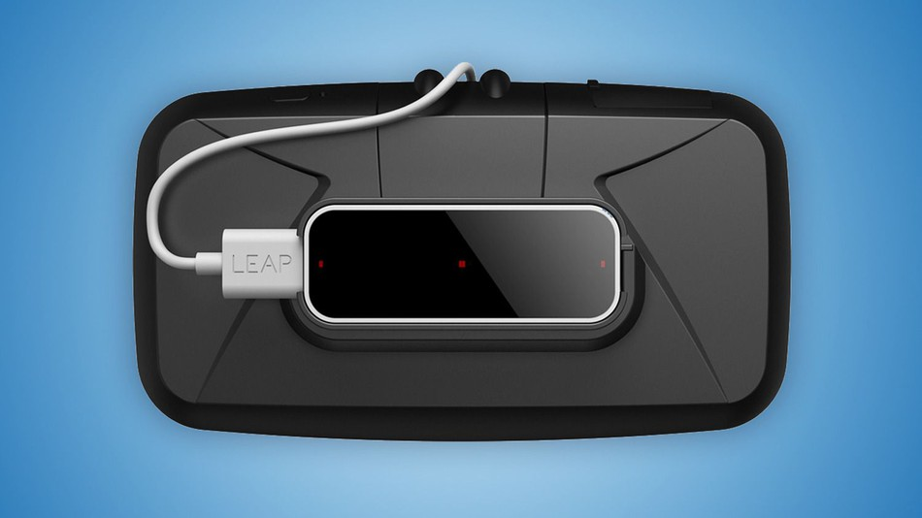
What is Virtual Reality (VR)?
A reality where the user is closed off from the real world and is put into an all virtual, simulated environment.
User can interact with the environment through the use of controllers or sensors that mimic/scan hand positions.
Examples: VR Vaccine

Slide 7
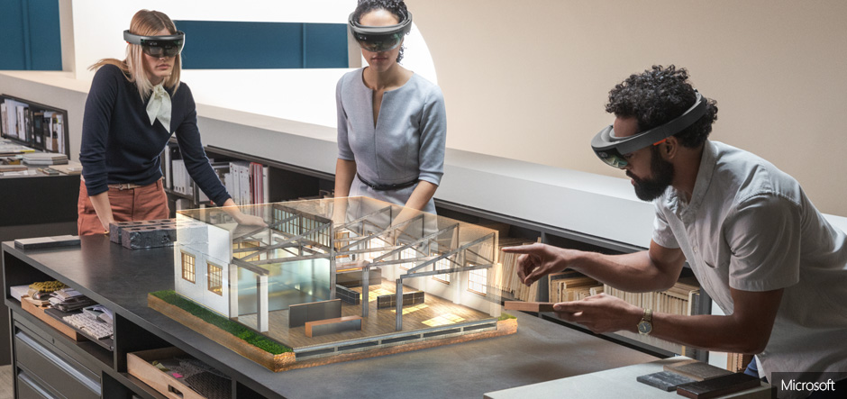
What is Mixed Reality (MR)?
The reality where both real world and digital elements come together.
Interaction and manipulation can be done in both the virtual and physical environment.
Image and sensing technologies allow user to interact using their hands and their front-facing FOV.

Slide 8
MR Psychonautics
Rachel St. Claire
Gwen Field, Tony Stracuzzi,
Lukas Garcia

Slide 9
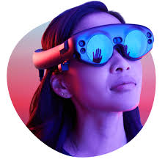
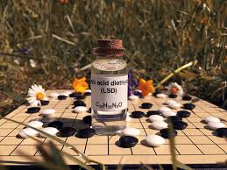
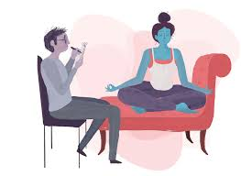

The Project
Create an experience that increases psychological aptitude for therapeutic programs involving hallucinogenic pharmaceuticals.
Prepare a patient who has never taken hallucinogenic pharmaceuticals, to be ready for therapy.
+
+
=

Slide 10
Why?
Prime patients to receive a better therapy program
Remove fears of hallucinating
Acclimate to effects to focus on the therapy
Thought experiment
Topical
Phase 3 clinical trials of MDMA for PTSD
P2 LSD for anxiety
P3 plans Psilocybin for depression + ‘beyond’

Slide 11
What is what?
MR = Mixed Reality
Hallucinogenic Pharmaceuticals
LSD, Psilocybin, Ketamine, DMT (Ayahuasca)
Psychological Aptitude
Mental readiness
The ‘set’ in “set and setting”

Slide 12
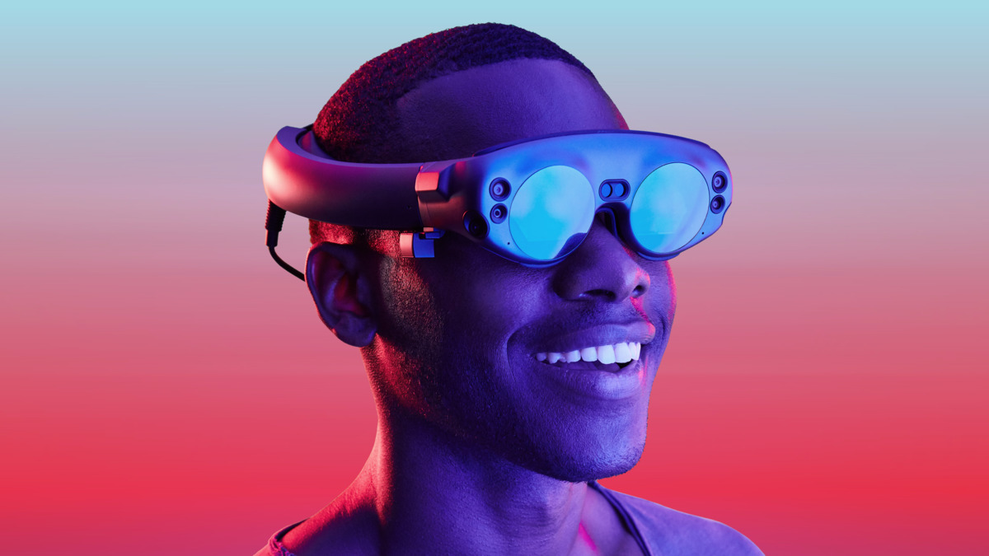

Into where?
Use the Magic Leap
MR headset that fits like a pair of sunglasses over the user’s eyes
User sees the real-world, as well as a transparent computer-generated system in front of them.
Coded in C#
May need to fit with a GoPro for real time capture

Slide 13


Who?
Patients
Undergoing therapy programs that prescribe hallucinogens
Multidisciplinary Association for Psychedelic Studies (MAPS)
“MAPS works to develop a legal framework for the application of psychedelic drugs both as medication and for personal psychological growth.”
The Heffter Research Institute
“…promotes research of the highest scientific quality with the classic hallucinogens and related compounds (…) in order to contribute to a greater understanding of the mind leading to the improvement of the human condition, and to alleviate suffering.”

Slide 14
How?
Use the Google Deep Dream Generator as an overlay
Face-swapping test runs will be developed in Python
Use optical illusions as a vision medium in the Magic Leap
But really…how in the heck?
Use real-time cycleGANs
Example: Real-time Inference

Slide 15
Stress in Virtual Reality
Tony Stracuzzi
Lukas Garcia

Slide 16
The Project
Find how subjects perform while in VR & desktop environments within violent and non-violent conditions .
Conditions are currently video games where, a user must interact with the environment and NPCs which are violent and non-violent.
Data is collected via Galvanic Skin Response (GSR) Testing, including a heart rate monitor.
Data as well as the in-game footage of the user interacting with the environment, is recorded for collection.

Slide 17
Why?
Data can be used to see if it is applicable to patients affected by Post-Traumatic Stress Disorder (PTSD).
VR devices can be used to alleviate a returning soldier’s pain or to check if they can return to service, or if it can ease the disorder altogether.
Can be used to test a non-combat soldier before they go out into the field and measure any stress that might accompany it.

Slide 18
Empathy in Virtual Reality
Gwen Field
Tony Stracuzzi,
Natalie Marsal

Slide 19
The Project
Investigate factors of empathy creation and stress levels that can occur within VR & desktop environments.
Big Questions:
Does the amount of time that’s taken into a personal user’s character creation have any effect on empathy and stress levels?
Does race in character creation have an impact upon the user when they are in virtual and/or desktop environments?

Slide 20
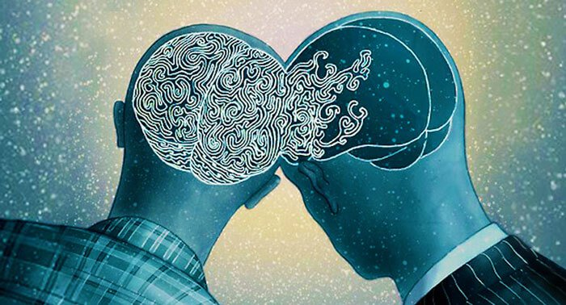
What is Empathy?
It is the capacity to understand or feel what another person, creature, being, etc. is experiencing from within a frame of reference.
The capacity to place oneself in another’s position and enact some sort of emotional state for that other being.

Slide 21
Generation of Empathy
An Impairment of Working Memory
Show a user a pattern
Does the image induce empathy?
Show user the pattern again
Can the user remember the pattern?
Objective way to measure empathy and see if a user can recollect pattern recognition.

Slide 22
Educational Mixed Reality
Vinny Macri
Trever X., Christian X.,
Miesha X.

Slide 23
The Project
Design multiple use applications for the newly released Magic Leap One.
Create an environment where a user can interact with a digital model of a brain and inspect the various components of the brain.
Enlarge and shrink the model
“Explode” the model to see various innards of a brain.
Rotate the model
Use other tools within the environment for better interaction and understanding of the model.

Slide 24
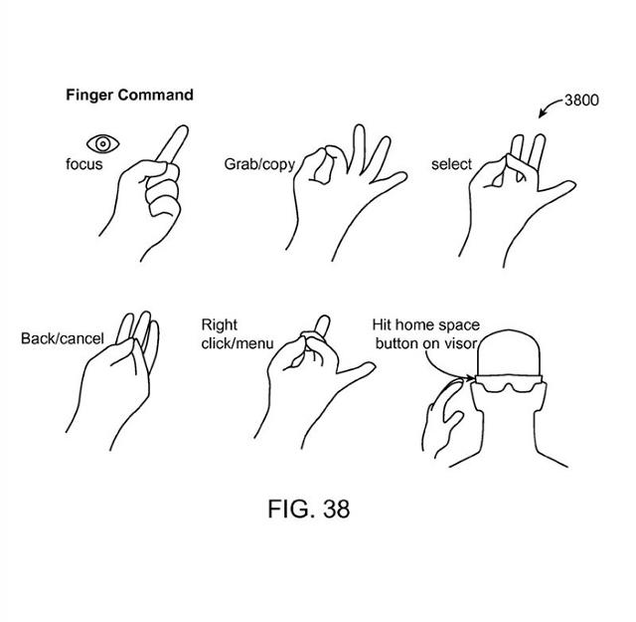
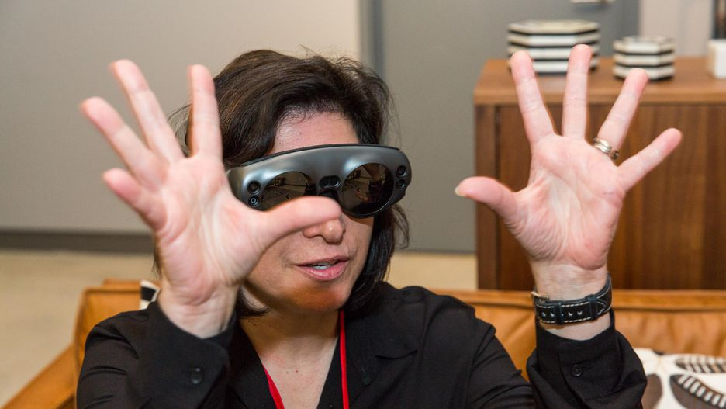
How?
Using the Magic Leap One, a user can interact with a computer-generated brain model with the use of their hands.
Pinch to shrink
Move hands away from each other to expand
Gesture to place the brain in the real world environment
The model is casted in front of the user’s FOV and a user can interact with the model at a whim.

Slide 25
Future Development Use
Mixed Reality headsets are going to be the newest and most upcoming use of XReality.
Ability for anyone to see beyond a real-world environment that was not possible before.
Possibility to bring VR versions of applications into MR.
Examples:
The Stanford Virtual Heart (Video)
Industrial SCADA Systems
Trimble Connect for Construction

Slide 26
Future Augmented Everything
Lukas Garcia

Slide 27
The Project
Design an augmented experience where a user wants, or better yet, needs, to see the world in an augmented space.
A user must be able to attain better information through the use of augmentation that they couldn’t get before.
Main Problem:
Augmented reality is stuck in small niche industries
It is not meant for everything, as certain people will prefer a real reality than an augmented one.
Goal:
Understand how and why augmented reality should continue to exist.

Slide 28
Problem & Solution
Industries where augmented reality can be used are fields where a user needs an extra tool or set of time to use a product.
Example:
Problem:
For makeup, a person would have to go to a mall counter, spend time choosing a color, try it on, and decide until choice is made. If not, wipe and retry.
Time is lost.
Solution:
Augment a mobile device for same use in half the time.
L'Oréal's Modiface (Video)

Slide 29
Visualizing the Next Step
In March 2018, designed an application where augmented models would show up over business cards.
Marketing and businesses could use augmented realities to reach audiences that are constantly on mobile devices.
Experiences make up the majority of any type of XReality.
Universal Studios Jurassic Park
Ocean Adventure in a Shopping Mall
It’s about finding the right mix of specific opportunities for both an augmented reality and the real world.
Do NOT want a hyper-reality.

Slide 30
Emotions in XReality
Lukas Garcia

Slide 31
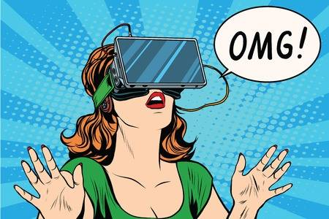
The Project
To understand how and why someone will emotionally connect to a virtual being or environment in VR.
Being doesn’t have to be realistic, yet person will stay closer to that being as if it were “alive”.
Adriana and the Vive Lab Dog.
A virtual environment doesn’t have to be realistic to the last detail, yet person could emotionally connect to that place.
Vive Google Earth VR

Slide 32
The Emotional Catalyst
I’m not a psychologist, just a computer scientist
…but I want to know how and why emotions have the ability to connect us to worlds that don’t exist; even more in virtual reality.
If researched correctly, human emotion can connect us closer to a virtual environment than ever before.
Problem:
How do I capture and record emotional data?
EEG? Checklist? GSR Testing?

Slide 33
Future of Emotions & Sensing
What could happen if a machine knew when we were or happy or angry?
This VR face mask could predict a new condition.
Emotion can be injected into the virtual environment.
The design of interaction is the key step
Affective interactions using VR can create a link between presence and emotions.
Haptic Feedback
Ability to recreate the sense of touch by applying forces, vibrations, or motion to a user.
Glove can force you to feel virtual objects in real-time.
Suit can make you feel pressure from a virtual environment.

Slide 34
XReality and the Future
The future has an unlimited source of possibilities for anyone in the XR environment.
You just have to believe it to make it a reality.
Questions:
Drop me an email at: lgarcia2013@fau.edu
Thank you, MPCR Lab!
“You can close your eyes to reality, but not to memories.”
~ Stanislaw Jerzy Lec

