Slide 1

my Comic Book Collection
Project by:
Lukas Garcia, Bryan Cabrera, Alan Young
April 19, 2019

Slide 2

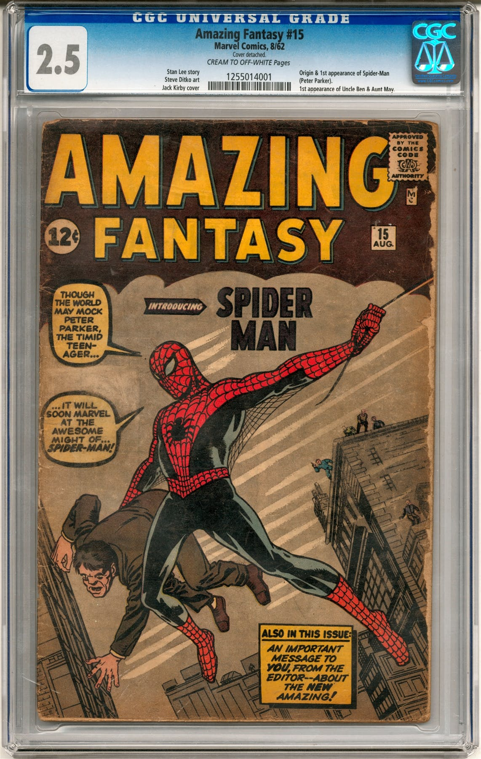
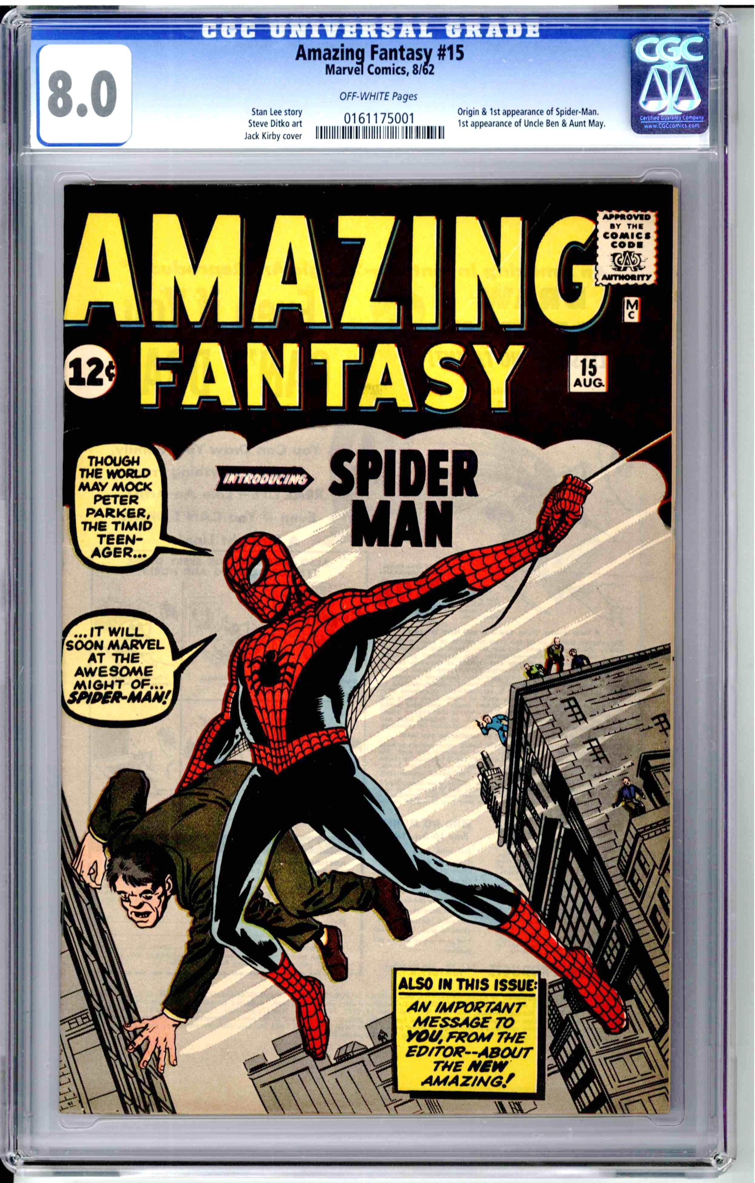
Why we did this project?
In a nut shell, comic book collecting on the go is a hassle.
Paper and pencil is the best method of choice, but it is very, very basic.
Comic book databases exist, but they’re not mobile.
Lots of comic books are based the series and the condition, especially the condition.

Slide 3
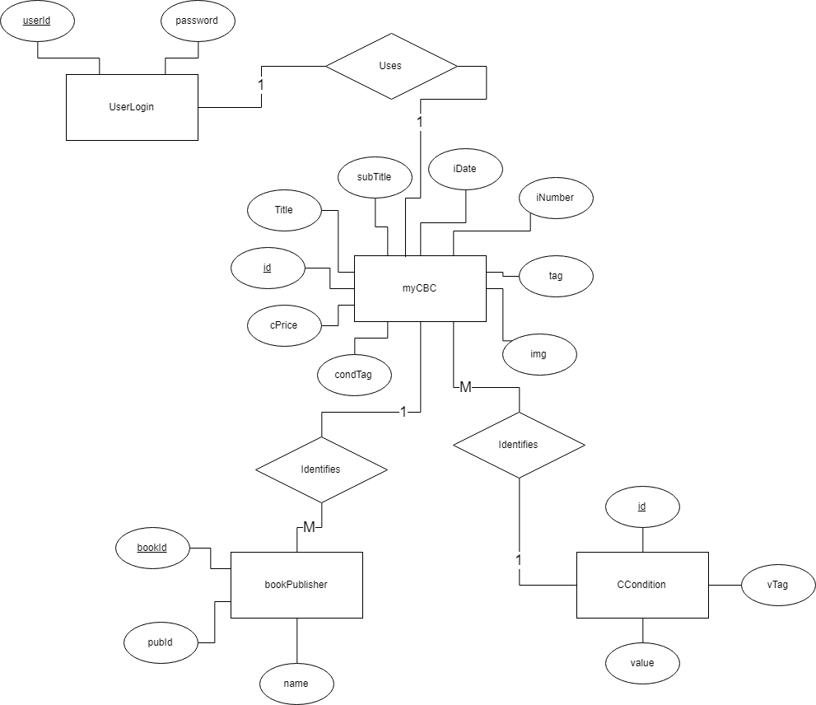
ER Model

Slide 4

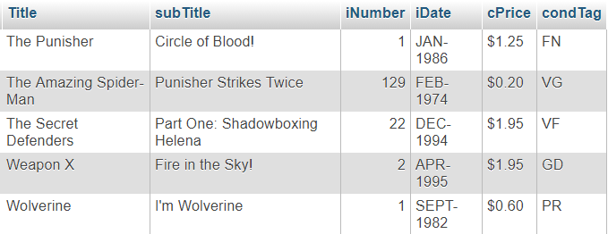
Query Examples
Show comic books that are published by Marvel

Slide 5


Query Examples
Show comic books that have a “Good” condition

Slide 6
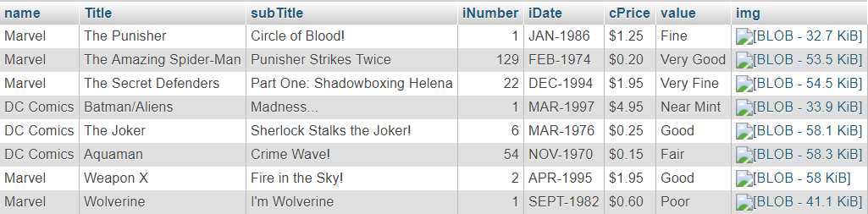
Query Examples
Show all comic books with Publisher and condition

Slide 7
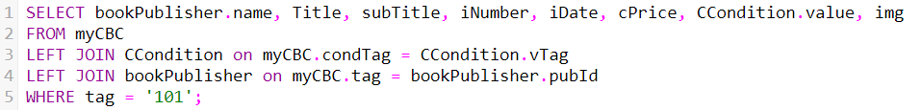
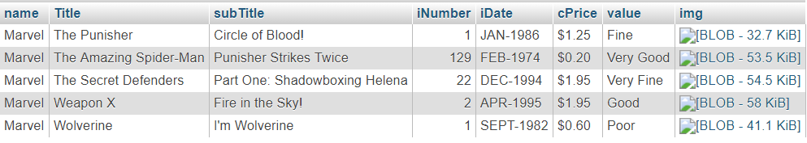
Query Examples
Show comic books that published are by Marvel with their condition

Slide 8
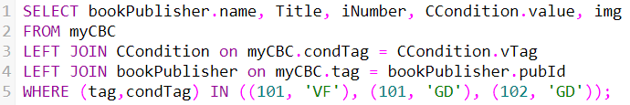
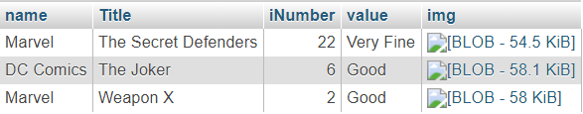
Query Examples
Show comic books that are published by Marvel and DC, with a “Very Fine” and “Good” condition.

Slide 9
Live Demo
http://lamp.cse.fau.edu/~lgarcia2013/cbc2/login.php

