Slide 1





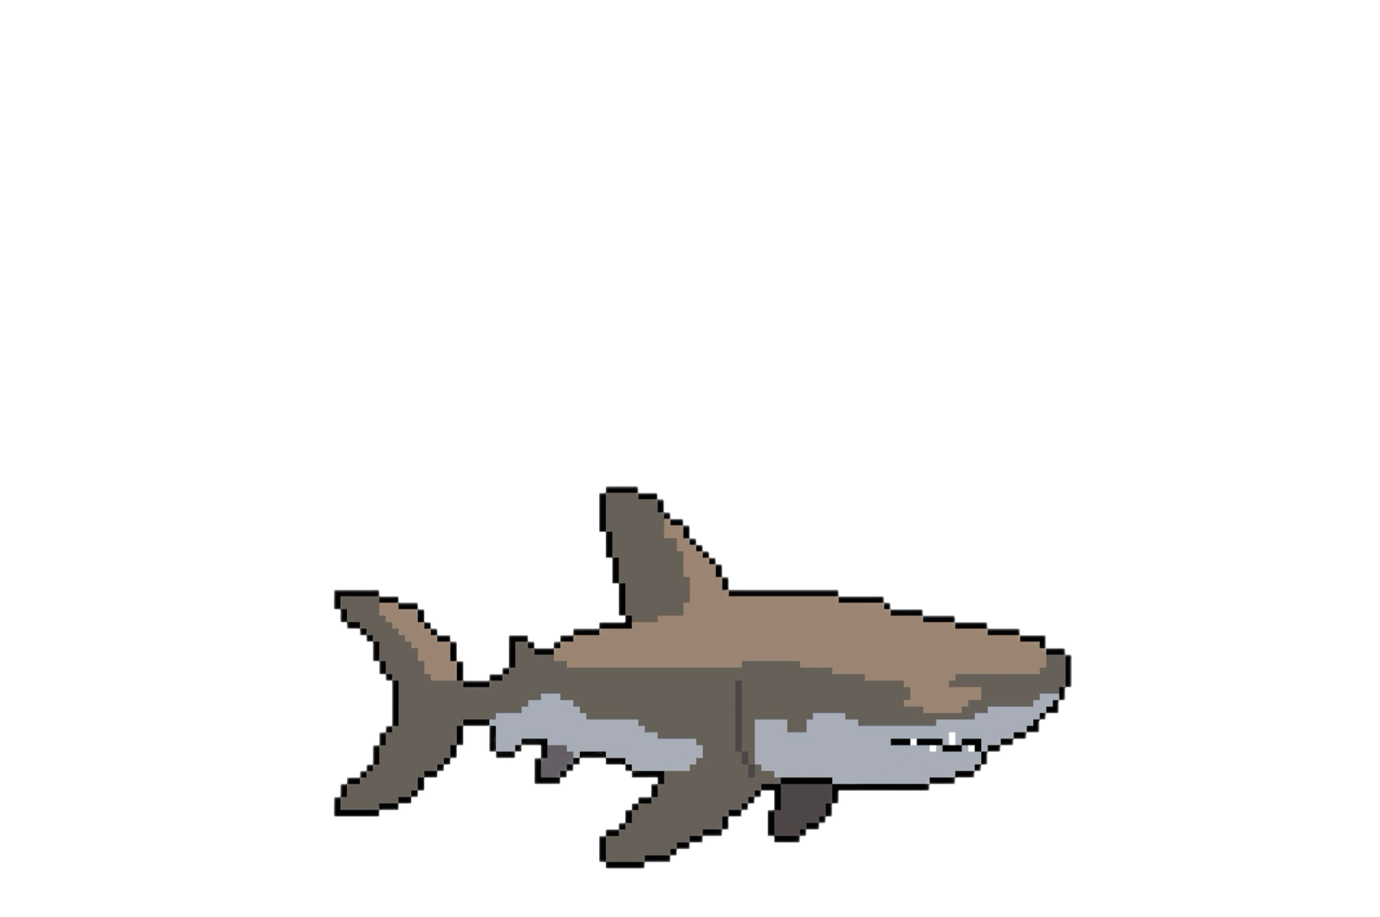

DEEPDIVE
Home
About
Contact
GAME PRESENTATION
DEEPDIVE
01
02
DEEPDIVE
03
Game Presentation

Slide 2

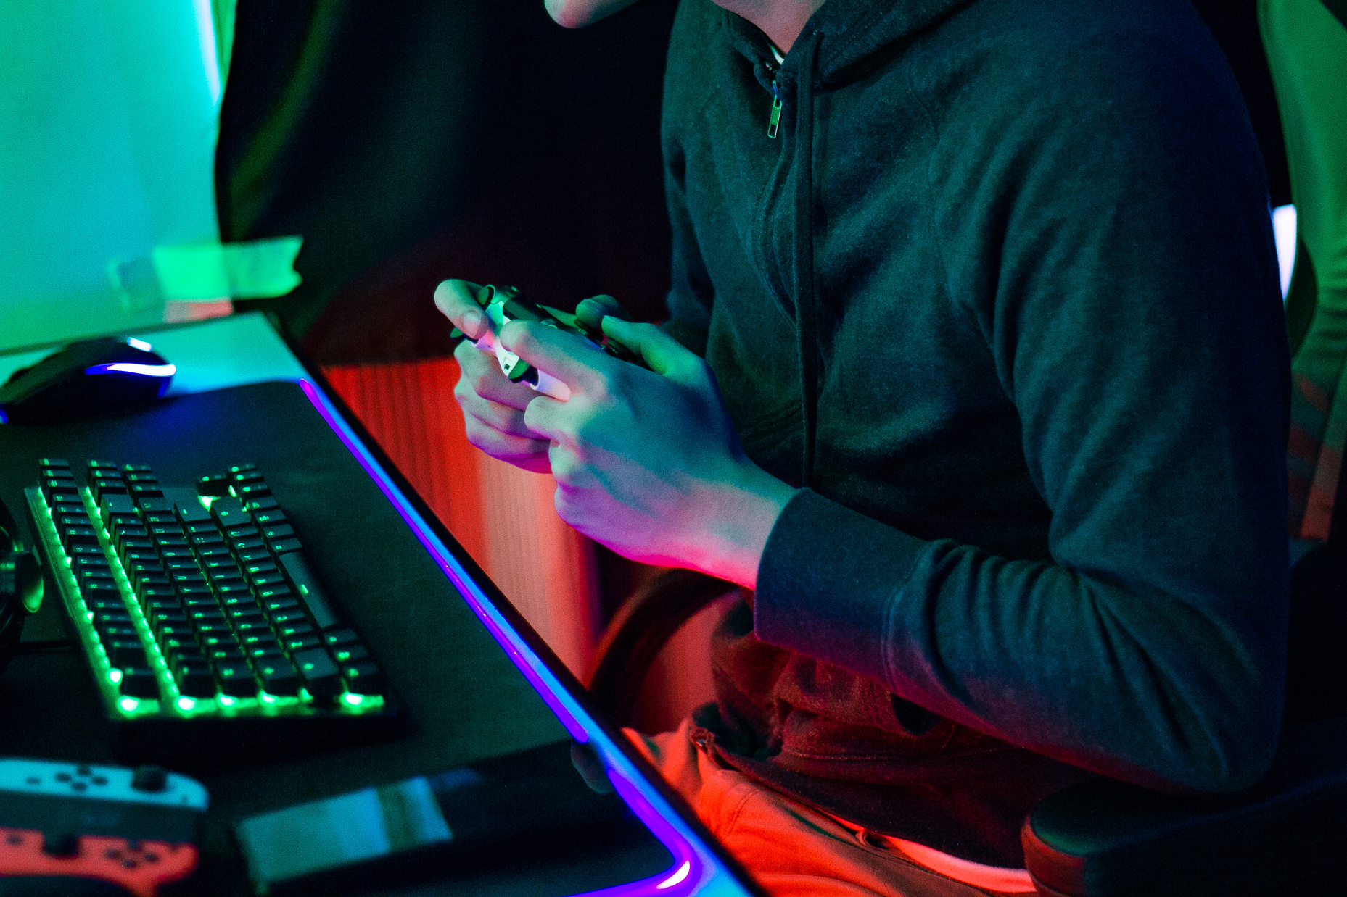

DEEPDIVE
Home
About
Contact
WELCOME INTO DEEPDIVE
01
DeepDive stems from the 2017 Global Jam theme: Waves.
It was assigned to us to develop team building skills in managing a real project.
02
03
Learn More
Game Presentation

Slide 3
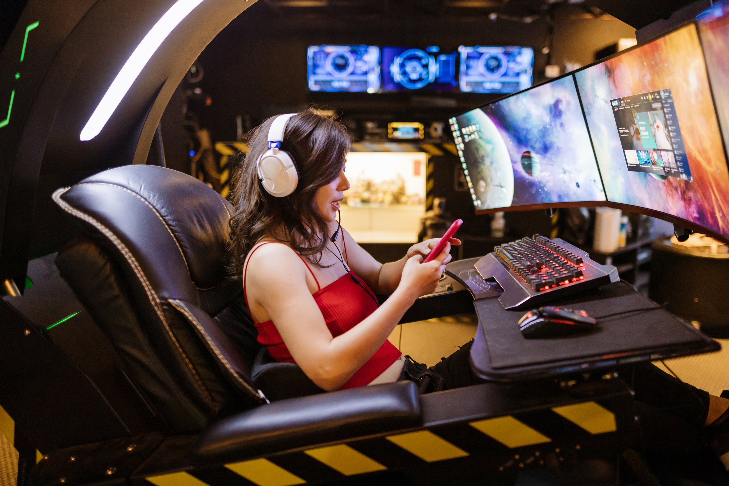
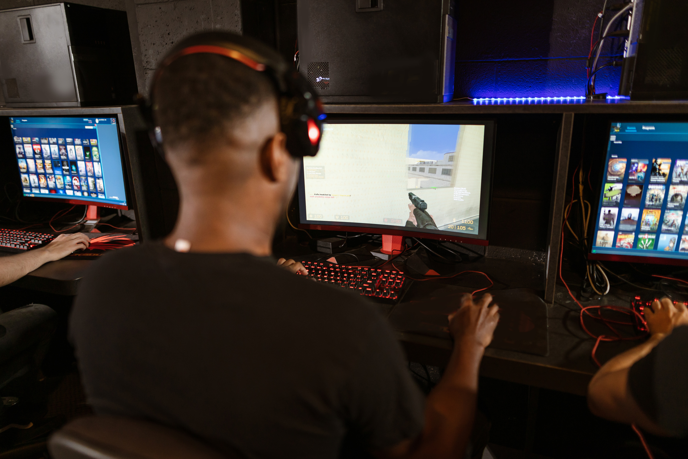

DEEPDIVE
Home
About
Contact
INTRODUCTION
The game genre is a survival story with 2D graphics.
The art style is pixel art..
01
02
03
Learn More
Game Presentation

Slide 4
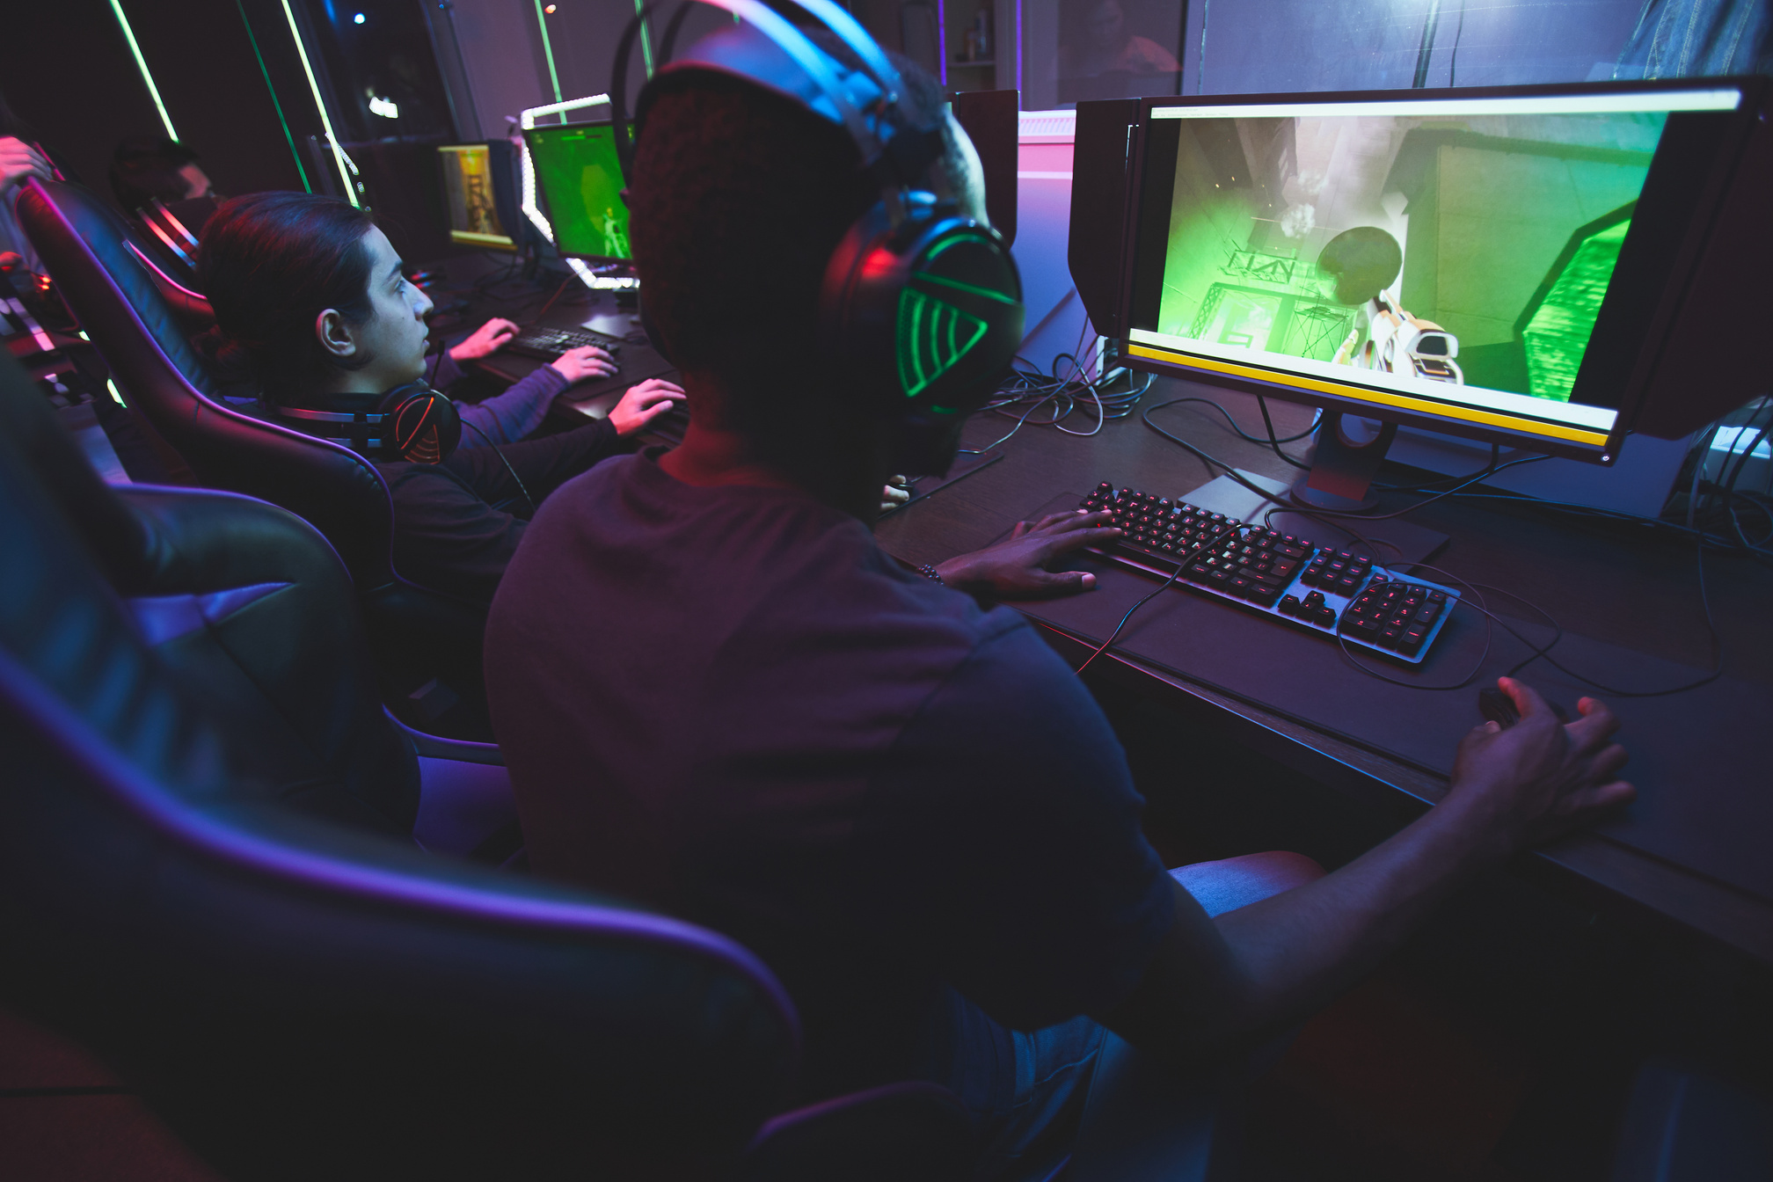

DEEPDIVE
Home
About
Contact
OUR VISION
The idea for this game was born from the great interest that all members of the team have in the marine ecosystem.
In addition to the sensitive issue of loan sharking.
01
02
03
Learn More
Game Presentation

Slide 5

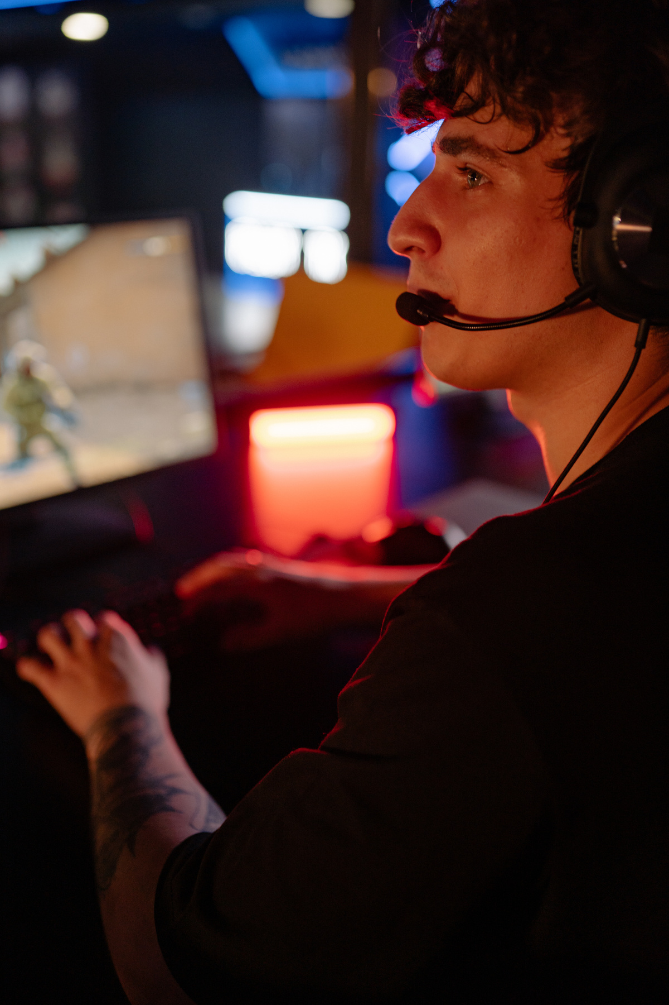


DEEPDIVE
Home
About
Contact
OUR PROJECT
Realizzazione del gioco
Each of the 4 team members had a central role in it, from the programmer to the 2D artists through the designer.
01
02
03
Team work e team building
The organization and management within the team was proactive.
Game Presentation

Slide 6




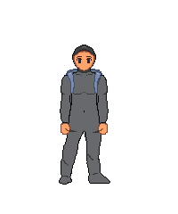
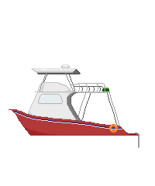
DEEPDIVE
Home
About
Contact
ACQUEAPERTE
1.A SPRITES
01
02
03
Game Presentation

Slide 7



DEEPDIVE
Home
About
Contact
ACQUEAPERTE
2.A COLLECTABLES
01
02
03
Game Presentation

Slide 8
DEEPDIVE
Home
About
Contact
ACQUEAPERTE
2.B ENEMY
01
02
03
Game Presentation

Slide 9
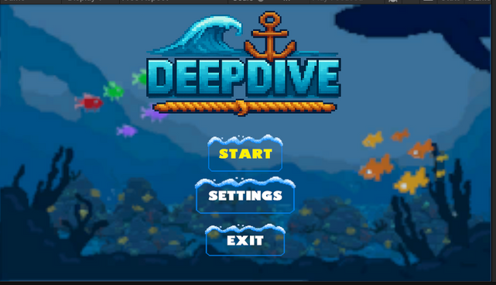
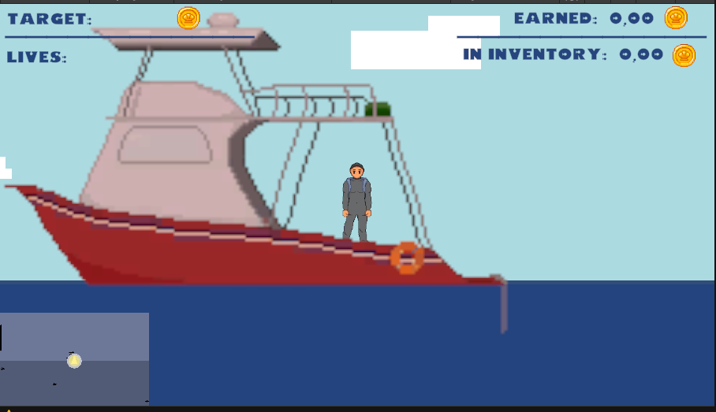
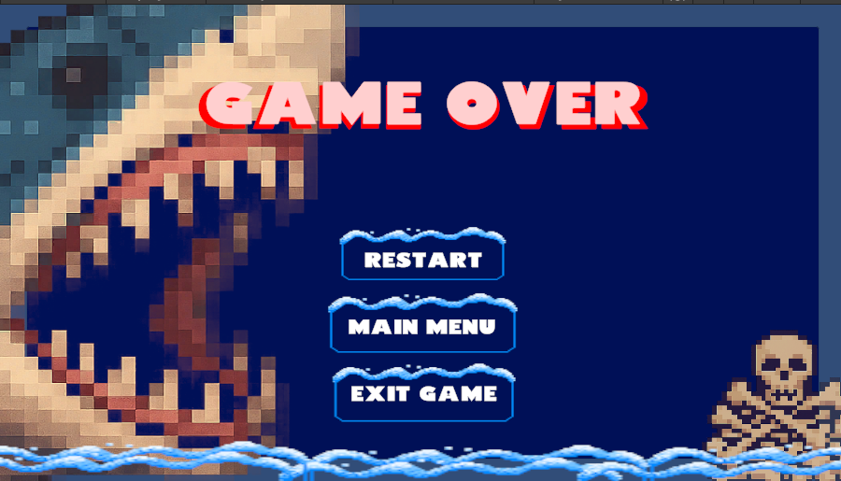
DEEPDIVE
Home
About
Contact
ACQUEAPERTE
3.A GAME SCENE
01
02
03
Game Presentation

Slide 10
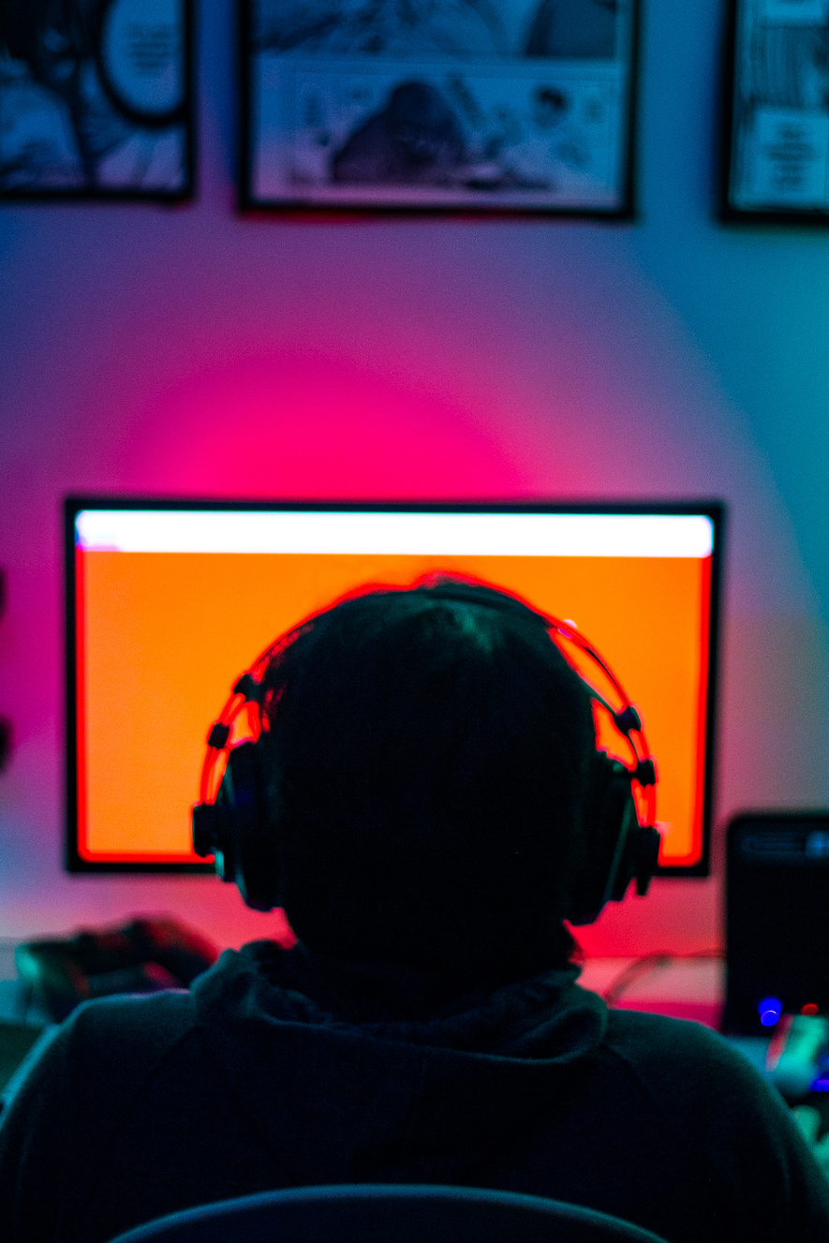



DEEPDIVE
Home
About
Contact
GET IN TOUCH
Stay in touch with our team to learn about the game's evolution.
The contact details are listed below.
DEEP DIVE
01
by
02
Phone Number
Email
WaveProduction
03
+39 3439426621
deepdive@info.com
Website
Social Media
www.deepdive.com
@deep_dive
Game Presentation

Slide 11


DEEPDIVE
Home
About
Contact
THANK YOU
01
THANK YOU
02
03
FOR YOUR ATTENTION
Game Presentation

