Slide 1
MARKETING ANALYTICS — HOMEWORK 1
Customer Churn Prediction
A supervised machine learning pipeline for binary churn classification
using Logistic Regression and Random Forest across two datasets.
Presented to: Professor Luigi Capone
Tools: Python - scikit-learn - pandas - matplotlib
Models evaluated: Logistic Regression - Random Forest
Student: Colombini Francesco – ID:944941

Slide 2
STEP 1, 2 & 3 — DATA LOADING, PREPROCESSING & MODEL SELECTION
02
Dataset Overview, Preprocessing Pipeline & Model Selection
Datasets
Model Architecture & Selection
Two classifiers were trained end-to-end inside a single scikit-learn Pipeline combining preprocessing + model. The best model per dataset was selected by ROC AUC on the held-out test set.
Dataset 1
Dataset 2
Training set: 32,000 rows
Training set: 40,000 rows
Test set: 8,000 rows
Test set: 10,000 rows
51.9% churn rate
87,1% churn rate
Random Forest
BASELINE
Preprocessing Pipeline
Key parameters
Captures non-linear feature interactions; robust to outliers; no scaling required. Used as a strong baseline.
· n_estimators: default (100)
1
80 / 20 Train–Test Split
· class_weight: 'balanced'
Random split with seed=23 for reproducibility. Stratification preserves churn ratio in both sets.
· random_state: 101
ROC AUC — DS1: 0.8897 | DS2: 0.9590
2
Column-type Detection
Numerical vs. categorical columns identified automatically via dtype inspection.
Logistic Regression
SELECTED
3
Numerical Pipeline
Key parameters
Linear classifier with probabilistic output. Coefficients are directly interpretable as feature-level influence on churn probability.
Median imputation for missing values → StandardScaler normalisation.
· max_iter: 1000
· class_weight: 'balanced'
· random_state: 101
4
Categorical Pipeline
Mode imputation → OneHotEncoder (handle_unknown='ignore').
ROC AUC — DS1: 0.8988 | DS2: 0.9694
Notes:
In this slide I describe the two datasets used and the preprocessing choices made. Both datasets share the same 14 features — age, income, tenure, monthly spend, campaign type and churn label. No missing values were present in either dataset. The preprocessing pipeline was kept separate for numerical and categorical variables to avoid any data leakage: all transformers were fit on training data only, then applied to the test set.

Slide 3


WHY MODEL CHOICE MATTERS
03
Choosing the Right Model for a Churn Problem
The choice of model directly determines what actions the business can take, who gets targeted, and how resources are allocated. For this reason, is not only a statistical modelling decision.
The Two Metrics That Drive Retention Decisions
Model Choice Through a Marketing Lens
Precision
Interpretability
Of all customers we flag as churners, how many actually churn?
RF
Black-box. You know who to target, but not why.
98.9%
LR
Each feature has a coefficient; in this way the firm know exactly which variable (e.g. low loyalty score) is pushing a customer toward churn. Actionable for campaign design.
Low precision = wasted retention spend. The business pay for campaigns targeting loyal customers who were never going to leave.
False Positive Cost
Recall
Of all customers who actually churn, how many did we catch?
RF
Slightly more false positives in this dataset → more wasted outreach budget.
89.1%
LR
Precision of 98.9% → minimal budget wasted on customers who are not at risk.
Low recall = missed revenue. Real churners slip through without ever receiving a retention offer.
Probability Output
RF
Probability scores available but less calibrated for tabular data.
LR
Well-calibrated churn probability score → enables tiered campaigns (e.g. high-risk vs. medium-risk segments).
Notes:
This slide is the marketing heart of the project. A data scientist might select a model based on AUC alone, but a marketing analyst has to think about what the model's output is used for. High precision means your retention budget is not wasted on loyal customers. High recall means you're not letting real churners slip through uncontacted. The key advantage of Logistic Regression here is not just that it wins on AUC — it's that its coefficients are directly usable: they tell you that, for example, a customer with a very low loyalty score and low tenure is being pushed towards churn by those specific variables, which then informs which message or incentive to send them.

Slide 4
STEP 4 — EVALUATION
04
Model Performance Results
Dataset 1 - 51.9% churn rate
Dataset 2 – 87,1% churn rate
Best model: Logistic Regression
Best model: Logistic Regression
Accuracy
81.5%
Accuracy
89.6%
Precision
82.2%
Precision
98.9%
Recall
81.6%
Recall
89.1%
F1 Score
81.9%
F1 Score
93.8%
ROC AUC
0.899
ROC AUC
0.969
Confusion Matrix
Confusion Matrix
Pred: 0
Pred: 1
Pred: 0
Pred: 1
Real: 0
3,171
725
Real: 0
1,134
82
Real: 1
756
3,348
Real: 1
958
7,826
Balanced performance across both classes. AUC of 0.899 indicates strong discriminative ability.
Higher churn base rate yields a stronger signal. Precision of 98.9%, very few false positives.
Notes:
Dataset 1 shows a balanced churn rate around 52%, so the model had to genuinely learn from both classes. Its AUC of 0.899 is solid for a linear model. Dataset 2 has a much higher churn rate of 87%, which gives the model a stronger signal — reflected in the near-perfect AUC of 0.969 and precision of 98.9%. The confusion matrices show that in both cases the false-positive rate is well controlled.

Slide 5
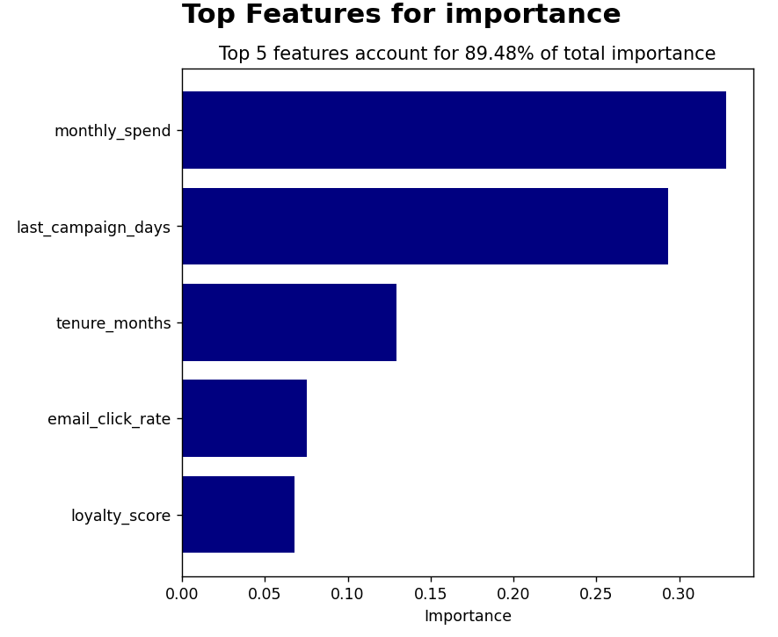
STEP 5 — FEATURE IMPORTANCE & CONCLUSIONS
05
Interpretation & Key Takeaways
Top Predictive Features
Conclusions
Logistic Regression coefficient magnitudes (normalised, Dataset 1)
Logistic Regression outperformed Random Forest
Despite being a simpler model, it achieved higher ROC AUC on both datasets, confirming that a well-preprocessed linear model can be very competitive for tabular churn data.
Pipeline design prevented data leakage
By fitting all transformers exclusively on training data and applying them to the test set, the evaluation metrics genuinely reflect out-of-sample performance.
Class imbalance was addressed systematically
The class_weight='balanced' parameter ensured neither class dominated the loss function, particularly important for Dataset 2 with its 87% churn majority.
The top 5 features account for most of the predictive weight.
Notes:
The top predictive features align with intuition — customers with low loyalty scores, shorter tenure, and lower spend are the most likely to churn. The choice of Logistic Regression over Random Forest was validated empirically by cross-dataset AUC comparison. The main technical takeaways are: proper train-test separation, systematic handling of class imbalance, and building a single reproducible pipeline from raw data to predictions.

Slide 6
MARKETING ANALYTICS — HOMEWORK 1
Thank you
Customer Churn Prediction
A supervised machine learning pipeline for binary churn classification
using Logistic Regression and Random Forest across two datasets.
Presented to: Professor Luigi Capone
Student: Colombini Francesco – ID:944941

