Slide 1
MARKETING ANALYTICS — HOMEWORK 2
Customer Lifetime Value Analysis
An End-to-End CLV Framework: RFM Segmentation - Descriptive CLV - BG/NBD Prediction - Actionable Strategy
Presented to: Professor Luigi Capone
DATASET AT A GLANCE
Student: Colombini Francesco – ID:944941
62,767
8,510
THE FIVE MAIN QUESTIONS
Transactions
Unique Customers
1. Which customers generate the highest lifetime value?
2. Which customers are at risk of churn?
3. How should marketing budgets be allocated across segments?
4. What customer retention strategies should be deployed?
5. Which customers deserve priority in loyalty programs?
2023–2025
3-yr cohort
$3.85
$102.61
Mean CLV / month
Mean Pred. CLV
full base
52-wk horizon
Università degli Studi di Milano-Bicocca - FMCG Customer Behaviour Dataset - PostgreSQL - Python

Slide 2
PART A
02
1. Data Architecture & Preprocessing Rationale
METHODOLOGY & RATIONALE
DATASET SCHEMA – DF_ITEMS
1. Data Ingestion
The dataset was assembled by joining six PostgreSQL tables (ORDER, CUSTOMER, ORDER_ITEM, PRODUCT, CATEGORY, and PRICE_CHANGE) yielding 62,767 transactional records across 2023–2025, addressing 15 total variables, with a stricted procedure to ensure consistency and reliability.
2. Data Quality
Only transactions with a confirmed price record are retained, eliminating orphaned rows without explicit imputation.
NaN values were replaced with None before loading into PostgreSQL to guarantee clean column typing throughout the pipeline
Zero missing values are present in the dataset.
3. Data Preparation
Fixed change of the currency of 83.0 INR/USD on all the numeric variables
2 new variables were created gross_revenue_usd and net_revenue_usd
Item_discount presented anomalous patterns, suggesting that these discounts were recorded at an order level, and mechanically distributed across individual items, making its aggregation unreliable
A floor of zero is applied to net_revenue_usd using .clip(lower=0) to prevent negative revenue entries from distorting the Monetary signal
New dataset created (df_orders) created using order-level aggregated revenue and used for the following steps of RFM, CLV, BG/NBD modelling
Column | Type | Role
order_id, product_id | String | Used for the merge of the datasets
customer_id | String | Unit of analysis
quantity, item_discount, unit_price | Numeric | Revenue inputs
brand, category_name, city, state, segment | Categorical | EDA & segmentation
order_date, signup_date | Date | Temporal anchors
year, week | Numeric | Temporal coordinates for the JOIN of PRICE_CHANGE
gross_revenue_usd | Numeric | quantity x unit_price_usd
net_revenue_usd | Numeric | gross_revenue_usd – item_discount_usd

Slide 3
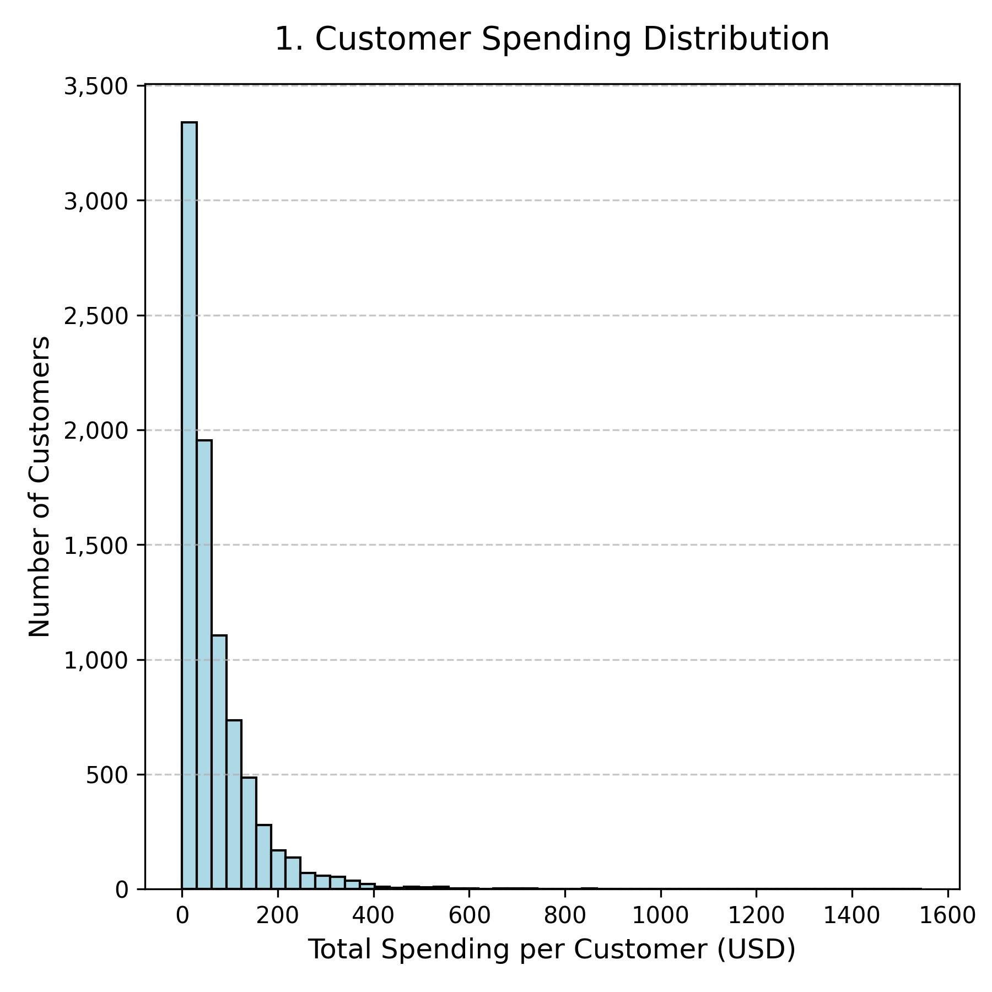
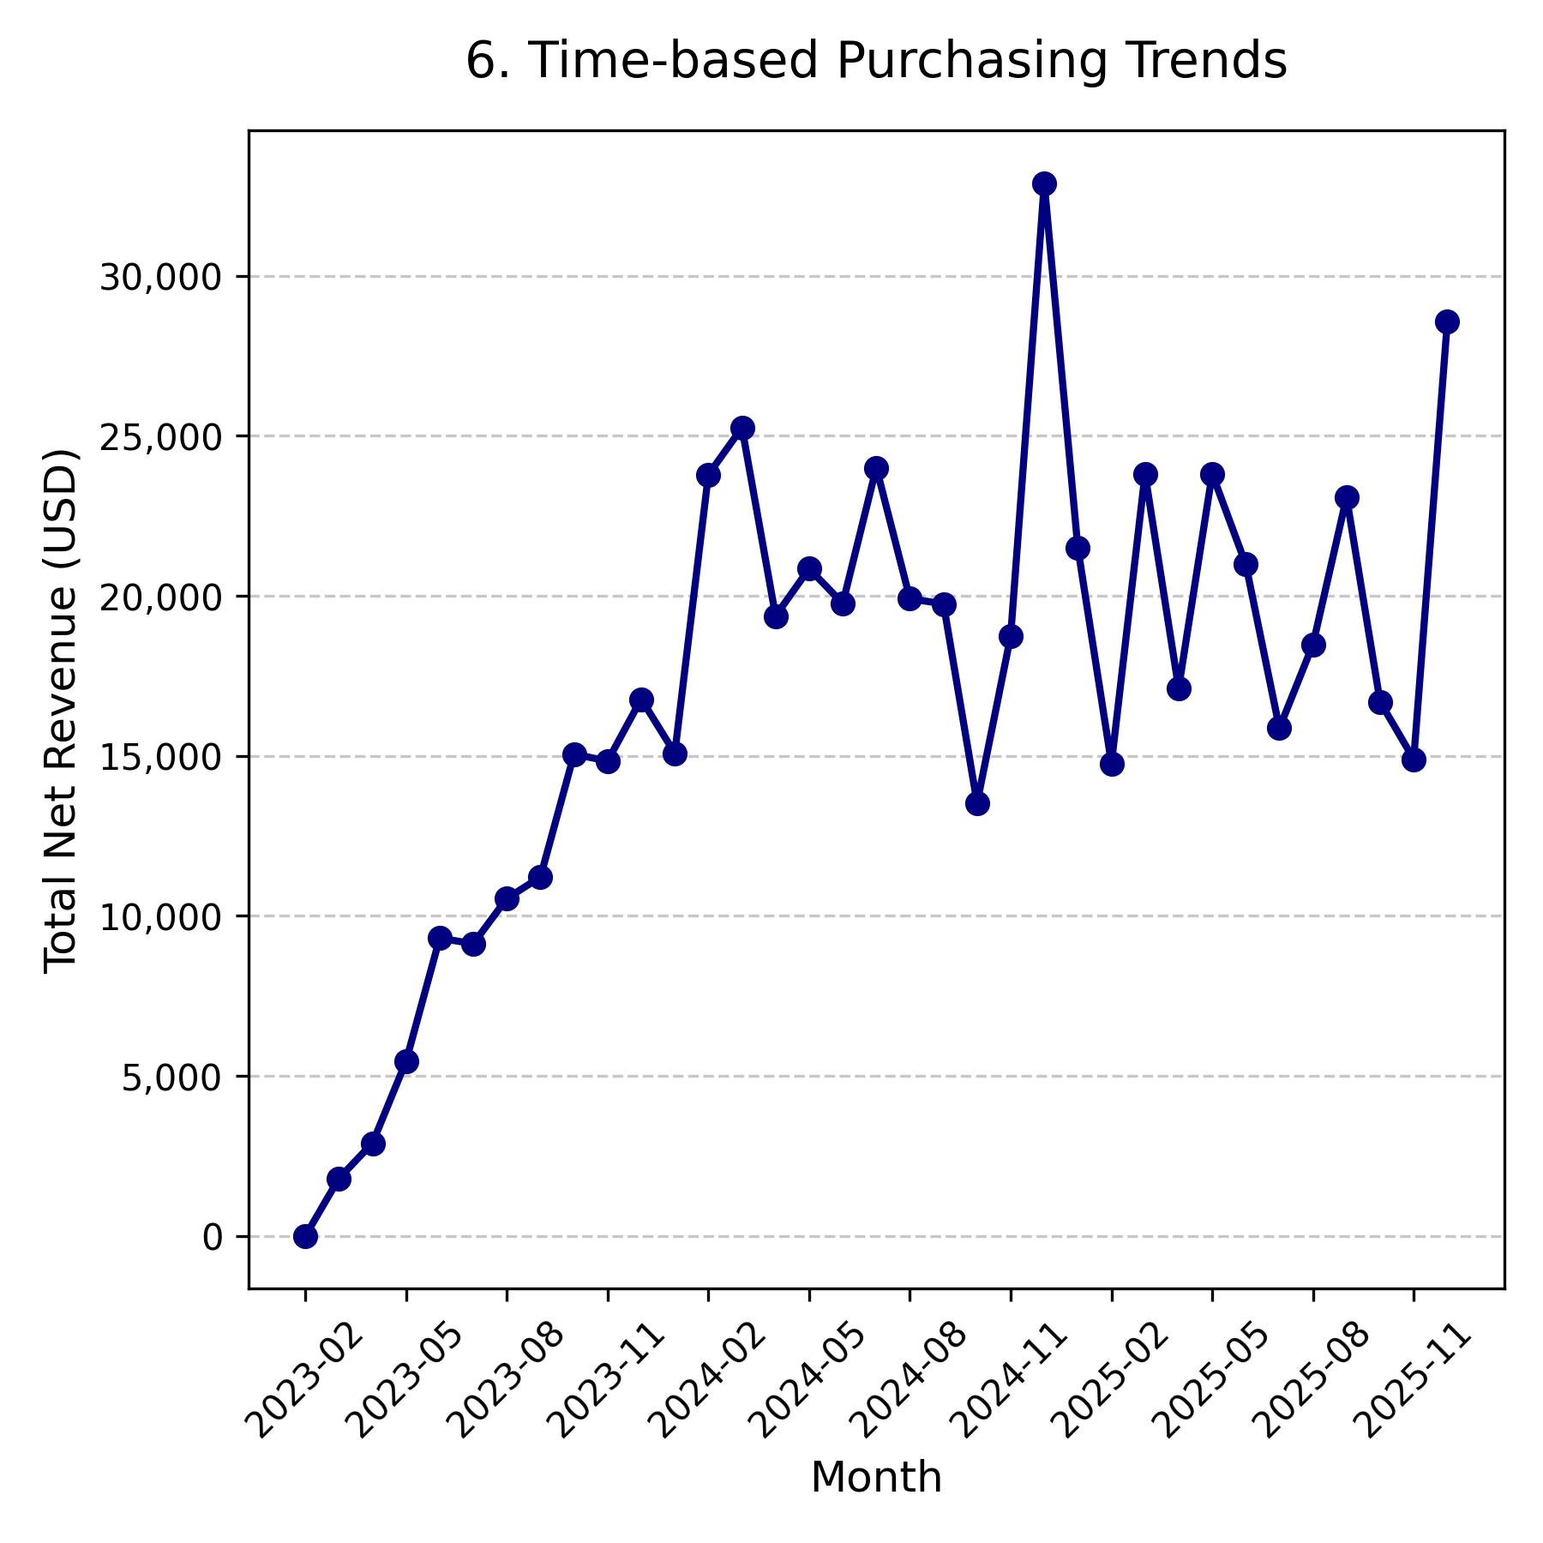
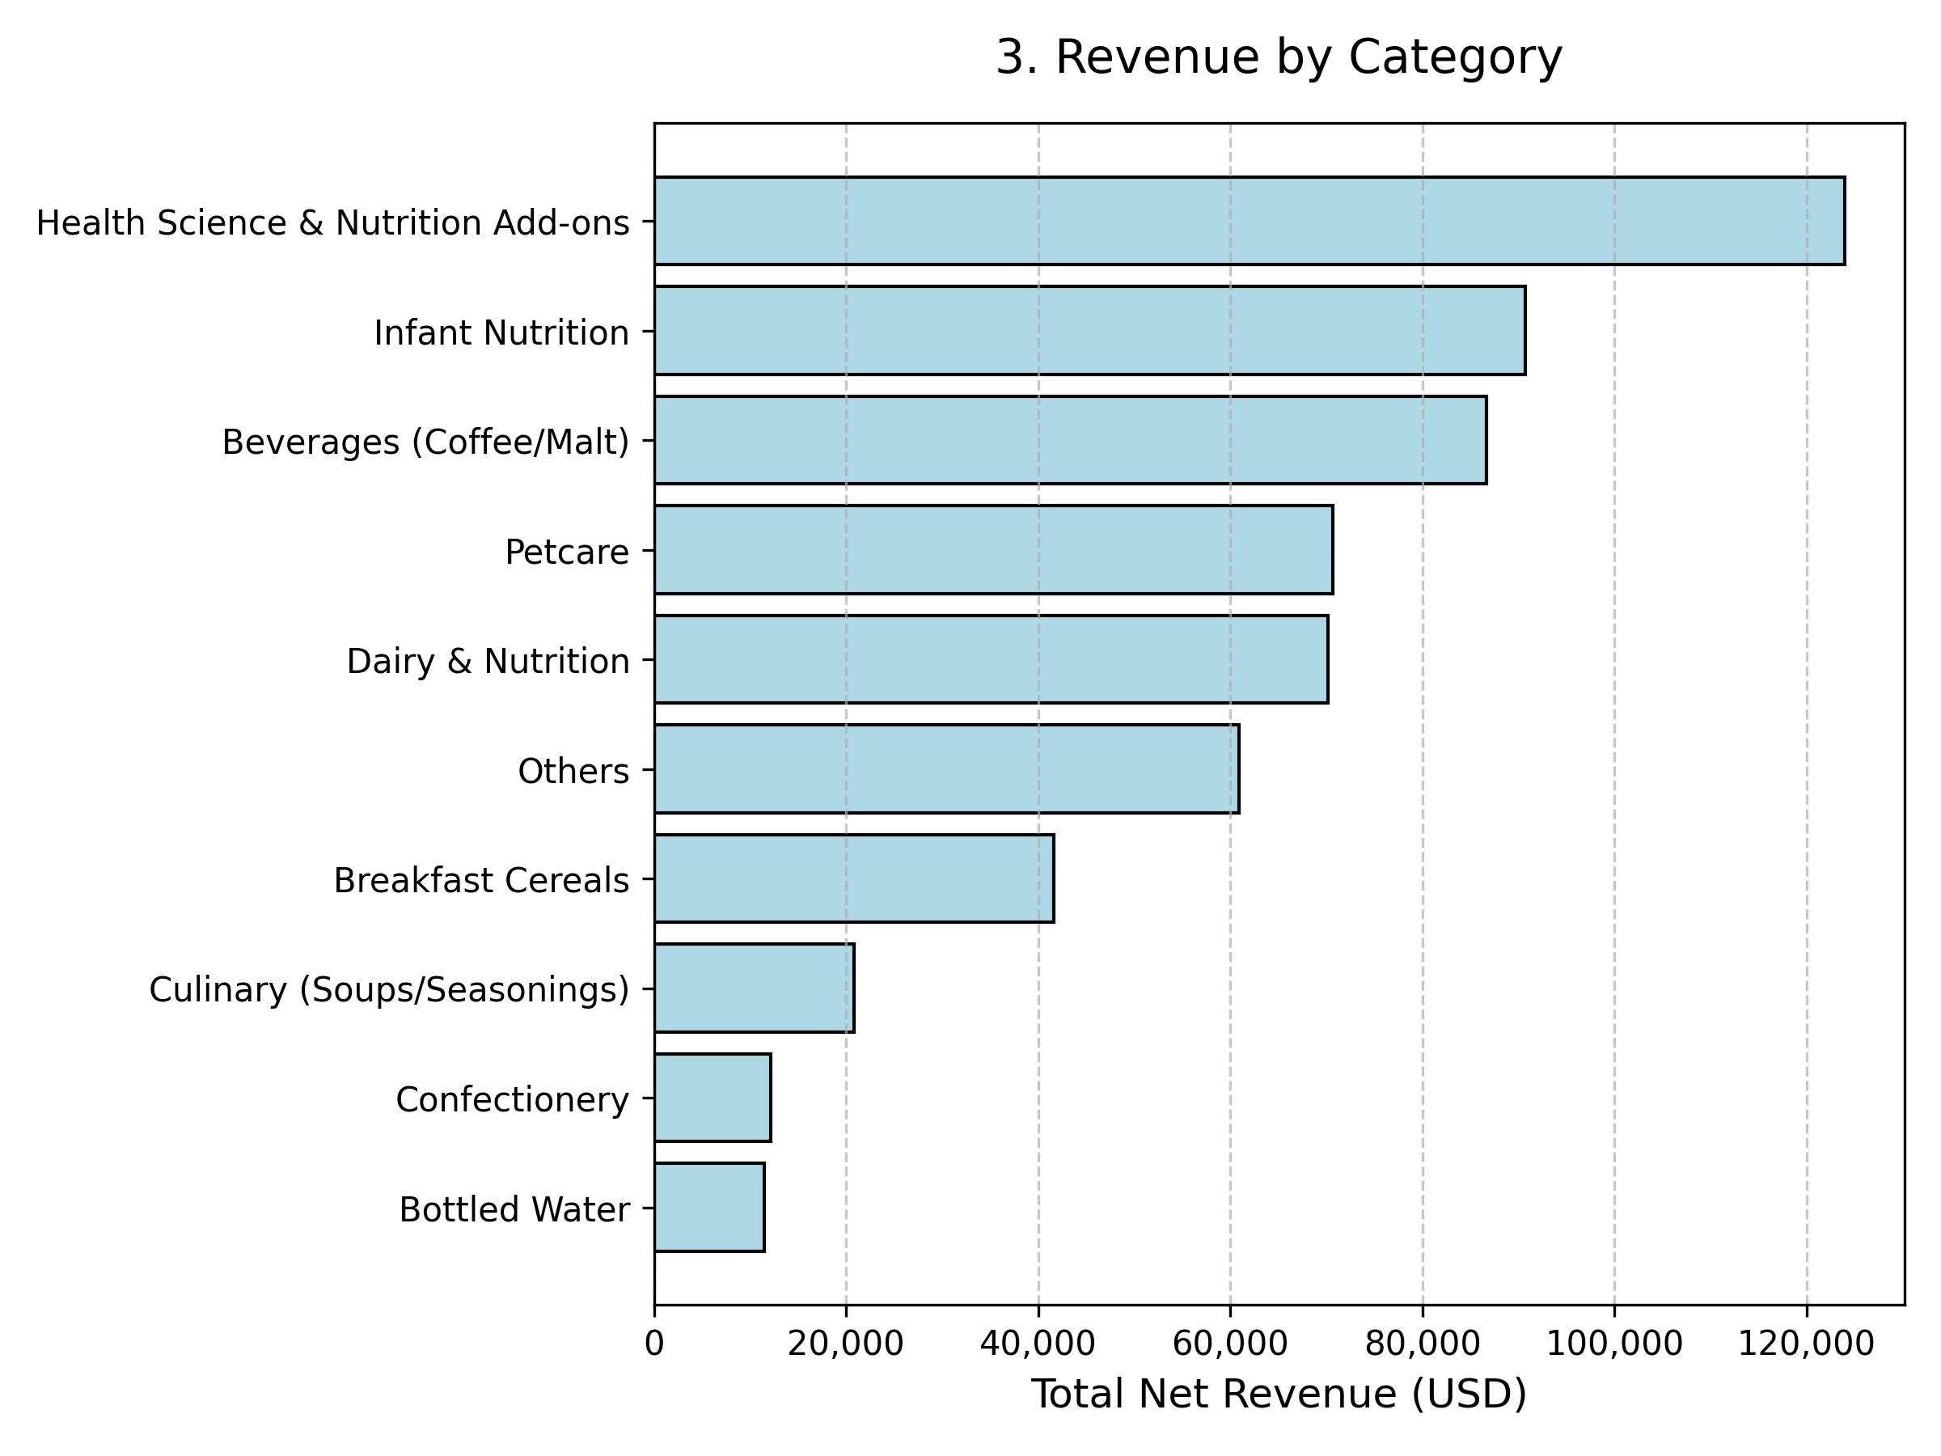
PART B
03
2. Exploratory Data Analysis
Net revenue was aggregated at the category_name level from df_items. The top categories by total revenue are Nutrition Adds-ons, Infant Nutrition and Beverages (Coffee/Malt).
Monthly net revenue was computed from df_orders over the full 36-month observation window (January 2023 – December 2025). This is important for interpreting the BG/NBD calibration/holdout split used in Part E, where 2023–2024 serves as the training window and 2025 as the holdout.
Customer level aggregation is strongly right-skewed. Most customers concentrate in a low-frequency, low-spend bracket, while a thin tail of highly active customers generates a disproportionate share of total revenue

Slide 4
PART C & D
04
3. RFM Analytical Framework & CLV Modeling Methodology
RFM ANALYSIS METHODOLOGY
CLV DESCRIPTIVE
RFM scores (1–5) were assigned via quantile-based binning to handle duplicate bin edges and replace fragile rank-based workarounds.
Recency scoring is intentionally inverted (low recency → high score), reflecting the business logic that recently active customers are more valuable, a deliberate asymmetry in the scoring function.
Of 125 theoretically possible RFM segments, 111 were observed; 83 contained fewer than 100 customers and were deemed statistically insufficient.
So, these sparse-segment customers were reassigned via constrained 3D Euclidean distance, with a hard constraint requiring the target segment to share the same R (Recency) score, preserving the most business-critical dimension, reducing to only 28 segments, with 2,985 customers (35.1%) successfully reassigned from sparse to representative segments.
Descriptive CLV used a customer-level three-component model:
CLV = (APV × PF) / Churn Rate, computed individually per customer rather than as dataset-wide aggregates.
Purchase Frequency (PF) is normalized by each customer's active lifetime in months, capturing individual purchase rates while accounting for tenure heterogeneity.
The results were computed for all 8,510 customers. The full-base mean CLV of $3.85/month rises to $6.11/month when restricted to the 3,154 active customers (Recency ≤ 90 days), confirming that active customers generate 59% more monthly value on average.
The top 20 customers by CLV (led by CUST002744 at $78.90/month) share a consistent behavioural profile: from 39 to 152 orders, APV of $9-16, and tenures spanning the full three-year window, confirming habitual purchase behaviour rather than one-off spending spikes.
DESCRIPTIVE CLV
CHURN DEFINITION
ACTIVE CUSTOMER ONLY
CLV = (APV × PF) ÷ Churn Rate
Recency > 90 days
Mean CLV = $6.11/month
Customer-level, monthly $
62.9% of base classified churned
Against $3.85/month for the full dataset

Slide 5
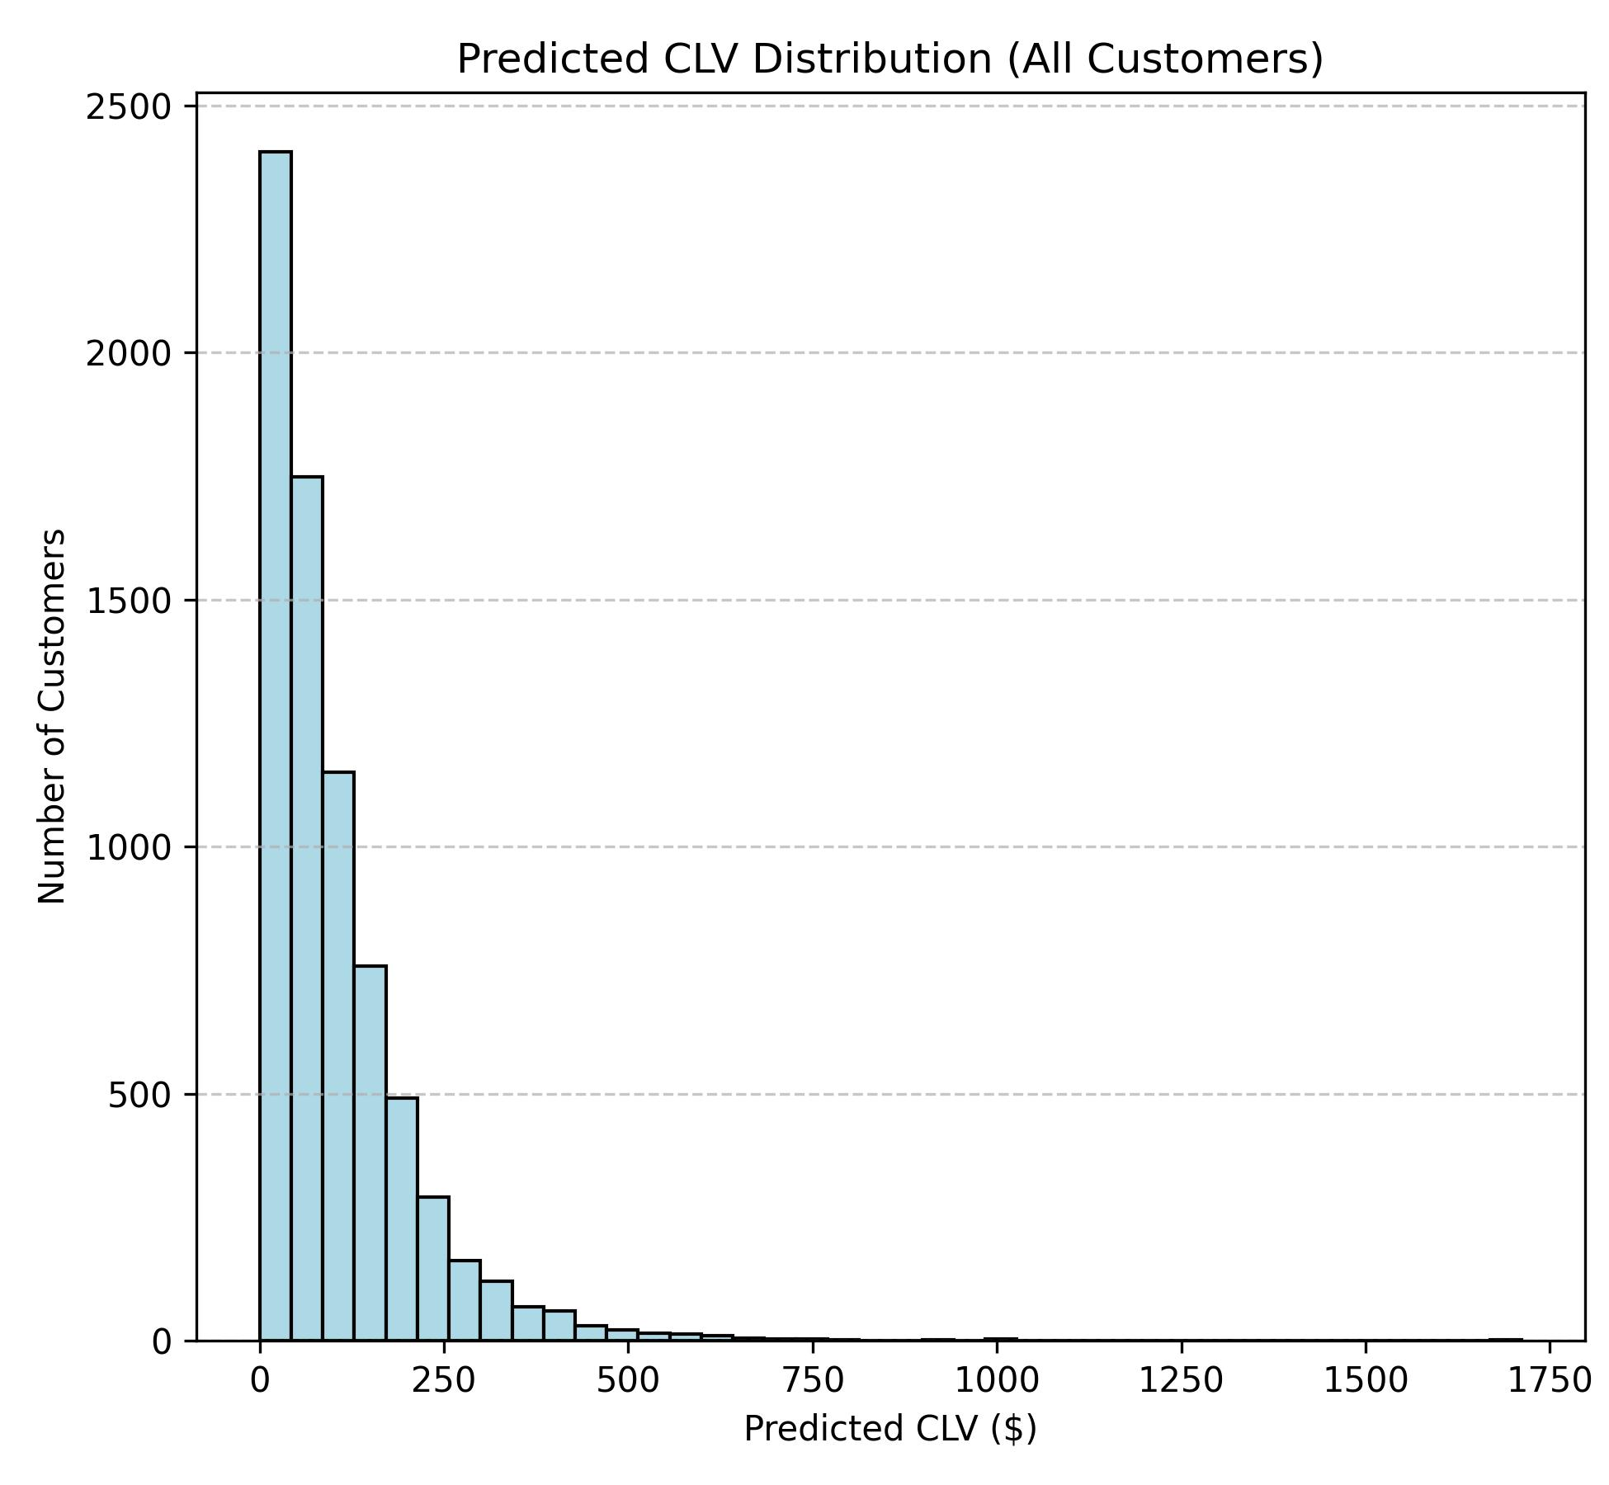
PART E
05
4. Predictive CLV& Empirical Evidence
PREDICTIVE CLV: BG/NBD + GAMMA-GAMMA
The BG/NBD combined with the Gamma-Gamma model was selected for 3 main reasons: the dataset is not subscription-based, there are enough data history to estimate the parameters of the model and the customers show heterogeneous purchasing behavior.
The data was transformed to be handled by BG/NBD summary in a weekly format. It consists of two separate models:
BetaGeoFitter models the purchase frequency and dropout process simultaneously.
GammaGammaFitter models the monetary value of transactions, assuming each customer has an individual mean spend drawn from a Gamma distribution.
The two models were combined to predict individual CLV over a 52-week horizon (after 104 of training) using a monthly discount rate of 1%, reflecting the time value of money.
The predictive model covered 7,369 customers (86.6% of base; 1,141 excluded due to zero monetary value causing log-likelihood instability).
All top 20 customers exhibit high recency relative to T (recency ≈ T), confirming they remained active throughout the observation window and are likely to continue purchasing in the prediction horizon.
The distribution of the CLV prediction and the evaluation metrics are displayed on the right.
2.345
1.783
0.426
RMSE
MAE
R²
Holdout period
Holdout period
Holdout period

Slide 6
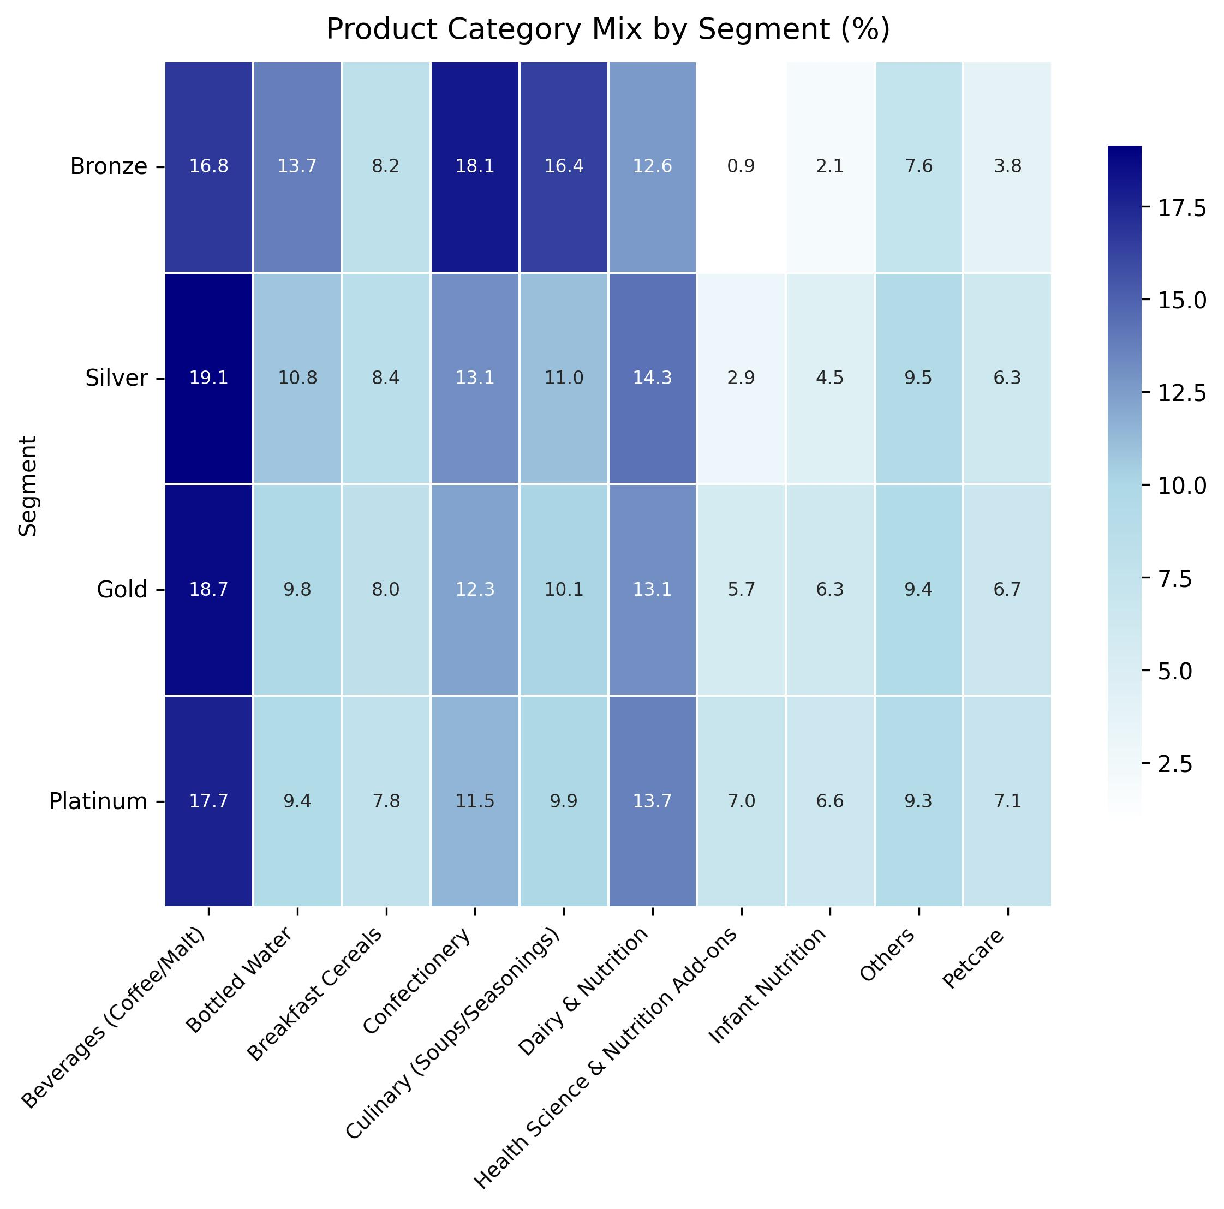
PART F
06
5. Customer Segmentation
Segmentation is based on descriptive CLV rather than predicted CLV, realized behaviour provides a more stable and interpretable basis for tier assignment without dependence on model assumptions about future purchasing.
PLATINUM
GOLD
SILVER
Top 20%
Next 30%
Next 30%
$10.69 / mo
$3.94 / mo
$1.53 / mo
n = 1,702
n = 2,553
n = 2,553
90.7 days recency
15.55 orders avg
APV $14.78
171 days recency
6.92 orders avg
APV $12.78
274.6 days recency
3.85 orders avg
APV $9.09
Habitual buyers at churn boundary, highest priority for proactive retention.
Stable mid-tier with highest upgrade potential, frequency gap vs. Platinum is the primary lever.
Occasional or seasonal buyers. Low engagement; simple win-back offers preferred over complex programs.
BRONZE
Bottom 20%
433.7 days recency
1.77 orders avg
APV $4.11
Largely dormant. Near-zero CLV; minimal direct marketing investment justified on ROI grounds.
$0.36 / mo
n = 1,702

Slide 7
PART F & CONCLUSION
07
6. Actionable Business Implications
1. Retention: Platinum Priority
2. Loyalty Program Architecture
3. Resource Allocation: Asymmetric budget
The Platinum segment are the customers that generate the highest value. For this reason, trigger reactivation campaigns before the 90-day churn threshold must be implemented. A 1% reduction in Platinum churn has great revenue impact given their $10.69/month CLV.
Tier benefits must be asymmetric: Platinum receives experiential rewards (early access, exclusive bundles) that reinforce habit without eroding margin. Gold milestones should reward incremental frequency, not spend. Bronze receives only low-cost digital win-back triggers.
Top-20 predicted CLV ranges $1,084–$1,711. Allocate a disproportionate retention budget to Platinum and upper-Gold. Bronze customers (avg CLV $0.36/month, recency 433 days) cannot recover acquisition cost at any reasonable payback horizon.
4. Promotion Design
5. Acquisition: Quality over volume
Upgrade Gold → Platinum
Category preferences are uniform across all tiers (Beverages > Dairy > Confectionery in Platinum through Silver), so blanket category promotions will not differentially activate high-value customers. So, it’s better to design promotions around frequency mechanics, not category affinity.
The frequency gap (6.92 vs 15.55 orders) is the primary differentiator. Churn often affect the customers with low frequency. So, it’s better to deploy replenishment reminders and subscription prompts in Beverages, Dairy, and Confectionery, the top categories across all tiers.
BG/NBD confirms that once engaged, customers rarely churn. Acquisition should target behavioural profiles matching Platinum and Gold: 6–7 repeat transactions in year one is the key early indicator of high lifetime value.

Slide 8
MARKETING ANALYTICS — HOMEWORK 2
Thank you
Customer Lifetime Value Analysis
An End-to-End CLV Framework: RFM Segmentation - Descriptive CLV - BG/NBD Prediction - Actionable Strategy
Presented to: Professor Luigi Capone
Student: Colombini Francesco – ID:944941

