Slide 1
MARKETING ANALYTICS — PROJECT
Marketing Mix Modelling
A Meridian MMM study with SHAP explainability, built on daily multi-territory marketing and sales data for a selected organization.
BUSINESS CONTEXT
Presented to: Professor Luigi Capone
Why We Built This Model
Student: Colombini Francesco – ID:944941
Quantify Contribution
Marketing budgets are split in different channels, and a causal view is necessary to define the future choices
Map Saturation
Specific channels could have already hit diminishing returns, must be modified to optimize the budget use.
BUSINESS OBJECTIVES
Quantify each channel marketing contribution,
Estimate ROI and marginal ROI,
Identify the highest-confidence path to incremental revenue.
Estimate ROI & mROI
Average and marginal return by channel must be identified to have a complete view on the actual spending
Simulate Allocation
If the company had extra budget to deploy next quarter, where should it go, and how confident can the answer be?
Università degli Studi di Milano-Bicocca - Python – Meridian - SHAP

Slide 2
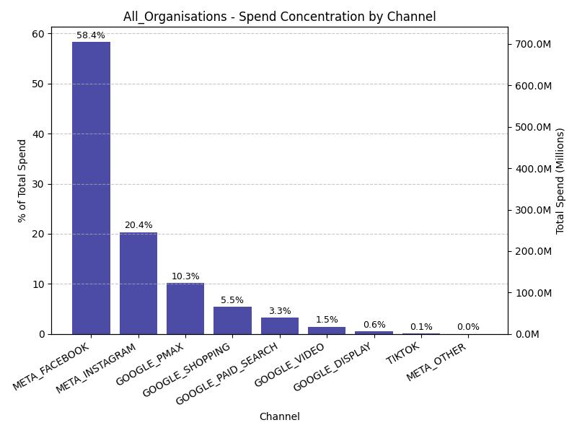
TASK 1
01
1. Data Overview and Modelling Scope
METHODOLOGY & RATIONALE
SPEND CONCENTRATION BY CHANNELS: OVERALL FIRMS
1. Data Ingestion
The dataset was extracted from the file conjura_mmm_data.csv, inspected in full before any filtering or modelling.
2. Data Quality
The dataset contains multiple firms, all with different channels use and spending, for this reason most of the channels are full of missing and a complete analysis over all the dataset don’t give useful information
3. Data Preparation
The raw territory-level dataset is transformed into a Meridian-ready table by defining NET_REVENUE, as the KPI, so the model targets real economic value rather than raw purchase counts.
A DISCOUNT_RATE control is added to capture promo-driven demand separately from media effects, and any missing media spend is filled with zero, treating gaps as inactivity rather than letting them break estimation.
Trend, day-of-week, and month features are also added so the model can separate genuine marketing impact from seasonality and long-run growth.

Slide 3
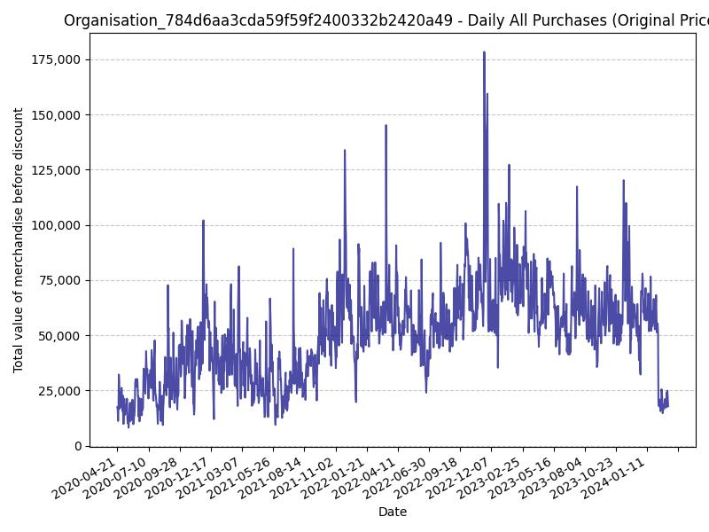
TASK 2
02
2. Data Preparation and Feature Engineering – Single Organization
01
05
Select Organization
TOTAL VALUE OF MERCHANDISE BEFORE DISCOUNT (DAILY)
Best-fit organization chosen for single-firm analysis with the most reliable and informative marketing history.
Chronological Split
02
Train / validation split preserves time ordering, essential for MMM
Clean Channels
Drop not necessary variables and handle missing values, removing channels with too much missing spend data, while the remaining media gaps were filled with zero (inactive channels = zero spending).
03
06
Engineer Features
Removed identifiers and non-model columns, created the main KPI NET_REVENUE, and added controls such as DISCOUNT_RATE, TREND, DAY_OF_WEEK, and MONTH. Only features with both _SPEND and _CLICK columns were selected as media variables.
Results
All these procedures, allow Meridian to separate adstock, saturation, and seasonal effects instead of confounding them.
04
Almost 3 years were considered for tracking the training data (mid 2020- mid 2023) and almost one to the test set (mid 2023-mid 2024)
Align Geo-Time Grid
Each geo has a complete time grid aligned the dates across geographies to ensure the same time structure.

Slide 4
TASK 3
03
3. MERIDIAN Framework
From prepared data to a trained causal MMM, in seven steps
1
2
3
4
5
6
7
Map Inputs
Build Holdout
ROI Prior
Train Model
Evaluate Fit
Save / Reload
Interpret
CORE TRAINING CONFIGURATION
REPRODUCIBILITY & VALIDATION
Target variable selection: NET_REVENUE
Carryover: max_lag = 8 (adstock captures delayed media effects)
Saturation: Hill-type curves model diminishing returns per channel
Time flexibility: knots = 50 spline knots for long-run trend
ROI prior: positive LogNormal, anchored to empirical training-period ROI
Holdout mask: final periods per geo are marked, not split, the full-time panel stays intact
Fit evaluation: R², MAPE, and wMAPE vs. observed revenue
Reproducibility: model saved and reloaded, no retraining on every run
Interpretation: fit plot (expected vs. actual) and per-channel response curves
SPECIFIC ORGANIZATION CHOICES
MEDIA VARIABLES
CONTROL VARIABLES
TIME VARIABLES
META_FACEBOOK, META_INSTAGRAM META_OTHER, GOOGLE DISPLAY
DISCOUNT_RATE (for seasonality)
INTERNAL KNOT (DECIDED BY MERIDIAN ITSELF)

Slide 5
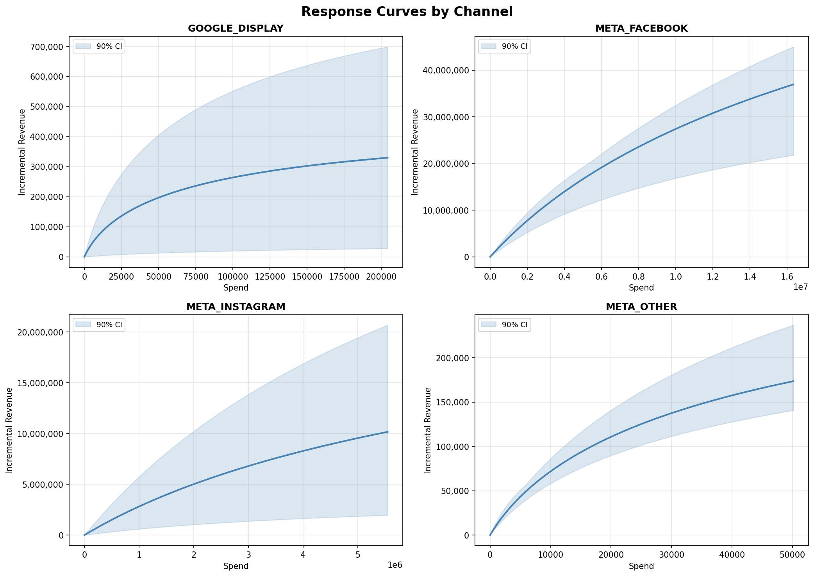
TASK 3
04
3. MERIDIAN Framework
MERIDIAN RESPONSE CURVES RESULTS
MODEL PERFORMANCE & VALIDATION
Metrics | National | GEO
R² | 0.772 | 0.778
MAPE | 16.5% | 21,8%
wMAPE | 15.1% | 17,9%
An R² near 0.77 at both geo and national level is solid enough to trust the ROI and scenario results that follow. wMAPE below 18% indicates the error is low relative to the size of the periods that matter most. Also, the curves suggest diminishing returns across all channels and the best relative efficiency appears to be Meta Facebook and Meta Instagram

Slide 6
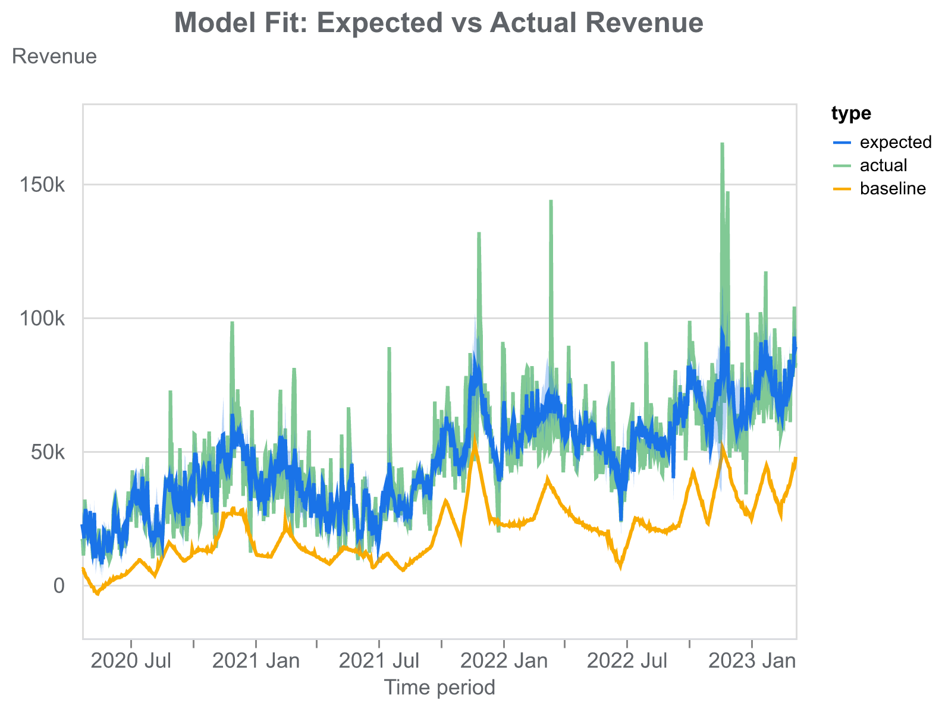
TASK 3
05
3. MERIDIAN Framework
MODEL FIT RESULTS
The Meridian fit looks very solid for a business: the expected line tracks the actual revenue trend well across the full horizon, which suggests the model is capturing the main structural drivers of demand, including seasonality, long-term growth, and the general media effect.
The baseline sits clearly below both expected and actual revenue, which is what it should be seen in a properly specified MMM, because it indicates the incremental contribution from marketing is being separated from the underlying organic level.
What stands out, is that the model captures the central tendency very well but smooths some of the sharp revenue spikes. That is normal in MMM because peaks are often driven by short-lived promotions, stock effects, external shocks, or channel interactions that are hard to fully recover at daily granularity.
So, the results are reliable for channel contribution and budget planning but not intended to reproduce every short-term outlier exactly.

Slide 7


TASK 4
06
4. Channel Efficiency: ROI and Marginal ROI by Channel
All channels show mROI < ROI, which is the expected behaviour under diminishing returns. This means that the last euro spent on each channel generates less revenue than the historical average.
Channel | ROI (median) | mROI (median) | Status
GOOGLE_DISPLAY | 2.54 | 0.87 | Over-invested
META_FACEBOOK | 3.32 | 2.32 | Under-invested
META_INSTAGRAM | 2.08 | 1.57 | Under-invested
META_OTHER | 4.97 | 2.59 | Under-invested
GOOGLE_DISPLAY is the only channel with mROI below 1, the clearest signal of saturation and weak marginal efficiency. This imply that each euro spent on that specific channel compute a net loss.
An efficient reallocation would shift budget from `GOOGLE_DISPLAY` toward the Meta channels, particularly `META_OTHER` which shows the highest mROI (2.59) and the highest ROI (4.97), indicating it is both the most efficient channel historically and still has room for further investment.
META_OTHER leads on both ROI and mROI, the strongest candidate for additional efficient spend, probably also because is the lowest spending channel. META_FACEBOOK and META_INSTAGRAM stay above break-even, so both still have room to grow.
7

Slide 8
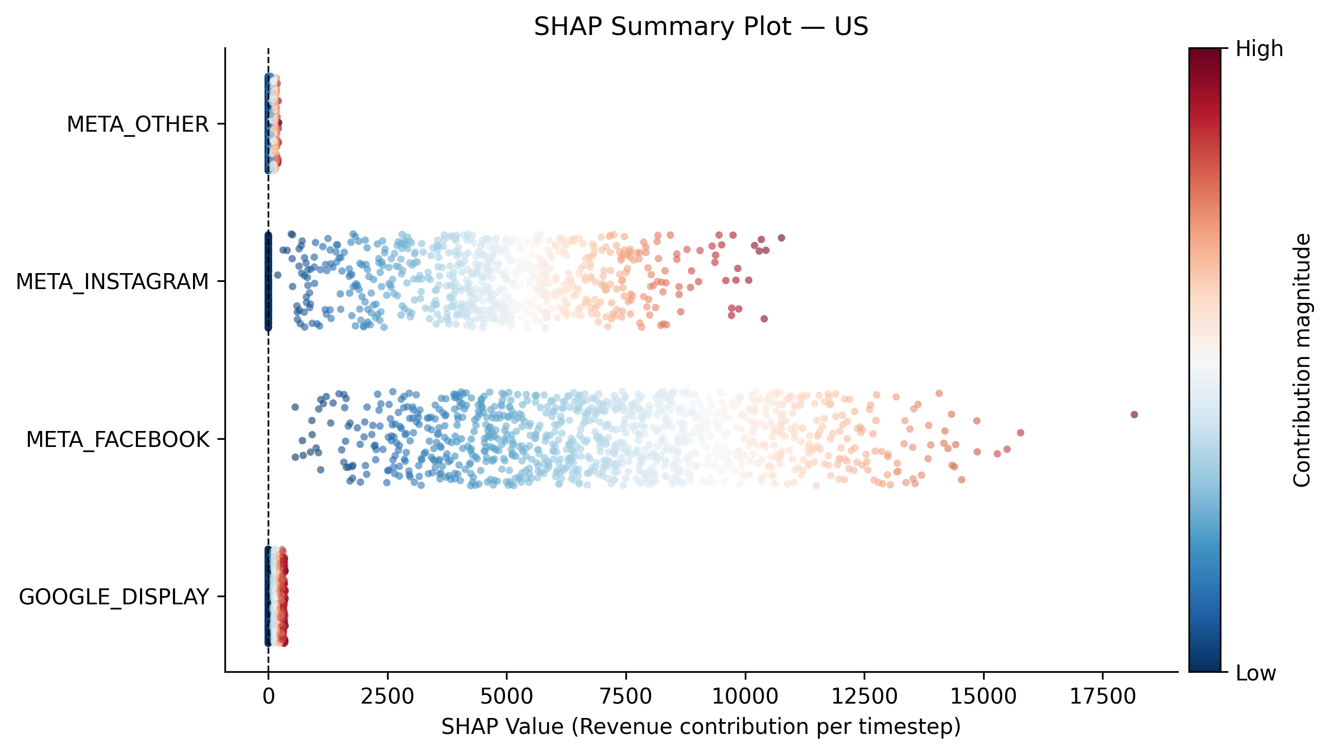




TASK 5
07
EXPLAINABILITY
5. SHAP - Style Contribution Analysis
WHAT DOES SHAP REALLY DO?
REVENUE CONTRIBUTION PER TIMESTEP BY CHANNEL - US MARKET
Channel-Level Contributions
Extracts each channel's estimated share of revenue from the fitted Meridian model
Summary & Dependence Plots
Generates visual summaries of contribution strength across channels
Geo-Specific Rankings
Computes importance rankings by territory, not just at the national level
Meta channels contribute the most to the model’s predicted outcome, showing broader distributions of positive SHAP values. Meta_Other and Google_Display contribute less overall, with values clustered closer to zero. Also, the colors suggest tgat higher feature values tend to drive larger (more influential) SHAP contributions.
Media-Intensity Comparison
Relates contribution strength back to observed spend and impression levels

Slide 9
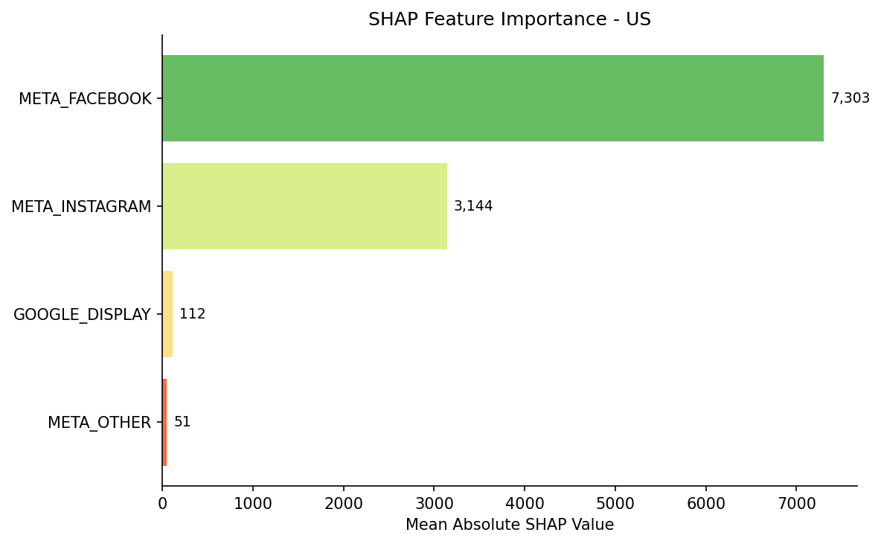
TASK 5
08
EXPLAINABILITY
5. SHAP - Style Contribution Analysis
CHANNEL-LEVEL IMPORTANCE BY SHAP ANALYSIS FOR US MARKET
ALERT: It must be considered that the spending of each channel is related with their importance, so an higher budget contribution (budgets below) could imply an higher SHAP result.
Also, for this reason, in the US market, META_FACEBOOK and META_INSTAGRAM show the greatest impact on the total NET_REVENUE.
Below the actual spending on each channel for each media channel.
TERRITORY_NAME | META_OTHER | GOOGLE_DISPLAY | META_INSTAGRAM | META_FACEBOOK
UK | $ 18,786.06 | $ 57,980.82 | $ 1,379,157.25 | $ 4,916,769.60
US | $ 5,927.82 | $ 55,449.27 | $ 2,052,001.72 | $ 3,776,218.90

Slide 10
PART F
09
6. Scenario Simulation: Comparing the 3 budget strategies
All scenarios share the same external extra budget (+20% of total historical spend = ~€2M) making delta_abs, incremental_purchases and incremental_roi directly comparable across rows. Scenario 3 also reallocates freed budget internally from saturated channels.
Scenario | Incr. Revenue | Incr. Purchases | Incr. ROI
1. Equal Allocation | €2,057,051 | 17,092 | 1.02
2. mROI-Optimized (all-in on META_OTHER) | €296,755 | 2,465 | ~0.15
3. Saturation-Aware Reallocation | €2,508,218 | 20,841 | 1.24
Best strategy: Saturation-aware reallocation wins on revenue, purchases, and ROI by combining the extra budget with an internal shift away from GOOGLE_DISPLAY.
Cautionary case: Concentrating all extra budget on META_OTHER looks very inefficient on the Meridian results, but the problem is that channel has limited historical spend and increasing the budget from 20K to over 2M saturates quickly and the results given are not reliable on the conclusion.

Slide 11
CONCLUSIONS
10
7. Actionable Business Implications
Reduce
Reallocate
Prioritize
Trim exposure on GOOGLE_DISPLAY, mROI below 1 confirms it is already saturated
Shift freed and incremental budget toward META_FACEBOOK and META_OTHER. The budget optimizer confirms this direction: +$700k on META_FACEBOOK and +$10k on META_OTHER generate an additional $419k in revenue (+1.4%)
META_OTHER first on ROI and mROI, but pace the shift to respect its scale limits
LIMITATIONS
NEXT STEPS
MAPE at the geo level (~22%) is higher than national, so territory-specific predictions carry more uncertainty than the aggregate view.
The mROI-optimized scenario shows that efficiency metrics alone can mislead without a scalability check, the same caution likely applies to any newly scaled channel.
ROI priors are informed by empirical training-period ROI, so results reflect recent market conditions and may shift if channel dynamics change materially.
The budget optimizer operates under spend constraints (±50% per channel), so the optimal solution is bounded by historical patterns and may underestimate gains achievable with more aggressive reallocation.
Pilot the saturation-aware reallocation at reduced scale before a full quarter-level shift.
Re-run ROI, mROI, and scenario simulation on a rolling basis as new spend and revenue data arrive.
Extend the SHAP-style explainability layer to monitor whether channel contribution rankings stay stable as budgets shift.
Evaluate whether additional organizations warrant their own MMM once the single-firm workflow is validated in production.
Use the optimizer output as the baseline for next quarter's budget plan: the +$700k shift toward META_FACEBOOK and the progressive increase on META_OTHER are the two highest-confidence moves the model supports.

Slide 12
MARKETING ANALYTICS — PROJECT
Thank you
Marketing Mix Modelling
A Meridian MMM study with SHAP explainability, built on daily multi-territory marketing and sales data for a selected organization.
Presented to: Professor Luigi Capone
Student: Colombini Francesco – ID:944941

