Slide 1



Investment Made Easy
(magnate..com)
Team name-Choders
Team leader:Priyanshu Rao(me210003056@iiti.ac.in) Team member:Devansh Gupta(me210003028@iiti.ac.in)

Slide 2


Problem statement
Create a web platform to directly provide a platform which can act as a bridge between the entrepreneurs and investors.
Your Solution Must Include:-
The platform should be able to handle two types of users, i.e. entrepreneurs and investors.
Try to include all the relevant details of both types of users, i.e., the investor and the startup founder. Also, confirm whether the Government of India verifies the startup. The platform must provide a forum where investors and startup founders can interact and negotiate.
Provide a functionality where investors can search for startups in various fields and choose wisely. The search results must include all the necessary details about the startups.
Similarly, entrepreneurs should be able to search for potential investors

Slide 3



Introduction
Magnate.com is a modern platform to make investing in upcoming businesses easy. The days of endless waiting to get a meeting are over; meet your potential investor or the company you are interested in online and start connecting right off the bat.

Slide 4


General Overview
We made our website's(magnate.com) front end using basic HTML,CSS and Javascript.
For backend node.js, postgresql was used.

Slide 5





Major learnings*
The First Concept
Basic HTML, CSS,JavaScript
The Second Concept
basic functionality of node.js
The Third Concept
basic backend functionality like how to take input from user and store that data in database and tablrs.
*: we didn't know anything about web development prior to the past 2 days,everythinng was learnt during the hackathon:)

Slide 6
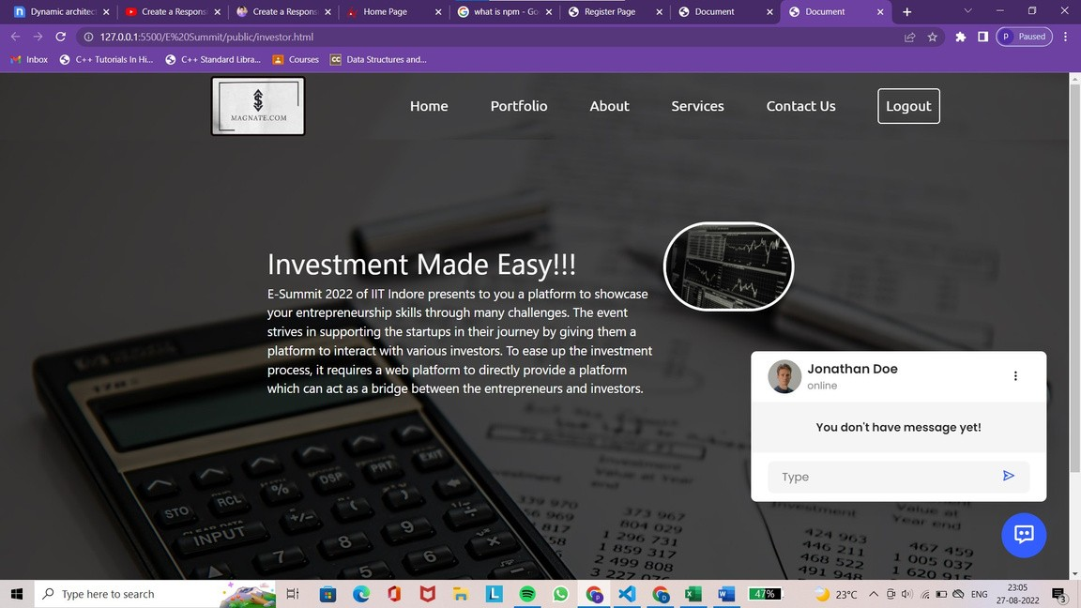
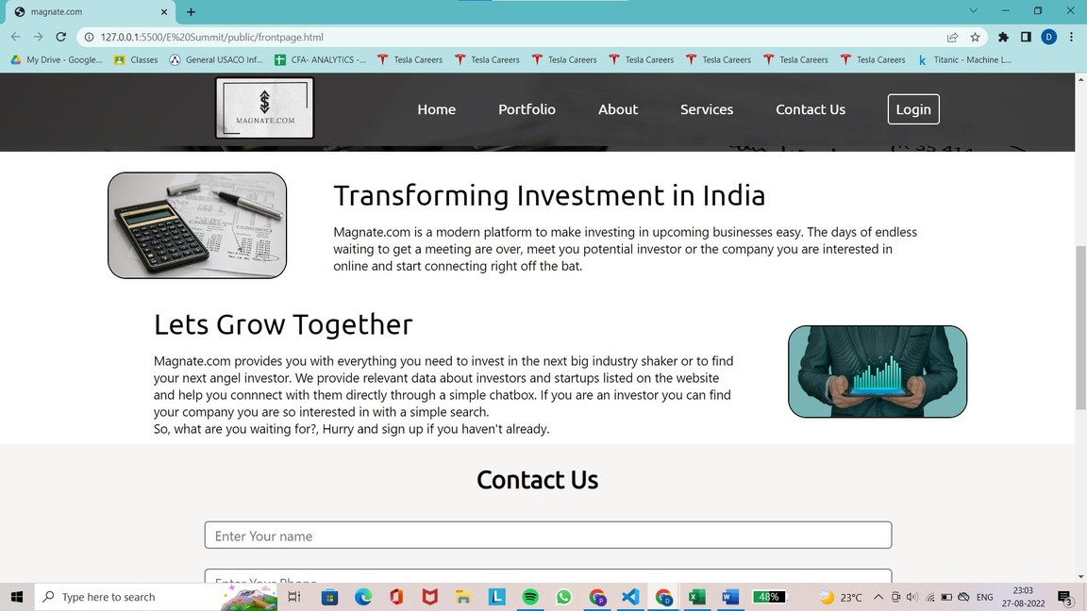
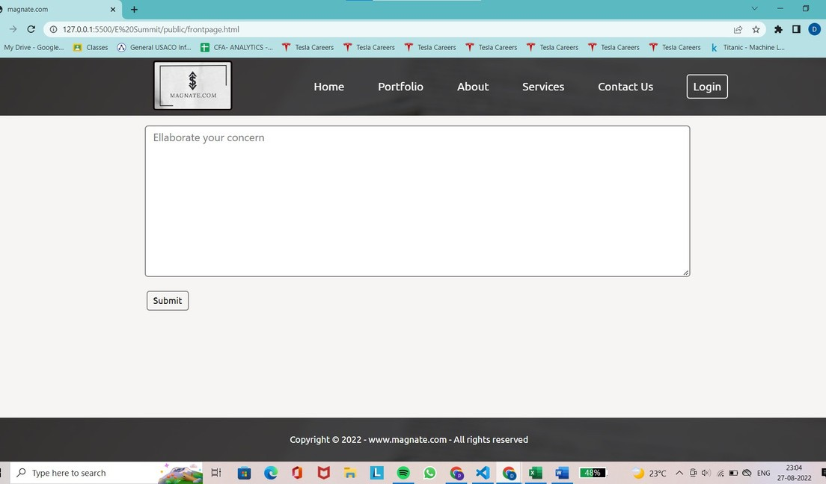
frontpage

Slide 7
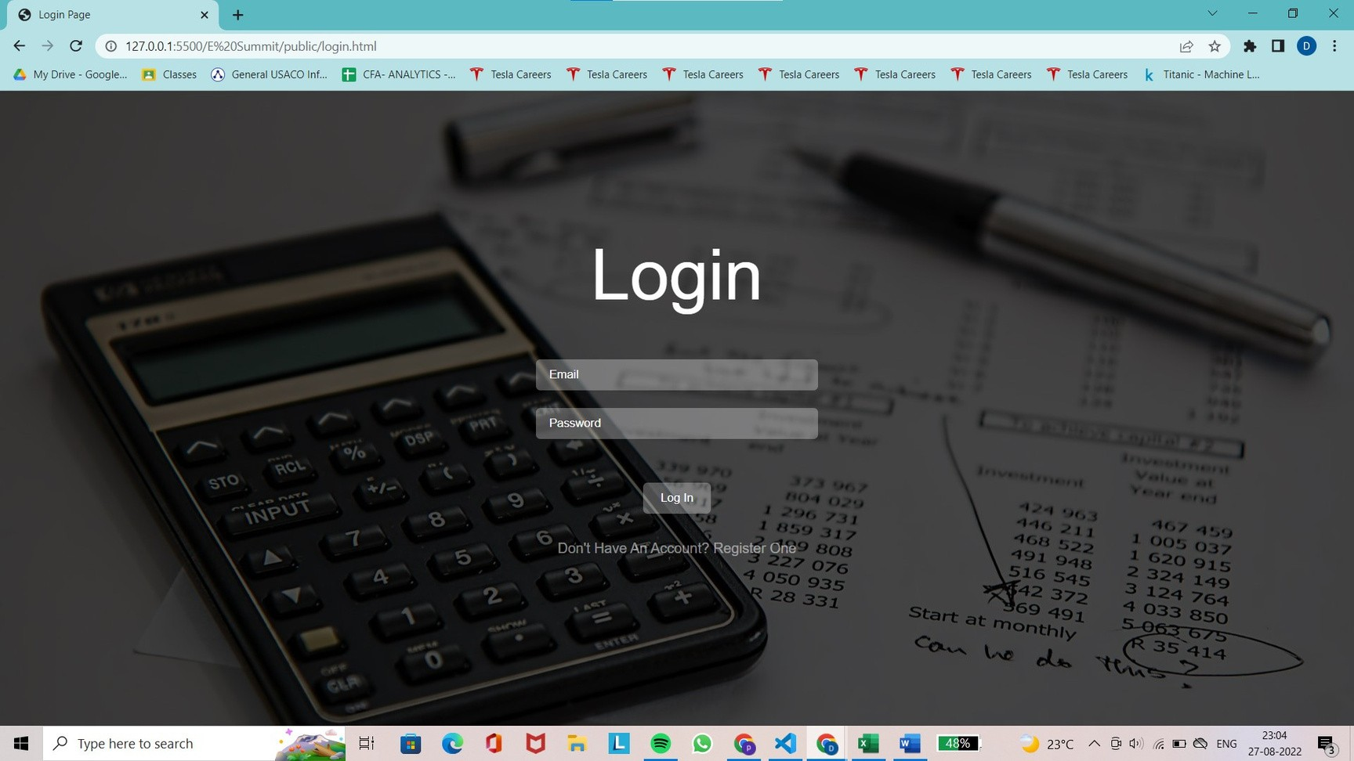
login page

Slide 8

registration page

Slide 9
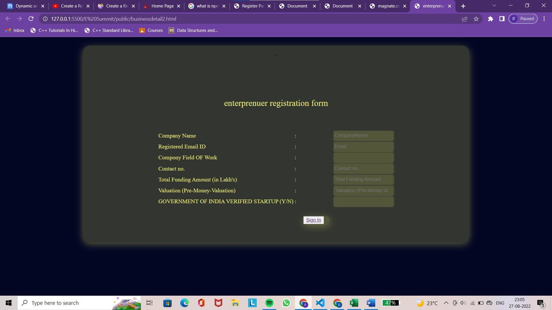
registration form

Slide 10



Thank you!

Slide 11


References
https://www.youtube.com/watch?
v=GeykycZ4Ixs&list=PLu0W_9lII9agiCUZY RsvtGTXdxkzPyItg&index=104&ab_channe l=CodeWithHarry
https://www.indianangelnetwork.com/
https://www.gripinvest.in
https://www.youtube.com/watch? v=Q33KBiDriJY&t=5701s&ab_channel=ed ureka%21
01
02
03
04

