Slide 1


funbiogeo: an R package for functional biogeography
Principles & Roadmap
Matthias Grenié & Nicolas Casajus, et al. - FREE CESAB Group

Slide 2
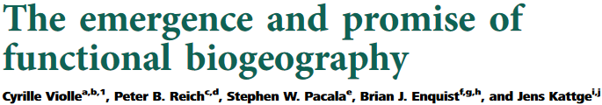
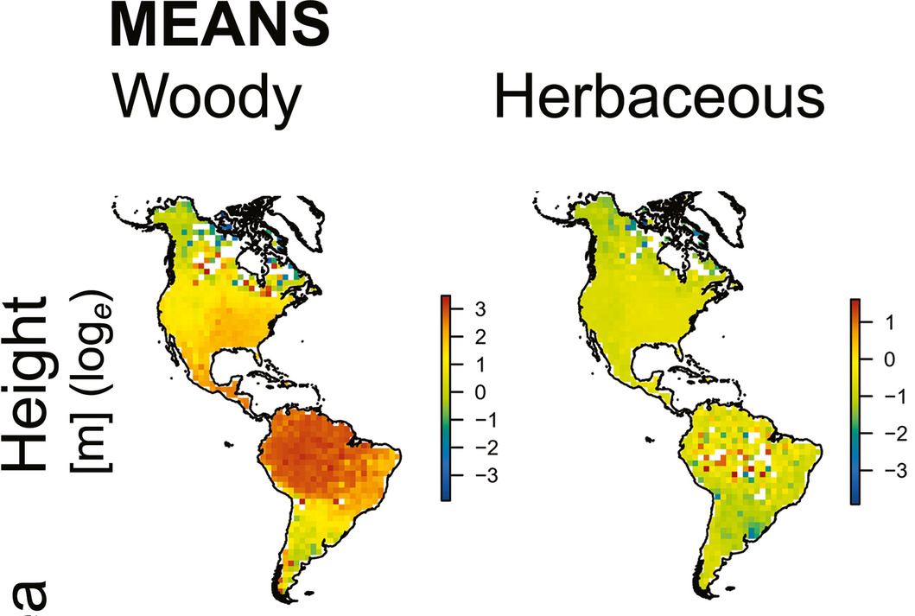
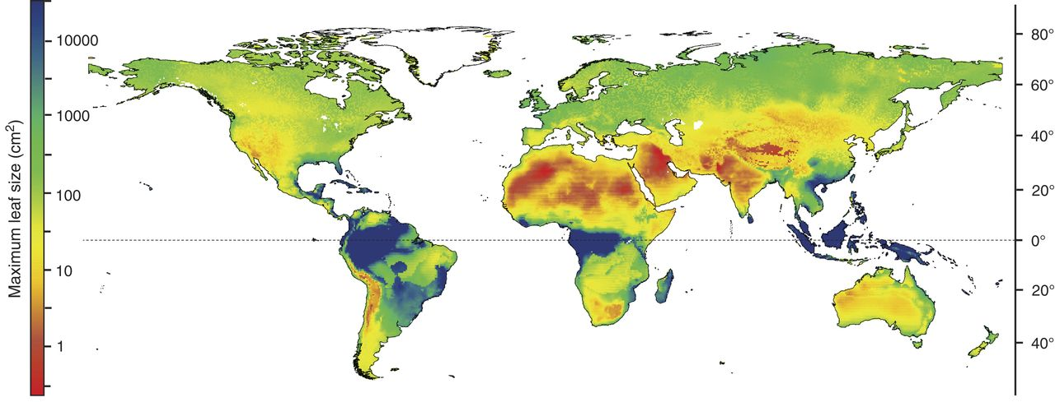
Functional Biogeography: close to than 10 years old?
Violle et al. 2014 PNAS
Šímová et al. 2018 JBI
Wright et al. 2017 Science

Slide 3



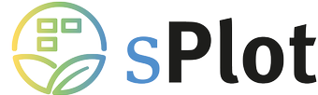
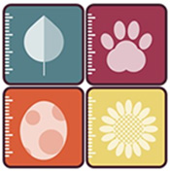

Increasing availability of data
Occurrences/Plots
Traits
Climate (+other environmental layers)

Slide 4
Standard workflow… but no standard tool!
Traits
Site-species
Environment
Well-covered sites
Traditionally managed by FD packages
FD indices
FD-environment correlations
FD maps

Slide 5
What should funbiogeo do?
Provide standardized functions to help build a standard workflow for functional biogeography
Be a learning tool for students and researchers interested in functional biogeography
Provide diagnostic plots to help functional ecologists navigate their analyses
Be agnostic about nature of functional diversity indices computed (many other good tools exist for that)

Slide 6
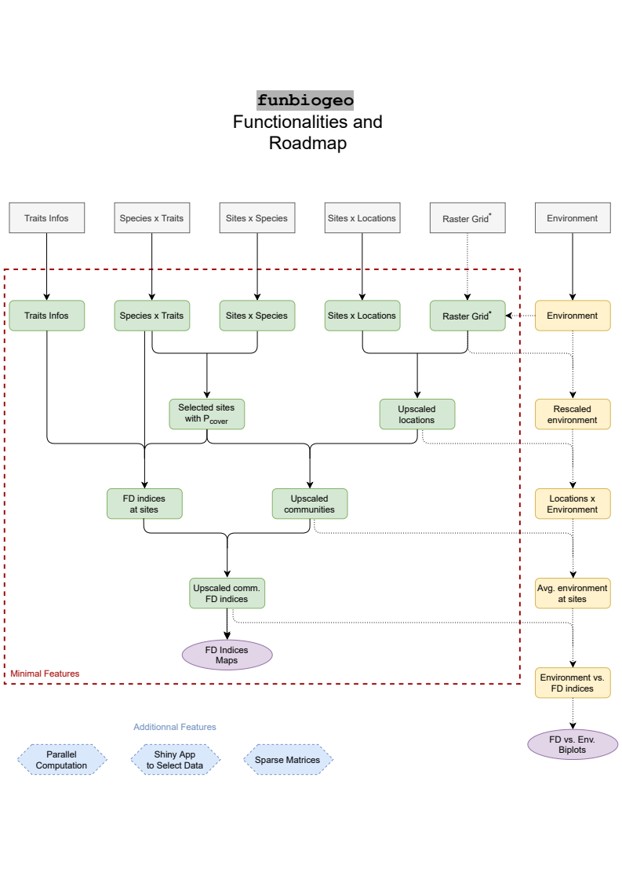
Previously discussed roadmap

Slide 7
Previously discussed roadmap: what has been achieved
✅
✅
✅
✅
✅
✅
✅
✅
✅

Slide 8
What still needs to be done
Works with non-continuous traits
Add nice default helper plots:
1. Trait coverage visualization
2. Site-mapping visualization
3. Actual sites environmental coverage visualization
Add discrete categorization between sites and/or species (groups of sites/species)
Temporal dimension of sites
Think about local trait measurements inclusion

Slide 9


@LeNematode
https://rekyt.github.io/
Thank you!
We welcome any contribution
ideas, suggestions, or even code
https://github.com/FRBCesab/funbiogeo

