Slide 1

Introduction on Functional Rarity
Concepts & Principles
Matthias Grenié – June 16th 2021
CESAB Workshop

Slide 2
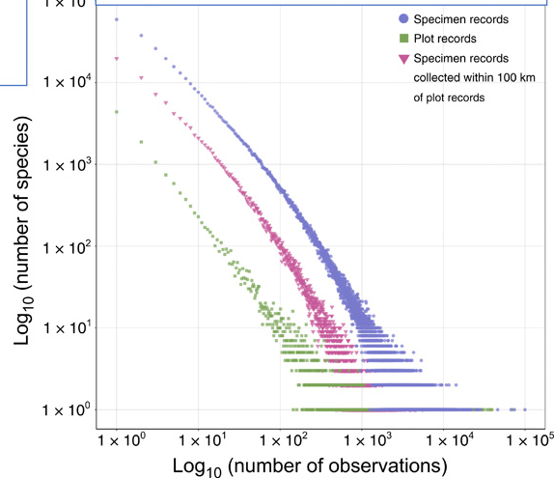
The widespreadness of rarity
"rarity is the attribute of a vast number of species of all classes"
– Charles Darwin, The Origin of Species 1859
Most species are rare few are common
Yet, ecology generally focuses on common species
Enquist et al. 2019 Sci. Adv.

Slide 3
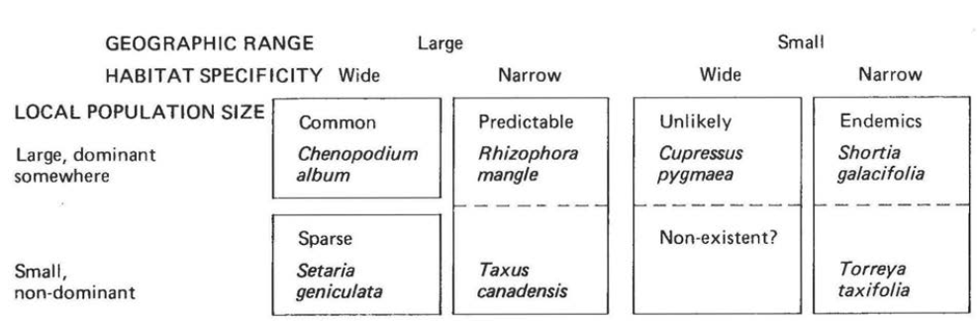
Different types of Rarity
“Seven forms of rarity” Deborah Rabinowitz 1981

Slide 4
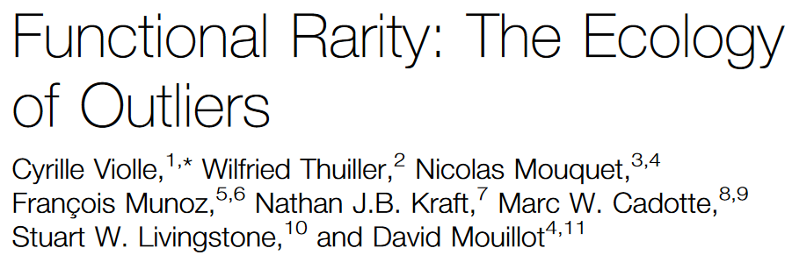
From Rarity to Functional Rarity
Violle et al. 2017 Trends in Ecology and Evolution
Species can also be rare along a trait dimension

Slide 5
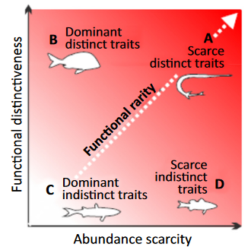
Decomposing Functional Rarity along Two Axes
Functional Rarity = “Classical” Rarity + Trait Rarity (= originality)
Trait Rarity
Violle et al. 2017
“Classical” Rarity

Slide 6
Decomposing Functional Rarity along Two Scales
Scale matters in Ecology
Local context and Regional context can differ
Locally Rare species may not be Regionally Rare (Example case)
Same for Originality

Slide 7
16 (rather 12) forms of functional rarity
Analogous to Rabinowitz classifications
These are discrete categories defined to understand the concepts
In practice we rather use quantitative continuous scales as rarity-commonness is a spectrum

Slide 8
Semantic issues
Functional rarity, functional originality, functional outlier, functional distinctiveness
Many different term, sometimes difficult to get

Slide 9
Functional Rarity Indices
Here focused on the ones proposed by Violle et al. 2017 and available through funrar by Grenié et al. 2017

Slide 10
Some Properties of Functional Rarity Indices
Here focused on the ones proposed by Violle et al. 2017 and available through funrar by Grenié et al. 2017
Mention Krondatyeva et al. 2019
Indices centered as species scale = one index per species (per site), different than diversity indices
Do not average rarity indices at site scale = diversity indices

Slide 11
Challenges of Functional Rarity Indices
Agnostic of trait data → Use with whatever trait you want (but at your own risks)
Think about missing trait data (they make no assumption)
Distinct species are on the edges of functional space
Unique species have no neighbors
Biological scale at which functional rarity is computed can be anything (individual unit in a set = actual individual, variety, species, etc.)

Slide 12
Uses
Conservation prioritization
Underlining specific ecosystem functioning
Detection of trait measurement errors?

Slide 13
Across taxa
Show examples from group and outside on different taxa

Slide 14


@LeNematode
https://rekyt.github.io/
Thank you!

Slide 15
Full Reference List

