Slide 1
Using the MPU-6050
Inertia Measurement Systems
Gyroscopes & Accelerometers
Sensor fusion
I2C
MPU-6050
Code

Slide 2
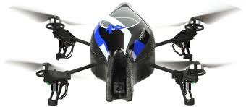
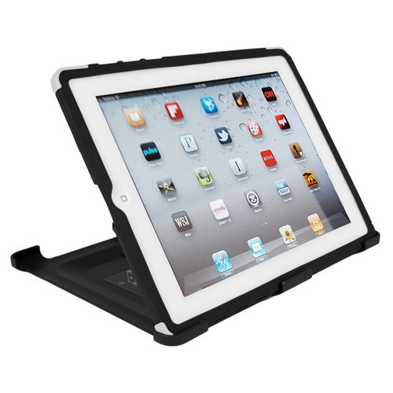
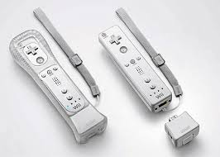
IMUs
There are small devices indicating changing orientation in smart phones, video game remotes, quad-copters, etc.
These devices contains gyroscopes combined with accelerometers and/or compasses and are referred to as an IMU, or Inertial Measurement Unit
The number of sensor inputs in an IMU are referred to as “DOF” (Degrees of Freedom), so a chip with a 3-axis gyroscope and a 3-axis accelerometer would be a 6-DOF IMU.

Slide 3
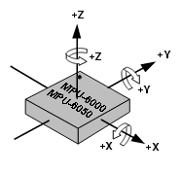
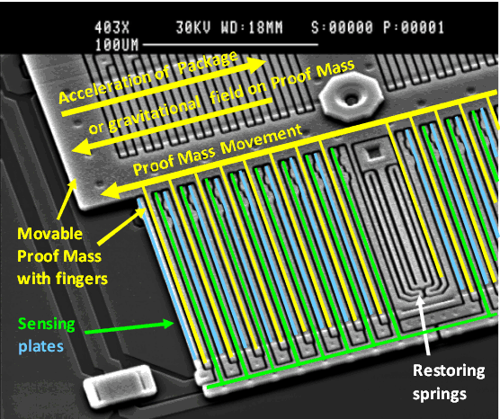
Accelerometers
Each accelerometer has a zero-g voltage level, you can find it in spec
Accelerometers also have a sensitivity, usually expressed in mV/g
Divide the zero-g level corrected reading by the sensitivity to produce the final reading
Image credit: http://www.freescale.com/files/sensors/doc/app_note/AN3461.pdf
Proof mass deflection is measured as a change in capacitance between the proof mass and sensing plates
Internal circuitry converts the tiny capacitance to a voltage signal which is digitized and output

Slide 4
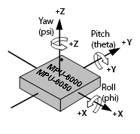
Accelerometers
Computing orientation from an accelerometer relies on a constant gravitational pull of 1g (9.8 m/s^2) downwards
If no additional forces act on the accelerometer (a risky assumption), the magnitude of the acceleration is 1g, and the sensor’s rotation can be computed from the position of the acceleration vector
If the Z-axis is aligned along the gravitational acceleration vector, it is impossible to compute rotation around the Z-axis from the accelerometer.
Digital accelerometers give information using a serial protocol like I2C , SPI or USART; analog accelerometers output a voltage level within a predefined range

Slide 5
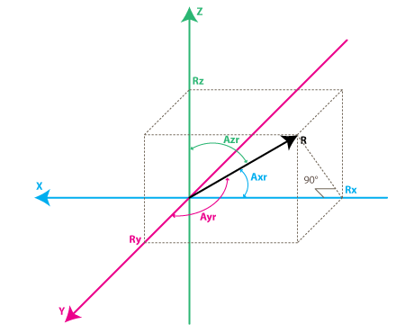
Accelerometer
cos(Axr) = Rx / R cos(Ayr) = Ry / R cos(Azr) = Rz / R
R = SQRT( Rx^2 + Ry^2 + Rz^2)
Find angles by using arccos() function (the inverse cos() function ):
Axr = arccos(Rx/R) Ayr = arccos(Ry/R) Azr = arccos(Rz/R)
Image credit: http://www.starlino.com/imu_guide.html

Slide 6
Gyroscope
A gyroscope measures angular velocity (the rate of change in orientation angle), not angular orientation itself
Must first initialize the sensor position with a known value (possibly from the accelerometer), then measure the angular velocity (ω) around the X, Y and Z axes at measured intervals (Δt)
ω × Δt = change in angle
The new orientation angle is the original angle plus this change
This is integrating - adding up many small computed intervals - to find orientation
Repeatedly adding up increments of ω × Δt results in small systematic errors becoming magnified over time
Gyroscopic drift---over long timescales the gyroscope data will become increasingly inaccurate

Slide 7
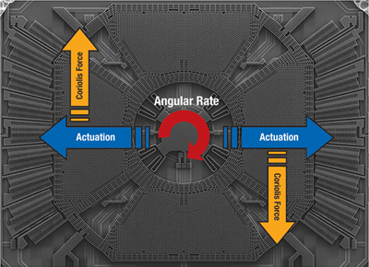
Gyroscope
Uses Coriolis effect to transform an angular velocity into a displacement
The Coriolis force acts perpendicular to the rotation axis and to the velocity of the body in the rotating frame
F_{c}= -2m Ω x v
The displacement induces a change in capacitance between the mass and the housing, thus transforming the angular rate input to the gyroscope into an electrical output
Image credit: http://www.digikey.com/us/en/techzone/sensors/resources/articles/MEMS-Accelerometers.html

Slide 8
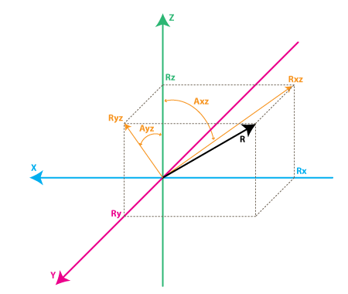
Gyroscopes
Each gyroscope measures the rotation around one axis
Axz – is the angle between the Rxz (projection of R on XZ plane) and Z axis
Ayz – is the angle between the Ryz (projection of R on YZ plane) and Z axis
Gyroscopes measure the rate of change of these angles.
Image credit: http://www.starlino.com/imu_guide.html

Slide 9
Computing Rotation Angles
Rotation from accelerometer data:
tan(Axz) = Rx/Rz => Axz = atan2(Rx,Rz)
Rotation from gyroscope data:
Axz(n-1) = atan2( RxEst(n-1) , RzEst(n-1) )
Axz(n) = Axz(n-1) + RateAxz(n) * T
Image credit: http://www.starlino.com/imu_guide.html

Slide 10
Sensor Fusion
An accelerometer measures inertial force, such as gravity (and ideally only by gravity), but it might also be caused by acceleration (movement) of the device. Even if the accelerometer is relatively stable, it is very sensitive to vibration and mechanical noise.
A gyroscope is less sensitive to linear mechanical movements, the type of noise that accelerometer suffers from. Gyroscopes have other types of problems like drift (not coming back to zero-rate value when rotation stops).
Averaging the data that comes from accelerometers and gyroscopes can produce a better estimate of orientation than obtained using accelerometer data alone.

Slide 11
Fusion Algorithms
Several choices: Kalman Filter, Complementary Filter, …
Combine orientation estimated from Accelerometer readings with that estimated from the Gyroscope readings
Racc – current readings from accelerometer Rgyro – obtained from Rest(n-1) and current gyroscope readings
A weighted average:
Rest(n) = (Racc * w1 + Rgyro * w2 ) / (w1 + w2)

Slide 12
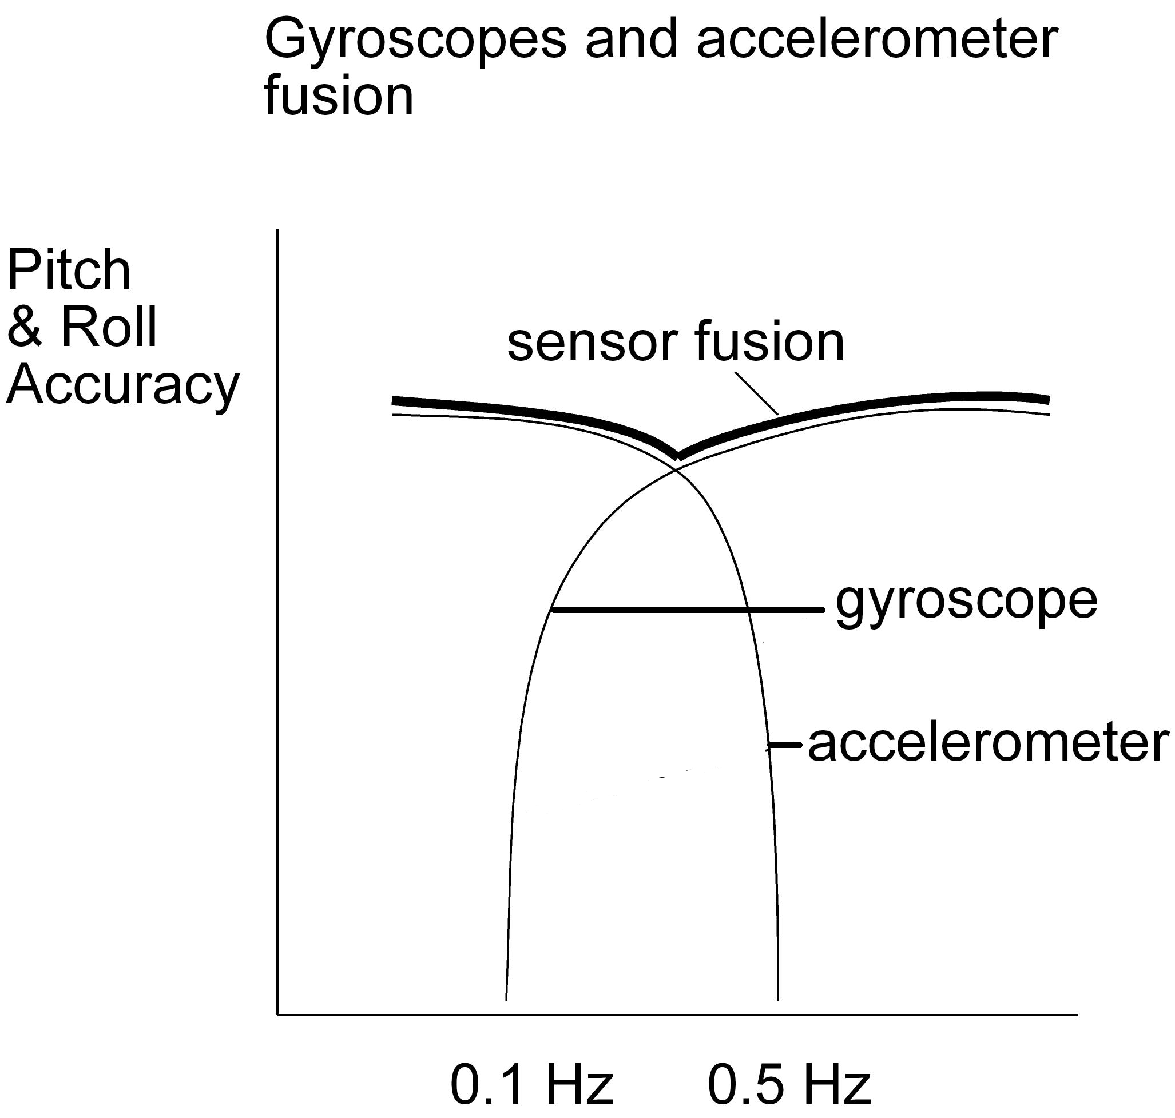
Sensor Fusion
Image credit: http://memscentral.com/Secondlayer/
mems_motion_sensor_perspectives-sensor-susion-high-res.htm

Slide 13
MPU-6050
The MPU-6050 is the world’s first integrated 6-axis MotionTracking device
It combines a 3-axis gyroscope, 3-axis accelerometer, and a Digital Motion Processor™ (DMP) all in a small 4x4x0.9mm package.
It uses a standard I2C bus for data transmission.
With it’s I2C bus, it can accepts inputs from an external 3-axis compass to provide a complete 9-axis MotionFusion output.
A number of different breakout boards are available containing the MPU-6050 chip, we have the GY-521.

Slide 14
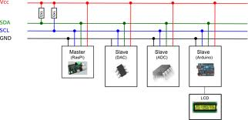
I²C
Understanding I2C
The physical I2C bus
Masters and Slaves
The physical protocol
I2C device addressing
The software protocol
I2C support in the WiringPi Library
A good Tutorial
Image credit: http://quick2wire.com/articles/i2c-and-spi/

Slide 15
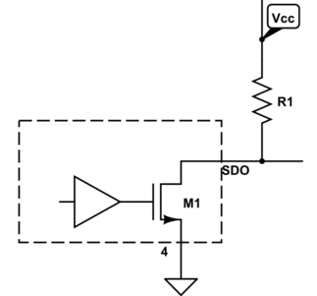
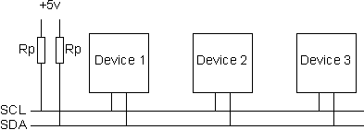
The physical I2C bus
Image credit: http://electronics.stackexchange.com/questions/70312/n-ch-fet-with-open-drain-output
Image credit: http://www.robot-electronics.co.uk/acatalog/I2C_Tutorial.html
Two wires: SCL and SDA
SCL is the clock line: used to synchronize all data transfers
SDA is the data line
Both SCL and SDA lines are "open drain" drivers
Can only be driven low
For the line to go high provide a pull-up resistors to 5v

Slide 16
Masters and Slaves
The devices on the I2C bus are either masters or slaves
The master drives the clock & initiates the transfers
Multiple slaves on the I2C bus, but there is typically only one master.
Both master and slave can transfer data over the I2C bus, but that transfer is always controlled by the master.

Slide 17
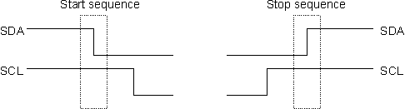

The I2C Physical Protocol
Data is transferred in sequences of 8 bits.
Bits are sent with the MSB (Most Significant Bit) first.
The SCL line is pulsed high, then low for each bit
After each 8 bits transfer, the slave sends back an acknowledge bit
It takes 9 SCL clock pulses to transfer 8 bytes of data
The standard clock (SCL) speed for I2C is up to 100KHz
Image credit: http://www.robot-electronics.co.uk/acatalog/I2C_Tutorial.html
Start and stop sequences mark the beginning and end of a transaction
Initiated by the master
The only time the SDA (data line) is changed while the SCL (clock line) is high.
During data transfer, SDA must not change while SCL is high

Slide 18

I2C Device Addressing
Image credit: http://www.robot-electronics.co.uk/acatalog/I2C_Tutorial.html
All I2C addresses are 7 bits or 10 bits---most are 7 (ours are)
Can have up to 128 devices on the I2C bus
Addresses are still sent in 8 bits
The extra bit (the last bit) indicates read or write
If the bit is zero the master is writing to the slave.
If the bit is 1 the master is reading from the slave

Slide 19
The I2C Write Protocol
Procedure to write to a slave device:
1. Send a start sequence 2. Send the I2C address of the slave with the R/W bit low (even address) 3. Send the internal register number you want to write to 4. Send the data byte 5. [Optionally, send any further data bytes]
slave will automatically increment the internal register address after each byte
6. Send the stop sequence.

Slide 20
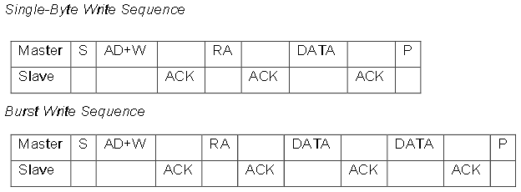
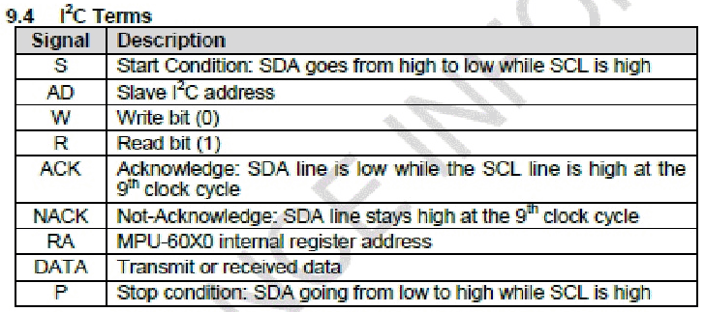
The I2C Write Protocol
Image credit: http://invensense.com/mems/gyro/documents/PS-MPU-6000A-00v3.4.pdf

Slide 21
The I2C Read Protocol
A read is more complicated
Before reading data from a slave device, you must tell it which of its internal addresses you want to read
A read starts off by writing to the slave
Procedure
1. Send a start sequence 2. Send I2C address of the device with the R/W bit low (even address) 3. Send the Internal register address 4. Send a start sequence again (repeated start) 5. Send the I2C address of the device with the R/W bit high (odd address) 6. Read data byte from the register 7. Send the stop sequence.

Slide 22
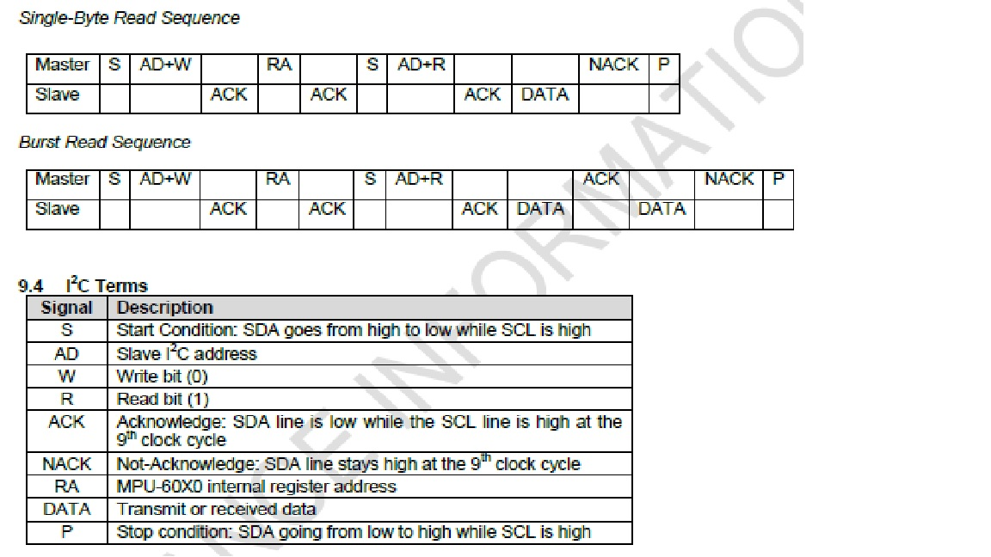
The I2C Read Protocol
Image credit: http://invensense.com/mems/gyro/documents/PS-MPU-6000A-00v3.4.pdf

Slide 23
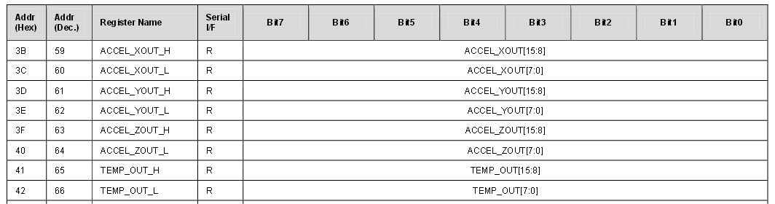
A Read Example with MPU 6050
For MPU-6050:
ACCEL_XOUT_H → register 3B
ACCEL_XOUT_L → register 3C
ACCEL_YOUT_H → register 3D
ACCEL_YOUT_L → register 3E
ACCEL_ZOUT_H → register 3F
ACCEL_ZOUT_L → register 40

Slide 24
I2C read using WiringPi I2C Library
…
int fd;
int16_t ax, ay, az;
uint8_t MSB, LSB;
fd = wiringPiI2CSetup(0x68); // I2C address of MPU6050
MSB = wiringPiI2CReadReg8(fd, 0x3B);
LSB = wiringPiI2CReadReg8(fd, 0x3C);
ax = (((uint16_t)MSB) << 8) | LSB;
MSB = wiringPiI2CReadReg8(fd, 0x3D);
LSB = wiringPiI2CReadReg8(fd, 0x3E);
ay = (((uint16_t)MSB) << 8) | LSB;
…

Slide 25
I2C read using WiringPi I2C Library
I2Ctest.cpp
Install in PiBits/MPU6050-Pi-Demo directory
(Installed later in lecture)
A modified Makefile
Replace the Makefile in the MPU6050-Pi-Demo package with this one
Give the command: make I2Ctest to compile the program

Slide 26

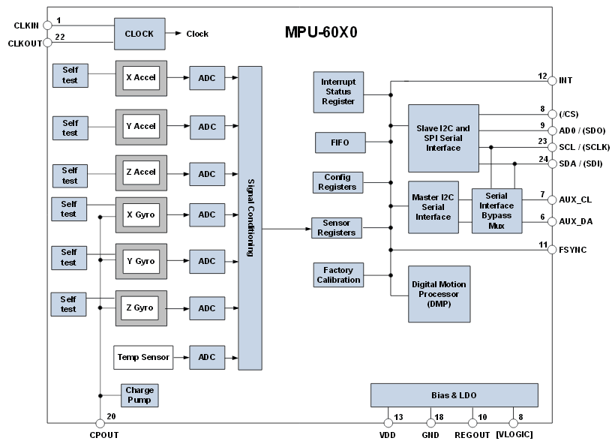
MPU-6050

Slide 27
The Physical Connection
Connecting the MPU to the Pi
MPU6050 Pi Pin ID
Pin ID VDD --> 3.3V on Pi
GND --> GND on Pi SCL --> SCL on Pi
SDA --> SDA on Pi
XDA XCL ADO --> GND on Pi INT

Slide 28
The Code
There is a library named I2Cdevlib for accessing the MPU-6050 and other I2C devices written by Jeff Rowberg. This code is for the Arduino.
This code was ported to the RPi by Richard Ghrist of Servoblaster fame. It is available in the same PiBits GitHub repository. Look in directory MPU6050-Pi-Demo
There are three demo programs
one displays raw accel and gyro data from the MPU6050
another displays more useful data (angle of rotation, rotation matrix, quaternion, Euler Angle, for example) using the on-chip DMP to do the processing.
the third demo draws a simple 3D wireframe model on the screen

Slide 29
Installation Instructions
git clone git://github.com/richardghirst/PiBits.git
cd 0PiBits/MPU6050-Pi-Demo
sudo apt-get install libgtkmm-3.0-dev
nano I2Cdev.cpp
Change all occurrences of "/dev/i2c-0" to "/dev/i2c-1“ & save file
nano setup-i2c.sh
Change "/dev/i2c-0" to "/dev/i2c-1““ & save file
make
./setup-i2c.sh
sudo i2cdetect -y 1
(the IMU should use address 68)
./demo_raw
Execute the version of program displaying raw accel and gyro values
Output is Ax, Ay, Az, Gx, Gy, Gz
./demo_dmp
Execute the version of program displaying output from the DMP
Output is quaternions, & yaw (about z), pitch (about y), roll (about x) angles

Slide 30
Setting up a X11 Connection
On a Windows platform
Install MobaXterm (select the free version) & run
In the /home/mobaxterm window, type:
ssh –X pi@lastName.cs.unca.edu (or use your wireless IP)
cd PiBits/MPU6050-Pi-Demo
./demo_3d
Ctrl-C Ctrl-C to stop the program
On Linux or Mac
ssh –X pi@lastName.cs.unca.edu (or use your wireless IP)
cd PiBits/MPU6050-Pi-Demo
./demo_3d
Ctrl-C Ctrl-C to stop the program

