Slide 1
Physical Modeling
By Matt Fisher

Slide 2
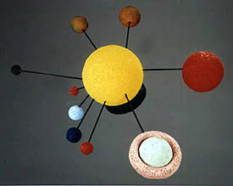
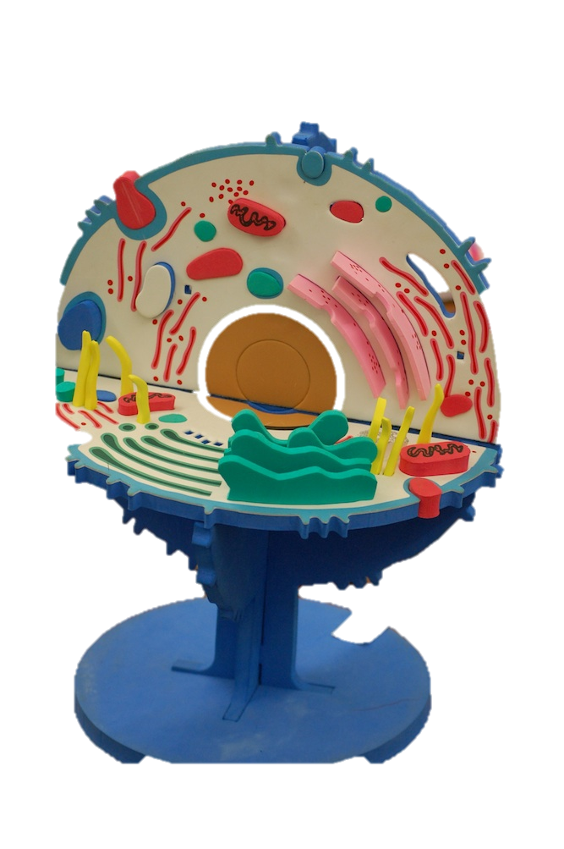
What is physical modeling?
A physical model is a physical copy of an object.
A model is something a person can touch
Models may be small like an atom or large like the solar system.
Larger objects normally have smaller models and smaller ones have bigger models.

Slide 3
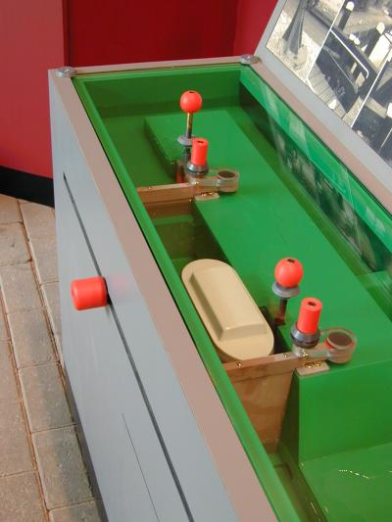
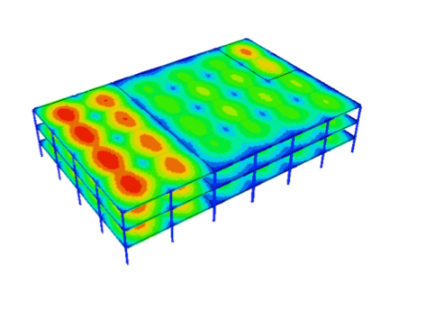
Why are models useful?
Physical models allow visualization and examination of the model.
They can show inner parts and how things work.
Computer models can be used to simulate what could or did happen in a situation.

Slide 4
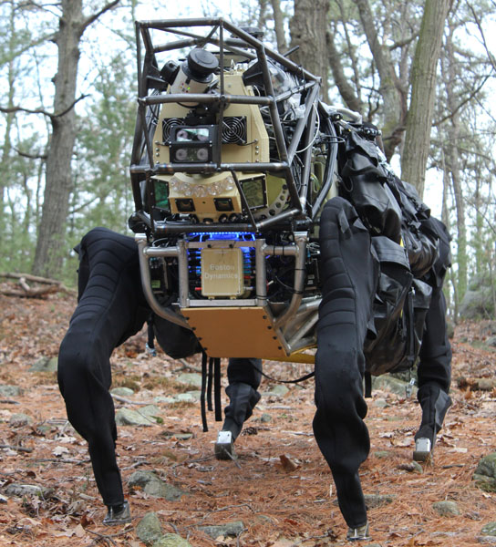
What does this have to do with robotics?
In robotics, we often have to model by building a prototype.
To help carry gear, DARPA is continuing research into developing a highly mobile, semi-autonomous legged robot to integrate with a squad of Marines or soldiers.

Slide 5
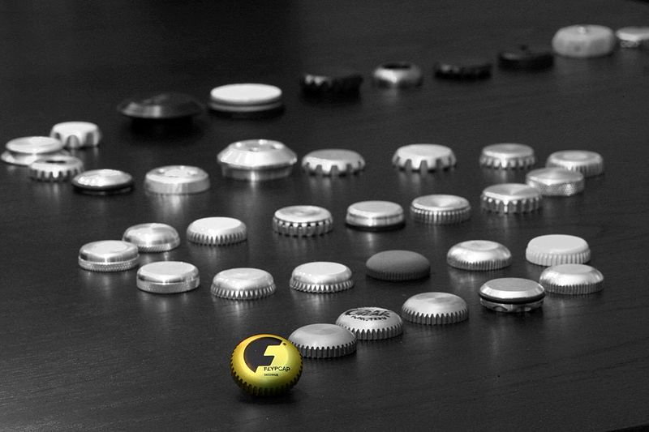
What is prototyping and how is it useful?
A prototype is an early model or sample.
It is used to test a concept or process.
Prototyping allows you to see the actual product assembled.
Prototype line of micro flying disc invention

Slide 6
Advantages to Prototyping
Prototyping provides a working model to the user.
It allows early assessment.
The developer gains insight by developing a prototype.
This results in better implementation of requirements.
It allows for the designer to see the actual product assembled. It allows you to check the design, to touch it and see how the whole thing fits together.

Slide 7
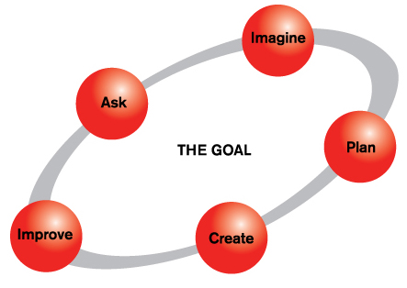
The Engineering Design Process
Prototyping is a crucial part of the design process.
The engineering design process is the formulation of a plan to help an engineer build a product with a specified performance goal.

