Slide 1
FIRST ROBOTICS DRIVE SYSTEMS
By Andy Baker
President
AndyMark, Inc.

Slide 2
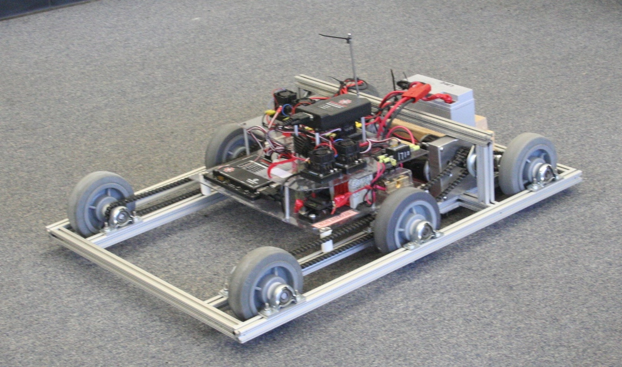
Topics
Importance
Basics
Drive Types
Resources
Traction
Mobility
Speed
Timing
Importance

Slide 3
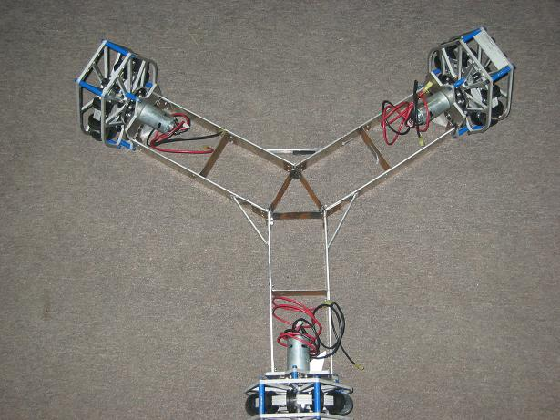
Importance
The best drive train…
is more important than anything else on the robot
meets your strategy goals
can be built with your resources
rarely needs maintenance
can be fixed within 4 minutes
is more important than anything else on the robot

Slide 4
Basics
Know your resources
Decide after kickoff:
  Speed, power, shifting, mobility
Use most powerful motors on drivetrain
Don’t drive ½ of your robot… WEIGH IT DOWN!
Break it early
Give software team TIME to work
Give drivers TIME to drive

Slide 5
Drive Types: 2 wheel drive
DrivenWheel
Motor(s)
Motor(s)
+ Easy to design
+ Easy to build
+ Light weight
+ Inexpensive
+ Agile
Not much power
Will not do well on ramps
Less able to hold position
Caster

Slide 6
Drive Types:
4 wheel drive, 2 gearboxes
DrivenWheels
Motor(s)
Motor(s)
Chain or belt
+ Easy to design
+ Easy to build
+ Inexpensive
+ Powerful
+ Sturdy and stable
Not agile
  Turning is difficult
  Adjustments needed
Resource:
Chris Hibner white paper on ChiefDelphi.com
Proves that a wide 4wd drive base can turn easily
DrivenWheels

Slide 7
Drive Types:
4 wheel drive, 4 gearboxes
DrivenWheels
Motor(s)
Motor(s)
+ Easy to design
+ Easy to build
+ Powerful
+ Sturdy and stable
+ Many options
Mecanum, traction
Heavy
Costly
DrivenWheels
Motor(s)
Motor(s)

Slide 8
Drive Types:
6 wheel drive, 2 gearboxes
+ Easy to design
+ Easy to build
+ Powerful
+ Stable
+ Agile*
*2 ways to be agile
Lower contact point on center wheel
Omni wheels on front or back or both
This is the GOLD STANDARD in FRC
+ simple
+ easy
+ fast and powerful
+ agile
Gearbox
Gearbox
Heavy **
Expensive **
** - depending on wheel type

Slide 9
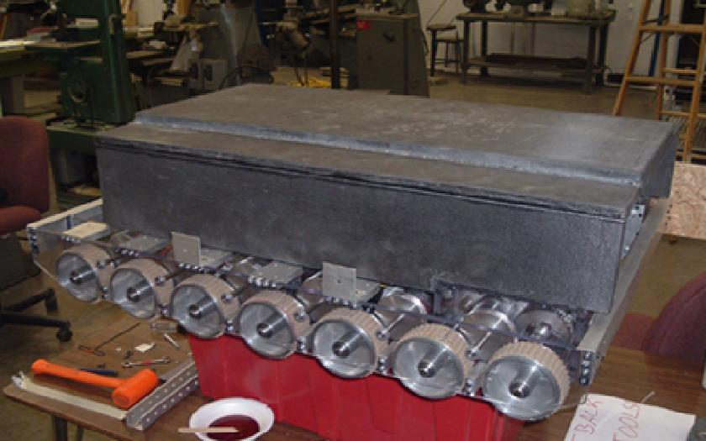
Drive Types:
N wheel drive, 2 gearboxes
+ Powerful
+ Stable
+ Agile*
Sole benefit: Ability to go over things
Gearbox
Gearbox
HEAVY
EXPENSIVE
*2 ways to be agile
Lower contact point on center wheel
Omni wheels on front or back or both

Slide 10
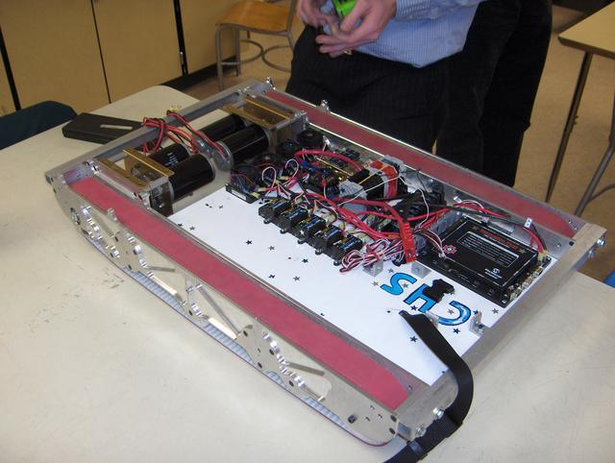
Drive Types:
Tank tread drive, 2 gearboxes
Gearbox
Gearbox
+ Powerful
+ VERY Stable
NOT AGILE
HEAVY
Inefficient
EXPENSIVE
Hard to maintain
Sole benefit: Ability to go over things
For turning, lower the contact point on center of track wheel
Will NOT push more than a well-controlled 6wd

Slide 11
Drive Types: 3 wheel
Various types
Lightweight
Fast
Non-standard
  (design intensive)
Examples:
  16 in 2008
  67 in 2005
Gearbox
Gearbox

Slide 12
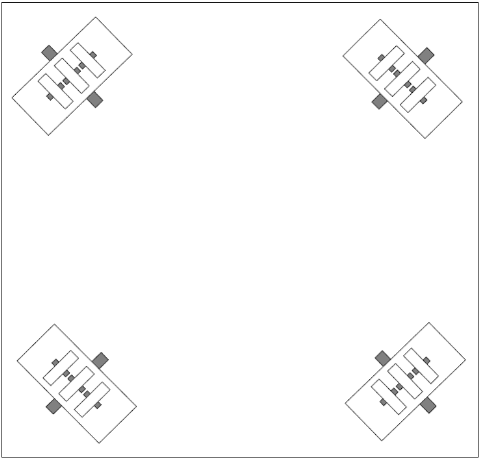
Drive Types:
Holonomic - Killough
4 wheel drive or 3 wheel drive
Stephen Killough, 1994
+ Simple Mechanics
+ Immediate Turning
+ Simple Control – 4 wheel independent
No brake
Minimal pushing power
Jittery ride, unless w/ dualies
Incline difficulty

Slide 13
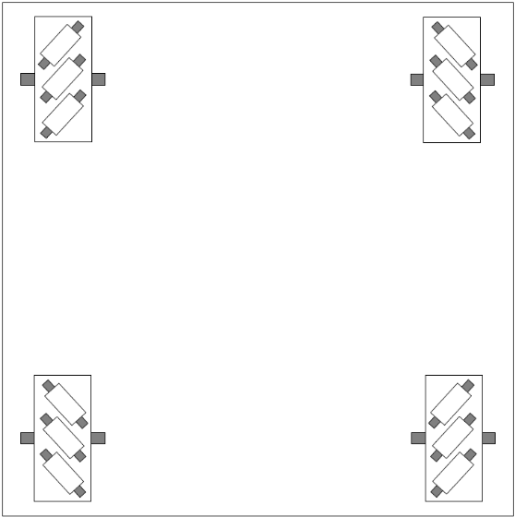
Drive Types:
Mecanum
+ Simple mechanisms
+ Immediate turn
+ Simple control – 4 wheel independent
Minimal brake
OK pushing power
Needs a suspension
Difficulty on inclines

Slide 14
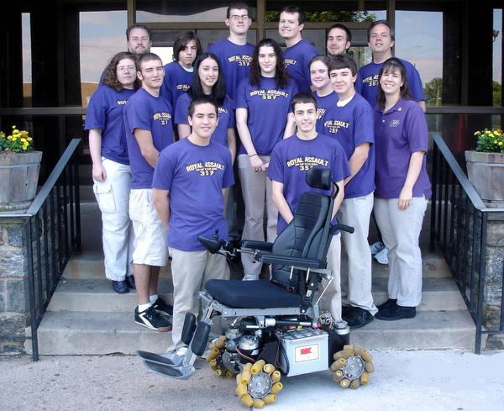
Mecanum wheel chair, team 357

Slide 15
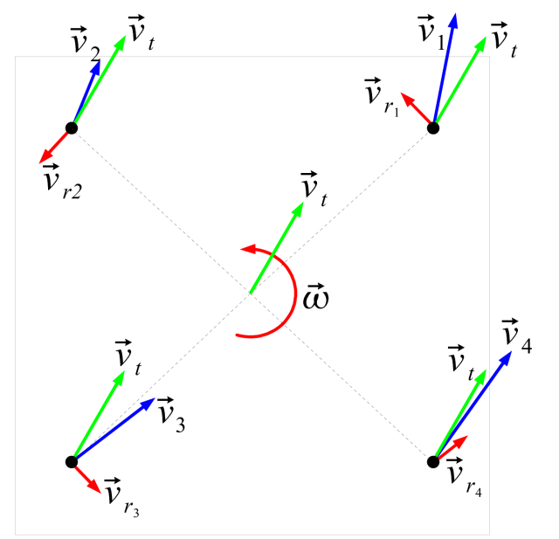
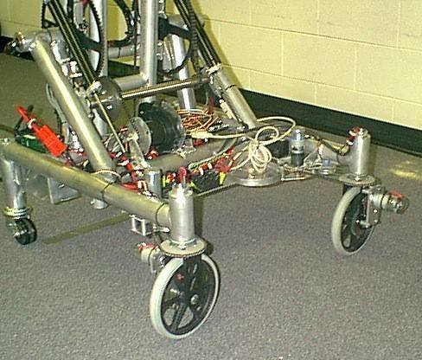
Drive Type:
Swerve or crab steering
High-traction wheels
Each wheel rotates to steer
+ No friction losses in wheel-floor interface
+ Ability to push or hold position
+ Simple wheels
Complex system to control and program
Mechanical and control issues
Difficult to drive
Wheel turning delay
Omnidirectional drive systems presentation: http://first.wpi.edu/Workshops/2008CON.html

Slide 16
Resources
Design
  Difficult: swerve
Machining
  Difficult: swerve
  Moderate: non-kit frame
Money
  Kit wheels have been cheap
Time
  6 weeks, long hours, multiple shifts?

Slide 17
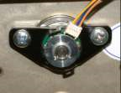
Traction
Static vs Dynamic (←10% lower)
  Once you slip, you will get pushed
  Design encoders into your system
  Dynamic breaking & traction control
Pushing force = Weight * μ
  μ = friction coefficient
Normal Force (weight)
Pushing Force
Static friction coefficients
μ = 0.1 = caster (free spinning)
μ = 0.3 = hard plastic
μ = 0.8 = smooth rubber, 80A durometer
= 1.0 = sticky rubber, 70A durometer
= 1.1 = conveyor treads

Slide 18
More on Traction
You can determine μ
mass
Fpull
Material w/ μ
Fweight
μ = Fpull / Fweight

Slide 19
Mobility
Move +/- 1 foot in any direction in under 1 second
Generally speaking, the more mobile your robot is, the less it can resist a push
More mobile less mobile
Killough
4wd long
Mecanum
Swerve
4wd wide
6+ wheel
Tank Treads

Slide 20
Center of gravity (Cg)
Robot mass is represented at one point
Mobility increases when Cg is low and centered
High parts = light weight
Low parts = heavy (within reason
Battery motors pump, etc.
Ms Mobile
Battery motors pump, etc.
Mr Tippy

Slide 21
Speed
Game dependent, however… this increases every year
2008 max: 20 ft/sec
Controllable top speed: 15 ft/sec
Average 1-speed rate: 9 ft/sec
Good pushing speed: 5 ft/sec
Worksheet example

Slide 22
Timing
Get something driving early
  End of week 2
  Practice for operators
  Lessons learned for electrical
  Strategy lessons
Continuously improve
  Good enough is not good enough
Finish final drivetrain by week 4

Slide 23
Importance
Boat anchor = any heavy mass that does not move
A non-reliable or non-repairable drive base will turn your robot into a boat anchor
Good drive bases win consistently
Reliable drive bases win awards
Well-controlled, robust drive bases win Championships

Slide 24
More info
Ken Patton and Paul Copioli
  Robot Drive System Fundamentals
  http://first.wpi.edu/Images/CMS/First/2007CON_Drive_Systems_Copioli.pdf
Ian Mackenzie and Andy Baker
  Omni Directional drive trains
  http://first.wpi.edu/Workshops/2008CON.htm

