Slide 1
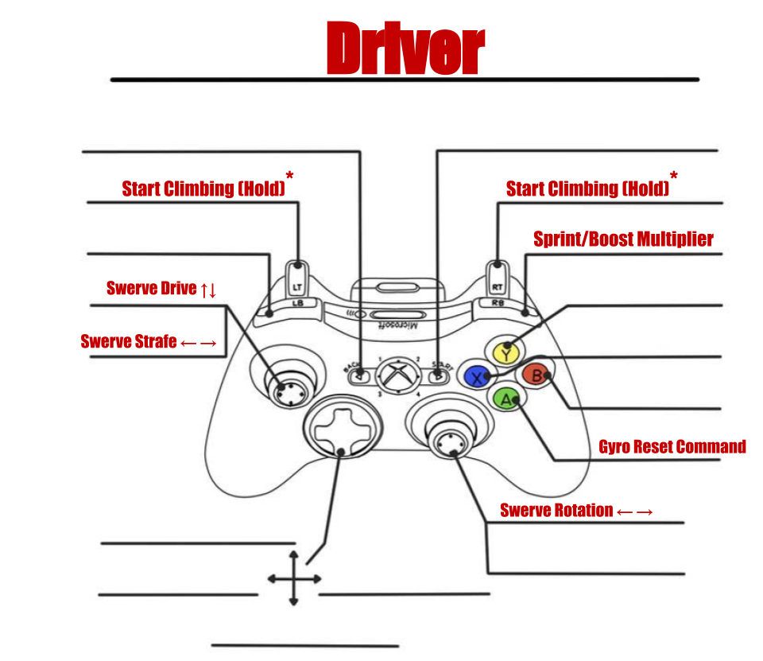
Driver Bindings
Unbound
Unbound
Align With Target
Eject Game Piece
Toggle Game Piece
Load Game Piece
Button - Unbound
Unbound
Axis – Swerve Translate
Unbound
Unbound
Unbound
Button - Unbound
Crawl - Forward
Axis – Swerve Rotate
Crawl - Left
Crawl - Right
Crawl - Backwards

Slide 2
Operator Bindings
Unbound
Unbound
Unbound
Unbound
GSM – Left Column
GSM – Right Column
Button - Unbound
L4 Target / Barge
Axis – Unbound
L3 Target / High Algae
L2 Target / Low Algae
L1 Target / Processor
Button - Unbound
Elevator Offset +
Axis – Unbound
Arm Offset CCW
Arm Offset CW
Elevator Offset -

