Slide 1

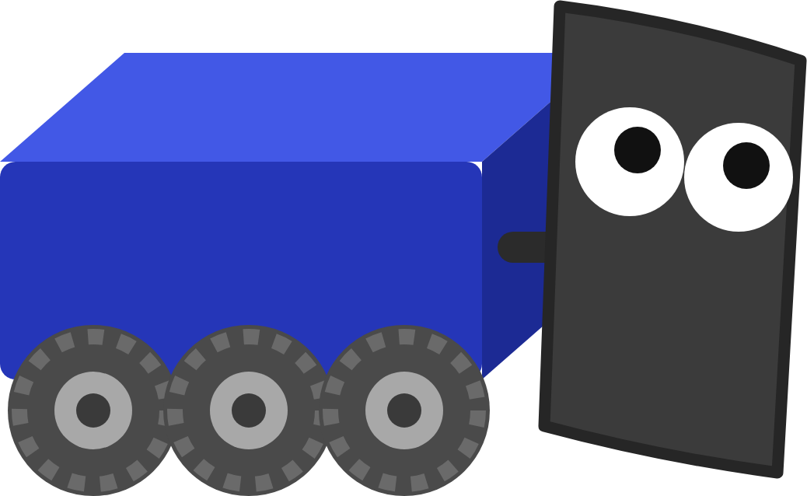
FRC ROBOT · DECK 8
Computer Vision
Teach the robot to see AprilTags, always know where it is, and turn to face the goal.
I can see the tags! Now I always know where I am.
Notes:
Welcome to the Computer Vision deck. So far the robot has known where it is only by counting wheel turns, and that slowly drifts. Today it learns to see the AprilTags on the field, combines what it sees with its wheels so it always knows where it is, and then uses that to turn and face the goal. The hands-on part is the Computer Vision lesson in Scriptum. Ask: how do you know where you are in a dark room? And when the lights come on?

Slide 2



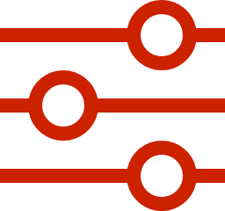

TODAY
From pictures to a pose to a shot
01
02
03
04
05
How a robot sees
AprilTags
Where am I?
Trusting the camera
Aiming at the goal
Cameras, pixels and shutters
Finding a tag and where the camera is
Odometry, vision and tag solutions
The pose estimator and its trust numbers
Angle to the goal, the AIM state, PID
By the end: your robot knows where it is to within 5 cm, and turns to face the goal at the press of a button.
MARS/WARS SOFTWARE TRAINING
2
Notes:
Five parts. First how a camera sees and how it finds an AprilTag. Then how the robot turns those tags into a position on the field, how much to trust the camera, and finally how to aim at the goal with a PID. Ask: what could a robot do if it always knew exactly where it was? (Aim, drive to a spot by itself, line up to score.)

Slide 3
01
How a robot sees
My wheels slip a little. My camera never gets lost!
Why the wheels aren't enough, and how a camera turns light into numbers
MARS/WARS SOFTWARE TRAINING
3
Notes:
Before the code, the hardware: why we need cameras at all, and what a camera actually measures.

Slide 4

HOW A ROBOT SEES
Why the wheels aren't enough
really here
Where the robot really went
What odometry adds up
Odometry
Counts wheel turns. Fast and smooth, but tiny mistakes pile up.
wheels think I'm here
Camera
start
Sees tags at known spots. Never drifts, but a bit noisy and a bit late.
Drift drawn bigger than life so you can see it.
Good robots do both: wheels for quick, smooth updates, cameras to pull the guess back to the truth.
MARS/WARS SOFTWARE TRAINING
4
Notes:
Odometry adds up how far each wheel turned, every loop. It's fast and smooth, but every loop adds a tiny mistake: wheels slip, and the wheel size is never exactly right. The mistakes pile up. In the lesson's simulator, wheels alone end up about 0.1 to 0.5 meters and a few degrees off after a 6 to 11 meter drive. The drift on this picture is drawn bigger so you can see it. Ask: what happens to a shot from half a meter off? (It misses.)

Slide 5

HOW A ROBOT SEES
How a camera sees
reflection
Light source
Object
Lens
Shutter
Sensor grid
Lens
Shutter
Sensor grid
Focuses the light. Our tag cameras use wide angle lenses; math flattens the picture.
Opens for a moment to let light in, then closes.
Millions of tiny squares (pixels). Each measures how much light hit it.
MARS/WARS SOFTWARE TRAINING
5
Notes:
A camera measures light. Light from a source bounces off things, the lens bends it and focuses it, the shutter opens to let it in for a moment, and the sensor grid measures how much light hits each tiny square. Most of our tag cameras use wide angle (fisheye) lenses, close to 180 degrees, so they see more tags; the software uses math to flatten the bent picture. Ask: why would a wide view help find tags? (More tags in view at once.)

Slide 6
HOW A ROBOT SEES
A picture is a grid of numbers
13
231
214
50
• 0 is black, 255 is white
210
198
43
27
• Color: three numbers per pixel
• Tags only need brightness
34
35
231
211
195
13
10
222
Each pixel is one number. The detector only ever sees numbers like these.
MARS/WARS SOFTWARE TRAINING
6
Notes:
To the computer a picture is just a grid of numbers, one per pixel: 0 is black, 255 is white. A color camera stores three numbers per pixel (red, green and blue); its sensor has a checkerboard color filter on top with twice as many green squares, like the human eye. Tags are black and white, so the detector throws the color away and keeps only brightness. Activity: read the zoomed numbers out loud and have the class say light or dark.

Slide 7

HOW A ROBOT SEES
Rolling vs global shutter
Rolling shutter
Global shutter
row by row
Rows are read one after another. A moving tag comes out slanted.
Every pixel at the same moment. The tag stays square.
MARS/WARS SOFTWARE TRAINING
7
Notes:
The shutter decides when each row of pixels is measured. A rolling shutter reads the rows one after another, top to bottom, so anything that moves while it reads comes out slanted. A global shutter measures every pixel at the same moment. Ask the old deck's question: why do we want a global shutter on the robot? (The robot and the tags move relative to each other all the time; a slanted tag gives a wrong position.)

Slide 8



HOW A ROBOT SEES
Our vision hardware
Global shutter cameras
NVIDIA Jetson
Why a GPU?
Black and white OV9281 and Thrifty cameras, and color Basler cameras. Wide angle lenses.
The vision computer on the robot. Finds tags on its GPU and sends the answers to the roboRIO.
Most teams use a Limelight or PhotonVision on a normal processor. Our GPU detector is about 5x faster.
In training: there's no Jetson. The simulator plays the cameras and sends the same answers.
MARS/WARS SOFTWARE TRAINING
8
Notes:
On our robots the cameras plug into an NVIDIA Jetson, a small computer with a graphics processor (GPU) that sits on the robot next to the roboRIO. It runs our own AprilTag detector, a GPU version first written by FRC Team 971, and sends the answers to the roboRIO over the robot network. Many teams use a Limelight or PhotonVision, which run on a normal processor; the GPU is about 5 times faster and keeps up with several 60 frames-per-second cameras. The Jetson lives at 10.41.43.200 on Varsity and 10.44.23.200 on JV. In Scriptum there's no Jetson: the simulator plays the cameras.

Slide 9
02
AprilTags
Every tag has its own ID. Like a name tag for the field!
Black and white squares at known spots on the field
MARS/WARS SOFTWARE TRAINING
9
Notes:
How a computer finds a tag in a picture, reads its ID, and works out where the camera must be.

Slide 10
APRILTAGS
What is an AprilTag?
white border
• A square code made of black and white bits
black border
• Tag36h11 on FRC fields since 2023
• Each pattern is one ID, and any two differ in 11+ bits
6 x 6 data bits
• Every tag's spot is known: FIRST publishes the field layout
MARS/WARS SOFTWARE TRAINING
10
Notes:
An AprilTag is a square code, a bit like a simple QR code. It was invented at the University of Michigan in 2011, and FRC fields have used the 36h11 family since 2023. 36 means 6 by 6 data bits; h11 means any two tags differ in at least 11 bits, so one can't be mistaken for another. Each pattern is one ID, and FIRST publishes exactly where every ID sits on the field. The pattern here is just for illustration. Ask: why black and white instead of colors? (Easy to see in any light.)

Slide 11




APRILTAGS
Finding a tag in a picture
1
2
3
Gray
Shrink
Threshold
Throw away the color, keep brightness
Fewer pixels, so the search is fast
Each pixel: light, dark or not sure
4
5
6
Clump
Find squares
Decode
Group pixels, drop the tiny clumps
Fit four corners to each clump
Read the bits, look up the ID
On our robots: all of this runs on the Jetson's GPU, for every picture from every camera.
MARS/WARS SOFTWARE TRAINING
11
Notes:
This is how the detector finds tags, step by step, about 60 times a second per camera. 1: throw the color away. 2: shrink the picture so the search is fast; the full picture is used later to sharpen the answer. 3: decide for each pixel whether it's definitely light, definitely dark or not sure, by comparing it with its neighbors. 4: clump the known pixels together and throw away tiny clumps. 5: fit four-sided shapes to the clumps; a big square with many small squares inside is a likely tag. 6: read the bits and look up the ID. Activity: hand out a printed tag and walk through the steps.

Slide 12
APRILTAGS
Reading the ID
1
Four corners
The square the detector found
1
0
1
1
0
0
2
Find each bit
0
1
1
0
1
0
Work out where the middle of each square is
1
1
0
0
0
1
0
0
1
1
1
1
3
Read 1 or 0
1
0
0
1
1
0
Light is 1, dark is 0
0
1
0
1
0
1
4
Match an ID
The closest pattern wins. One or two wrong bits are OK. Nothing close? Not a tag.
MARS/WARS SOFTWARE TRAINING
12
Notes:
Once the detector has a four-sided shape with corners, it works out where the middle of each data bit should be, and reads each one as 1 (light) or 0 (dark). It then finds the ID whose pattern is closest, allowing one or two wrong bits for glare or blur. If nothing is close enough, it's not a tag, and the detector drops it. Activity: give students a printed tag and a 6 by 6 grid to fill in with 1s and 0s.

Slide 13
APRILTAGS
From four corners to where the camera is
1
Corners in the picture
Where the detector found them
2
The tag's real size
Known: every tag is the same size
3
The camera's lens
camera
Measured once, when we calibrate it
the picture
Answer: where the camera is. This math is called PnP.
the tag
MARS/WARS SOFTWARE TRAINING
13
Notes:
Now the clever part. The detector knows where the four corners are in the picture. It knows how big the tag really is, and from calibrating the camera it knows exactly how the lens bends light. Put those together and there is only one place the camera could be to see the corners like that. This is called Perspective-n-Point, or PnP. And because FIRST tells us where every tag is on the field, the camera's spot relative to the tag becomes the camera's spot on the field. Ask: why does a tag far away look smaller? How could that tell you the distance?

Slide 14
APRILTAGS
From the camera to the robot
VisionConstants.java
front camera
// x forward, y left, z up (meters)
FRONT_CAMERA_TRANSFORM = new Transform3d(
1
new Translation3d(0.3, 0.0, 0.3),
0.3 m forward
new Rotation3d(0.0, 0.0, 0.0));
BACK_CAMERA_TRANSFORM = new Transform3d(
new Translation3d(-0.3, 0.0, 0.3),
2
robot center
new Rotation3d(0.0, 0.0, Math.PI));
1
Where it's bolted
back camera
0.3 m forward and 0.3 m up
2
Which way it faces
The back camera is turned 180 degrees (pi radians)
MARS/WARS SOFTWARE TRAINING
14
Notes:
PnP says where the camera is, but we want the middle of the robot. The camera is bolted somewhere on the robot, and we measure exactly where: in the lesson the front camera is 0.3 meters forward of the center and 0.3 meters up, facing forward, and the back camera is 0.3 meters behind, turned around by pi radians (180 degrees). The code shifts the camera's answer back to the robot's center. This is VisionConstants.java, trimmed. Ask: what goes wrong if someone moves a camera and doesn't update these numbers? (Every position is off by the same amount.)

Slide 15
APRILTAGS
What the cameras can see
Front camera
5 tags
Back camera
1 tags
• A tag counts when it's in view and facing the camera
front camera
• Two or more tags at once: a multi-tag solution
back camera
• Only one tag in view? That answer gets dropped.
Tag spots simplified for the picture.
MARS/WARS SOFTWARE TRAINING
15
Notes:
This is the field from above, with the blue alliance on the left. The robot has two cameras, one on the front and one on the back, and each sees a wedge of the field. A tag counts when it's inside a wedge and facing the camera. Red outlines are the tags the cameras can use right now. The tag spots here are simplified; the real 2026 layout has more tags. When a camera sees two or more tags at once, its answer is a multi-tag solution, the accurate kind. Ask: if the robot turns around, which tags would it see?

Slide 16
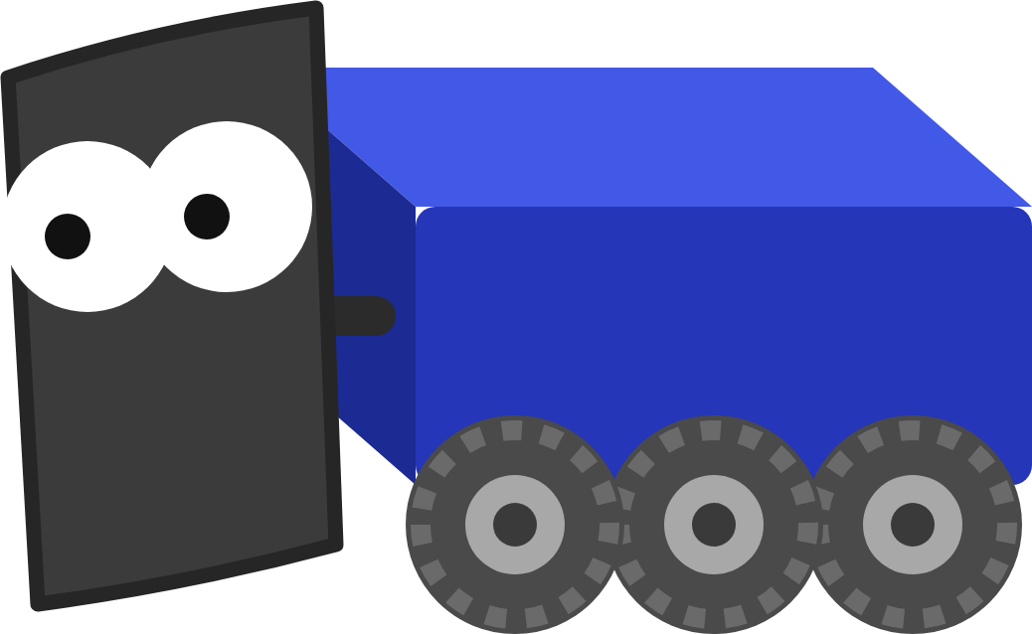
APRILTAGS
One tag or two?
One tag
Two tags
?
?
The same picture fits two different spots.
Only one spot fits both. This is the accurate kind.
The lesson keeps only multi-tag answers: VisionConstants.MIN_TAG_COUNT = 2
MARS/WARS SOFTWARE TRAINING
16
Notes:
One tag on its own is a trap. A small square seen from a little to the left can look almost exactly like the same square seen from a little to the right, so a single tag can fit two different camera spots. With two tags in view, only one spot fits both. That's why the lesson's code keeps only solutions made from at least two tags: VisionConstants.MIN_TAG_COUNT is 2. Activity: hold up a sheet of paper and have students on opposite sides of the room sketch it. Do the sketches look alike?

Slide 17
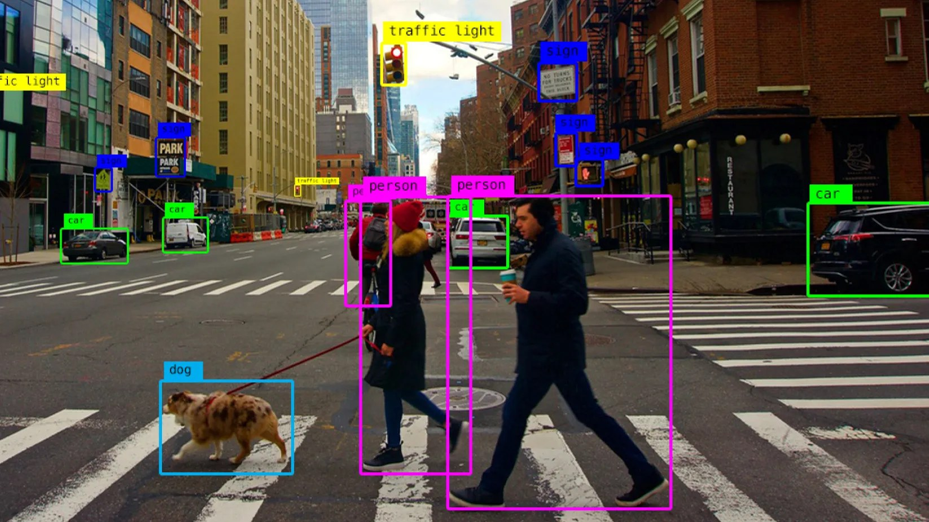
APRILTAGS
Beyond tags: finding game pieces
1
Collect pictures
Of the object, from many angles and distances
2
Draw boxes
Label every game piece, in Roboflow
3
Train a model
We use YOLO models
4
Make it fast
TensorRT, so it runs on the Jetson
Not in this lesson: but it's how a robot finds a game piece and drives to it by itself.
MARS/WARS SOFTWARE TRAINING
17
Notes:
Tags aren't the only thing a camera can find. Object detection teaches the computer to spot things like game pieces or other robots. The team collects pictures (in 2024, video from a phone on a cart pushed around the field), draws a box around every game piece in Roboflow, and trains a YOLO model on them. TensorRT then speeds the model up so it runs on the Jetson. It's not part of this lesson, but it's how a robot can drive to a game piece by itself. Picture from the MARS/WARS docs.

Slide 18
03
Where am I?
Localization is a big word for “where am I?”
Field coordinates, and how tag solutions reach your code
MARS/WARS SOFTWARE TRAINING
18
Notes:
Localization means working out where the robot is on the field. This part is the plumbing: the coordinates, the two sources, and the path a camera answer takes to your code.

Slide 19

WHERE AM I?
Field coordinates
Translation2d
A spot: x and y, in meters
GOAL (4.0, 4.0)
Rotation2d
y
A direction. 0° is along +x, left (counterclockwise) is +
Pose2d
Both: where the robot is and which way it faces
START (1.5, 1.5, 0°)
x
(0, 0): blue alliance corner
MARS/WARS SOFTWARE TRAINING
19
Notes:
Everything uses one set of field coordinates. The origin is the blue alliance corner. x runs down the field, y runs across it, in meters. Headings are measured from the +x direction, and turning left (counterclockwise) is positive. The lesson's robot starts at (1.5, 1.5) facing 0 degrees, and the goal is at (4.0, 4.0) in the middle of the blue hub. In WPILib a spot is a Translation2d, a direction is a Rotation2d, and both together are a Pose2d. Ask: what's the robot's pose if it turns to face straight up the slide? ((1.5, 1.5, 90 degrees).)

Slide 20
WHERE AM I?
Odometry vs vision: the best of both
how far off (m)
1
Wheels drift
0.5
Smooth, but the error keeps growing
0.4
odometry
2
Camera is noisy
0.3
Never drifts, but every answer wobbles
0.2
0.1
3
Blend them
camera
Smooth and stays on the truth. That's the pose estimator
0.0
blended
0
5
10
15
20
time (s)
MARS/WARS SOFTWARE TRAINING
20
Notes:
This graph shows how far off each kind of guess is during a 20 second drive (a sketch, not real data). Odometry starts perfect and slowly drifts away. The camera alone never drifts, but every answer is a little different: it's noisy. Blend the two and you get the best of both: smooth like the wheels, and pinned to the truth like the camera. That blend is the pose estimator's job, and it's what you build today. Ask: which line would you want to aim a shot from?

Slide 21



WHERE AM I?
From a tag to the robot's pose
ON THE JETSON
Camera
Find tags
PnP
Tag solution
Takes a picture
Corners and IDs
Where the camera is
Pose, time, tag IDs
over the robot network
ON THE ROBORIO
Proxy server
Filter
Pose estimator
getPose()
Holds the latest ones
New? Sensible?
Adds the wheels
Used to aim
your code: addVisionMeasurement()
In Scriptum, SimulationSubsystem plays the Jetson and the cameras.
MARS/WARS SOFTWARE TRAINING
21
Notes:
Follow one camera answer from picture to code. On the Jetson: take a picture, find the tags, work out where the camera is with PnP, and pack it into a tag solution. It travels over the robot network to the roboRIO, where MW-Lib's ProxyServerThread holds the latest ones. LocalizationSubsystem filters them, and your new line hands each good one to the pose estimator, which blends it with the wheel readings. The drivetrain reads the result with getPose() to aim. In the simulator, SimulationSubsystem plays the Jetson. Activity: eight students, one per box, pass a sticky note with a pose on it.

Slide 22

WHERE AM I?
What's in a tag solution
1
Pose
TagSolutionData solution
Where the camera says the robot is
pose
(3.21, 2.07, 31.5°)
1
2
Timestamp
timestamp
12.384 s
2
When the picture was taken, not when it arrived
detectedIds
[3, 4]
3
3
Tag IDs
Two or more: a multi-tag solution
cameraSerial
"front"
4
4
Camera
Which camera sent it: front or back
See them: in AdvantageScope, search for Proxy/TagSolutions while the robot can see tags.
MARS/WARS SOFTWARE TRAINING
22
Notes:
One tag solution is one camera's answer: from the tags I can see, the robot is here, and I took the picture then. It holds the pose, the timestamp of the picture, the IDs of the tags it used and which camera sent it. These numbers are made up for the example. In AdvantageScope you can see the real ones under Proxy/TagSolutions. Ask: this one used tags 3 and 4. Is it multi-tag? (Yes, two tags.)

Slide 23

WHERE AM I?
Throwing out bad answers
LocalizationSubsystem.java
1
Not before a reset
Old pictures show the old spot
private boolean isSensible(TagSolutionData solution) {
1
return solution.timestamp.getSeconds() >= ignore_before_seconds_
2
2
Not spinning fast
&& Math.abs(drive_.getAngularSpeed())
<= VisionConstants.MAX_YAW_RATE_RADIANS_PER_SECOND
Over 180° a second blurs the picture
3
&& solution.detectedIds.size()
>= VisionConstants.MIN_TAG_COUNT
3
At least two tags
4
&& isOnField(solution.pose);
}
One tag can fit two spots
4
On the field
Java: Conditions
The robot can't be outside the walls
Before this: isNew() skips answers already used. The proxy server repeats its last 20 every loop.
MARS/WARS SOFTWARE TRAINING
23
Notes:
Not every answer deserves trust, so LocalizationSubsystem checks each one before your code uses it. First, isNew() skips answers it has already used: the proxy server hands back its last 20 every loop. Then isSensible(), shown here, needs all four things true at once, joined with &&: the picture isn't from before a reset, the robot isn't spinning faster than 180 degrees a second (that blurs the picture), it used at least two tags, and the pose is inside the field walls. This part is provided. Ask: why throw away a pose that's outside the field? (The robot can't be there, so the answer is wrong.)

Slide 24
04
Trusting the camera
Trust the camera... but not too much!
The pose estimator, standard deviations and the picture's time
MARS/WARS SOFTWARE TRAINING
24
Notes:
This is the heart of Part 1 of the lesson: one line of code, and two numbers you choose.

Slide 25
TRUSTING THE CAMERA
The pose estimator blends the guesses
• Each guess has a standard deviation: how far off it could be
how likely
blend: 3.14 m
• Small: trust me. Big: barely listen.
camera: 3.10 m, ± 0.06
• The estimator leans toward the one it trusts more
wheels: 3.40 m, ± 0.15
Three numbers each time: x (m), y (m), heading (rad)
0
2.8
3.0
3.2
3.4
3.6
x position on the field (m)
MARS/WARS SOFTWARE TRAINING
25
Notes:
Every guess comes with a standard deviation: how far off it could be. Small means trust me, big means barely listen. Here the wheels say the robot is at x = 3.40 m but could be 0.15 m off; the camera says 3.10 m, give or take 0.06 m. The pose estimator blends them and leans toward the one it trusts more: 3.14 m, and it's surer than either one alone. The numbers are made up for the picture. Order in the code: x in meters, y in meters, heading in radians. Ask: what would the blend be if both had the same standard deviation? (Halfway: 3.25 m.)

Slide 26
TRUSTING THE CAMERA
Your code: hand each answer to the estimator
LocalizationSubsystem.java
1
The pose
for (TagSolutionData solution : solutions) {
Where the camera says the robot is
// ... old and bad answers are skipped (provided) ...
pose_estimator_.addVisionMeasurement(
1
solution.pose,
2
The picture's time
2
solution.timestamp.getSeconds(),
3
When it was taken, not now
VecBuilder.fill(
LocalizationConstants.VISION_XY_STD_METERS,
LocalizationConstants.VISION_XY_STD_METERS,
LocalizationConstants.VISION_HEADING_STD_RADIANS));
3
How far off
}
x and y in meters, heading in radians
LocalizationConstants.java
4
Your trust numbers
Starter 5.0 ignores the camera. Try 0.3
4
public static final double VISION_XY_STD_METERS = 0.3;
public static final double VISION_HEADING_STD_RADIANS = 0.3;
MARS/WARS SOFTWARE TRAINING
26
Notes:
This is the one line you add in Part 1, inside the loop in LocalizationSubsystem.updateLogic(). 1: the pose the camera worked out. 2: the time the picture was taken, from the solution itself. 3: how far off it could be, as three numbers: x, y, heading. Then in LocalizationConstants.java you pick those numbers. The starter 5.0 means the camera could be 5 meters off, so the estimator ignores it. The guide suggests trying 0.3. Ask: what unit is the heading number in? (Radians.)

Slide 27
TRUSTING THE CAMERA
Use the picture's time, not now
GOTCHA
the estimator slots it in back here
Pass the time now instead?
Timer.getFPGATimestamp()
where the robot is, each loop
The estimate lags 0.08 to 0.12 m behind while the robot drives.
0 ms
20 ms
40 ms
60 ms
80 ms
100 ms
120 ms
140 ms
160 ms
picture taken
answer arrives
solution.timestamp.getSeconds()
MARS/WARS SOFTWARE TRAINING
27
Notes:
A camera answer is a little old by the time it arrives: the picture has to be taken, worked on and sent. Here the picture is taken at 40 ms but arrives at 100 ms, three loops later. The pose estimator keeps a short history, so if you tell it when the picture was really taken, it slots the answer in at 40 ms and replays the wheel readings since. If you pass the time now (Timer.getFPGATimestamp()), it pins an old position to the present, and the estimate lags 0.08 to 0.12 m behind while the robot drives. The times here are an example. Ask: why doesn't this matter when the robot is sitting still? (It hasn't moved since the picture.)

Slide 28
TRUSTING THE CAMERA
Too big, just right, too small
Too big
Just right
Too small
VISION_XY_STD_METERS = 5.0
VISION_XY_STD_METERS = 0.3
VISION_XY_STD_METERS = 0.01
error (m)
error (m)
error (m)
0.3
0.3
0.3
0.2
0.2
0.2
0.1
5 cm
0.1
5 cm
0.1
5 cm
0.0
0.0
0.0
0
15
0
15
0
15
time (s)
time (s)
time (s)
Cameras ignored. Odometry drifts away.
Follows the camera. Millimeters off when stopped.
Believes every noisy picture. It shakes.
Heading too: 99999 ignores the camera's heading, and the wheels' is 2 to 7° off. Give it a small number.
MARS/WARS SOFTWARE TRAINING
28
Notes:
Three runs with different trust numbers, sketched. 5.0, the starter: the camera is ignored, so the error grows like odometry and fails the 5 cm check. 0.3: the estimate follows the camera, and once the robot stops it ends up within millimeters (the guide says about 3 mm and 0.2 degrees). 0.01: every noisy picture is believed, so the estimate shakes; watch it shiver on the 2D Field. The same goes for heading: a huge number like 99999 ignores the camera's heading, and the wheels' heading is 2 to 7 degrees off. Activity: have groups try each setting and compare their error plots.

Slide 29
05
Aiming at the goal
Point me at the goal. I'll do the math!
Face the goal from wherever the robot ended up
MARS/WARS SOFTWARE TRAINING
29
Notes:
Part 2 of the lesson. The robot knows where it is; now it uses that to turn and face the goal, with a new state and a PID you tune.

Slide 30
AIMING AT THE GOAL
The arrow to the goal
5
DrivetrainSubsystem.java
GOAL
public Rotation2d getAngleToGoal() {
4
1
return FieldTargets.GOAL.getTranslation()
2
.minus(getPose().getTranslation())
3
.getAngle();
3
}
2.5
2
45°
1
Where the goal is
2.5
(4.0, 4.0)
1
2
Minus where I think I am
Goal - robot = (2.5, 2.5). Use the estimate
0
3
Which way it points
0
1
2
3
4
5
45°. Facing 0°, so turn 45° to the left
MARS/WARS SOFTWARE TRAINING
30
Notes:
To face the goal you don't turn to a fixed number; you look at where the goal is from where you are. Draw an arrow from the robot to the goal: goal minus robot. From the start pose (1.5, 1.5) to the goal (4.0, 4.0) that arrow is (2.5, 2.5), which points at 45 degrees. The robot faces 0 degrees, so the error is 45 degrees: the goal is to the left. In code, Translation2d.minus() makes the arrow and getAngle() gives its direction. Use getPose(), the estimate: the robot can only aim from where it thinks it is. Ask: the robot drives to (4.0, 1.5). What's the angle now? (90 degrees.)

Slide 31
AIMING AT THE GOAL
Angles wrap around
90°
• Headings are a circle
• 170° and -170° are only 20° apart
• Continuous input: always the short way
• WPILib uses radians: pi = 180°
robot 170°
±180°
0°
short way: 20°
long way: 340°
DrivetrainSubsystem.java
goal -170°
aim_pid_.enableContinuousInput(-Math.PI, Math.PI);
aim_pid_.setTolerance(
Math.toRadians(DrivetrainConstants.AIM_TOLERANCE_DEGREES));
-90°
MARS/WARS SOFTWARE TRAINING
31
Notes:
Headings go around a circle. 170 degrees and -170 degrees are only 20 degrees apart, but as plain numbers they're 340 apart, and a plain PID would spin the long way round. Continuous input tells the PID the numbers wrap from -pi to pi, so it always takes the short way. WPILib works in radians: pi radians is 180 degrees. The tolerance says how close counts as aimed, converted to radians. Activity: stand up, face 170 degrees, and have someone call -170. Which way do you turn?

Slide 32
AIMING AT THE GOAL
A new state and a PID
DrivetrainConstants.java
DrivetrainSubsystem.java
public enum DriveStates {
private final PIDController aim_pid_ =
2
IDLE,
new PIDController(
ARCADE,
DrivetrainConstants.AIM_KP,
DrivetrainConstants.AIM_KI,
AIM
1
DrivetrainConstants.AIM_KD);
}
Java: Variables (enums)
DrivetrainConstants.java (after tuning)
1
A third state
public static final double AIM_KP = 2.0;
AIM, after ARCADE and a comma
public static final double AIM_KI = 0.0;
public static final double AIM_KD = 0.2;
2
The PID
Its gains come from the constants
MARS/WARS SOFTWARE TRAINING
32
Notes:
Part 2 starts with a new state. Add AIM to the DriveStates enum, after ARCADE with a comma. An enum is a fixed list of named values, perfect for states. Then make the PID controller from the three gains in DrivetrainConstants, so changing a constant changes the PID. The starter AIM_KP is 0.2; the numbers shown are where the lesson's solution ended up after tuning. Ask: why keep the gains in the constants file instead of typing 2.0 in the subsystem? (One place to tune them.)

Slide 33
AIMING AT THE GOAL
The AIM case
DrivetrainSubsystem.java
case AIM
1
switch (system_state_) {
What the robot does while aiming
1
case AIM:
2
2
Flip the sign
aim_turn_ = -aim_pid_.calculate(
3
The minus is on purpose
getPose().getRotation().getRadians(),
getAngleToGoal().getRadians());
4
drive_.arcadeDrive(0.0, aim_turn_);
3
From the estimate
break;
Heading and goal direction, in radians
case ARCADE:
5
aim_pid_.reset();
drive_.arcadeDrive(OI.getForward(), OI.getTurn());
4
Spin in place
break;
No forward speed, just the turn
5
Reset elsewhere
Java: Conditions (switch)
Old error doesn't carry over
MARS/WARS SOFTWARE TRAINING
33
Notes:
This is the switch in DrivetrainSubsystem.updateLogic(), trimmed. 1: the new case. 2: ask the PID for a turn and flip its sign; more on that next. 3: the current heading and the goal direction, both from the pose estimate, in radians. 4: no forward speed, just the turn, so the robot spins on the spot. 5: every other state resets the PID, so old error doesn't carry into the next aim (IDLE gets the same reset). Ask: what would happen without break? (It falls into the next case.)

Slide 34
AIMING AT THE GOAL
Which way is positive?
No minus sign
With the minus sign
aim_pid_.calculate(...)
-aim_pid_.calculate(...)
Error +45° gives turn +0.8. Positive turns right: it spins away.
Turn -0.8 turns left, toward the goal.
MARS/WARS SOFTWARE TRAINING
34
Notes:
Here's the trap. The PID's error is goal minus heading, and headings count counterclockwise, so a positive error means the goal is on the left. But on this robot a positive turn command turns it RIGHT, like pushing the stick right. So without the minus sign, the robot spins away from the goal. If your robot turns the wrong way, check the sign first. Activity: one student is the robot, another calls out the PID's number, and the class decides which way to turn with and without the flip.

Slide 35
AIMING AT THE GOAL
Aimed means stopped too
DrivetrainSubsystem.java
1
Close enough
public boolean isAimed() {
Error under 2 degrees
1
return Math.abs(Math.toDegrees(getAimErrorRadians()))
< DrivetrainConstants.AIM_TOLERANCE_DEGREES
2
2
And stopped
&& Math.abs(drive_.getAngularSpeed()) < 0.15;
}
&&: both must be true
DrivetrainCommands.java
3
Button down
Start aiming: AIM
public static Command aim() {
DrivetrainSubsystem drive = DrivetrainSubsystem.getInstance();
return Commands.startEnd(
4
Button up
3
() -> drive.setWantedState(DriveStates.AIM),
Back to driving: ARCADE
4
() -> drive.setWantedState(DriveStates.ARCADE));
}
MARS/WARS SOFTWARE TRAINING
35
Notes:
isAimed() answers yes or no, and both halves must be true, joined with &&: the error is inside the 2 degree tolerance, AND the robot has stopped turning. A robot swinging through the goal isn't aimed, even for a moment; a shooter that fires then will miss. The command is the same shape as the shoot command from State Machines: startEnd sets AIM when the button goes down and ARCADE when it comes up. The left bumper (E on the keyboard) is already wired to it in OI. Ask: what would || do here instead of &&?

Slide 36
AIMING AT THE GOAL
Tuning the aim
AimErrorDegrees
1
kP 0.2: stalls short
50
About 6° short. Too weak to finish
40
2
kP 1.0: swings past
30
Gets there, but about 6° too far
20
3
kP 2.0 + kD 0.2
10
kP 0.2
Fast, and barely swings past
± 2°
0
kP 2.0, kD 0.2
4
Watch the graph
-10
kP 1.0
10° past
AimErrorDegrees and AimOutput
0
1
2
3
time since pressing E (s)
MARS/WARS SOFTWARE TRAINING
36
Notes:
This is what AimErrorDegrees looks like for three settings, from a simple model of the lesson's robot (sketch, not real data). kP 0.2, the starter: the error falls, then stalls about 6 degrees short, because the turn command gets too small to move the wheels. That's steady-state error. kP 1.0: it gets there, but swings about 6 degrees past. kP 2.0 with kD 0.2: fast, and it barely swings past at all. The checks: within 2 degrees for half a second, within 4 seconds, and never more than 10 degrees past. Ask: which line would make the shot miss, and why?

Slide 37
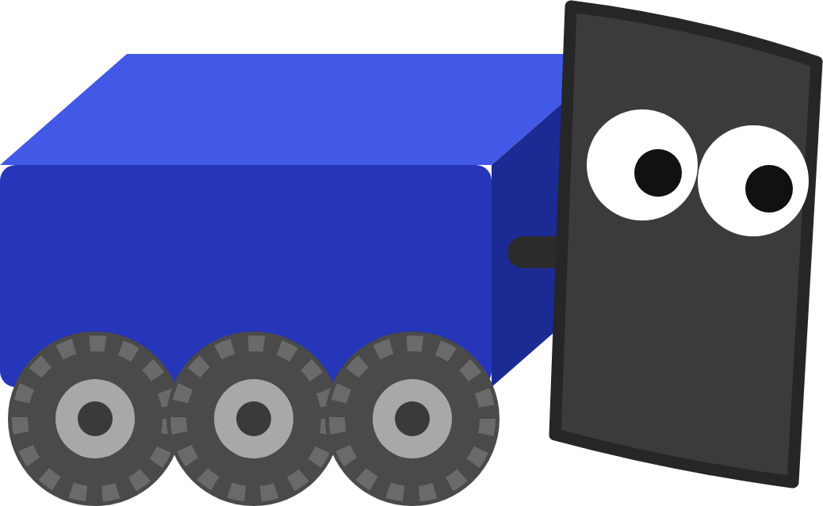
AIMING AT THE GOAL
Tuning by hand
1
2
3
4
5
Start clean
Raise kP
Back off
Add kD
kI last
kI = 0, kD = 0
Until it's fast but starts to swing
Lower kP a little
To brake before it swings past
Only if it stops a little short
EACH TRY
• Change one number, press Start, Enable, hold E
• Read AimErrorDegrees: down to 0 and stay there?
• Final run: Start fresh. The check remembers your worst swing
MARS/WARS SOFTWARE TRAINING
37
Notes:
There's no formula for the gains: you find them by trying, and the recipe is the same for almost every PID. Change one number at a time and write down what it did. Push kP too high (try 6) and the robot never settles, it just wobbles: that's the edge of what a PID can do. The overshoot check remembers the worst swing from every press of E, so press Start again before your final clean run. Activity: have each group record kP, kD, settle time and overshoot in a table on the board.

Slide 38
YOUR TURN
Computer Vision
Feed the camera tag solutions to the pose estimator, then add an AIM state that turns the robot to face the goal.
5 CHECKPOINTS
Tag solutions added
addVisionMeasurement() with pose, picture time, trust
Within 5 cm and 1°
Drive 5+ meters, stop, wait 2 seconds
Aim state written
AIM, the PID, getAngleToGoal(), isAimed(), aim()
Aims within 2°
Hold E: faces the goal within 4 seconds
No wild overshoot
Never more than 10° past the goal
Stretch: tiny trust numbers, aim while driving, fastest settle
In Scriptum: FRC Robot › Computer Vision
MARS/WARS SOFTWARE TRAINING
38
Notes:
This is the hands-on part: the Computer Vision lesson in Scriptum's FRC Robot track, about three hours. Part 1 is vision: one line of code and two trust numbers, then drive more than 5 meters, stop, wait 2 seconds and Verify. Part 2 is aiming: the AIM state, the PID, the command, then tune. The estimate and aim checks need the simulator running, and the overshoot check remembers every press, so start fresh before the final run. The stretch ideas are optional.

Slide 39
RECAP
What you can do now
Explain how a camera finds an AprilTag
RELATED JAVA TRAINING
NEXT UP
Turn tags into the robot's pose
Conditions
Choreo Autonomous
Blend wheels and camera with trust numbers
Variables
Draw two paths in Choreo, then follow them, pick up, aim and shoot.
Use the picture's time, not now
Work out the angle to the goal
Tune a PID that aims without overshoot
Optional practice in Scriptum's Java track.
MARS/WARS SOFTWARE TRAINING
39
Notes:
Wrap up. The robot can now see tags, knows where it is to within a few centimeters, and turns to face the goal on a button. Knowing where you are is what makes autonomous possible: next deck, the robot drives paths from Choreo by itself and uses this aim state before it shoots. The Java lessons on the right are optional practice for the switch and the enum used today.

